Slide 1

ENGLISH 8
BINH KHANH SECONDARY SCHOOL

Slide 2
KIM’S GAME
You will have 15’’ to see the pictures on the screen. Try to
remember them. Then three students in each group will go to
the board and write the words showing things in the pictures
in one minute. The group with more words will be the winner.

Slide 3
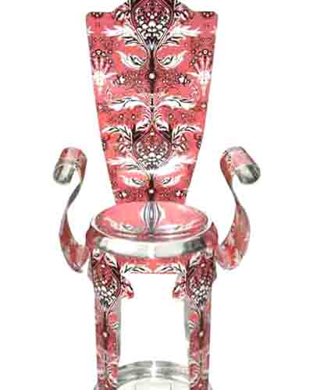
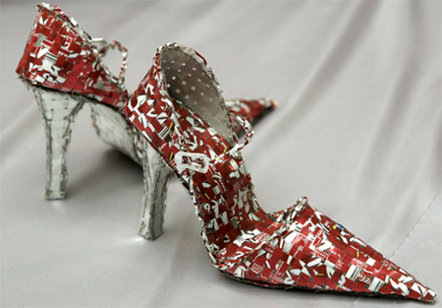
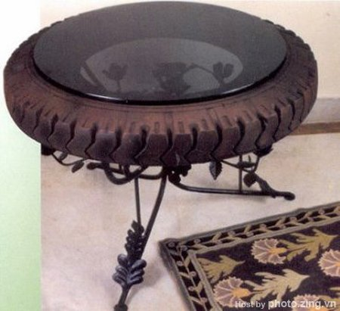
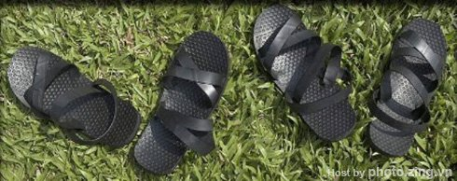
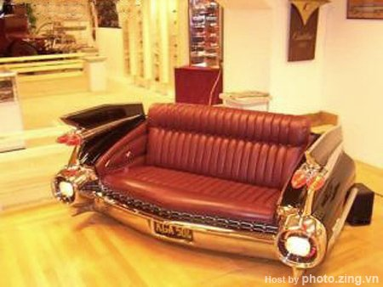
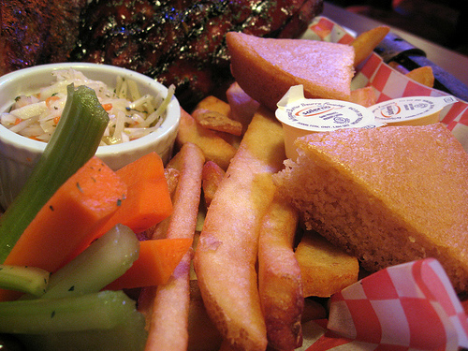



7
6
5
4
3
2
1
0
Notes:
Kim’s game

Slide 4

cans
chair
couch/sofa
bottles
table
shoes
sandals
bag
Vegetable matter

Slide 5
Arrange the sentences to make the instructions
on how to prepare the tea leaves to keep mosquitoes away, using the words of sequencing:
“ , , , ”
First
Next
Then
Finally
..…..., put the dry tea leaves in a pot for future use.
.……, dry the leaves in the sun.
..….,take the used tea leaves from the tea pot.
.......,scatter the tea leaves on a tray.

Slide 6


Unit 10: Recycling
Lesson: Language Focus
1. Passive form in the present simple:
* New words:
- liquid (n):
(Water is a liquid.)

Slide 7
- detergent (a):

Slide 8
- dip (v):

Slide 9
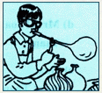
- blow – blew – blown (v):

Slide 10
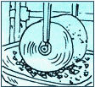
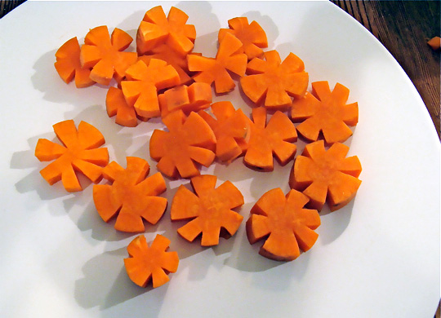
Unit 10: Recycling
Lesson: Language Focus
1. Passive form in the present simple:
* Model sentence:
Break the glass into small pieces.
V
O
.
S + am/is/are +p.p
The glass is broken into small pieces.
S
be + pp
Cut the carrots into small flowers.
The carrots are cut into small flowers.

Slide 11
Task 1
Read a guide on how to recycle glass. Look at the instructions, rewrite
them in the passive form and put the pictures in the correct order.
a) Break the glass into small pieces.
The glass is broken into small pieces.
b) Then wash the glass with a detergent liquid.
V
O
c) Dry the glass pieces completely.
V
O
d) Mix them with certain specific chemicals
V
O
e) Melt the mixture until it becomes a liquid
V
O
f) Use a long pipe, dip it into the liquid, then
blow the liquid into intended shapes.
V
O
V
O
V
O

Slide 12
Key answer
a) The glass is broken into small pieces.
b) Then the glass is washed with a detergent liquid.
c)The glass pieces are dried completely.
d)They are mixed with certain specific chemicals.
e)The mixture is melted until it becomes a liquid.
f) A long pipe is used, it is dipped into the liquid,then the liquid is blown into intended shapes.

Slide 13
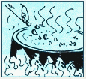
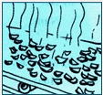
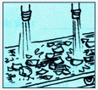
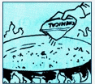
1
1
2
3
3
4
5
6
4

Slide 14
1
1
3
3
4
3
5
2
6

Slide 15

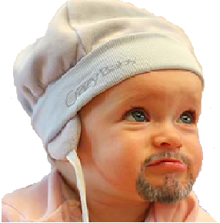
When will the
project be
started, Doctor?
Very soon.
The project will be started very soon.

Slide 16
2. Passive form in the future simple:
* Model sentences:
(+) The project will be started very soon.
S + will + be + p.p
(-) The project won’t be started very soon.
(?) Will the project be started very soon?.

Slide 17
Task 2
A famous inventor, Dr.Kim, is going to build a time machine. One of his assistant, Hai, is asking him questions about the invention.
Complete the dialogue.Use the correct form of the verbs in brackets.
Hai: When (0) will the project be started, Doctor ? (start )
Dr Kim: Very soon.
Hai : Many people want to see the time machine.
Dr Kim: Yes.It (1) to the public when (show)
it is finished.
Hai : (2) it by the end of the year,Doctor? (build)
Dr Kim : I’m afraid not, but it (3) before Tet.(finish)
Hai : (4) it by you ? (make)
Dr Kim : No, I need you to build it . When can you start ?
Hai: Let’s begin tomorrow.
Will be shown
Will
be built
will be finished
Will
be made

Slide 18
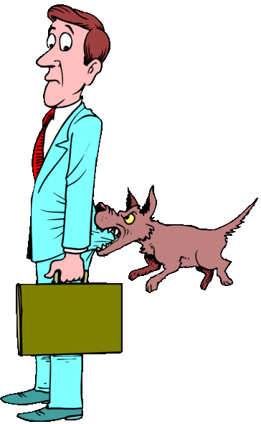
3. Adjective followed by a to infinitive:
* Model sentence:
It’s difficult to follow your directions
It’s dangerous to go near a dog.
It + be + adjective + to infinitive
Turn right, then left, then right and then left again.

Slide 19
Task 3
Complete the dialogue. Use the words in the box.
easy/understand dangerous/go difficult/follow hard/believe important/wait
a) Ba: Turn right,then left and then left again.
Nam: It’s ( 0) difficult to follow your direction.
Can you start again, please ?
b) Mr Dao: Can you do the exercise,Hoa ?
Hoa: Yes, Mr Dao. It’s (1)
c) Lan: In the future, mankind might live on the moon.
Nga: Really ? It’s (2)
d) Mrs Thoa: Stop, Tuan ! It’s (3) near the stove
Tuan : Sorry, Mom.
e) Hoa: Should I stir the mixture, Aunt Thanh ?
Aunt Thanh: No, It’ (4) for five minutes.
easy to understand
hard to believe
dangerous to go
important to wait

Slide 20
4. Adjective followed by a noun clause:
* New words:
- congratulations(n):
xin chúc mừng

Slide 21
4. Adjective followed by a noun clause:
* New words:
- look forward to (v):

Slide 22
4. Adjective followed by a noun clause:
* New words:
*
*
*
*
*
Password:
*
*
*
*
*
Confirm your password
- confirm (v):

Slide 23
4. Adjective followed by a noun clause:
* New words:
- relieved (a):
>< worried

Slide 24
4. Adjective followed by a noun clause:
* Model sentence:
Your father and I are delighted that you passed your English exam.
It + be + adjective + noun clause

Slide 25
Task 4
Complete the letter. Use the correct forms of the verb be and the
adjectives in the box.
Dear Nam,
Your grandfather and I ( 0 ) are delighted that you passed your English exam. Congratulations!
Aunt Mai (1)__________that you remembered her birthday last week. She told me you gave her a beautiful scarf.
I(2) _________ that your mother is feeling better.Please give her my love.
We’re looking forward to seeing you in June. However, grandfather
(3) ______ that the day is wrong. (4)___ you ____ that you are arriving on Saturday 20th ?
I (5) ________ that there are no trains from Ha Noi on Saturday.
Write soon and confirm your arrival date and time.
Love,
Grandma
happy delighted certain relieved sure afraid
was happy
am relieved
is afraid
Are
sure
am certain

Slide 26
Task 4
Complete the letter. Use the correct forms of the verb be and the
adjectives in the box.
Dear Nam,
Your grandfather and I ( 0 ) are delighted that you passed your English exam. Congratulations!
Aunt Mai (1)__________that you remembered her birthday last week. She told me you gave her a beautiful scarf.
I(2) _________ that your mother is feeling better.Please give her my love.
We’re looking forward to seeing you in June. However, grandfather
(3) ______ that the day is wrong. (4)___ you ____ that you are arriving on Saturday 20th ?
I (5) ________ that there are no trains from Ha Noi on Saturday.
Write soon and confirm your arrival date and time.
Love,
Grandma
happy delighted certain relieved sure afraid
was happy
am relieved
is afraid
Are
sure
am certain

Slide 27
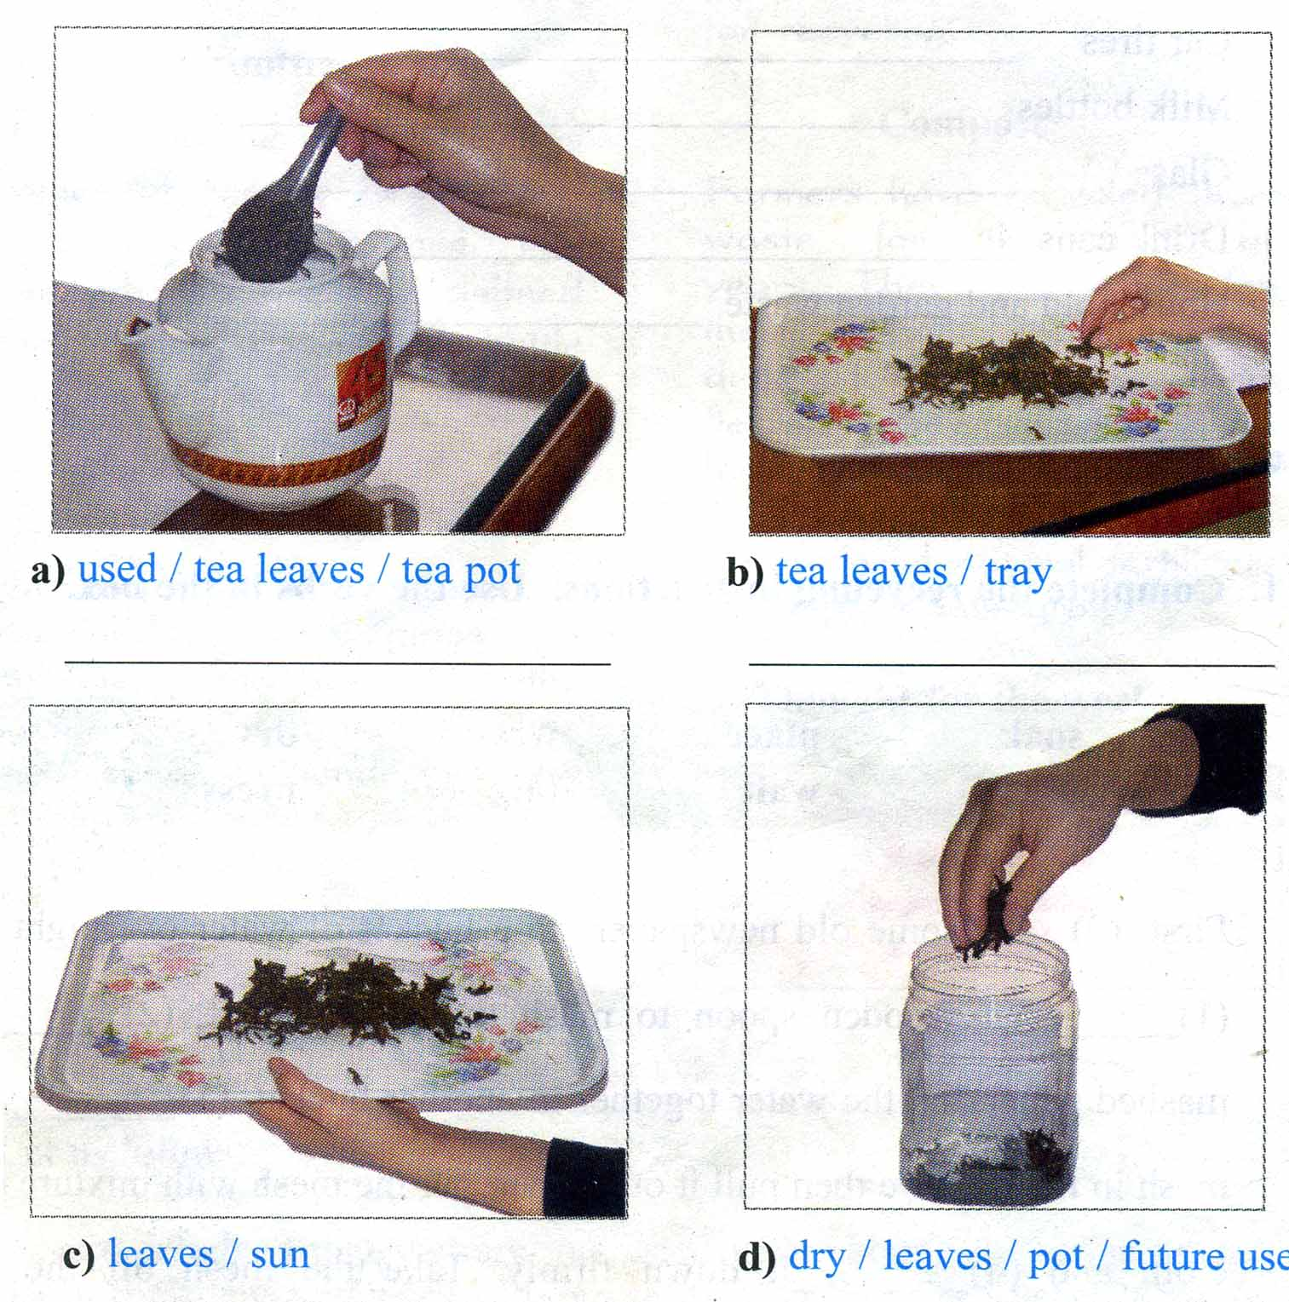

Slide 28
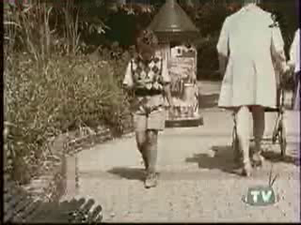

Slide 29
Good bye class
See you again
Thank you for your listening

Slide 30
3. Adjective followed by a to infinitive:
Turn right, then left, then right and then left again.
* Model sentence:
It’s difficult to follow your directions
It’s dangerous to go near a dog.
It + be + adjective + to infinitive
It’s difficult to
follow your
dirrections.

Slide 31
Unit 10: Recycling
Lesson: Language Focus
1. Passive form in the present simple:
* New words:
- liquid (n):
chất lỏng
- detergent (a):
để tẩy
- dip (v):
nhúng
- blow – blew – blown (v):
thổi
* Model sentence:
Break the glass into small pieces.
S + am/is/are +p.p
V
O
.
The glass is broken into small pieces.
S
be + pp

