Slide 1
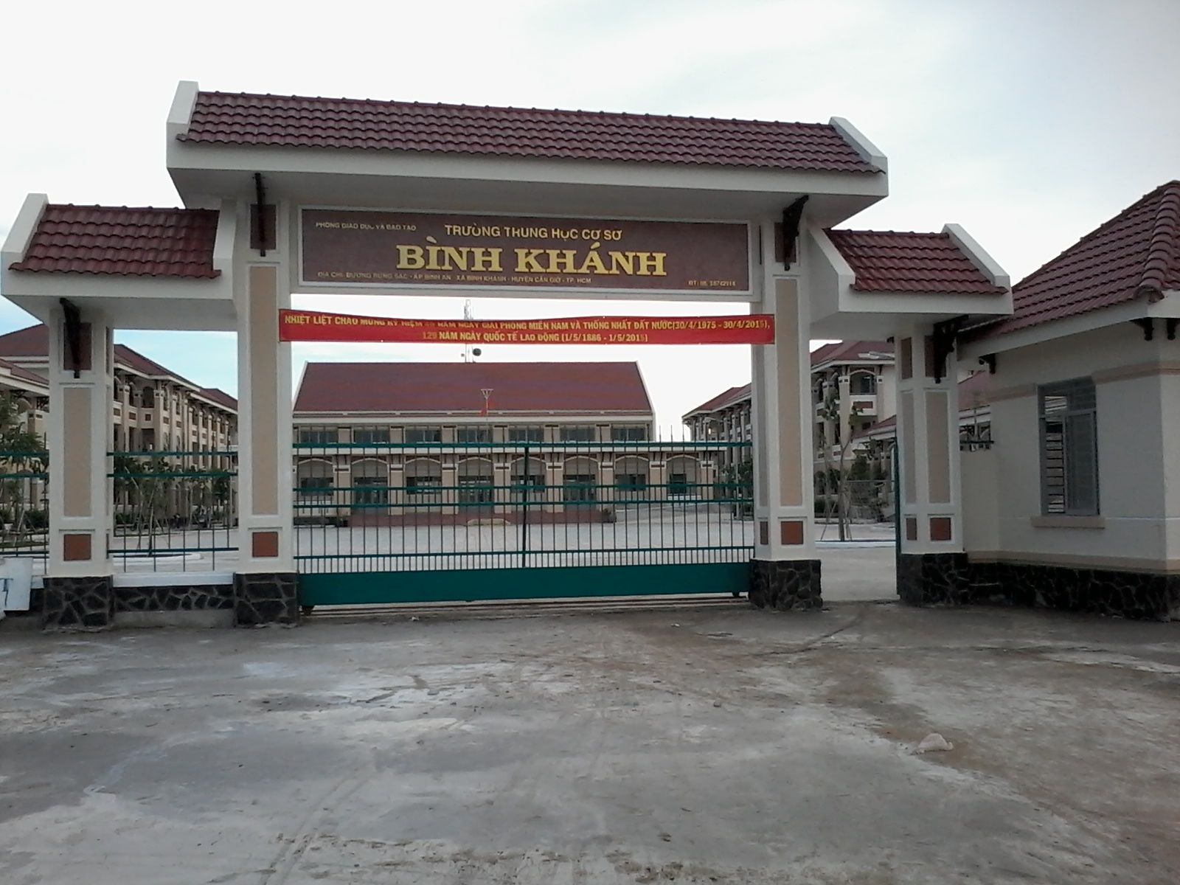



BINH KHANH SECONDARY SCHOOL
ENGLISH 8

Slide 2
Unit 11: Lesson 2-
Unit 11-Lesson2-Speak
Speak

Slide 3
Bingo
Turn on the lights
Open the door
Close the window
Borrow a book
Ask a question
Carry the bag
Sing a song
Visit a market
Visit a museum
Buy a stamp
Make a list of 4 words you want on your notebooks. Listen and check (√) when you hear each one Say “Bingo” when you have 4 checks

Slide 4
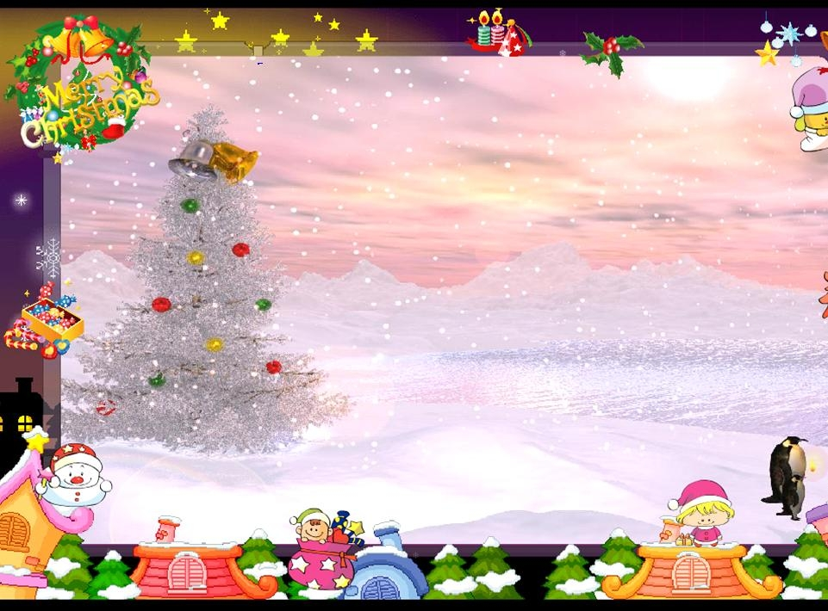
English 8
Unit 11
Unit 11
Traveling around Viet Nam
Lesson 2: Speak

Slide 5
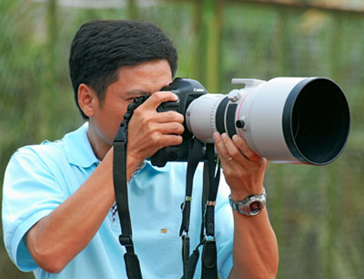
I/Vocabulary
Unit 11-Lesson2-Speak
-(to) take a photo
(take-took-taken)
-(to) mind
-(to) suggest
-would rather
-vegetarian (adj/n)
Chụp ảnh
Làm phiền
Đề nghị
Muốn
Người ăn chay

Slide 6
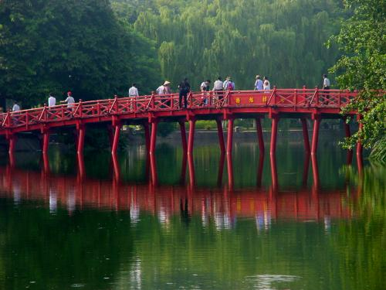
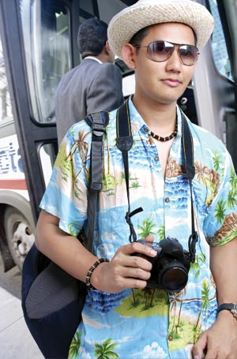
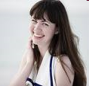
II/Model dialogue
Unit 11-Lesson2-Speak
Peter
Minh
Peter: Do you mind carrying my bag?
Minh: No,I don’t mind.
Peter: Do you mind if I take a photo of you?
Minh: No,of course not
Would you mind if I borrowed your hat?
Peter: I’m sorry I can’t.

Slide 7
Use “mind’’ in request
Unit 11-Lesson2-Speak
Request
Reply
(√)
(x)
Do/Would you mind + V-ing…?
Do you mind if I + V(present)…?
Would you mind if I + V(past)…?
No,I don’t mind.
No,of course not.
Not at all.
Please do.
Please go ahead.
I’m sorry,I can’t.
I’m sorry,that is not possible.
I’d prefer you didn’t.
I’d rather you didn’t.

Slide 8
II/Model dialogue
Unit 11-Lesson2-Speak
Peter
Minh
Peter: Do you mind carrying my bag?
Minh: No,I don’t mind.
Peter: Do you mind if I take a photo of you?
Minh: No,of course not
Would you mind if I borrowed your hat?
Peter: I’m sorry I can’t

Slide 9
A:Do you mind turning on the lights?
B:Not at all
A:Do you mind if I open the door?
B:Please do
A:Would you mind if I closed the window?
B:Please go ahead
Turn on the lights
Open the door
Close the window
Borrow a book
Ask a question
Carry the bag
Sing a song
Visit a market
Visit a museum
Buy a stamp

Slide 10
Unit 11-Lesson2-Speak
Markets Thai Binh Market. Ben Thanh Market Open approx. 5 am – 8 pm
Museums History Museum Open 8 am-11.30 am and 1 pm – 4pm daily (except Monday) Revolutionary Museum Open 8 am-11.30 am and 2 pm –4.30pm Tuesday through Sunday
Restaurants Cuong’s Vegetarian Restaurant. Good Food Vietnamese Restaurant. Lucky’s Ice-cream CafÐ. Open approx. 11 am – 11 pm
Stamps and coins Market. Open 10 am – 7 pm
Zoo and Bontanical Garden. Open 10 am – 6 pm

Slide 11

Student A: a tourist on vacation in Ho Chi Minh City
Unit 11-Lesson2-Speak
Student B: a tourist information officer at Sai Gon Tourist
-Could you give me some information, please?
-Do you mind if I suggest one?
-Would you mind if I asked you a question?
-How about going to Thai Binh Market?It opens from….to….
-I want to visit a market. Could you suggest one?
-Do you mind suggesting one?
-I suggest going to Ben Thanh Market?It opens from…to…
-That sounds interesting.
No, I don't want to go there.

Slide 12
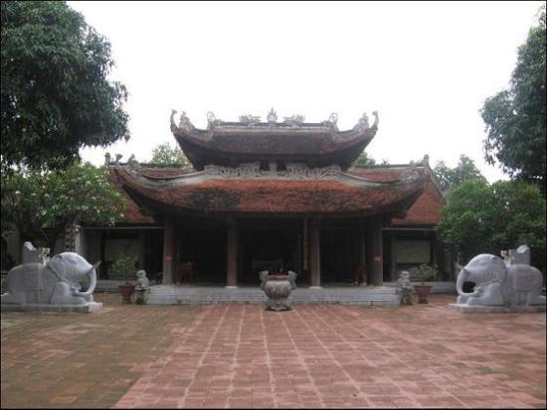
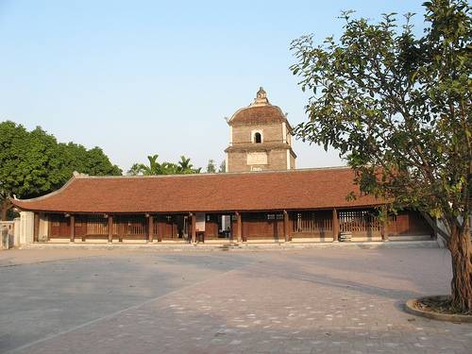
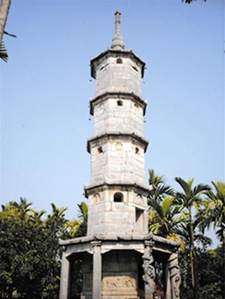
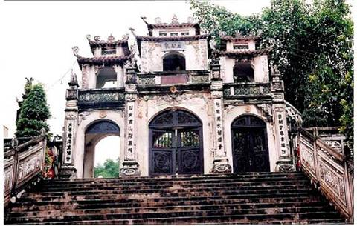
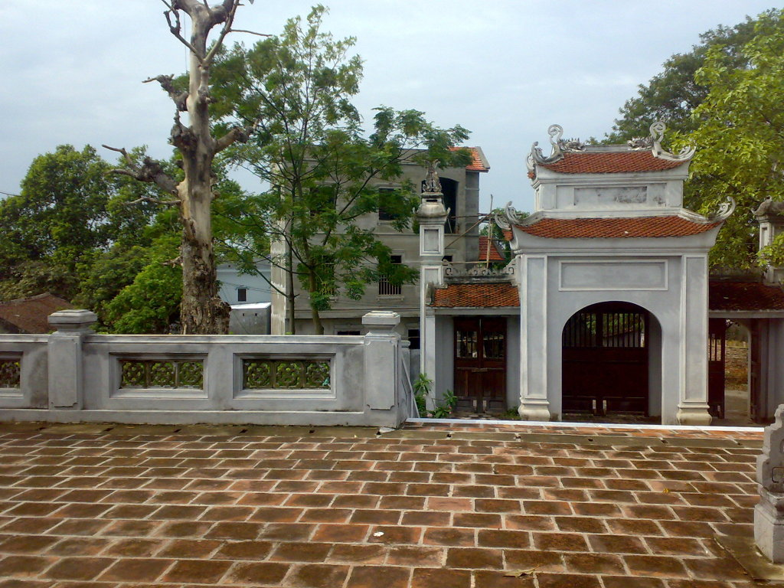
Dau Pagoda
Do Temple
But Thap pagoda
Ba chua kho Temple
Van Mieu

Slide 13
Homework
Learn by heart all new words.
Practice making requests using:
Do/would you mind +V-ing…?
Do you mind if I + V(present)...?
Would you mind if I + V(past)...?

