Slide 1
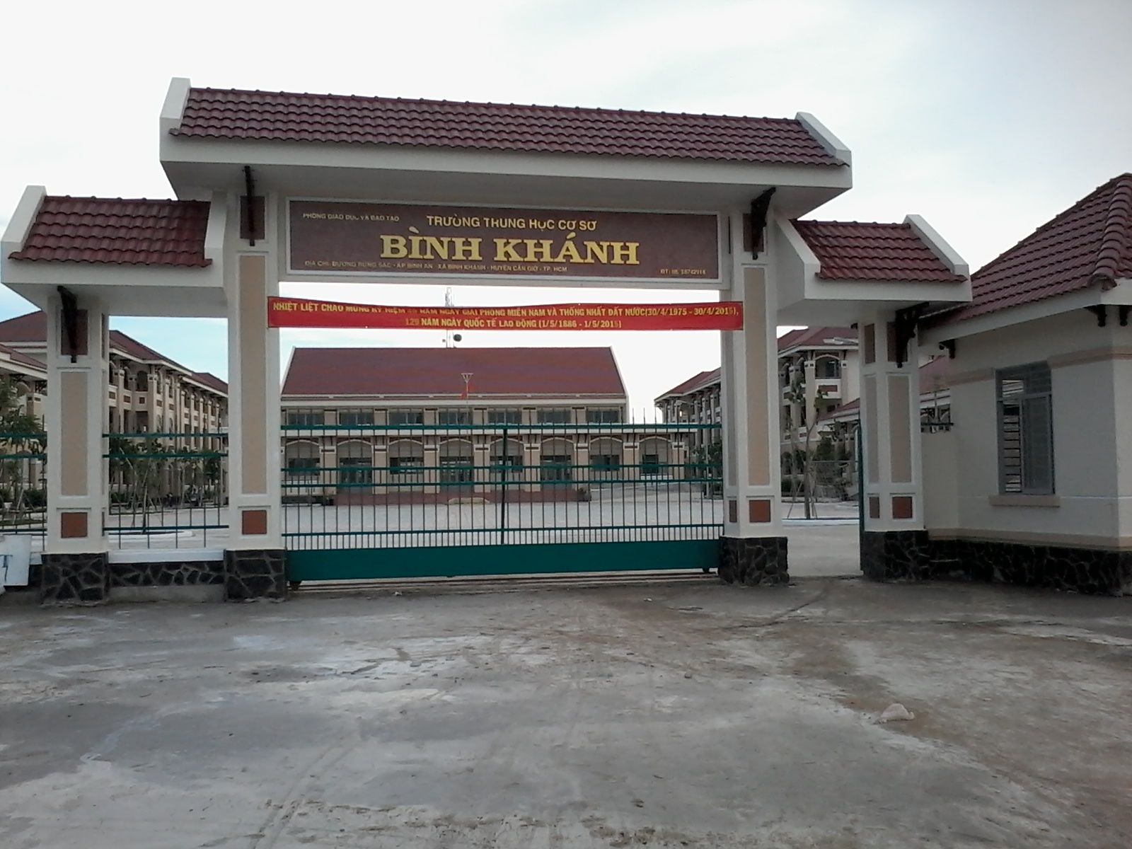



BINH KHANH SECONDARY SCHOOL
ENGLISH 8

Slide 2
* WARM UP
Kim’s game

Slide 3
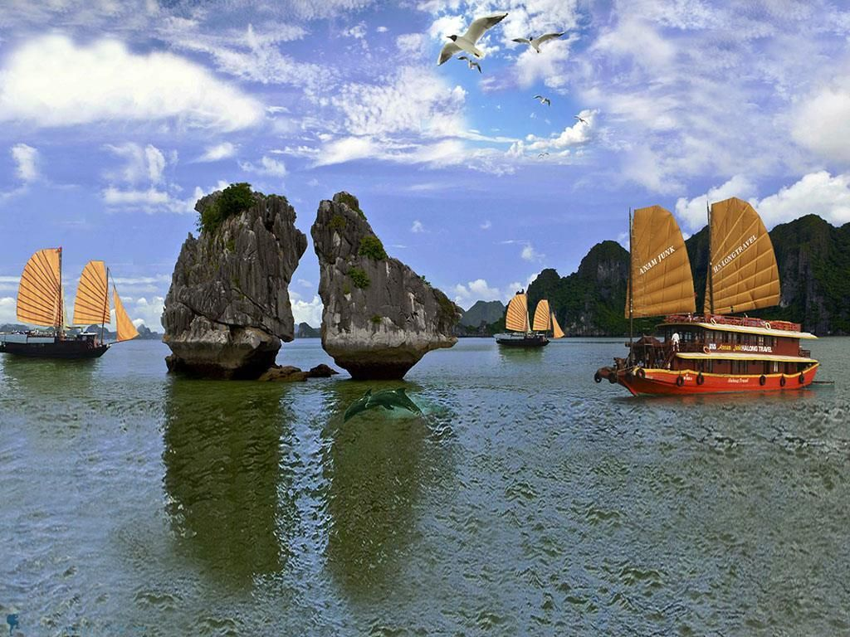
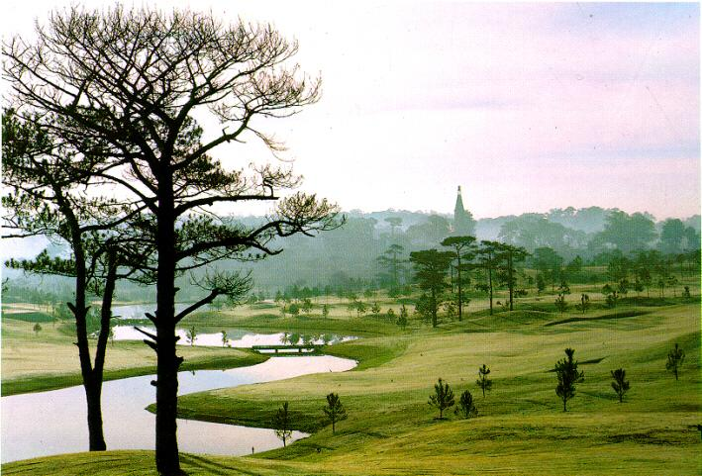
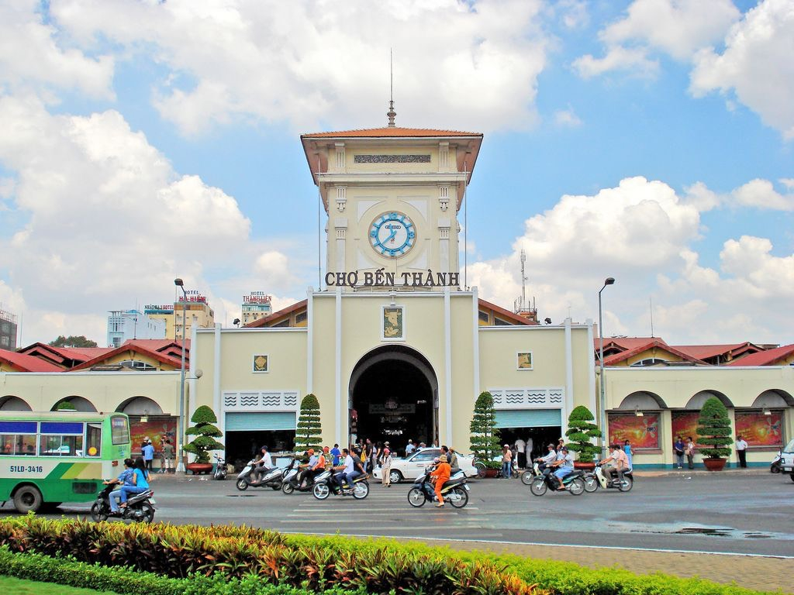
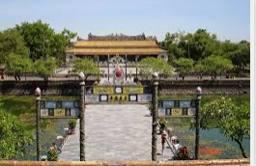
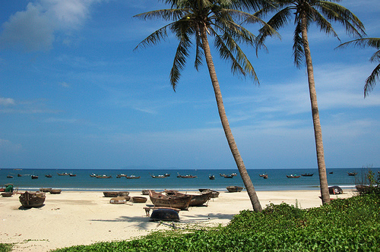
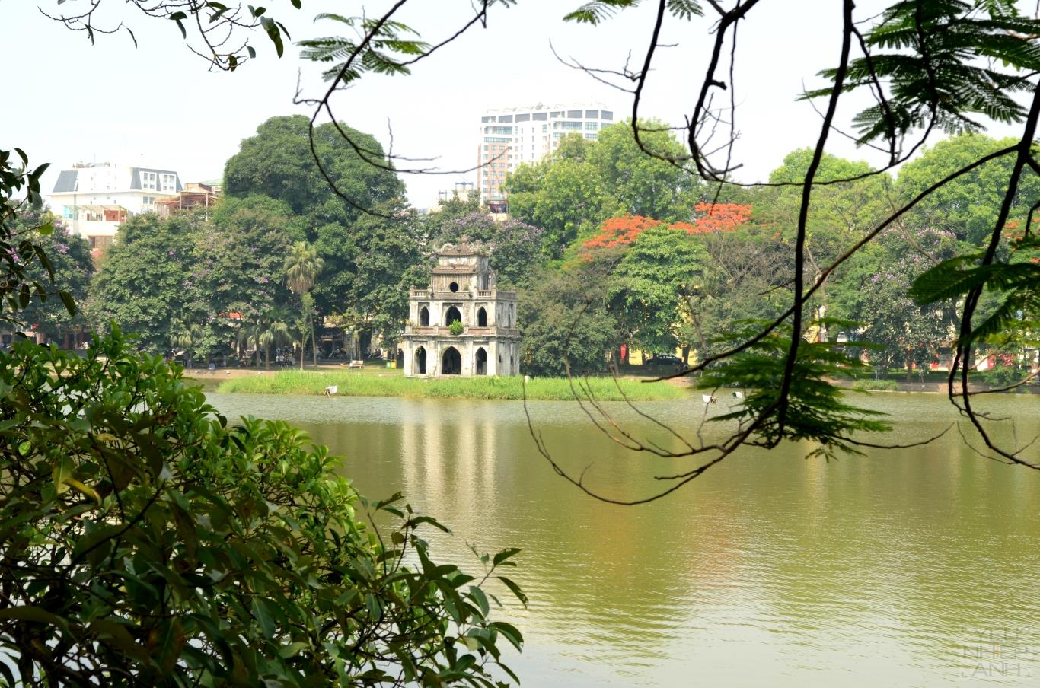
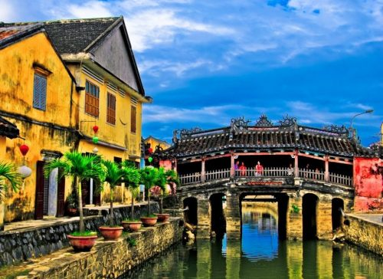
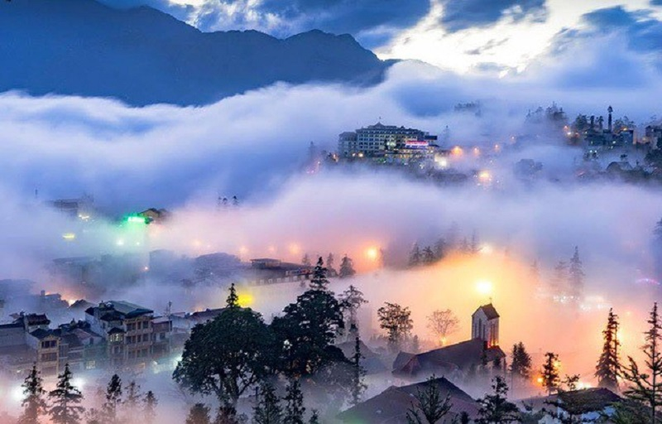

Slide 4
GROUP A | GROUP B

Slide 5
* WARM UP
Kim’s game

Slide 6
Nha Trang
Da Lat
HCM City
Sa Pa

Slide 7
Hạ Long
Hue
Ha Long bay
Ha Noi
Hoi An

Slide 8

Unit 11:
Read

Slide 9

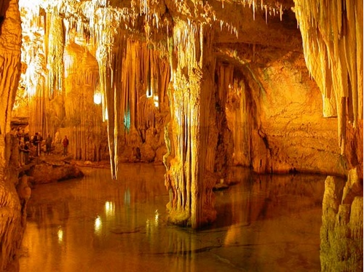
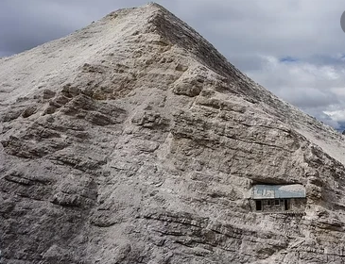
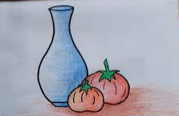
I. VOCABULARY
- sight /saɪt/ (n):
phong cảnh
- slope /sləʊp/ (n):
sườn núi
- limestone /ˈlaɪmstəʊn/ (n) :
đá vôi
- tribal /ˈtraɪbl/ (adj) :
thuộc bộ lạc, bộ tộc
- magnificent /mæɡˈnɪfɪsnt/ (adj) :
lộng lẫy, hùng vĩ

Slide 10
Matching
1- sight (n):
a. lộng lẫy, hùng vĩ
2. slope (n):
b. phong cảnh
3. limestone (n):
c. sườn núi
4. tribal (adj) :
d. thuộc bộ lạc, bộ tộc
5. magnificent (adj) :
e. đá vôi
f. hang động

Slide 11
1
Ha Long Bay
Da Lat
2
3
Nha Trang
Sa Pa
4

Slide 12

PREDICTION
Can you check (v) the topics mentioned in the brochures ?

Slide 13
Prediction: Check (V) the topics mentioned in the brochures about the resort

Slide 14
 | Nha Trang | Da Lat | Sa Pa | Ha Long Bay
1. caves
2. flights to Ha Noi
3. hotels
4. local transport
5. mini-hotels
6. mountain slopes
7. railway
8. restaurants
9. sand beaches
10. tourist attractions
11. types of food
12. villages
13. waterfalls
14. World Heritage

Slide 15
 | Nha Trang | Da Lat | Sa Pa | Ha Long Bay
1. caves
2. flights to Ha Noi
3. hotels
4. local transport
5. mini-hotels
6. mountain slopes
7. railway
8. restaurants
9. sand beaches
10. tourist attractions
11. types of food
12. villages
13. waterfalls
14. World Heritage

Slide 16

Unit 11:
Traveling around Viet Nam
I. VOCABULARY.
II. READ

Slide 17



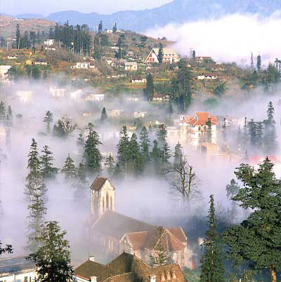
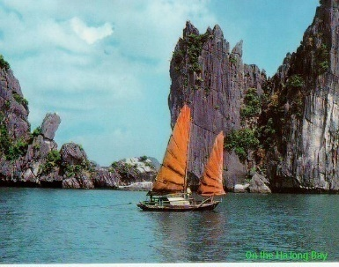
Seaside resort
Sights
*Oceanic Institute
*giant Buddha
*offshore island
Accommodation
*a small selection of hotels
Arrivals/Departures
*flights daily to Ho Chi Minh City except Monday
*flights to Ha Noi twice a week
*buses and trains to northern and southern destinations
Known as the city of Eternal spring
Sights
*waterfalls, lakes
*railway
*flower garden
Accommodation
*many hotels but difficult to find accommodation at busy times
Arrivals / departures
*flights to and from Ho Chi Minh City three times a week
*buses and mini buses to Nha Trang and HCM City
Mountainous resort
Sights
*tribal villages
*beautiful mountain slopes
*jungle stream
Accommodation
*some hotels and guest houses
Arrivals / Departures
*buses daily to Lao Cai Town
*trains daily from Lao Cai to Ha Noi
Recognized by UNESCO as a World Heritage Site
Sights
*magnificent caves
*beautiful limestone islands
*quiet sand beaches
Accommodation
*hotels and mini-hotels in Ha Long City
and various islands
Arrivals / Departures
*buses and trains daily to and from Hai Phong and Ha Noi

Slide 18
Exercise 1:
Tick (√ ) the topic mentioned in the brochure

Slide 19
 | Nha Trang | Da Lat | Sa Pa | Ha Long Bay
1. caves
2. flights to Ha Noi
3. hotels
4. local transport
5. mini-hotels
6. mountain slopes
7. railway
8. restaurants
9. sand beaches
10. tourist attractions
11. types of food
12. villages
13. waterfalls
14. World Heritage

Slide 20
 | NHA TRANG | DA LAT | SA PA | HA LONG BAY
1. caves
2. flights to Ha Noi
3. hotels
4. local transport
5. mini-hotels
6. mountain slopes
7. railway
8. restaurants
9. sand beaches
10. tourist attractions
11. types of food
12. Villages
13. waterfalls
14. World Heritage
√
√
√
√
√
√
√
√
√
√
√
√
√
√
√
√
√
√
√
√
√
√
√
√
√
√
√
√
√
√
√
√
√
√
√
√
√
√
√
√
√
Notes:
√ √

Slide 21
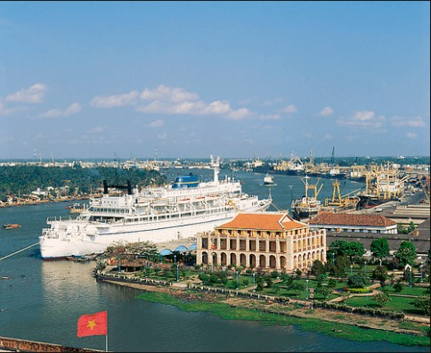
1
2
3
4
5

Slide 22

These people want to spend their coming summer vacation in Viet Nam. Help them find a suitable place. Check the boxes.

Slide 23
GROUP WORK:
Time: 8 MINUTES
Ss work individually: 3 MINUTES
Ss work in group: 5 MINUTES
EXERCISE 2:
Answer: Where should people go?
These people want to spend their coming summer vacation in Viet Nam. Help them find a suitable place. Check the boxes.

Slide 24
 | Nha Trang | Da Lat | Sa Pa | Ha Long Bay | Nha Rong Harbor
a, Andrew studies tribes around the world. He likes mountain-climbing.
b, Mary loves Viet Nam and she wants to travel by train to see as much of the country as possible. She also wants to visit an oceanic institute in Viet Nam.
c, John is interested in the history of Viet Nam. He wants to visit the place where President Ho Chi Minh left Viet Nam in 1911.
d, Joanne likes swimming and sunbathing. She has been to Viet Nam twice and she has visited Nha Trang already.
e, Donna is a florist. She has a flower shop in Los Angeles. She is thinking of importing flowers from Viet Nam.

Slide 25
EXERCISE 2: Answer . Where should people go?
These people want to spend their coming summer vacation in Viet Nam. Help them find a suitable place (Nha Trang, Da Lat, Sa Pa, Ha Long Bay or Nha Rong Harbor).
Name | Place | Why does he/she want to go there ?
Andrew
b. Mary
c. John
d. Joanne
e. Donna
He should go to Sa Pa because there are tribal villages there.
Sa Pa

Slide 26
Name | Place | Why does he/she want to go there ?
a.Andrew
b. Mary
c. John
d. Joanne
e. Donna
He should go to Sa Pa because there are tribal villages there.
Sa Pa
Nha Trang
Mary should go to Nha Trang because wants to visit Oceanic Institute in Viet Nam.
John should go to Nha Rong Harbor because he wants to visit the place where President Ho Chi Minh left Viet Nam in 1911.
Nha Rong Harbor
Ha Long Bay
Jonne should go to Ha Long Bay because he likes swimming and sunbathing.
Da Lat
Donna should go to Da Lat because she is a florist.

Slide 27
Pair work:

Slide 28
Homework
Learn by heart vocabulary.
Read and translate the text.
Prepare the next lesson:
Unit 11- language focus

Slide 29
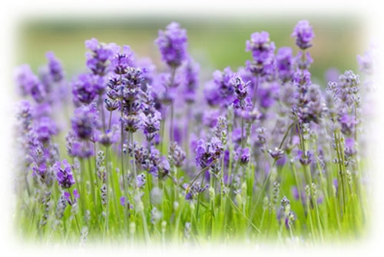
Goodbye

