Slide 1
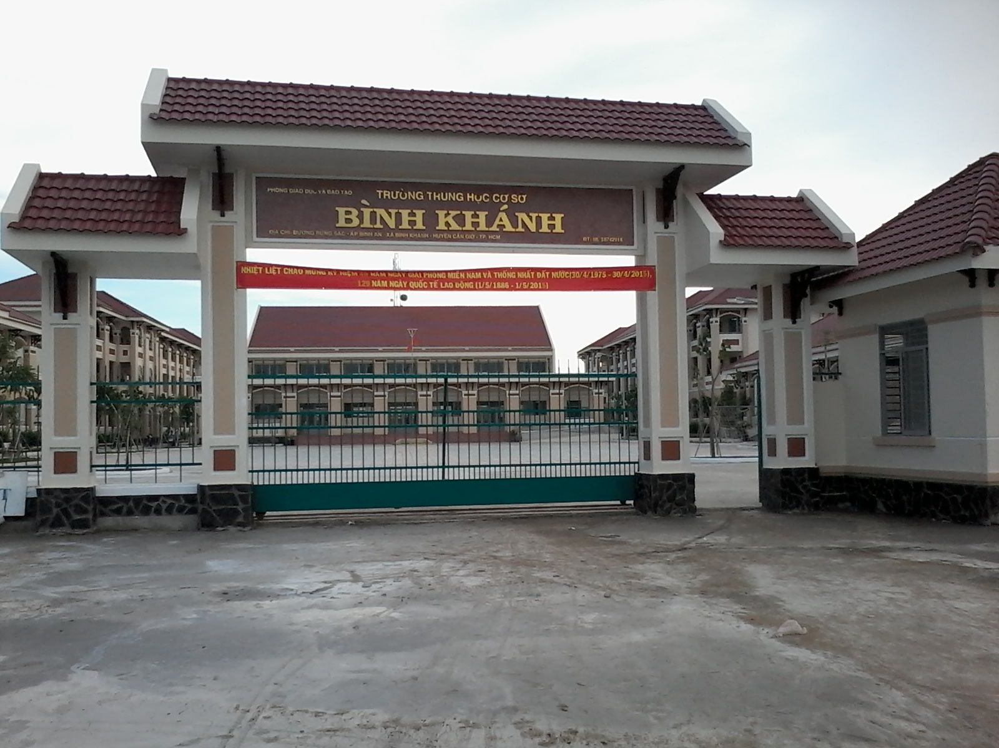



BINH KHANH SECONDARY SCHOOL
ENGLISH 8

Slide 2

PELMANISM
To become
appeared
fell
To fall
1
2
3
4
to appear
became
tried
to try
5
6
7
8

Slide 3


Congratulations

Slide 4

unit 11
TRAVELING AROUND VIET NAM
Lesson 4: WRITE (PAGE 105 - 107)

Slide 5
Vocabulary:
(an) adventure :
cuộc phiêu lưu
(a) canoe :
chiếc xuồng, ca nô
(to) overturn :
lật úp
(to) paddle :
chèo xuồng
(to) stumble :
trượt chân, vấp ngã
(to) rescue :
cứu, cứu nguy
(to) appear :
xuất hiện

Slide 6
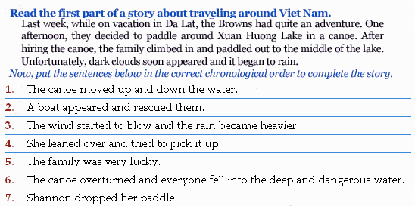
Unit 11: Traveling around Viet Nam Lesson 5: Write
2
6
1
4
7
5
3

Slide 7
Unit 11: Traveling around Viet Nam Lesson 5: Write
the completed story
Last week, … it began to rain…
1. C The wind started to blow and the rain became heavier.
2. A The canoe moved up and down the water.
3. G Shannon dropped her paddle.
4. D She leaned over and tried to pick it up.
5. F The canoe overturned and everyone fell into the deep and dangerous water.
6. B A boat appeared and rescued them.
7. E The family was very lucky.

Slide 8
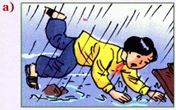
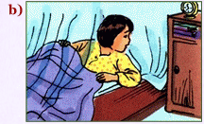
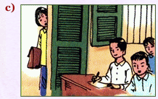
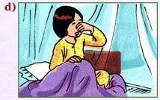
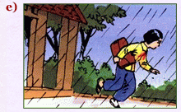
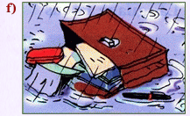
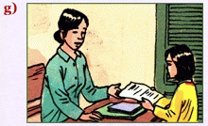
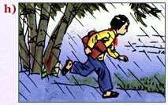
Put the events below in the correct chronological order.
Uyen had a day to remember last week.

Slide 9
Correct chronological order events
1
5
6
2
3
7
4
8

Slide 10
WRITE THE STORY
1. She / math exam / Friday / and she / get up / late.
2. She / realize / her alarm clock / not / go off.
3. As she / leaving / it /start / rain / heavily.
4. Uyen / try / run / fast / she could.
5 Suddenly / she / stumble / rock /and fall.
6 schoolbag / pool / and everything / get wet.
7 Strangely / rain / stop / as she / get / her classroom.
.
8 Luckily, Uyen / enough time / finish.

Slide 11
1. She / math exam / Friday / and she / get up / late.
She had a math exam on Friday and she got up late.
2. She / realize / her alarm clock / not / go off.
She realized her alarm clock did not go off.
3. As she / leaving / it /start / rain / heavily.
As she was leaving home it started to rain heavily.
4. Uyen / try / run / fast / she could.
Uyen tried to run as fast as she could.
5 Suddenly / she / stumble / rock /and fall.
Suddenly she stumbled against a rock and fell (onto the road)
6 schoolbag / pool / and everything / get wet.
Her schoolbag went into a pool and everything got wet.
7 Strangely / rain / stop / as she / get / her classroom.
Strangely, the rain stopped as she got to her classroom.
8 Luckily, Uyen / enough time / finish.
Luckily, Uyen had enough time to finish her exam.

Slide 12
A Completed story about uyen
Uyen had a day to remember last week. She had a math exam on Friday and she got up late. She realized her alarm clock did not go off. As she was leaving home it started to rain heavily. Uyen tried to run as fast as she could. Suddenly, she stumbled against a rock and fell (onto the road). Her schoolbag went into a pool and everything got wet. Strangely, the rain stopped as she got to her classroom. Luckily, Uyen had enough time to finish her exam.

Slide 13
Homework :
Learn vocabulary by heart and rewrite the story again.
Do exercises 3,4 in workbook
Prepare for: Revision

Slide 14


GOOD BYE
See you next time.

