Slide 1
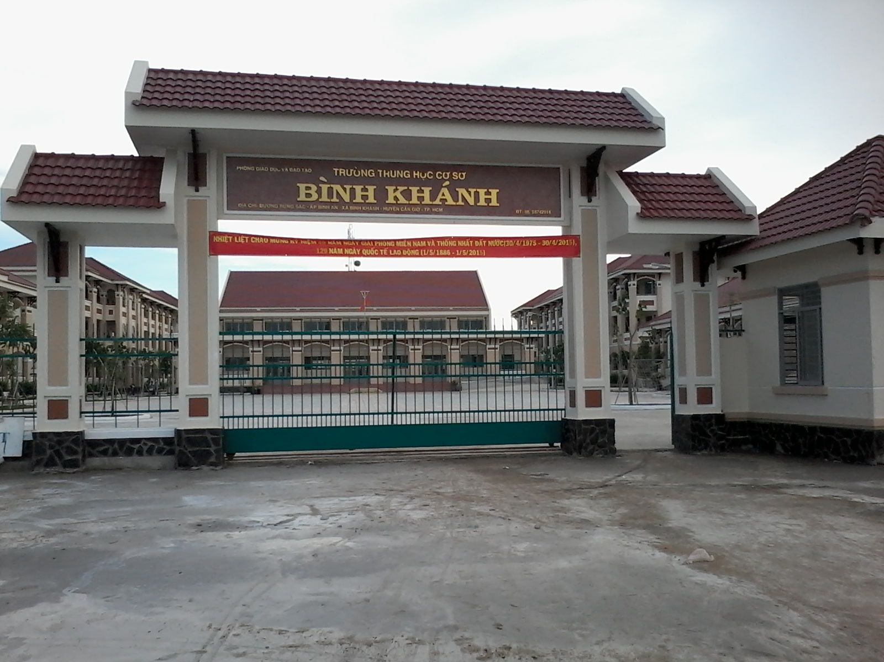



BINH KHANH SECONDARY SCHOOL
ENGLISH 8

Slide 2
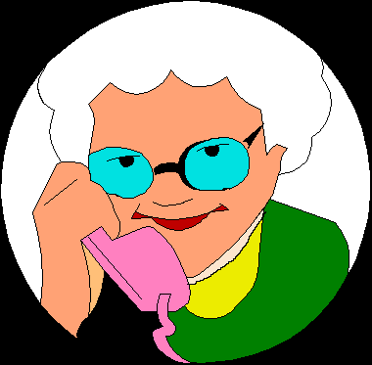

Mary
Tom
Who is Mary?
→
The woman wearing a green dress is Mary.
Who is Tom?
→
Tom is the man wearing a red shirt.

Slide 3
Who is Mary?
→The woman wearing a green dress is Mary.
Noun phrase
present participle phrase (V-ing)
Who is Tom?
→Tom is the man wearing a red shirt.
Noun phrase
present participle phrase (V-ing)

Slide 4
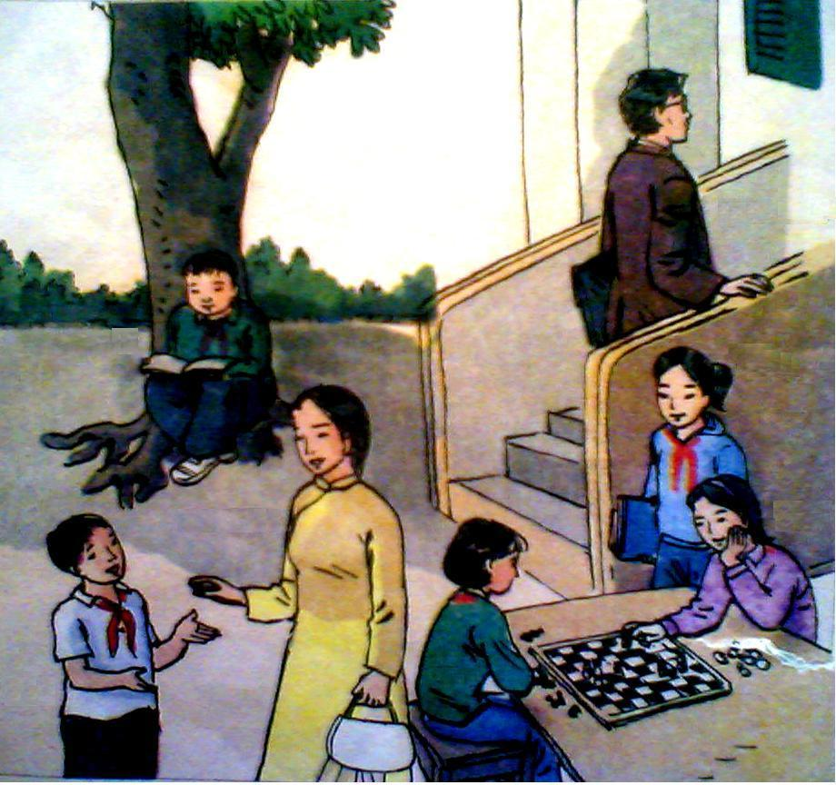
Unit 11 : TRAVELING AROUND VIET NAM
Language Focus
1/ Look at the people in the school yard at Quang Trung School. Say who each person is.

The boy reading a book is Ba
Noun
Present participle phrase
(V -ing)

V-ing đứng sau danh từ chỉ người để giải thích, miêu tả cho danh từ đó
Mr Quang
Ba
Lan
Miss Lien
Nga
Nam
Hoa

Slide 5
1/ Look at the people in the school yard at Quang Trung School. Say who each person is.
Mr. Quang
Ba
Lan
Miss Lien
Nga
Nam
Hoa
Who is …? →
The boy reading a book is Ba.
The boy talking to Miss Lien is Nam.
The woman wearing a yellow ao dai is Miss Lien.
The girls playing chess are Hoa.
The girl standing next to Nga is Lan.
The man walking up the stairs is Mr. Quang.

Slide 6

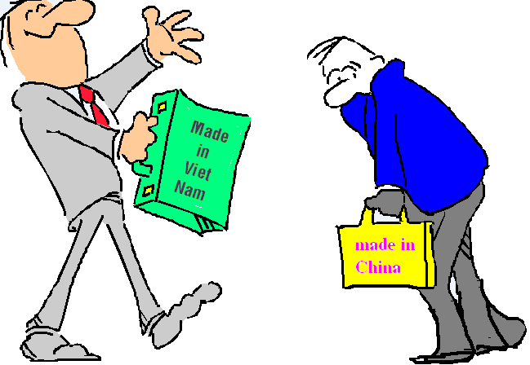
Who is Hai?
Hai
- The man standing on the left is Hai.
- The man carrying the suitcase made in Viet Nam is Hai.
past participle phrase
(Ved/V3)
Noun

Slide 7
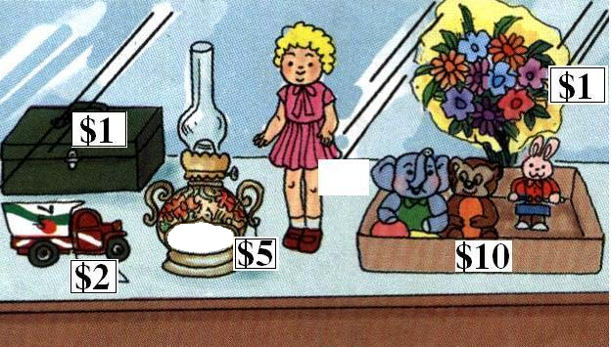
Unit 11 : TRAVELING AROUND VIET NAM
Language Focus
2/ Look at this stall. Describe the goods for sale. Use the past participles of the verbs in the box

The old lamp made in China is five dollars.
past participle phrase
(Ved/V3)
wrap in paint make in
recycle from dress in keep in
Noun

Ved/V3 đứng sau danh từ chỉ vật để giải thích, miêu tả cho danh từ đó.
$2
MADE IN CHINA

Slide 8
Unit 11 : TRAVELING AROUND VIET NAM
Language Focus
2/ Look at stall. Describe the goods for sale. Use the past participles of the verbs in the box
wrap in paint make in
recycle from dress in keep in
$2
MADE IN CHINA
- The case painted green is one dollar.
- The truck toy recycled from drink cans is two dollars.
- The doll dressed in a pink dress is two dollars.
- The flowers wrapped in the yellow paper are one dollar.
- The animal toys kept in the box are ten dollars.

Slide 9
Unit 11 : TRAVELING AROUND VIET NAM
Language Focus
Request with MIND
1/ Do you mind
Would you mind
+ V-ing…? Bạn có phiền …?
Reply:
Agree: No, I don’t mind / No, of course not / Not at all
Disagree: I’m sorry. I can’t / I’m sorry. That is not possible
2/ Do you mind if + S + …(simple present tense)?
Would you mind if + S + …(simple past tense)?
Bạn có phiền nếu (ai) (làm gì)?
Reply:
Agree: Please do / please go a head
Disagree: I’d prefer you didn’t / I’d rather you didn’t

Slide 10
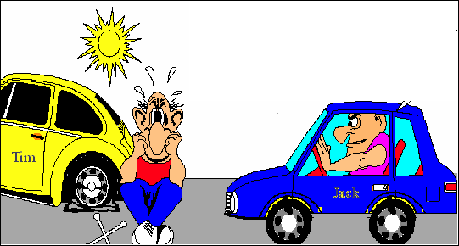
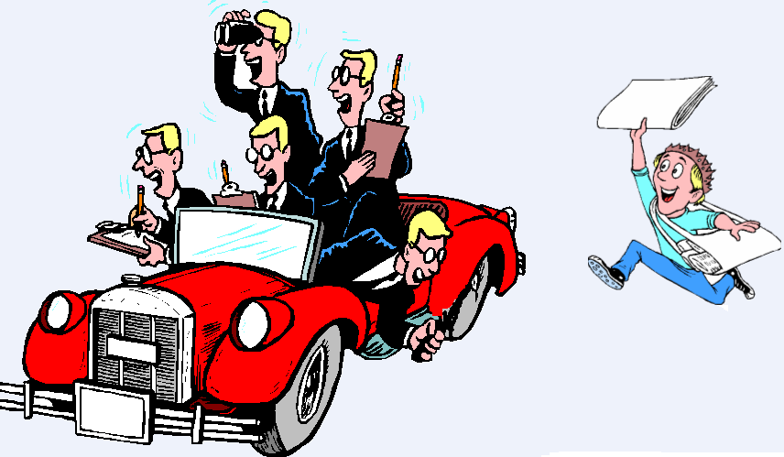
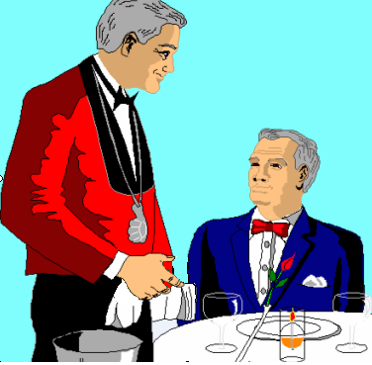
Unit 11 : TRAVELING AROUND VIET NAM
Language Focus
3/ Use these words to make and respond to requests.
a) move / car ✓
c) get / coffee X
Would / Do you mind moving your car?
No, of course not.
b) put out / cigarette ✓
d) wait / moment X

Slide 11
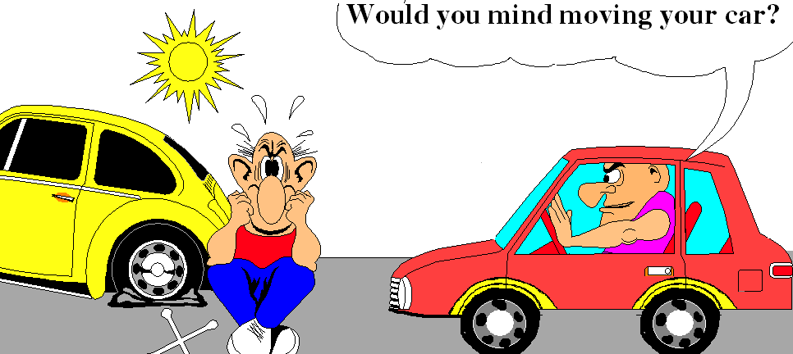
1/ The man ………………in the red car is Jack.
a. sitting
b. sit
c. sat
d. to sit
2/ The car ………………down in the street belongs to Tim.
a. break
b. broke
c. broken
d. breaking

Slide 12
No, of course not.
But …
Would you mind moving your car?

Slide 13
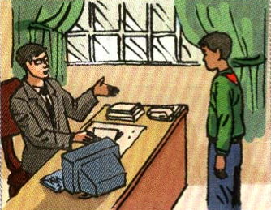
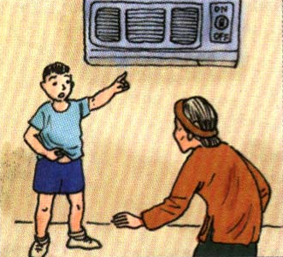
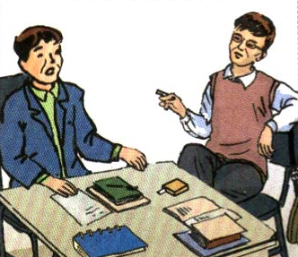
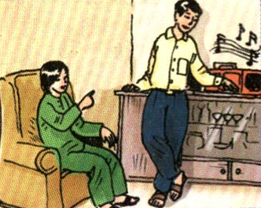
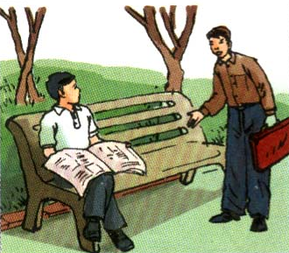
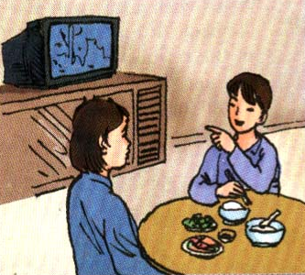
4/ Ask questions and give suitable responses
a)
b)
c
f
d
e
Request: Do you mind if I sit down?
Response: Please do.
b). Request: Would you mind if I smoked?
Response: I’d rather you didn’t.
Cons

Slide 14
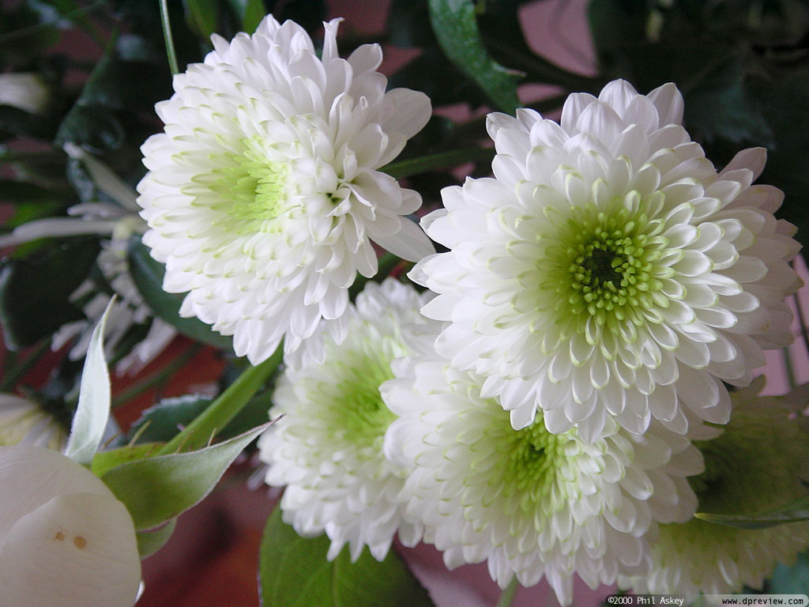
THE END
HOMEWORK
 Learn the structures and do the exercises again.
 Prepare Unit 12 A VACATION ABROAD – Getting started + Listen and read.
❒ Which country do you want to visit?
❒ Why?
THANK YOU FOR JOINING US
Goodbye

Slide 15
Would / Do you mind putting out your cigarette?
No, of course not.
b) put out / cigarette ✓

Slide 16
c) get / coffee X
- Would / Do you mind getting me some coffee?
- I’m sorry. I can’t

Slide 17
d) wait / moment X
- Would / Do you mind waiting for me a moment?
- I’m sorry, that is not possible.

Slide 18
c)
- Would you mind if I asked you some questions?
- Please do.

Slide 19
d)
- Would / Do you mind turning off the stereo?
- No, I don’t mind.

Slide 20
e)
- Would / Do you mind turning on the air-conditioner?
- No, I don’t mind.

Slide 21
f)
- Would you mind if I turned off the T.V?
- I’d prefer you didn’t.

Slide 22
Choose the best answer
1/ The boy ……..to Miss Lien is Nam.
a) talk b) talking c) to talk
2/ The case …………..green is one dollar.
a) painted b) painting c) to paint
3/ Do you mind ……………me some coffee?
a) get b) getting c) got
4/ Would you mind ……………out your cigarette?
a) put b) putting c) to put
5/ Do you mind if she ……………on the air conditioner?
a) turns b) turning c) to turn
6/ Would you mind if I ……………?
a) smoke b) smoking c) smoked

Slide 23
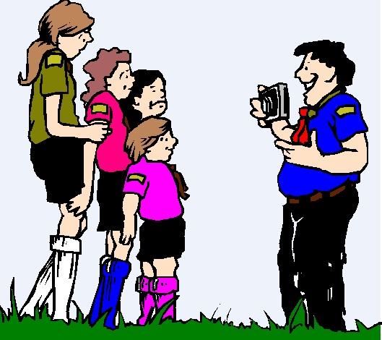

Slide 24
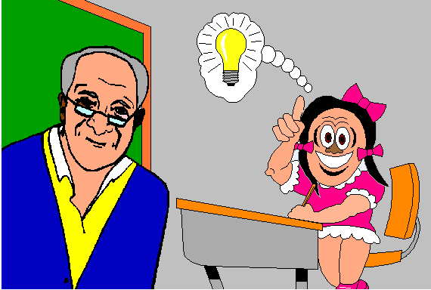

Slide 25
Combine two sentences into one, using –ing or –ed
1/ The old man is a good doctor. He lives near my house.
→
2/ The book is interesting. The book was written by her
→
3/ The house belongs to my uncle. It is made of wood.
→
4/ The girl is very intelligent. She sits next to me.
→
The old man living near my house is a good doctor.
The book written by her is interesting.
The house made of wood belongs to my uncle.
The girl sitting next to me is very intelligent.

