Slide 1
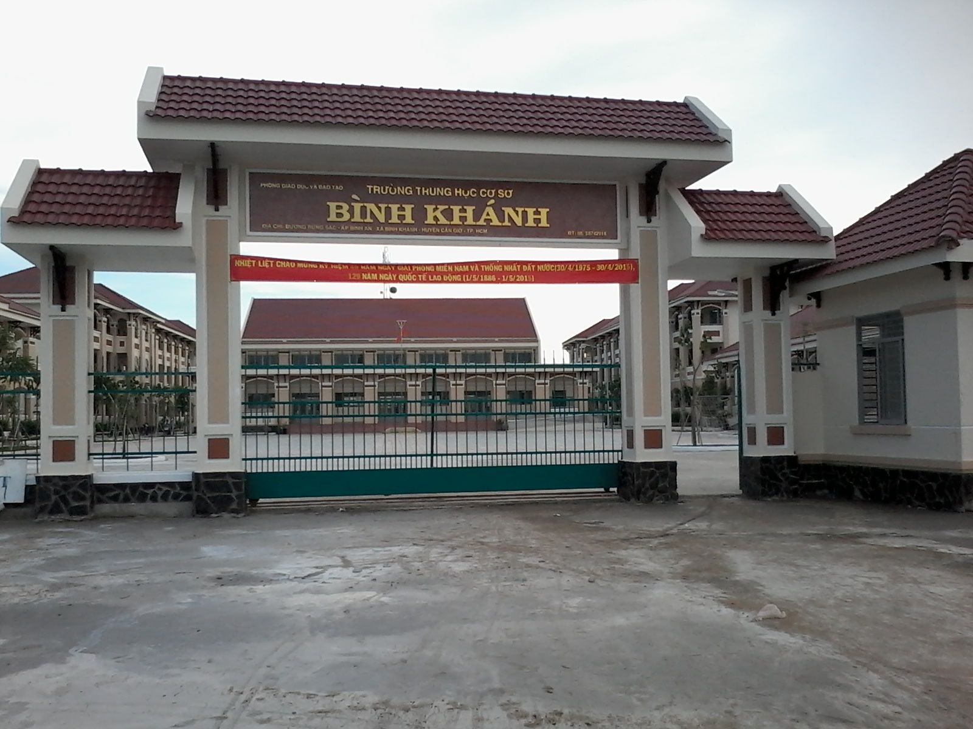



BINH KHANH SECONDARY SCHOOL
ENGLISH 8

Slide 2

W A R M U P

Slide 3

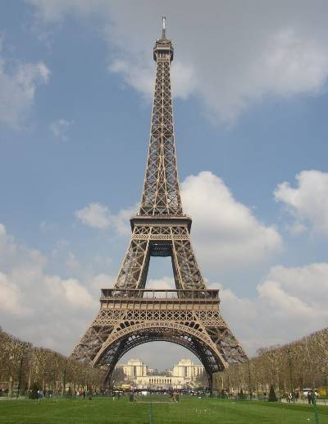
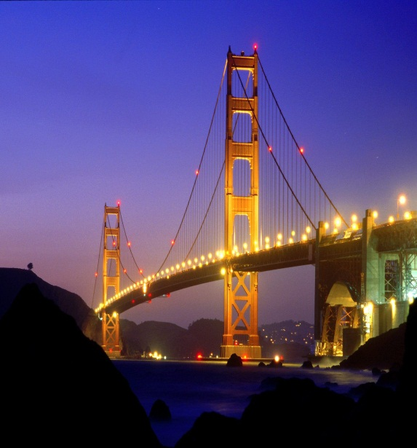
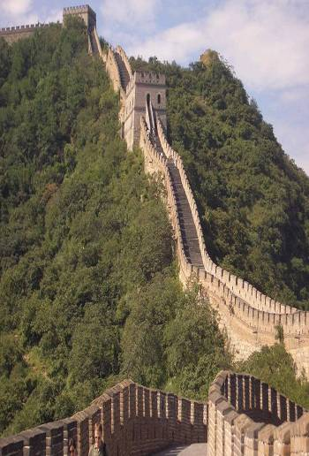
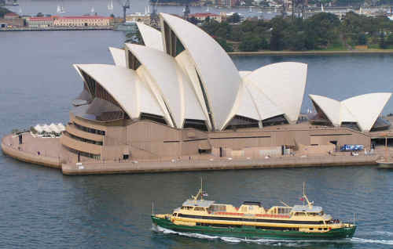
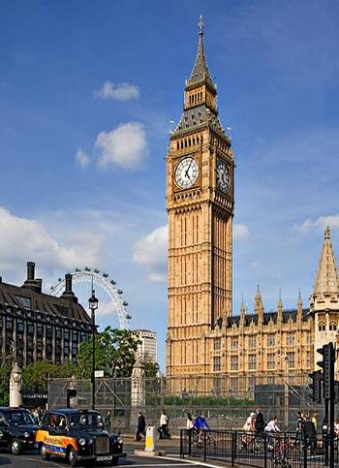
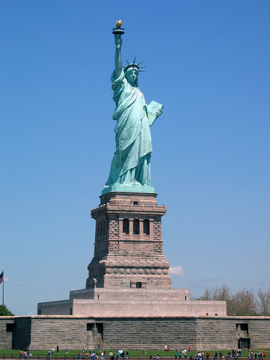
A
B
C
Golden Gate Bridge
Big Ben
Eiffel Tower
Sydney Opera
House
D
E
F
Great Wall
The Statue of Liberty

Slide 4

U n I t 1 2 :
A V A C A T I O N A B R O A D
L E S S O N : R E A D

Slide 5
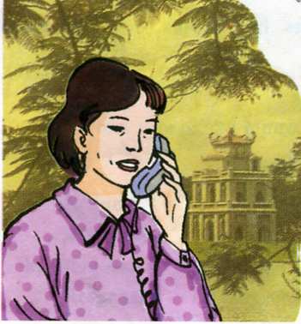

Mrs. Quyen and her husband are traveling around America. They have just visited many famous places.

Slide 6
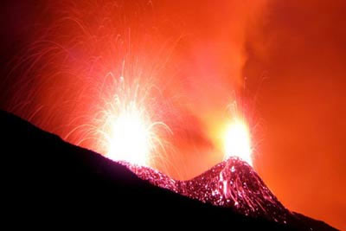
Read
Read these postcards from Mrs. Quyen to her children.
New words
volcano (n):
núi lửa
lava (n):
Dung nham, nham thạch
pour out:
phun trào
overhead (adv):
Phía trên đầu

Slide 7
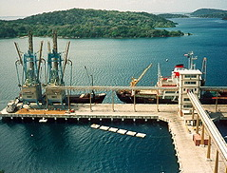

include (v): bao gồm
Wharf (n):
cầu tàu
thung lũng
valley (n):
prison (n):
nhà tù
a place to live

Slide 8
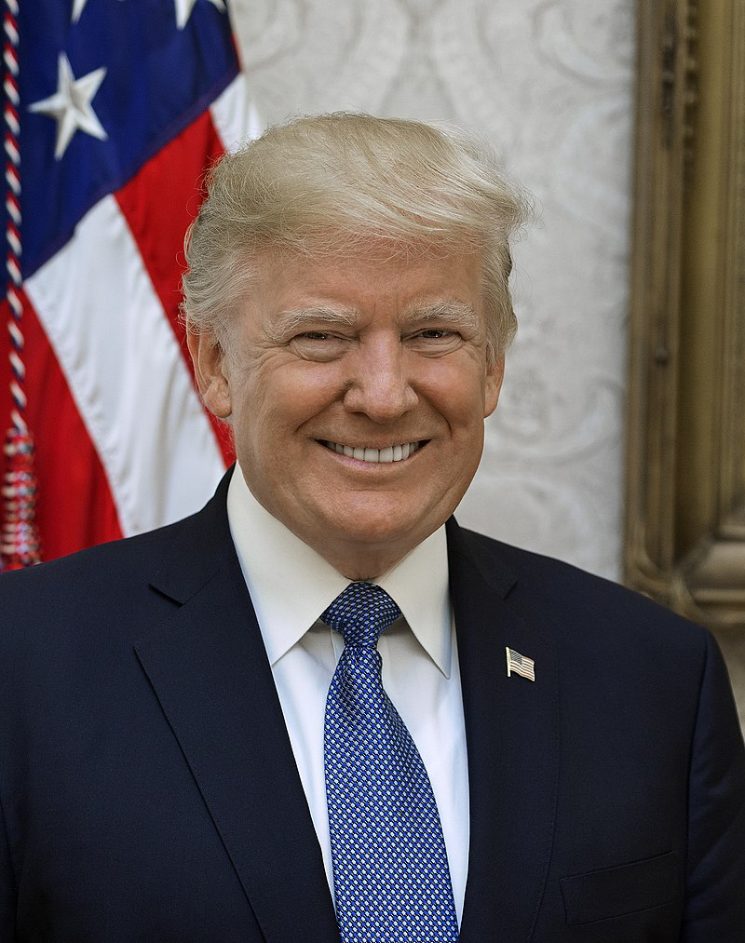
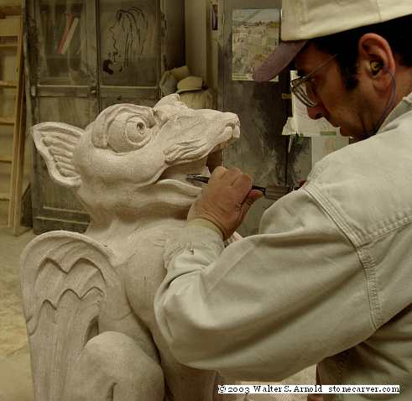
president (n):tổng thống
carve (v): khắc, chạm
Chạm khắc

Slide 9
situate (v): tọa lạc
Statue of Liberty: Tượng Nữ thần tự do
souvenir (n)
quà lưu niệm

Slide 10


Leave me out
Volocano
Larva
pour outt
Sightseeeing
Vaelley
Wharft
Overheard
Prision
Carved
Volcano
Lava
pour out
Sightseeing
Valley
Wharf
Overhead
Prison
Carve

Slide 11
Mrs. Quyen and her husband are traveling around America. They have just visited many famous places.

Slide 12
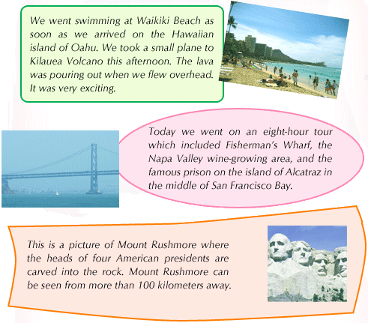

Slide 13
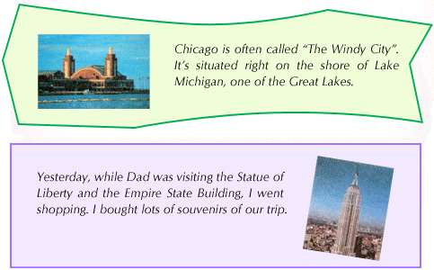

Slide 14
1. Write what Mrs. Quyen did and saw in each of these places.

Slide 15
Place | What she did and saw
a. Hawaii
b. New York
c. Chicago
d. Mount Rushmore
e. San Francisco
went swimming, visited Kilauea Volcano.
went shopping, bought lots of souvenirs.
saw Lake Michigan.
saw the heads of four American presidents.
visited Fisherman's Wharf, the Napa Valley wine-growing area and the Alcatraz prison.

Slide 16
2. Answer the following questions.
a) How did Mrs. Quyen go to Kilauea Volcano?
She went there by plane.
b) Where in San Francisco did Mrs. Quyen see the famous prison?
She saw the prison on the island of Alcatraz.
c) What is special about Mount Rushmore?
People can see Mount Rushmore from more than 100 kilometres away.

Slide 17
d) What is the other name of Chicago?
It is also called "The Windy City".
e) What did Mrs. Quyen do while her husband was visiting the Statue of Liberty?
She went shopping.

Slide 18
Homework
Learn by heart all new words
Prepare: Unit 12: WRITE
LANGUGE FOCUS 2,3

