Slide 1
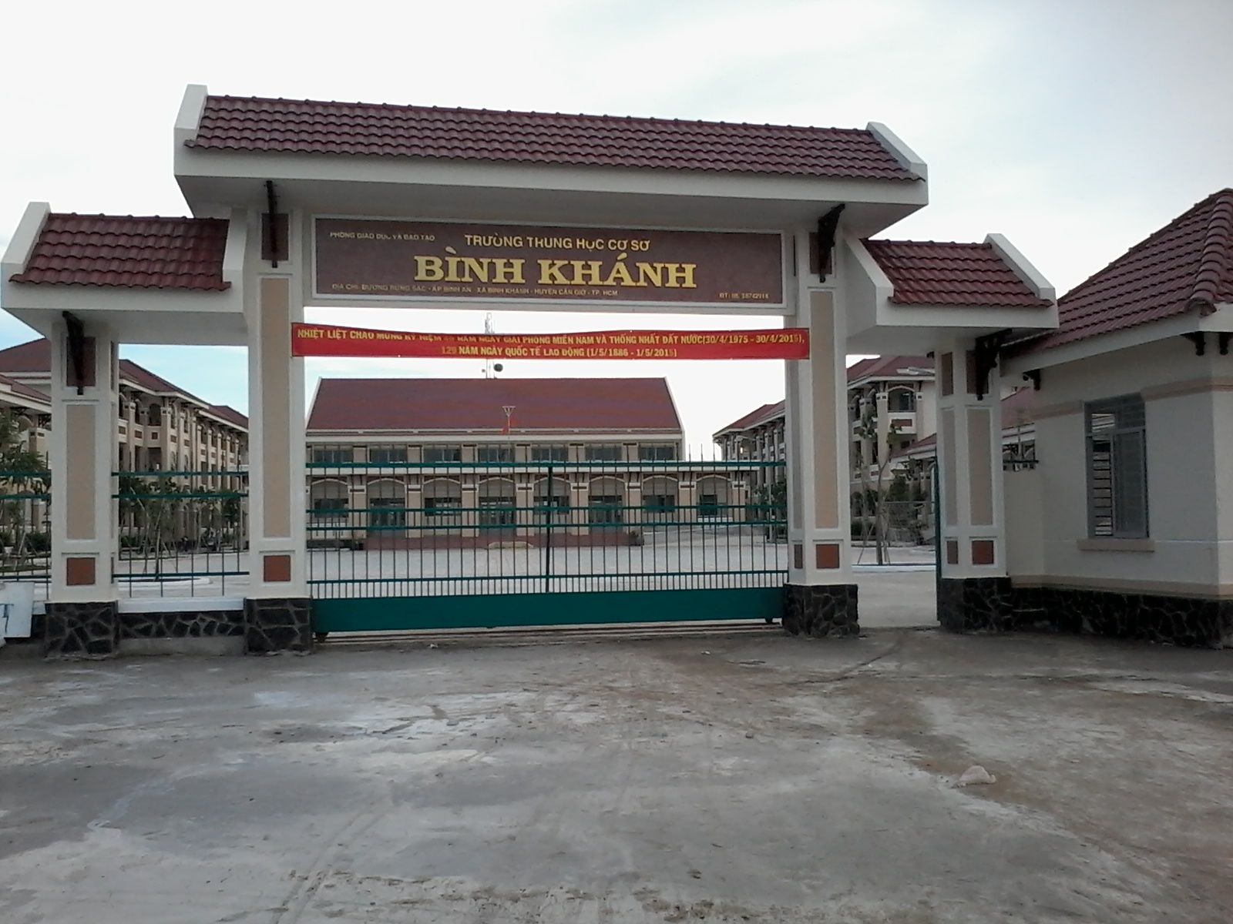



BINH KHANH SECONDARY SCHOOL
ENGLISH 8

Slide 2
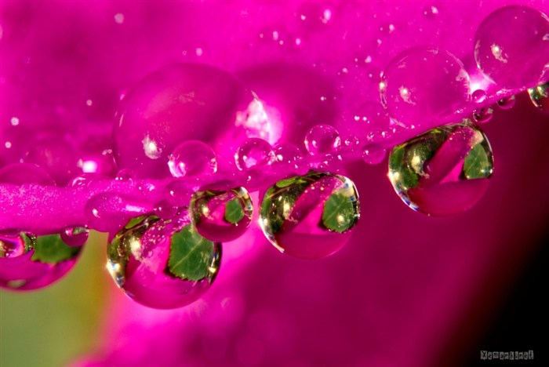
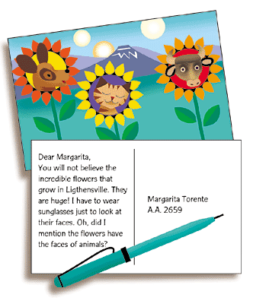
I. WARM UP: GUESSING WORD
1
2
3
4
5
6
7
8
0
S
P
S
T
C
A
R
D
T
1.What is it?
TIME
TIME IS OVER
2.The first letter is P
3.It is used all over the world
4.We usually write messages on it and send to others

Slide 3
ENGLISH 8
Unit 12: A vacation abroad
Lesson : WRITE

Slide 4
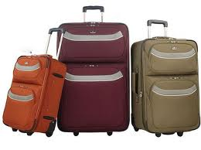

Period :81 –WRITE
1. New words
complain (v)
: than phiền ,phàn nàn
hospitable (a)
: mến khách
suitcase (n)
:cái vali

Slide 5
Match these words with their suitable meanings
1.C 2.A 3.D 4.B 5.F 6.E
1.wonderful
A. than phiền
2.complain
B. mến khách
3. souvenir
C. tuyệt vời
4.hospitable
D. đồ lưu niệm
5. suitcase
E. sự nặng nề
6. heaviness
F. cái va li
Time is over

Slide 6
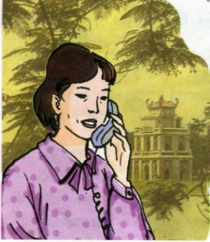
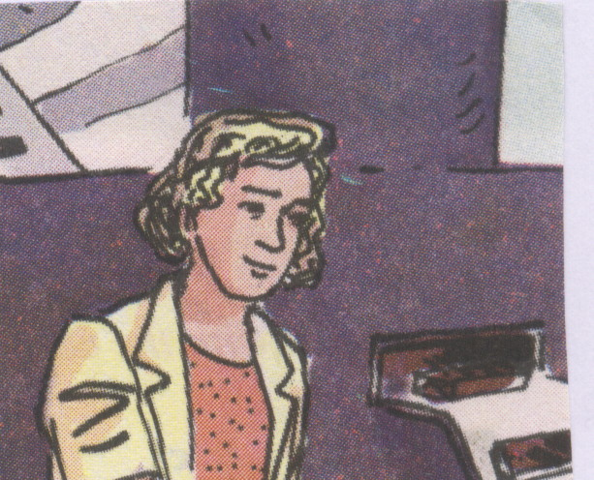
Set the scene:
Mrs. Quyen
Sally

Slide 7

Prediction
EXERCISE 1:Complete the postcard Mrs Quyen sent from the USA
Dear Sally,
We are having a wonderful time (1) ….the USA. The (2) ….. are friendly and the (3) ….. has been warm and sunny.
In San Francisco, I (4 ) ….. my friend, Sandra Smith and (5) …. family. It was (6) …. to see them.
I (7)…. lots of souvenirs (8) … the children. Thanh is always complaining about the (9)…… of my suitcase.
See you (10)…..
Love,
Quyen

Slide 8
EXERCISE 1:Complete the postcard Mrs Quyen sent from the USA
Opening
Dear Sally,
We are having a wonderful time (1) in the USA. The (2) people are friendly and the (3) weather has been warm and sunny.
In San Francisco, I (4 ) visited my friend, Sandra Smith and (5) her family. It was (6) nice to see them.
I (7) bought lots of souvenirs (8) for the children. Thanh is always complaining about the (9) heaviness of my suitcase.
See you (10)soon
Love,
Quyen
Body
Closing

Slide 9
Make a Mind Map
EXERCISE 2: Imagine you are a tourist on vacation in a certain place / city in Viet Nam. Write a postcard to a friend about your trip. You need to cover the information about
postcards
friendly
books
5.What you buy
1. How you feel
about the people
hospitable
souvenirs
Place?
DaLat
HaNoi..
helpful
museums
4.What
you
see
warm
parks
2.What the weather
is like
3.Who you
meet/see
zoos
cold
relatives
windy
teachers
old friends

Slide 10


Dear…..
I am having a……………………
…………………………………..
See you soon
….
2/ WRITING:
4
3
1
postcards
2
friendly
books
5.What you buy
1. How you feel
about the people
hospitable
souvenirs
Place?
DaLat
HaNoi
helpful
museums
4.What
You
see
warm
parks
2.What the weather
is like
3.Who you
meet/see
zoos
cold
relatives
windy
teachers
old friends

Slide 11
Find five mistakes and correct them in this postcard
Dear Lien,
I am having a nice time in Ha Noi for 2 days. The people are kind and the weader has been cold
HaNoi, I visited not only my Aunt but my teachers. It was happy see them.She took me to visit many places such as Hoang Kiem Lake,museums and parks
I bought lots of souvenirs for my family and my friends. I returned to Tien Giang next week
See you later.
Love,
An
have had
weather
but also
to see
will return

Slide 12
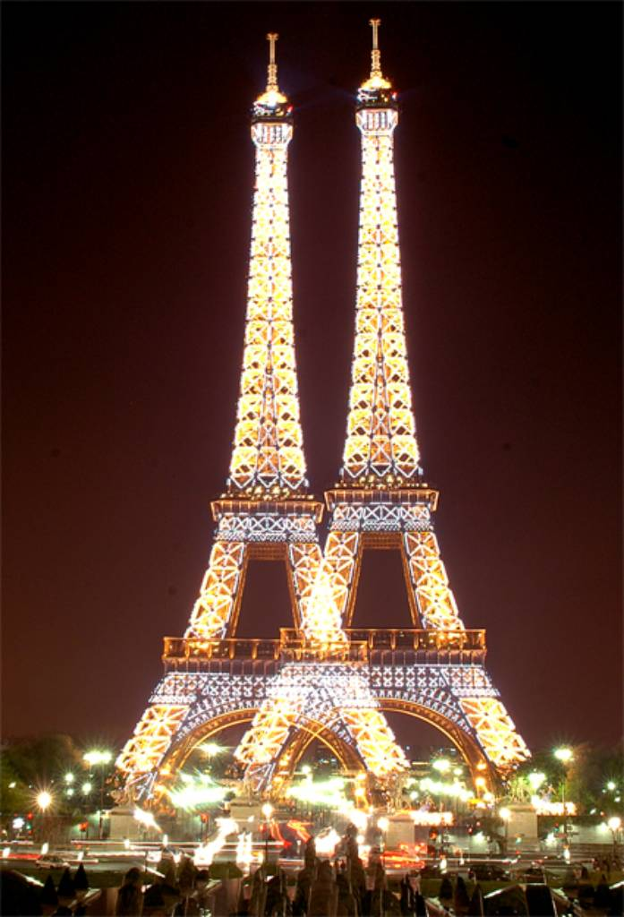
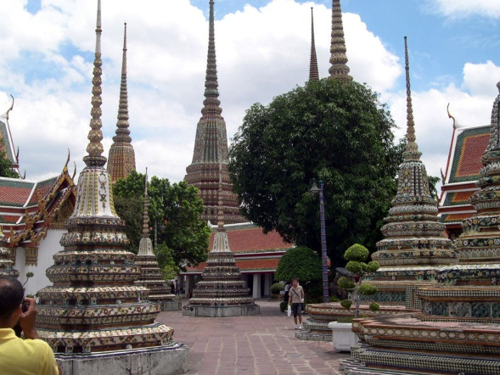
Homework
1.Imagine you are a tourist on vacation in Pari/ Thailand… .Write a postcard to your family about your trip
2. Prepair Unit 12 -Language Focus
Past progressive with when /while
Progressive tenses with always

Slide 13
Thanks very much for your attending !

Slide 14




The bye bye song
The bye bye song
The bye bye song
Bye, bye.
See you tomorrow.
Bye, bye.
See you tomorrow.
Bye, bye.
See you tomorrow.
Bye, bye. Bye, bye.
Notes:
14
14

