Slide 1
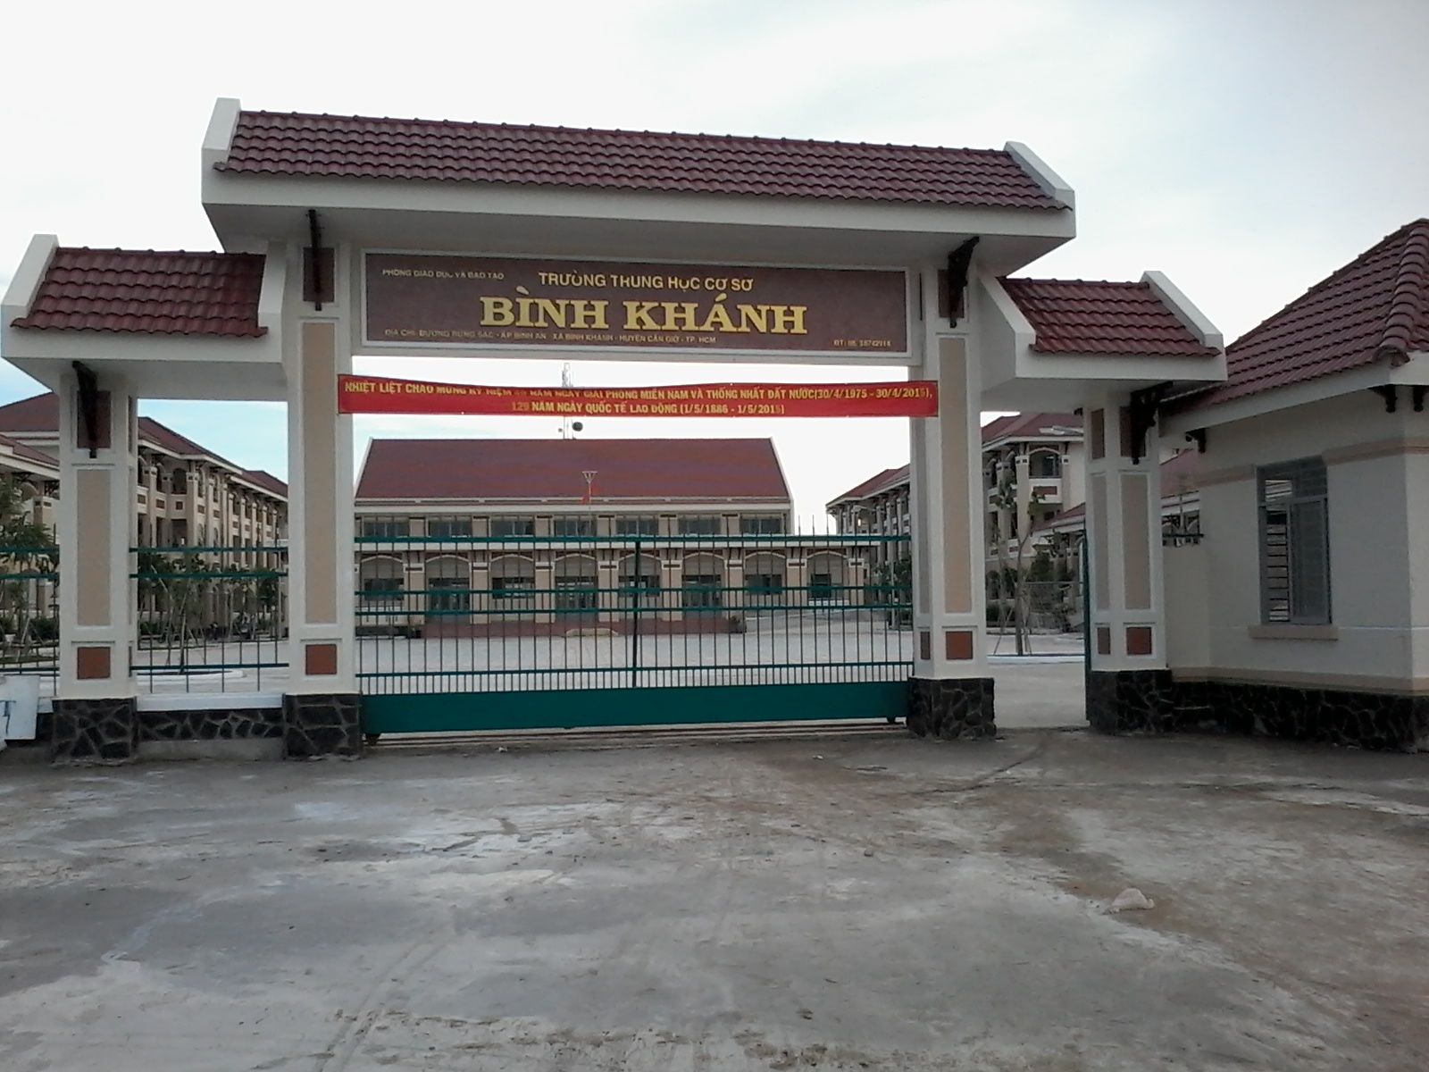



BINH KHANH SECONDARY SCHOOL
ENGLISH 8

Slide 2

Unit 12: A vacation abroad
Lesson 6: Language Focus
(Pages 119, 120)

Slide 3
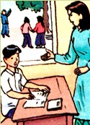
Unit 12: A vacation abroad
Language focus
I. Present progressive with always
Bao/forget/ homework
Ba is forgetting his homework.
Present progressive.
Bao is always forgetting his homework.

Slide 4
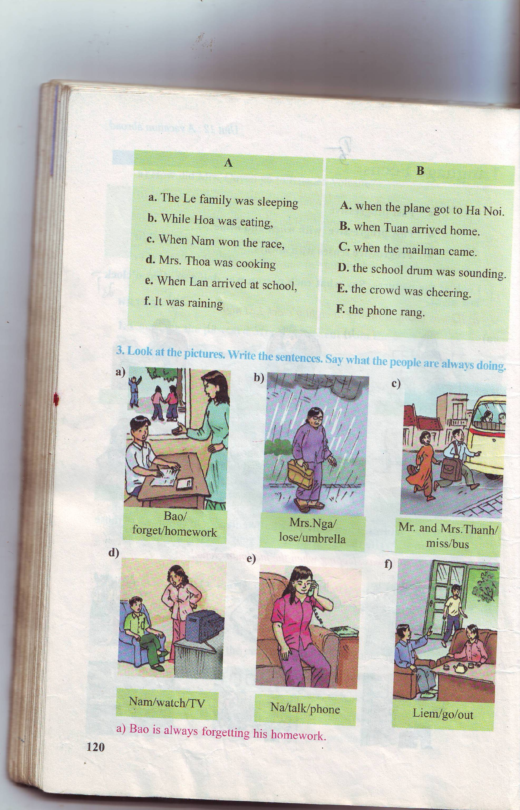
3. (Page 120):
III. Progressive tenses with always
Bao
forgetting
He his homework.
is
always
Form:
S + be(am, is, are) + always + V-ing…
Use : Diễn tả hành động xảy ra thường xuyên, lời phàn nàn, than phiền.
Diễn tả hành động xảy ra có tính liên tục, tích cực
Mr. Ha is always working. (Ông Hà làm việc suốt)

Slide 5
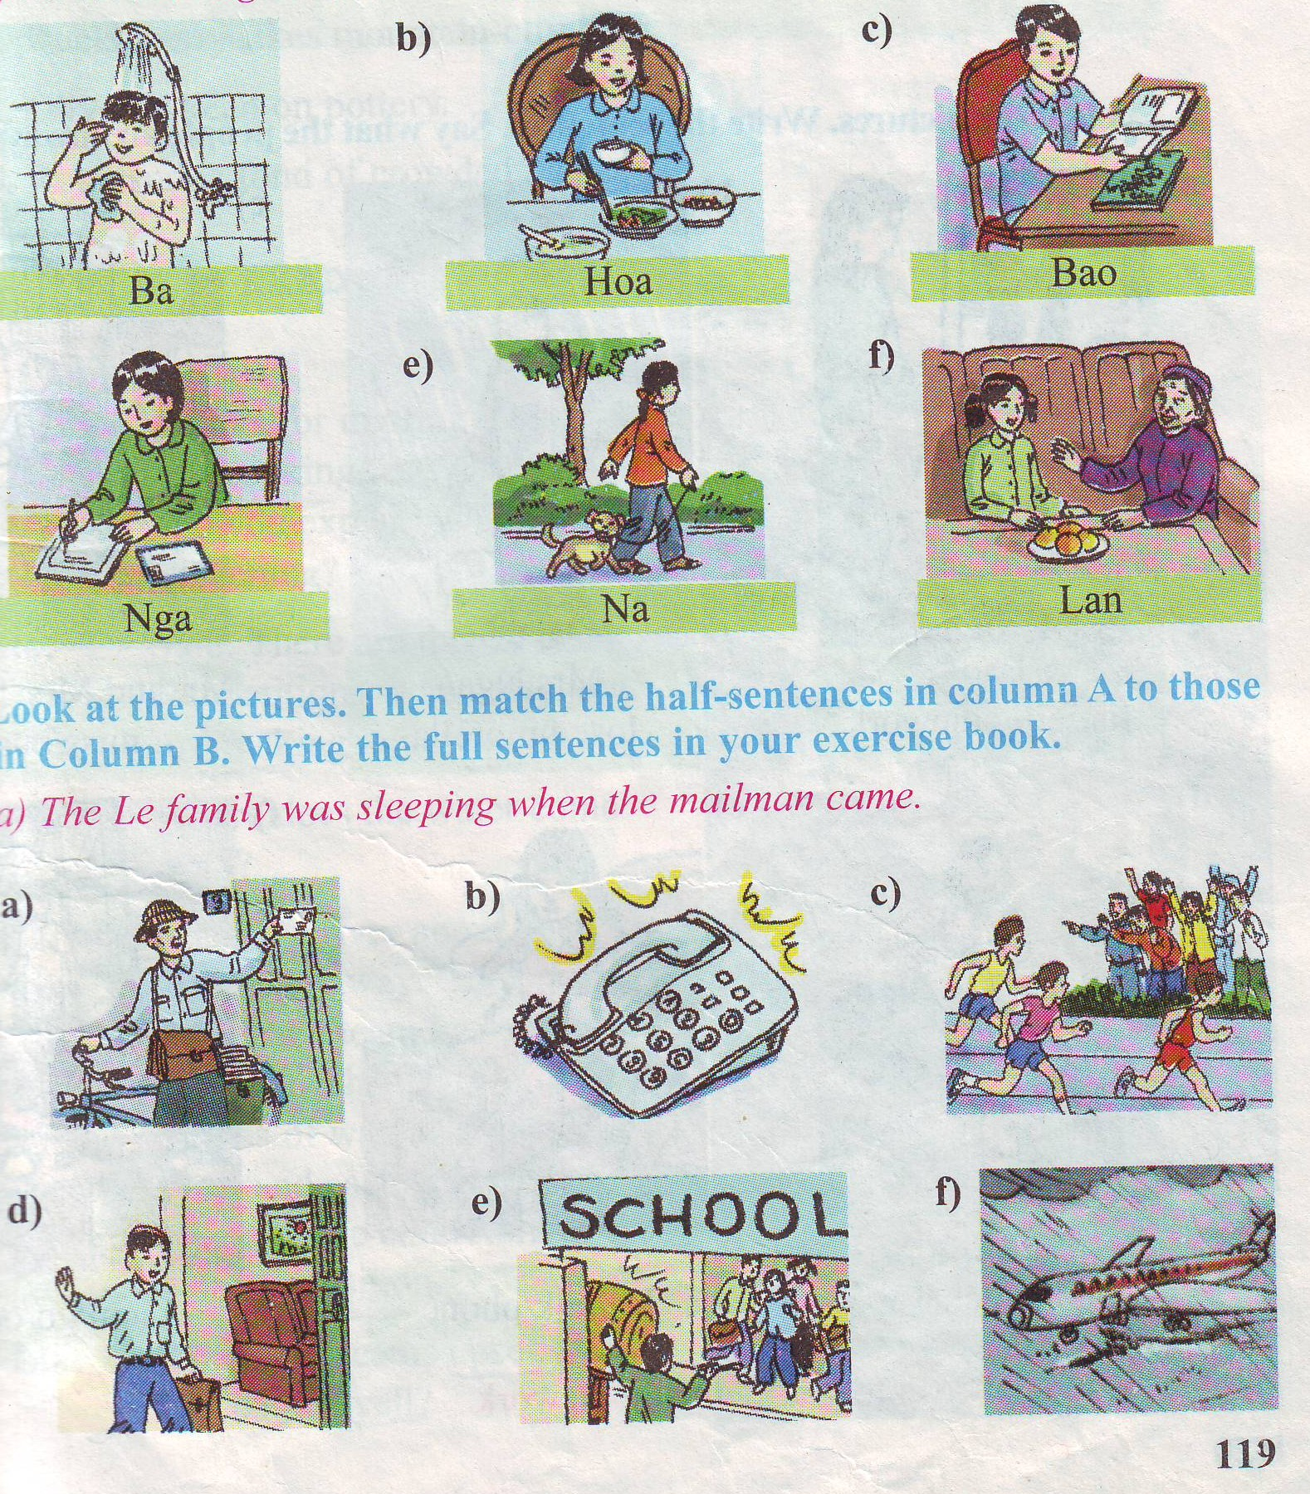
What were Lan and
her grandmother doing
at 8 o’clock last night?
Lan and her grandmother were talking
at 8 o’clock last night.
The past progressive tense
(Thì quá khứ tiếp diễn )
Form: S + was/were + V-ing…
Use : Diễn tả hành động, sự việc đang xảy ra tại một thời điểm xác định trong quá khứ.

Slide 6
S + Be(am, is, are) + always + V-ing…
Bao/ forget / homework
Bao is always forgetting his homework.
Mrs.Nga/lose/umbrella
Mrs Nga is always losing her umbrella.
Mr. and Mrs.Thanh/miss/the bus
Mr and Mrs Thanh are always missing
the bus.

Slide 7
S + Be(am, is, are) + always + V-ing…
Nam/watch/TV
Nam is always watching TV.
Na/ talk/phone
Na is always talking on the phone.
Liem/go/ out
Liem is always going out.

Slide 8
3. (Page 120):
a. Bao is always forgetting his homework.
b. Mrs Nga is always losing her umbrella.
c. Mr and Mrs Thanh are always missing bus.
d. Nam is always watching TV.
e. Na is always taking on the phone.
g. Liem is always going out.

Slide 9





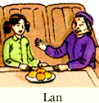
Match each sentence with the correct picture
walk with a dog
take a shower
read a comic
eat dinner
talk to Grandma
write a letter

Slide 10

A: What is Ba doing now?
B: He is taking a shower now.
Present progressive
A: What was Ba doing at 8 o’clock last night?
B: He was taking a shower.
Past progressive

Slide 11
Unit 12: A vacation abroad
Language focus
I. Present progressive with always
1. Look at the pictures. Ask and answer what each person was doing at 8 o’clock last night
II. Past progressive
Form: S + was/ were + V-ing
I/ He/ She + was + V-ing
We/ you/ They + were + V-ing
take a shower
A: What was Ba doing at 8 o’clock last night?
B: Ba was taking a shower.

Slide 12
1. (Page 119):
at 8 o’clock last night
a)
Ba was taking a shower
Hoa / eat/ dinner
Bao / read/ a comic
d)
Nga / write/ a letter
Na / walk/ with her dog
Lan /talk/ with her grandmother

Slide 13
1. (Page 119):
at 8 o’clock last night
a)
Ba was taking a shower
Hoa was eating dinner
Bao / read/ a comic
d)
Nga / write/ a letter
Na / walk/ with her dog
Lan /talk/ with her grandmother

Slide 14
1. (Page 119):
at 8 o’clock last night
a)
Ba was taking a shower
Hoa was eating dinner
Bao was reading a comic
d)
Nga was writing a letter
Na was walking with her dog
Lan was talking with her grandmother

Slide 15
Past progressive with when and while
2. (Page 119):
Look at the pictures
Nam
Tuan
Lan

Slide 16
Unit 12: A vacation abroad
Language focus
I. Present progressive with always
The Le family was sleeping when the mailman came.
Past simple
Past progressive
II. Past progressive
The mailman came while the Le family was sleeping
Form: S + was/ were + V-ing
Past simple
Past progressive
III. Past progressive with when and while
Form: When + simple past (thì, khi)
While + past progressive (trong khi)
Use: Diễn tả hành động đang diễn ra trong quá khứ thì có hành động khác xảy đến xen vào (hành động sau thường dùng quá khứ đơn)

Slide 17
2. (Pages 119- 120):
II. Past progressive with when and while
a. The Le family was sleeping when the mailman came.
when
Be( was/ were) +V-ing
V-past
Past progressive
when
Past simple
b. The phone rang while Nga was eating.
while
V-past
Be( was/ were) +V-ing
Past simple
while
Past progressive
Ex: My father was playing chess while my mother was sewing.

Slide 18
Form:
Main clause | Conjunction | Adv clause
Past Progressive | When | Past simple
Past simple | While | Past Progressive
Was / were + V-ing
{
Was/ were
V-past
Was / were + V-ing
Was/ were
V-past
- When dùng để diễn tả 1 hàng động đang diễn ra trong quá khứ thì có 1 hành động khác xen ngang. Hành động nào đang diễn ra ta chia thì quá khứ tiếp diễn, hành động xen ngang ta chia thì quá khứ đơn.
While dùng để diễn tả 2 hành động cùng xảy ra 1 lúc, cả 2 hàng động đều chia thì quá khứ tiếp diễn.

Slide 19
Note some new words:
- race (n): cuộc thi, cuộc đua
- plane (n): máy bay
mailman (n): người đưa thư
drum (n): cái trống
sound (v): kêu/ vang
- crowd (n): đám đông

Slide 20

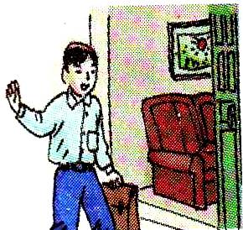
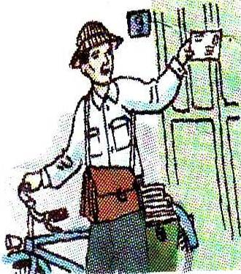

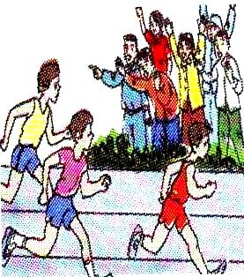
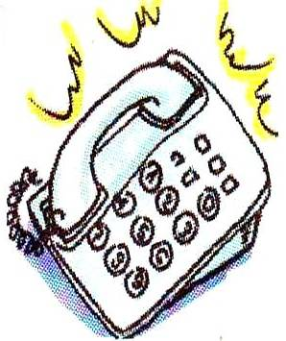
Matching
a. The Le family
was sleeping
when the plane got
to Ha Noi
b. While Hoa was eating ,
B. when Tuan arrived
home
c. When Nam won
the race,
C. when the mailman
came
d. Mrs Thoa was
cooking.
D. the school drum
was sounding
e. When Lan arrived at
school,
E. the crowd was
cheering
f .It was raining
F. the phone rang.

Slide 21
Answers: 2. (P119- 120):
a-C: The Le family was sleeping when the mailman came.
b-F: While Hoa was eating, the phone rang.
c-E : When Nam won the race, the crowd was cheering.
d-B: Mrs Thoa was cooking when Tuan arrived home.
e-D: When Lan arrived at school, the school drum was sounding.
f-A: It was raining when the plane got to Ha Noi.

Slide 22

Excercise: Choose the best answer.
1. The family………..when the mailman came. A. is sleeping B. was sleeping C. has slept D. have slept 2. .............I was doing homework, my friend came A. when B. at which C. while D. at time 3. I was reading..............My sister was playing with her dolls A. when B. while C. how D. what
4. Nga ………… a letter at 8 o’clock last night. A. write B. was writing C. is writing D. writes 5. We were sleeping when the telephone………….. A. rings B. ringing C. rang D. ring 6. When I arrived at school, the school drum .........…… A. was soundingB. is sounding C. are sounding D. were sounding 7. Mrs Nga………….always ………….her umbrella A. was/ losing B. has/ lost C. will/ lose D. is/ losing 8. My father is ………. forgetting things on the bus. A. always B. usually C. often D. sometimes

Slide 23



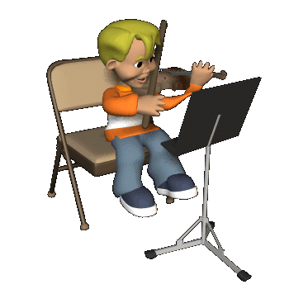


2. ANSWER THE QUESTIONS :
Lucky Number
1
2
3
4
5
6
7
8
9
Team 1
Team 2
Put the verb into correct form:
When I (see) him ,he (sit) asleep in a chair
Find and correct the mistake:
They are learning English at 8.15 yesterday morning
Complete the sentence:
Mai/always/watch/TV
Choose the best answer:
I was studying when the light went out (when/while)
Put the verb into correct form:
The phone (ring) while I (cook)
Complete the sentence:
What/you/do/from 7 to 9 a.m yesterday morning?
….
What were you doing from 7 to 9 a.m yesterday morning?
were
saw
was sitting
The phone rang while I was cooking
Mai is always watching TV

Slide 24
Unit 12: A vacation abroad
Language focus
I- Past progressive
Homework
Form: S + was/ were + V-ing
1- Learn structures by heart.
2- Review grammar and vocabulary of unit 12
3 - Prepare unit 13: Getting started – Listen and read (Find new words to talk about Festivals).
II- Past progressive with when and while
While + past progressive
When + simple past
III- Present progressive with always
S + is/ am/ are+ always + V-ing
III- Homework

Slide 25



THANK YOU
for your attention !
Good bye!

