Slide 1

ENGLISH 8
BINH KHANH SECONDARY SCHOOL

Slide 2

Warmly welcome to our class!
Monday, September 27th, 2021
Unit 2 : Making arrangements
Lesson 3 : Read (p.21-22)

Slide 3

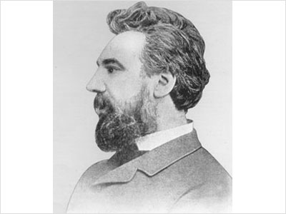

Who is this?
Alexander Graham Bell.
What did he invent?
He was a telephone inventor.

Slide 4
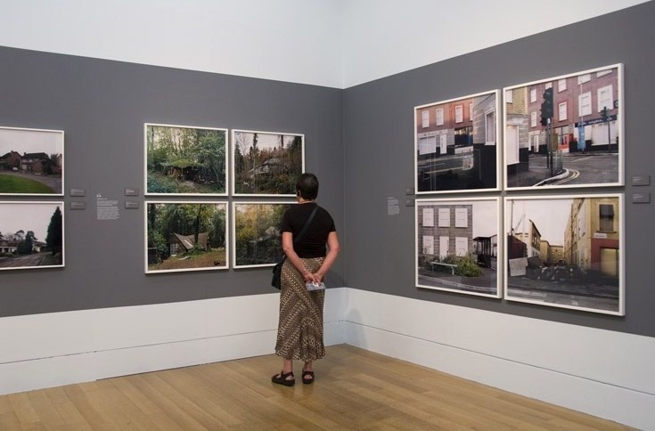
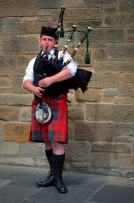
Unit 2 : Making arrangements
Lesson 3 : Read (p.21-22)
1. Vocabulary
1. Vocabulary:
- Scotsman (n)
: người xứ Scotland
- Scotland (n)
: nước Scotland
- emigrate (v)
go to another country to live.
: di cư
- transmit (v)
: truyền, phát (tín hiệu)
- conduct (v)
= carry out
: Thực hiện
- deaf-mute (n)
A person can not speak and hear
: người câm điếc
- device (n)
: thiết bị
- demonstrate (v)
: biểu diễn
- exhibition (n)
: cuộc triển lãm
- assistant (n) = helper
: trợ lý, người phụ tá

Slide 5
Unit 2 : Making arrangements
Lesson 3 : Read (p.21-22)
2. True/False statements prediction
T
F
a. Alexander G. Bell was born in the USA.
b. He worked with deaf-mute patients in a hospital in Boston.
c. Thomas Watson was Bell’s assistant.
d. Bell and Watson introduced the telephone in 1877.
e. Bell experimented with ways of transmitting speech
over a long distance.
f. Bell demonstrated his invention at a lot of exhibitions.

Slide 6
On March 3, 1847, Alexander Graham Bell was born in Edinburgh. He was a Scotsman although he later emigrated, first to Canada and then to the USA in the 1870s.
In America, he worked with deaf-mutes at Boston University. Soon, Bell started experimenting with ways of transmitting speech over a long distance. This led to the invention of the telephone.
Bell and his assistant, Thomas Watson, conducted many experiments and finally came up with a device which they first introduced in 1876. Bell said on the telephone: 'Mr. Watson, come here. I want you.' This was the first telephone message.
Traveling all over America, Bell demonstrated his invention to the public at countless exhibitions, and by 1877 the first telephone was in commercial use.

Slide 7
Unit 2 : Making arrangements
Lesson 3 : Read (p.21-22)
* Read and check(v) and correct the false sentences
T
F
a. Alexander G. Bell was born in the USA
a. Alexander G. Bell was born in Edinburgh Scotland.
√
b. He worked with deaf-mute patients at Boston University.
√
b. He worked with deaf-mute patients in a hospital in
Boston
c. Thomas Watson was Bell”s assistant.
√
d. Bell and Watson introduced the telephone in 1876.
√
d. Bell and Watson introduced the telephone in 1877
e. Bell experimented with ways of transmitting speech
between deaf-mutes over a long distance
√
e. Bell experimented with ways of transmitting speech
over a long distance.
f. Bell demonstrated his invention at a lot of exhibitions.
√

Slide 8
3. Put the events in the correct order:
Alexander Graham Bell …
a) went to live in the United States
b) successfully demonstrated his invention.
c) worked with Thomas Watson.
d) was born in Scotland.
e) went to live in Canada
f) invented the telephone.
g) worked with people who could neither speak nor hear
3-
6-
5-
1-
2-
7-
4-

Slide 9
3. Put the events in the correct order :
Alexander Graham Bell …
d) was born in Scotland.
e) went to live in Canada
a) went to live in the United States
g) worked with people who could neither speak nor hear.
c) worked with Thomas Watson.
b) successfully demonstrated his invention.
f) invented the telephone.
1 -
2 -
3 -
4 -
5-
6-
7-
neither … nor : kh«ng … mµ còng kh«ng

Slide 10
Unit 2 : Making arrangements
Lesson 3 : Read (p.21-22)
4.Comprehension questions
When was Alexander Graham Bell born?
Where was he born?
Where did he live?
Who did he work with at Boston University?
When did he invent the first telephone?

Slide 11

Question 1:
When was Alexander Graham Bell born?
He was born in 1847
A
in 1876
B
B
in 1847
in 1847
C
in 1870
1
2
3
4
5
6
7
8
9
10

Slide 12
Question 2:
Where was he born?
He was born in Scotland
A
in the USA
B
in Canada
C
C
in Scotland
in Scotland
1
2
3
4
5
6
7
8
9
10

Slide 13
Question 3:
Where did he live?
He lived in the USA
A
A
in the USA
in the USA
B
in Canada
C
in Scotland
1
2
3
4
5
6
7
8
9
10

Slide 14
Question 4:
Who did he work with at Boston University?
He worked with Thomas Watson
A
students
B
B
Thomas Watson
Thomas Watson
C
teachers
1
2
3
4
5
6
7
8
9
10

Slide 15
Question 5:
When did he invent the first telephone?
He invented the first telephone in 1876
A
in 1870
B
in 1877
C
C
in 1876
in 1876
1
2
3
4
5
6
7
8
9
10

Slide 16
Unit 2: MAKING ARANGEMENTS
Leson 3: READ
2. True or false. Check () the boxes.
Then correct the sentences.
F. in the USA
F. at Boston University
T
F. 1876
F. between deaf – mute people
T
1. New words:
. invent (v) : phát minh
. deaf-mute (adj) : câm điếc
. patient (n) : bệnh nhân
. assistant (n) : trợ lí
. transmit (v) : truyền, phát tín hiệu
. demonstrate (v) : biểu diễn
. exhibition (n): cuộc triển lãm
3. Put the events in the correct order.
Alexander Graham Bell …
1. d) was born in Scotland.
2. e) went to live in Canada
3. a) went to live in the United States
4. g) worked with people who could neither speak nor hear.
5. c) worked with Thomas Watson.
6. f) invented the telephone.
7. b) successfully demonstrated his invention.
Grammar:
Neither … nor : không … cũng không.
4. Comprehension questions

Slide 17
(?) What is the telephone used for?
To chat with friends.
To communicate.
To have a message.
To call someone.
To make arrangements.
To talk to a person who lives far from.
To get information at the airport or railway station quickly.

Slide 18

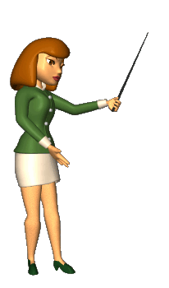
Unit 2 : Making arrangements
Lesson 3 : Read (p.21-22)
5. Homework:
Read the text again
Learn by heart the new words and structures
Prepare: Lesson 4. Write;
Lesson 5: Language Focus

