Slide 1

ENGLISH 8
BINH KHANH SECONDARY SCHOOL

Slide 2
Checking the previous lesson
1. Play: Crossword game
K
S
A
T
U
R
D
A
Y
1
T
S
E
P
T
E
M
B
E
R
2
E
W
E
L
L
3
L
Y
E
A
R
4
E
P
H
Y
S
I
C
S
5
P
K
I
T
C
H
E
N
6
H
L
O
N
G
7
O
N
O
S
E
8
N
9
A
D
D
R
E
E
S
S
B
O
O
K
The adverb form of the word “ Good “
The book you write addresses and phone numbers in
A part of body helps you smell
The subject in which you do experiments
The name of the month has nine letters
The place where we usually cook meals
It is opposite to “ Short “
The day between Friday and Sunday
It has twelve months

Slide 3
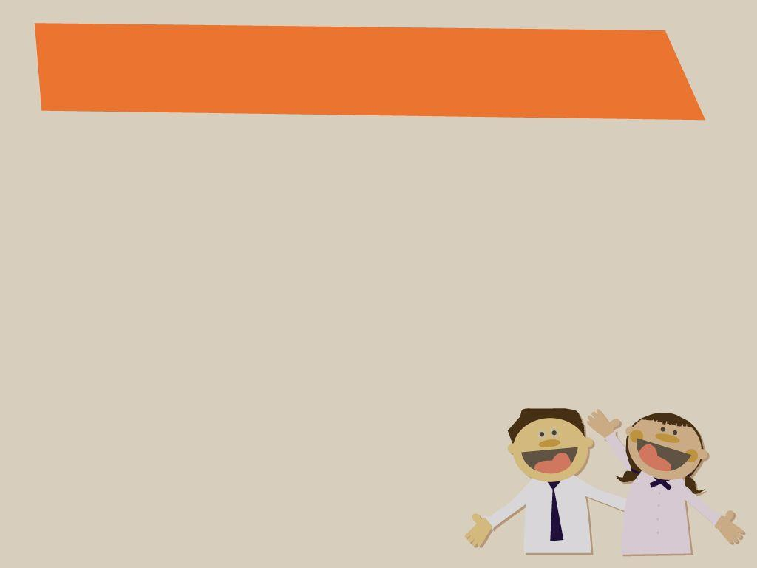
2. Answer the questions
Who invented the telephone?
Alexander Graham Bell
2.When did he invent the first telephone?
In 1876

Slide 4

Unit 2:
MAKING ARRANGEMENTS
Period 11:Write

Slide 5

Guess: What should we mention in a telephone message?
Date:
Time:
For:
Message:
Taken by:

Slide 6
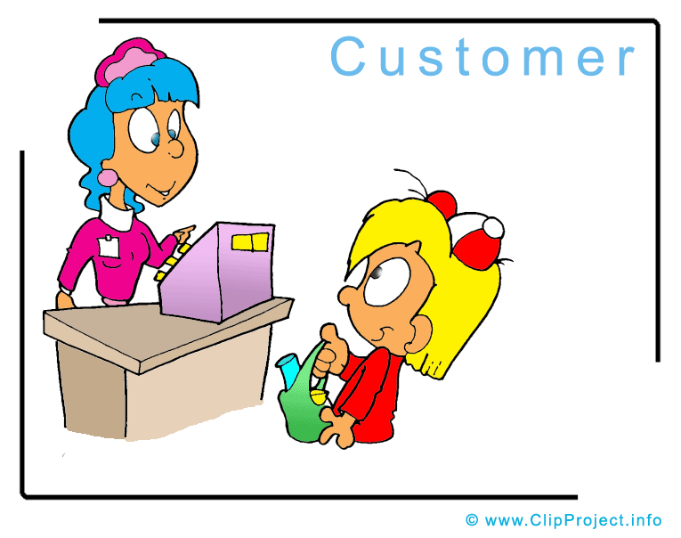


* Vocabulary
- customer (n) /ˈkʌs.tə.mɚ/
- khách hàng
- delivery (v) /dɪˈlɪv.ɚ.i/
- sự phân phát, sự giao hàng
- service (n) /ˈsɝː.vɪs/
- sự phục vụ, dịch vụ
- reach (v)
- tới, đến
- taken by
- được nhắn bởi
stationary (n)
/ˈsteɪ.ʃə.ner.i/
- văn phòng phẩm

Slide 7
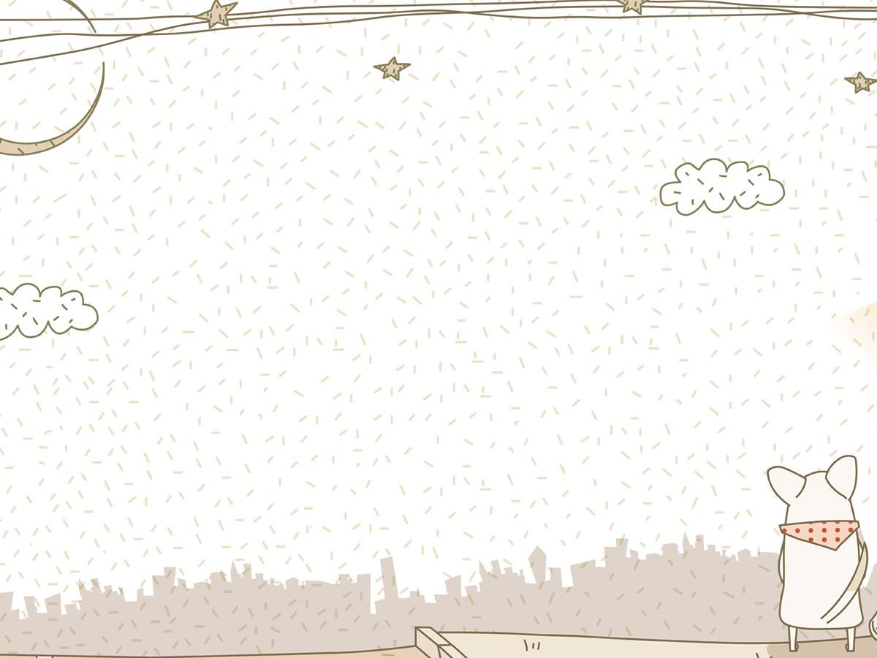
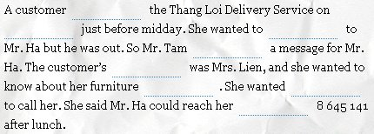
Read the message, then fill in the gaps in the passage
that follows with the information.
Thang Loi Delivery Service Date: May 12 Time: 11.50 am For: Mr. Ha Message: Mrs. Lien called about her furniture delivery. She wants you to call her after lunch. Her telephone number is 8 645 141 Taken by: Tam
(1)
phoned
(2)
May 12
(3)
speak
(4)
took
(5)
name
(6)
delivery
(7)
Mr. Ha
(8)
number

Slide 8
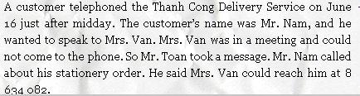
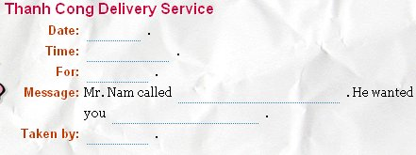
2. Read the passage and complete the telephone message.
June 16
After midday
Mrs. Van
about his stationary order
to call him after lunch. His telephone number is 8634082
Mr. Toan

Slide 9

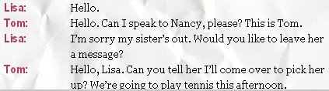

Read the dialogue then help Lisa write a message for Nancy.
Use the information from the dialogue

Slide 10
Read the dialogue then help Lisa write a message for Nancy.
Use the information from the dialogue
Date: ………………………. Time:………………………. For: ………………………. Message: …………………………………….. ……………………………………. ……………………… Taken by:……………………….
Today
1.30 pm
Nancy
Tom called about playing tennis this
afternoon. He will come over to pick
you up at 1.30.
Lisa

Slide 11
Remember to write a message
Date:
Time:
For:
Message:
Taken by:

