Slide 1

ENGLISH 8
BINH KHANH SECONDARY SCHOOL

Slide 2

Unit 2: MAKING ARRANGEMENTS
Lesson 5: Language focus

Slide 3

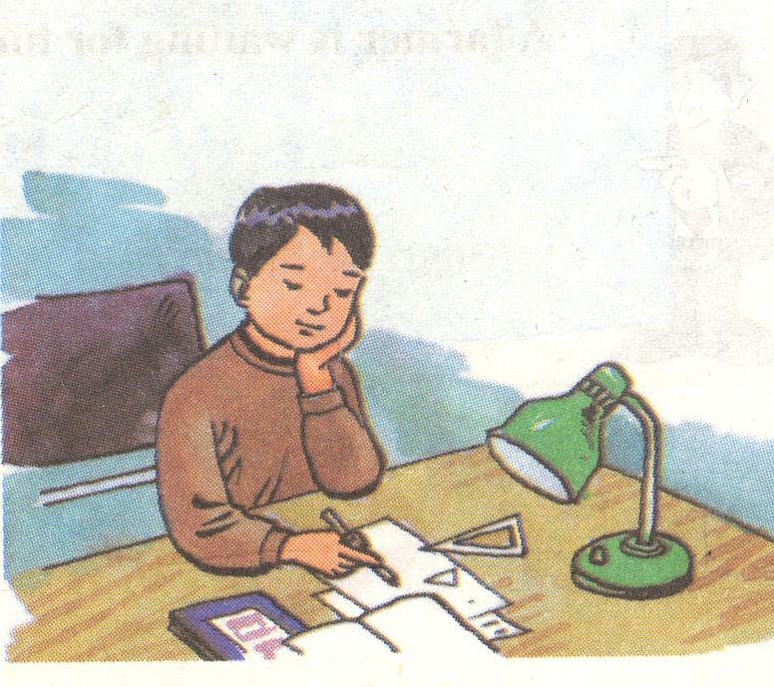

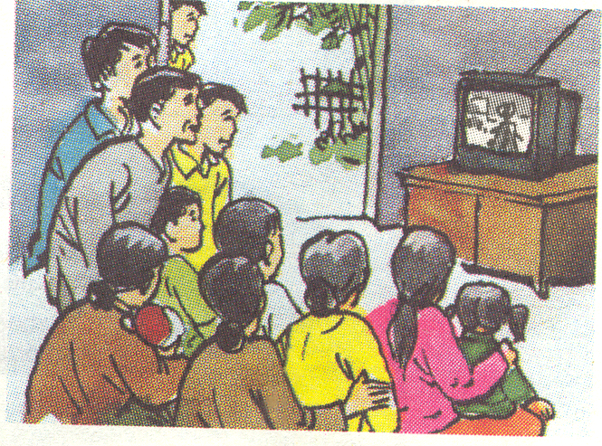
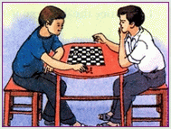
Look at these pictures. Then answer the question. What are they going to do tonight?
a)
b)
He is going to do his homework.
They are going to read books.
c)
d)
They are going to watch TV.
They are going to play chess.

Slide 4
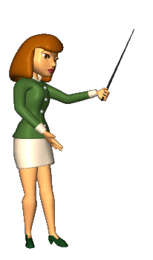

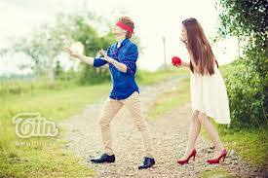
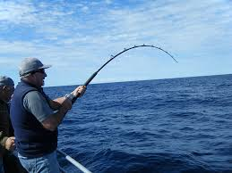

1. VOCABULARY
- fishing rod ['fi∫iηrɔd] (n) :
cần câu (cá)
- novel ['nɔvəl] (n) :
tiểu thuyết
- action movie ['æk∫n 'mu:vi] (n):
phim hành động
- Hide and seek['haidənd'si:k] (n)
trò chơi trốn tìm
- perhaps [pə'hæps] ( adv):
có lẻ, có thể

Slide 5
Matching
A | B
1. action movie | a. cần câu cá
2. novel | b.tiểu thuyết
3. fishing rod | c. trò chơi trốn tìm
4. hide and side 5. perhaps | d. phim hành động e. có lẻ, có thể
1. D
2. B
3. A
4. C
5.E

Slide 6
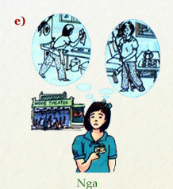
2. Grammar
* Talk about intentions with “be going to”
* Form:
S + be + going to + V-infinitive
Ex: They have free time on Sunday.
= They are going to go camping
Nga has a movie ticket.
=> She is going to see a movie.
Usage: Dùng để diễn tả một sự việc, một hành động sắp sửa xảy ra và chắc chắn xảy ra (trong một tương lai gần).

Slide 7
→ They are going (to go) fishing.
3.Practice
1.Work with a partner. Say what the people are going to do.
a. Quang and Nam bought new fishing rods yesterday.
b. Trang’s mother gave her a new novel this morning and she has no homework today.
→ She is going to read a new novel.
c. Van has a lot of homework in Math and she is going to have Math at school tomorrow.
→ She is going to do her homework in Math.
d. Mr. Hoang likes action movies very much and there’s an interesting action movie on TV tonight.
→ He is going to watch an action movie on TV tonight.
e. Hien’s friend invited her to his birthday party.
→ She is going to give him a nice birthday present.

Slide 8
2.a) Complete the table about you.Add three more activities to the list.
What are you going to do on the weekend?
Are you going to….. | YOU | YOUR PARTNER
see a movie?
play sports?
meet your friends?
help your parents?
do your homework?
watch TV?
read books?
listen to music?
go shopping ?

Slide 9
2.b) Practice with your partner.
What are you going to do on the weekend?
Are you going to….. | YOU | YOUR PARTNER
see a movie?
play sports?
meet your friends?
help your parents?
do your homework?
watch TV?
read books?
Ex: S1: Are you going to see a movie?
S2: Yes, I am.
/ No, I am not.

Slide 10
outside
downstairs
inside
Adverbs of place
upstairs
there
here

Slide 11
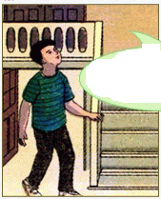
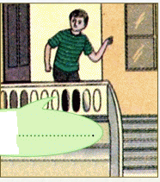
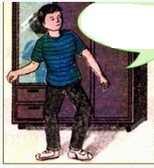
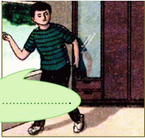
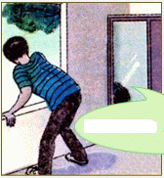
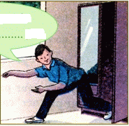
3. Complete the speech bubbles. Use each adverb in the box.
Ba is playing hide and seek with his cousin, Tuan.
outside
inside
there
here
upstairs
downstairs
a)
b)
c)
He isn’t
…...............and he isn’t upstairs.
Where is Tuan?
I think he’s
.…………
No, he isn’t ...............
d)
e)
I’m not outside.
I’m ............, Ba
f)
No, he isn’t
............
Perhaps he’s .................

Slide 12
3. Complete the speech bubbles. Use each adverb in the box.
Ba is playing hide and seek with his cousin, Tuan.
outside
inside
there
here
upstairs
downstairs
a)
b)
c)
Where is Tuan?
I think he’s
.…………
No, he isn’t ...............
He isn’t…...............
and he isn’t upstairs.
here
downstairs
upstairs

Slide 13
3. Complete the speech bubbles. Use each adverb in the box.
Ba is playing hide and seek with his cousin, Tuan.
outside
inside
there
here
upstairs
downstairs
d)
e)
f)
Perhaps he’s .................
No, he isn’t
............
I’m not outside.
I’m ............, Ba
outside
there
here

Slide 14
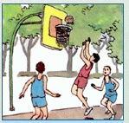
Look at the pictures. Then answer the question.
What are they going to do on the weekend?
→ They are going to play volleyball.

Slide 15
Choose the best answer.
Don’t go ………, it’s too cold
here B. inside C. outside

Slide 16
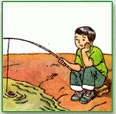

Is he going to do his homework?
→ No, he isn’t.

Slide 17

Choose the best answer.
I think your book is over……, on that green table.
A. there B. downstairs C. inside

Slide 18
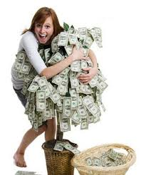
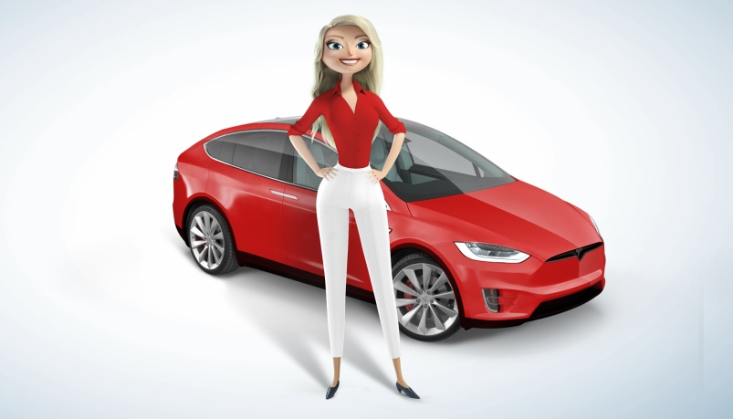
Use “ be going to”
Lan has a lot of money
She is going to buy a car .

Slide 19

Homework
Learn new words and grammar by heart.
Prepare Unit 3: lesson 1: Getting Started
and listen and read.
New words : tidy, feed, saucepan, cupboard, rice cooker, ….
Grammar : must, have to.

Slide 20


