Slide 1
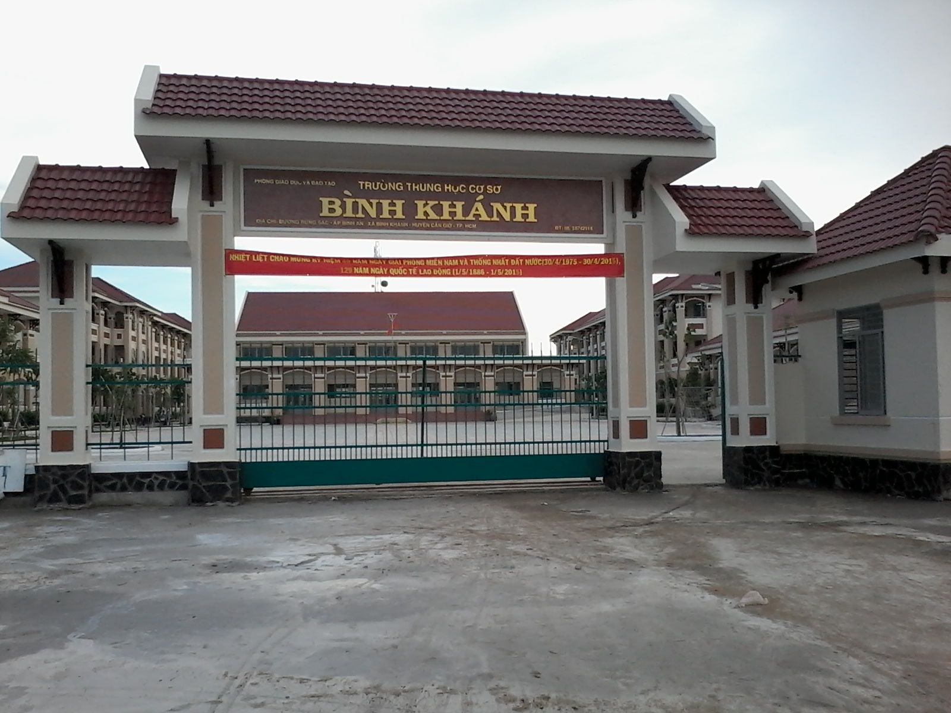



BINH KHANH SECONDARY SCHOOL
ENGLISH 8

Slide 2

TO OUR CLASS 8!

Slide 3

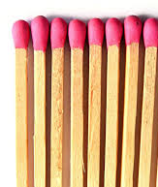
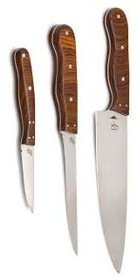
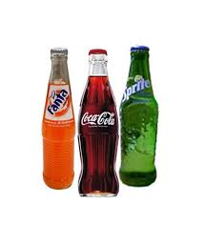
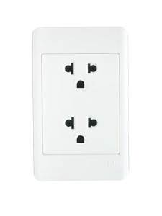

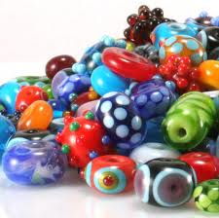
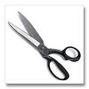
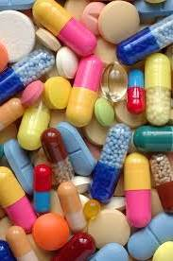
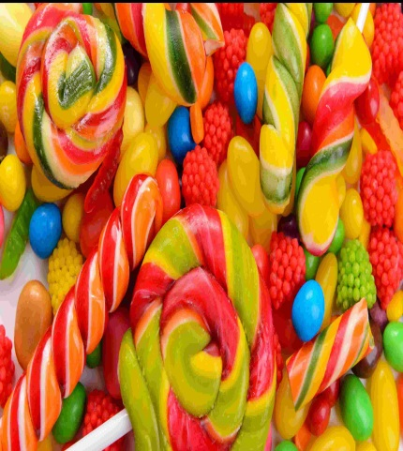
a
b
c
d
e
f
g
h
i
j
5.an electrical socket
1. candy
2. knives
3. drugs
4. beads
6. matches
7. soft drinks
8. fire
9. scissors
10. chemicals

Slide 4

Which things can be dangerous to children in the house?
chemicals
matches
knives
soft drinks
an electrical socket
fire
beads
scissors
drugs
candy

Slide 5
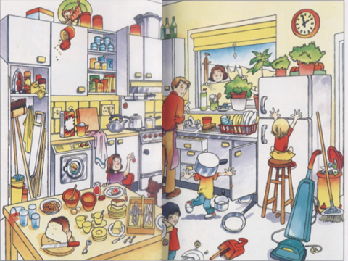
Is it dangerous when children play in the kitchen like this?
What should we do to keep safe in the home?

Slide 6

READ+ L.F 4
ENGLISH 8
UNIT 3: AT HOME
LESSON 3: READ

Slide 7
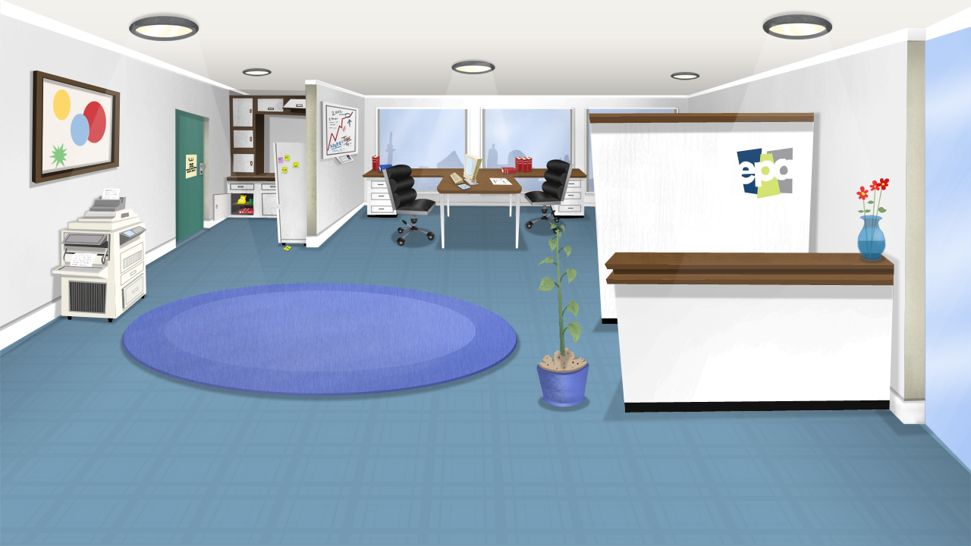

Unit 3: AT HOME
Read
Lan’s mother, Mrs Quyen is at her local community center. She is reading one of the posters on the wall. It talks about “Safety Precautions in the Home”.

Slide 8
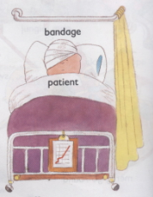
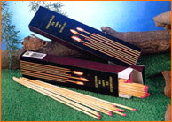
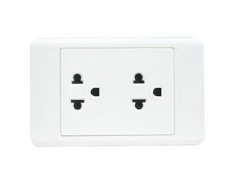
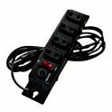
H2SO4
NaCL

Slide 9
a precaution
sự đề phòng
a socket
ổ (cắm điện)
a match
que diêm
chemical (n)
hóa chất
safety (n)
sự an toàn
(to) destroy
tiêu hủy, tàn phá
(to) injure
gây thương tích

Slide 10


Unit 3 : lesson 3 - Read
Lan / s mother , Mrs Quyen ,is at her local community center .she is reading one of the poster on the wall .
Safety Precautions in the Home
You must put all chemicals and drugs in locked cupboards .Children may drink or eat these things because they look like soft drinks or candy .
You must not let children play in the kitchen .The kitchen is a dangerous place .
☞ You have to make sure children do not play with matches .Each year ,fire destroys homes and injures children because someone plays with matches. Remember ,it only takes one match to cause a fire .
You must cover electrical sockets so that children do not try to put anything into them .Electricity can kill.
You have to keep all dangerous objects out of the children / s reach. These include scissors ,knives ,and small objects such as beads.

Slide 11
True or false? Check () the boxes. Correct the false sentences.
Unit 3: AT HOME
Sentence | True | False
a) It is safe to leave medicine around the house.
b) Drugs can look like candy.
c) A kitchen is a suitable place to play.
d) Playing with one match cannot start a fire.
e) Putting a nife into an electrical socket is dangerous.
f) Yong children do not understand that many household objects are dangerous.

It’s safe to keep medicine in locked cupboards.


The kitchen is a dangerous place to play.

Playing with one match can cause/start a fire.




Slide 12
Exercise 2: Work in groups.
What must we do and mustn’t do to protect our children from the danger?
1) We put all chemicals and drugs in locked cupboards.
must
(must/ mustn’t)
mustn’t
(must/ mustn’t)
2) We let children play in the kitchen.
(must/ mustn’t)
mustn’t
3) We let children play with matches.
(must/ mustn’t)
must
4) We cover electrical sockets.
have to
5) We put all dangerous objects out of children’s reach.
(have to/don’t have to)

Slide 13
LUCKY NUMBERS
1
2
3
4
5
6
7
8

Slide 14


BRAINSTORMING
gas
Danger in the home
for the children
BEGIN

Slide 15
Unit 3 : Lesson 3 - Read
gas
drug
electricity
Danger in the home
for the children
knife
bead
scissors
match
boiling water
chemical
fire

Slide 16


Homework
 Learn vocabulary
 Write the answers.
 Prepare: WRITE

Slide 17

Thank you very much
GOODBYE

Slide 18
LAN | LAN’S MOTHER
-Where … … put the dishes? -What about … … knives? -Why? -Yes, . Mom | -You … … in the dish rack. Your little brother … … break. -You should … … locked cupboard. Don’t … … him play … … kitchen. -Because your brother mustn’t … … matches … … start a fire.

Slide 19
Answers
- Where must I put the dishes?
- You must put them in the dish rack. Your little brother can break.
What about these knives?
- You should put them in locked cupboard. Don’t let him play in the kitchen.
Why?
- Because your brother mustn’t play with matches. Only one match can start a fire.
-Yes, Mom

Slide 20
2. Why mustn’t we let children play in the kitchen?
Because the kitchen is a dangerous place.

Slide 21
LUCKY NUMBER

Slide 22
LUCKY NUMBER

Slide 23
4. Why must we cover electrical sockets?
Because children often try to put something into electrical sockets and electricity can kill.

Slide 24
1. Why must we put all chemicals and drugs in locked cupboard?
Because children often try to eat and drink them.

Slide 25
5. Why do we have to put all dangerous objects out of children’s reach?
Because the dangerous objects can injure or kill children.

Slide 26
LUCKY NUMBER

Slide 27
3. Why mustn’t children play with matches?
Because playing with one match can cause a fire.

