Slide 1
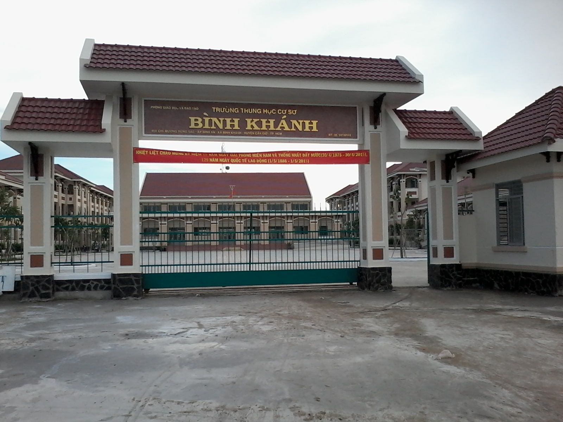



BINH KHANH SECONDARY SCHOOL
ENGLISH 8

Slide 2



UNIT 3: AT HOME
WRITE
LESSON 4:

Slide 3
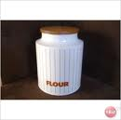


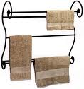
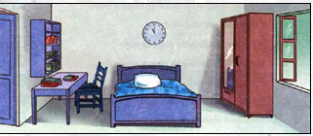
Unit 3 - AT HOME - Write
*New words
1. jar (n):
cái lọ
 a jar of flour
2. towel rack (n):
giá treo khăn
3. wardrobe (n)
: tủ quần áo
4. folder (n)
: Kẹp hồ sơ
5. lighting fixture(n)
: đèn chùm
6. above (prep):
bên trên
7. beneath (prep):
bên dưới

Slide 4
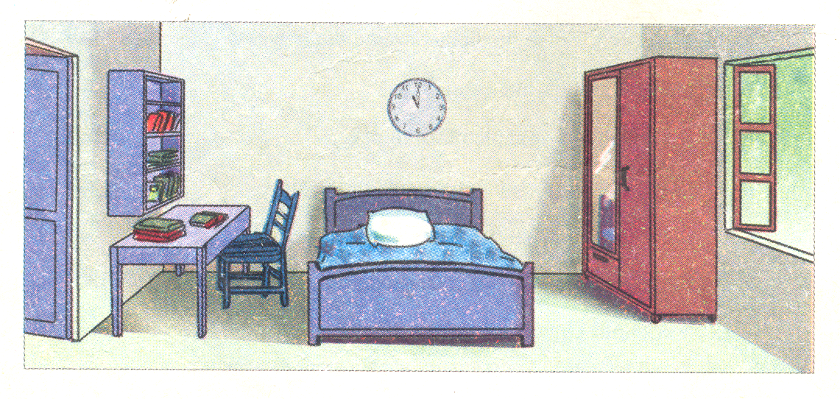
1. Read the description of Hoa’s room
Find out the prepositions of place
and underline
This is Hoa’s bedroom. There is a desk on the left of the room. On the desk there are many folders, and above the desk there is a bookshelf. There is a bed near the desk. On the right side of the room, there is a window. There is a wardrobe beside the window. The wardrobe is opposite the desk.

Slide 5
1. Read the description of Hoa’s room
* There is a/an ........
* There are ........
This is Hoa’s bedroom. There is a desk on the left of the room. On the desk there are many folders, and above the desk there is a bookshelf. There is a bed near the desk. On the right side of the room, there is a window. There is a wardrobe beside the window. The wardrobe is opposite the desk.

Slide 6
Where is the bookshelf?
The bookshelf is on the wall.
- What is there on the left of the room?
- What is there on the right side of the room?
There is a desk on the left of the room
On the desk (, there) are many folders.
On the other side of the room, there is a window.
= On the left of the room (, there) is a desk
There are many folders on the desk.
= There is a window on the other side of the room.
= The window is on the other side of the room .
Many folders are on the desk .
= The desk is on the left of the room

Slide 7
* Notes:
There is …… on the left/ right of ……….
on the other side
are …..
in the middle
the desk.
above/ beneath
next to/ beside
…………….
= On the left of …… , there is/ are……….
is/ are ……. .
= ………………..is/ are
on the left of ……….
next to/ beside …….
Write a description of Hoa’s kitchen
Eg:
This is Hoa’s kitchen

Slide 8
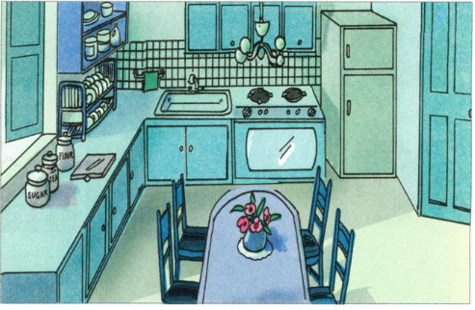
2. Write a description of this kitchen
Ex
This Hoa’s kitchen.
is
/
There/ refrigerator/ right corner/ room.
1
-There is a refrigerator in the right corner of the room.
-Next to the refrigerator (there) is a stove and oven.
Next to/ refrigerator/ stove and oven.
2
-On the other side of the oven (there) is a sink and next to
the sink (there) is a towel rack.
3
On the other side/ oven/ sink/ next to sink/ towel rack.
-The dish rack is on the counter to the right of the window, beneath the shelves.
4
Dish rack/ counter/ to the right/ window/ beneath/ shelves.
-On the counter, beneath the window, there are jars of sugar, flour
and tea.
5
On/ counter/ beneath/ window/ jars/ sugar/ flour/ tea.
-In the middle of the kitchen, there is a table and four chairs.
6
In the middle/ kitchen/ table/ four chairs.
-The lighting fixture is above the table and beneath the lighting
fixture (there) is a vase with flowers.
7
Lighting fixture/ above/ table/ beneath/ lighting fixture/ vase with flowers.

Slide 9
2. Write a description of this kitchen
Where is the dish rack ?
It is on the counter to the right of the window, beneath the shelves.
This is Hoa’s kitchen. There is a refrigerator in the right comer of the room. Next to the refrigerator is a stove and oven. On the other side of the oven there is a sink and next to the sink is a towel rack. The dish rack is on the counter to the right of the window, beneath the shelves. On the counter beneath the window there are jars of sugar, flour and tea. In the middle of the kitchen there is a table and four chairs. The lightning fixture is above the table and beneath the lightning fixture is a vase with flowers.

Slide 10
IV/ Homework
Write a description of your bed room / livingroom
Be ready “language focus”
___The end___
Thanks for joining us
Good bye and see you again

