Slide 1
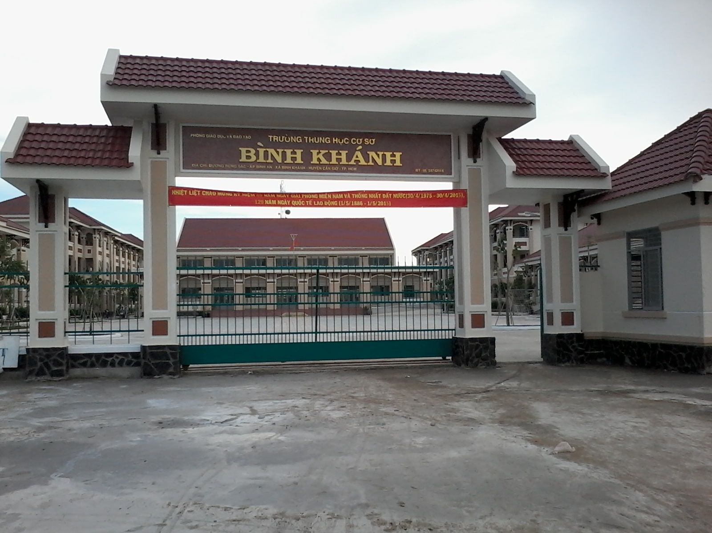



BINH KHANH SECONDARY SCHOOL
ENGLISH 8

Slide 2
Unit 3 Language fous

Slide 3
I/ Warm-up
Can you speak French?
Can you sing an English song?

Slide 4
II/ Revision 1- modals
EX 1: Read and complete the sentences:
1.She has to………………..the garbage everyday.
2.Tim doesn’t have to………….uniform at school.
3. I have a toothache. I must …………..a dentist.
4. Cars mustn’t…………..in front of the entrance.
5. People oughtn’t to………………..like that
6. She ought to………………………early.
7. Mai can’t ……………….. a nice picture.
8. My sister can……………….French.
Park, go, draw, empty, see, wear, drive, get up
empty
wear
see
park
drive
get up
draw
speak

Slide 5
1. Model sentences:
She has to empty the garbage everyday.
2. I have a toothache. I must see a dentist
3. She ought to get up early

Slide 6
2. a. Form of MUST
+ S + must / ought to + V
- S + must not/ ought not to + V.
? Must/ Ought + S + V / to V ?
b.Form of HAVE TO
+ S + have/ has to + V
- S + don’t / doesn’t + have to + V
? Do/ Does + S + have to + V ?

Slide 7
3. Meaning - Must: ( phaỉ)thường diễn tả một sự bắt buộc xuất phát từ người nói: -Have to ( phải) diễn tả sự bắt buộc do ngoại cảnh đưa đến. - Ought to ( nên )được dùng để diễn tả lời khuyên

Slide 8
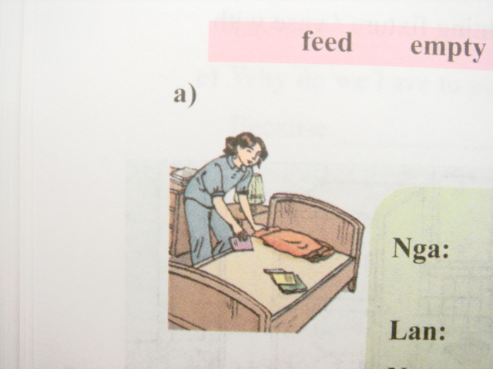
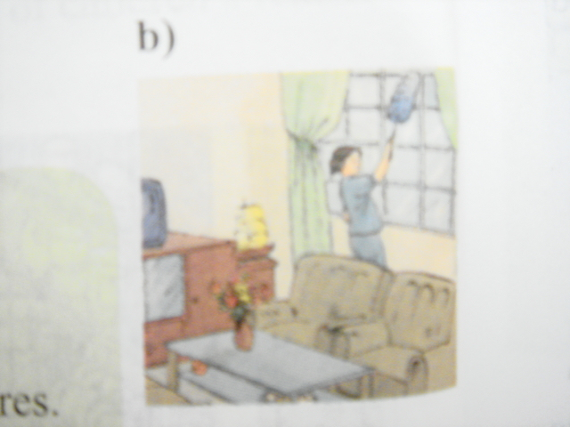
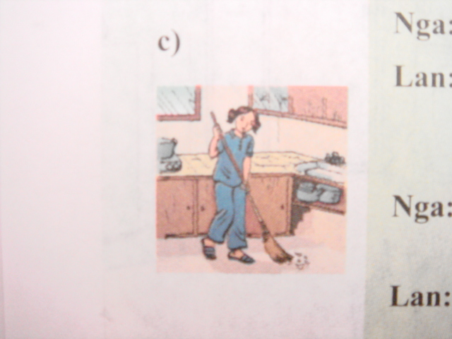
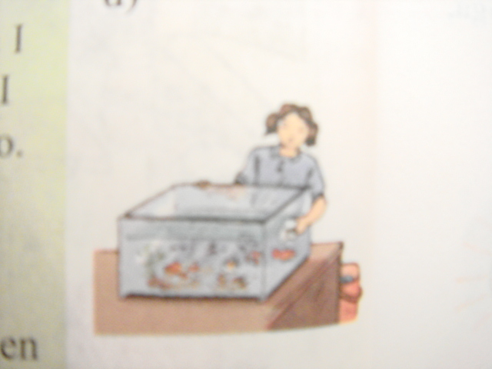
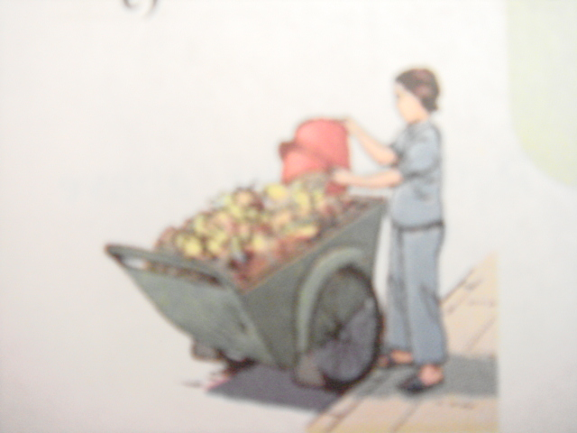
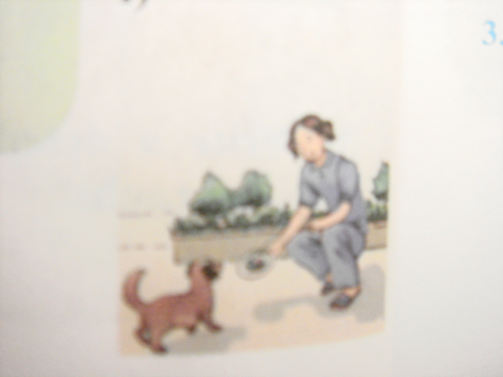
4. Practice: EX 2: Look at the picture. Complete the dialogue( L F 1. P.34)
Name the picture with verbs: feed, empty, do, tidy, sweep, clean, dust
Use must or have to and the verbs to complete the dialogue
tidy
1.Must tidy
dust
2.Have to dust
sweep
3Must sweep
d
e
f
6.must feed
4.have to clean
5.must empty
clean
empty
feed

Slide 9
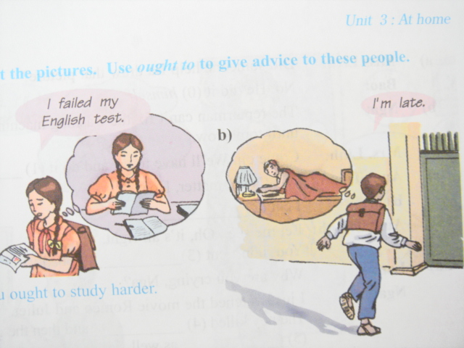
EX 3:Language focus 2
You ought to study harder
You ought to get up early

Slide 10
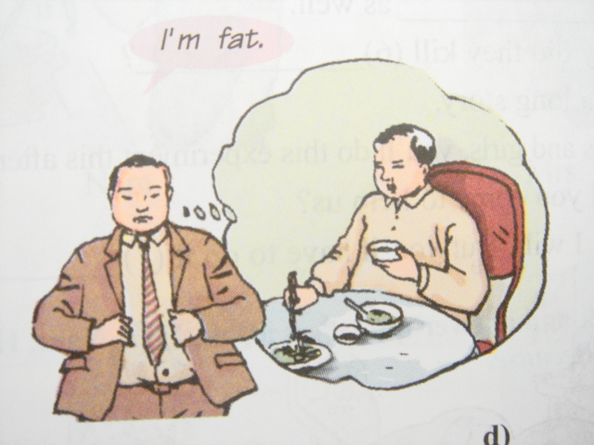
You ought to eat more fruit and vegetables

Slide 11
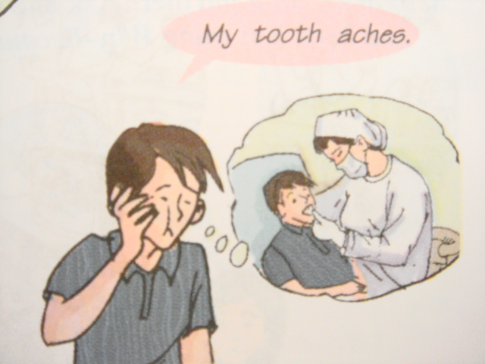
You ought to go to the dentist
( to see a dentist)

Slide 12
III.Revision 2: Brain storming
Thing you can’t do
Fix the TV
Drive plane
Thing you can do
Tidy up
Do homework

Slide 13
You do your homework and no one helps you. What do you say?
I do my homework myself
Reflexive pronouns
1. Forms
Pronouns Reflexive pronouns
I → myself
you → yourself / yourselves
he → himself
she → herself
it → itself
we → ourselves
they → themselves

Slide 14
2.Practice. Ex 1.Complete the dialogue( LF 3.P 35).Then practice with partner
Answer
1: ourselves
2: myself
3: yourself
4: himself
5: themselves
6: yourself

Slide 15
Ex 2. Word cue drill
you/ do / homework.
He/ fix / machine.
Mary / cook / dinner.
These students/ paint/the picture.
example:
- Did you do your homework?
+ yes. I did it myself

Slide 16
IV. Revision 3
The students!
Hai was absent today, wasn’t he?
-Yes.
1.Model sentence:
Why was Hai absent?
Because he was ill.

Slide 17
2. Practice. EX 6: Match. Then practice.
A | B
1.Why did Nam come to the party? | a. Because they’ll have an appointment at ten
2.Why were you late ? | b. Because she had to finish the report.
3.Why do they have to live soon | c. Because he had a lot of homework to do
4.Why are you laughing? | d. Because we missed the 1st bus
5.Why don’t you take a taxi? | e. Because the stories are so funny
6.Why did your sister stay late at the office? | f. Because I don’t have enough money.
7.Why couldn’t Jane pass the final exam? | g. Because she didn’t study hard enough.

Slide 18
2. Practice. EX 1: Match. Then practice.
A | B
1.Why did Nam come to the party? | a. Because they’ll have an appointment at ten
2.Why were you late ? | b. Because she had to finish the report.
3.Why do they have to live soon | c. Because he had a lot of homework to do
4.Why are you laughing? | d. Because we missed the 1st bus
5.Why don’t you take a taxi? | e. Because the stories are so funny
6.Why did your sister stay late at the office? | f. Because I don’t have enough money.
7.Why couldn’t Jane pass the final exam? | g. Because she didn’t study hard enough.
c
d
a
e
f
b
g

Slide 19
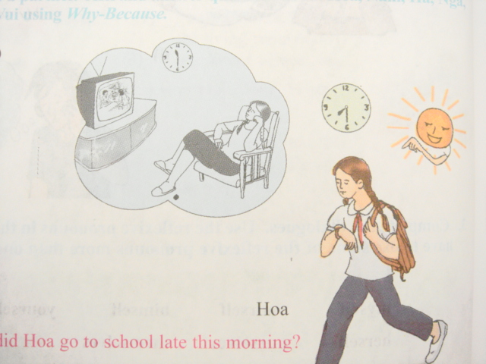
EX 7: Language focus 4
Why did Hoa go to school late?
Because she watched TV late last night.

Slide 20
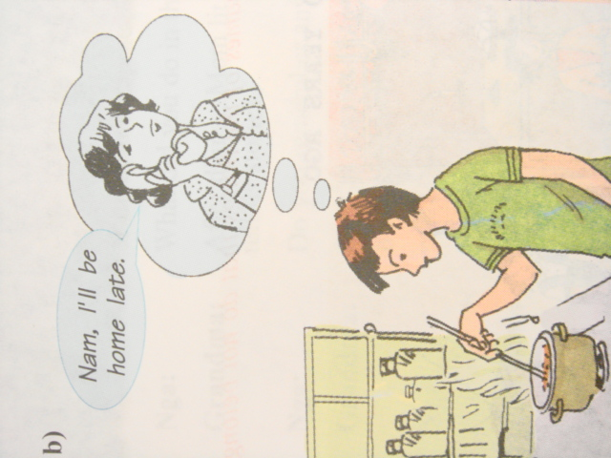

Slide 21
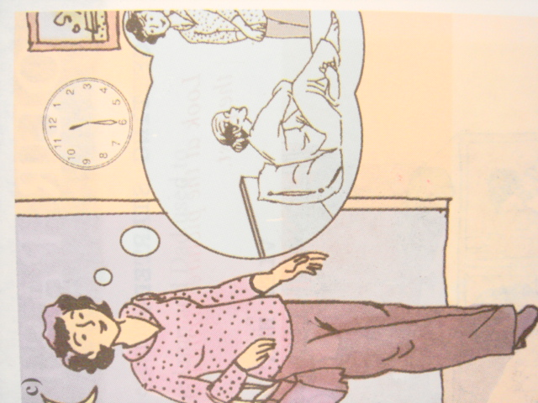

Slide 22
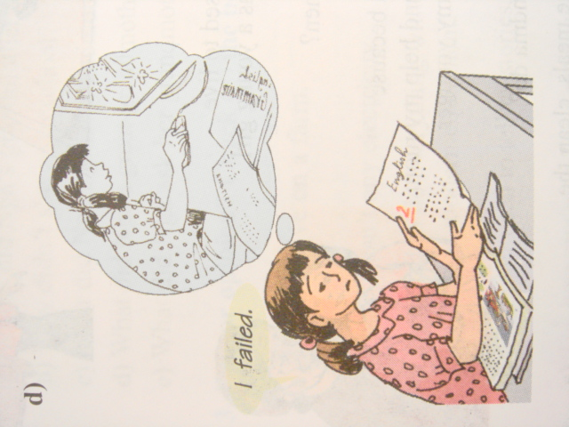

Slide 23
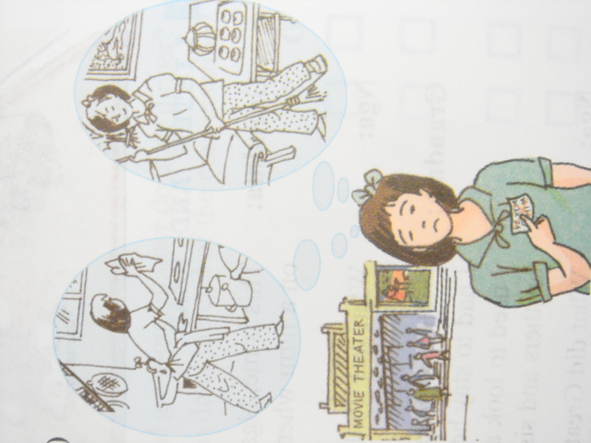

Slide 24
Ex8: Make questions with why
Huy was sad because he failed the exam
Why was Huy sad?
2. I was late for work because my car broken down.
Why were you late for work?
3. He cut himself because he was careless.
Why did he cut himself?
4. Ted can’t drive a car because he is not old enough.
Why can’t Ted drive a car?

Slide 25
pelmanism
1
I
1
2
she
2
3
he
3
4
we
4
5
they
5
6
herself
6
7
himself
7
8
myself
8
9
out
9
10
themselves
10
1
2
3
4
5
6
7
8
9
10
I
myself
she
herself
he
himself
we
ourselves
they
themselves

