Slide 1
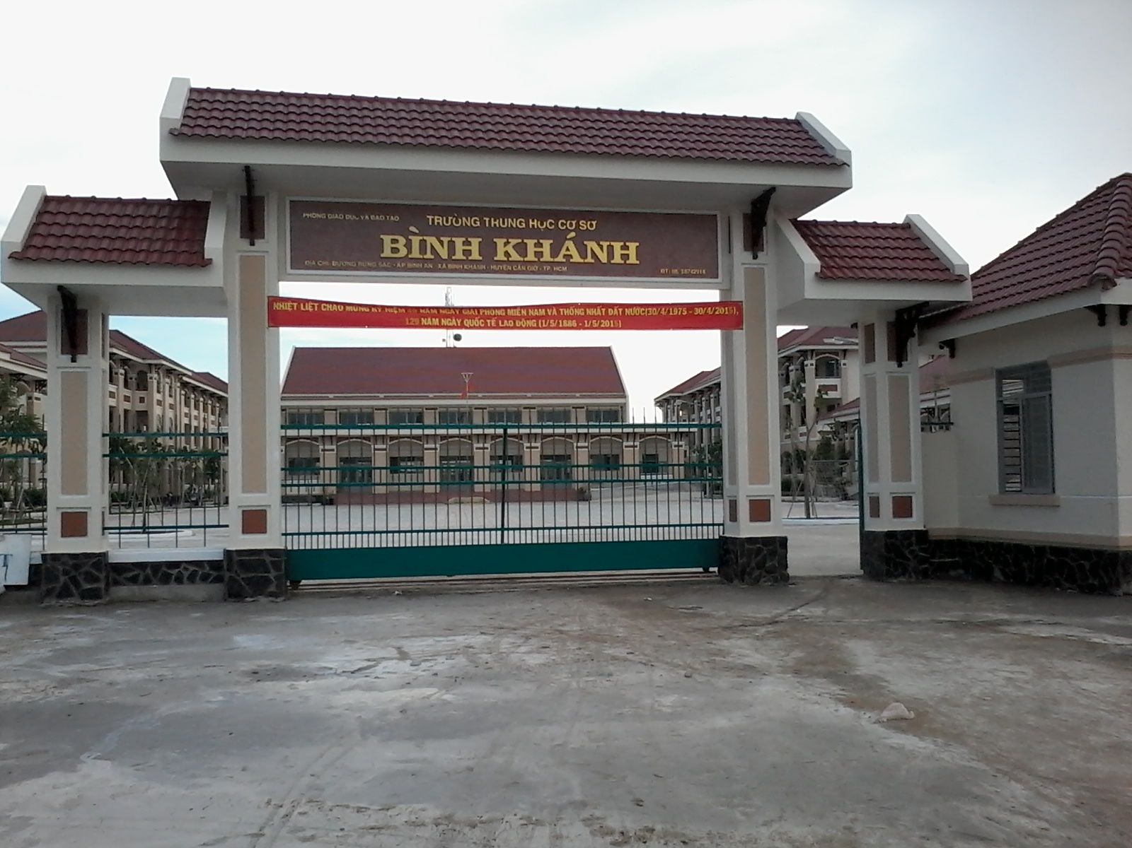



BINH KHANH SECONDARY SCHOOL
ENGLISH 8

Slide 3
UNIT 4 - OUR PAST
LESSON 3 : READ
THE LOST SHOE

Slide 4

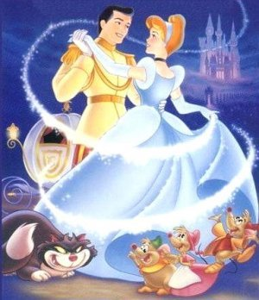
Unit 4: OUR PAST
Lesson 3: READ
How many characters are there in this story? Who are they?
There are six charaters in this story.
1. a farmer
2. the farmer’s daughter
(Little Pea)
3. the farmer’s new wife
4. the new wife’s daughter
(Stout Nut)
5. a fairy
6. a prince

Slide 5
Unit 4: OUR PAST
Lesson 3: READ
* VOCABULARY
1. cruel (adj) >< kind: độc ác
2. upset (adj) >< happy: đau khổ
3. festival (n): lễ hội
4. prince (n): hoàng tử
5. fairy (n): bà tiên
6. drop (v): đánh rõi

Slide 6
Unit 4: OUR PAST
Lesson 3: READ
* VOCABULARY
1. cruel (adj) >< kind
3. festival (n)
5. fairy (n)
2. upset (adj) >< happy
4. prince (n)
6. drop (v)
* TRUE/ FALSE
T
___1. Little Pea was a poor farmer’s daughter.
___2. Her father got married again after her mother died.
___3. The second mother was very nice.
___4. Her second mother didn’t make her do chores all day.
___5. A fairy changed Little Pea’s rags into beautiful clothes to take part in the festival.
___6. The prince decided to marry the girl who was the most beautiful.
T
F
cruel
F
made
T
F
owned the shoe

Slide 7
Unit 4: OUR PAST
Lesson 3: READ
* VOCABULARY
1. cruel (adj) >< kind
3. festival (n)
5. fairy (n)
2. upset (adj) >< happy
4. prince (n)
6. drop (v)
1/ complete sentences with words from the story
a/ Little Pea’s father was a ______.
b/ Little Pea’s mother _____ when she was young.
c/ Little Pea _____ to do the housework all day after her father got married _____ .
d/ The prince wanted to ____________ a girl from Little Pea’s village.
e/ Stout Nut’s mother did not make _____ _____ for Little Pea.
f/ The prince found Little Pea’s ____ shoe.
farmer
died
had
again
choose/ marry
new
clothes
lost

Slide 8
Unit 4: OUR PAST
Lesson 3: READ
2/ Answer the questions
a/ Who was Little Pea?
b/ What did Stout Nut’s mother make Little Pea do all day?
c/ How did Little Pea get her new clothes?
d/ Who did the prince decide to marry?
e/ Is this a true story? How do you know?

Slide 9
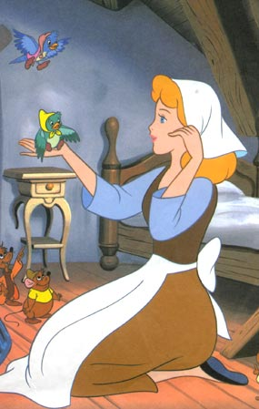
a/ Who was Little Pea?
She was a poor farmer’s daughter

Slide 10
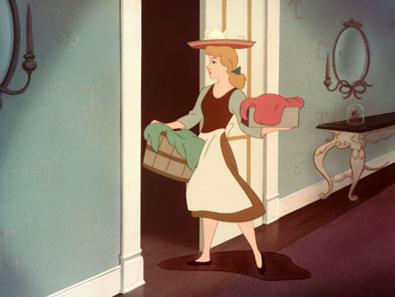
b/ What did Stout Nut’s mother make Little Pea do all day?
→She made Little Pea do chores all day.

Slide 11
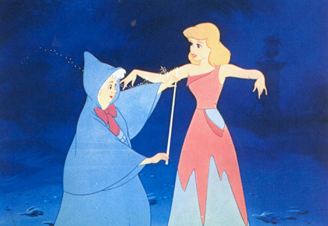
c/ How did Little Pea get her new clothes?
A fairy magically changed Little Pea’s rags into beautiful clothes.

Slide 12
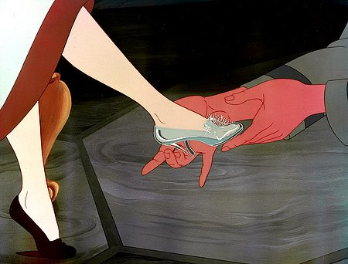
d/ Who did the prince decide to marry?
He decided to marry the girl who owned the shoe.

Slide 13
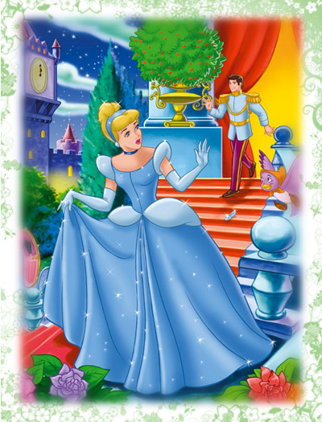
e/ Is this a true story? How do you know?
No, It isn’t. It’s a folktale.

Slide 14
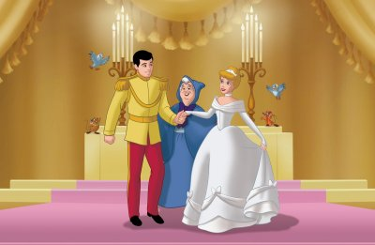
What is the moral lesson from the story?
“ONE GOOD TURN DESERVES ANOTHER”
ở hiền gặp lành

Slide 15
* HOMEWORK
-Learn new words.
-Answer the questions in notebook again.
-Retell the story.
-Prepare new lesson: Unit 4-WRITE
(How the Tiger got his stripes)
**********

