Slide 1
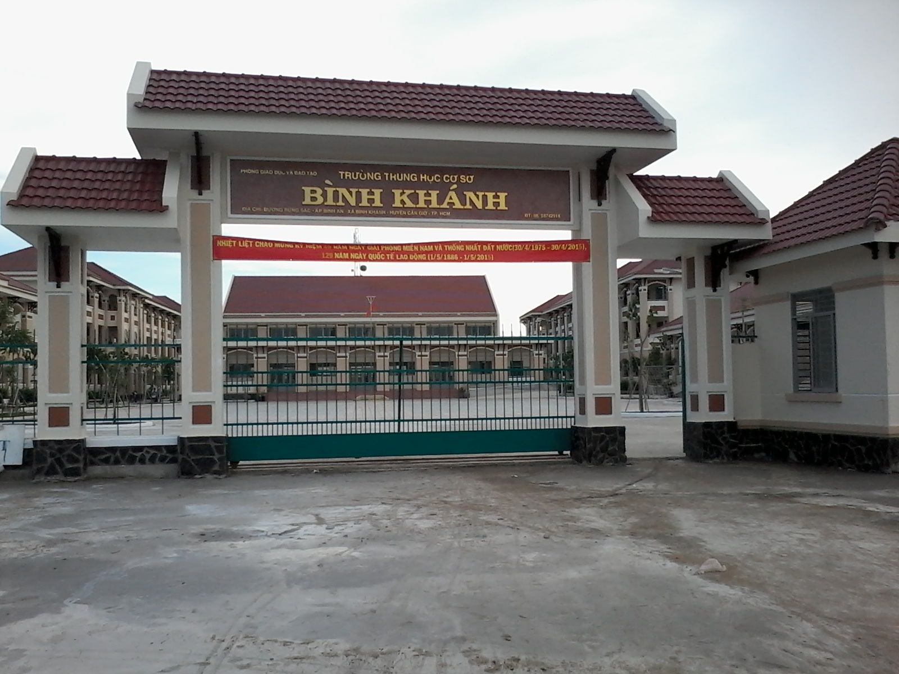



BINH KHANH SECONDARY SCHOOL
ENGLISH 8

Slide 2



WELCOME TO OUR CLASS


Slide 3
I. WARM UP:
NET WORK
Sọ Dừa
Tấm Cám
folk tales
Cây tre trăm đốt
Cô bé Lọ Lem
...........
Trí khôn của ta đây

Slide 4

Unit 4: OUR PAST
Lesson 4: WRITE (P. 42 – 43)
II. PRE - WRITING:
New words:
1. (to) graze:
gặm cỏ

Slide 5
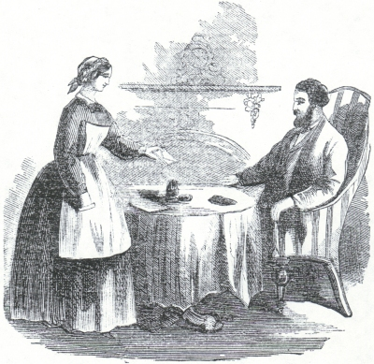
Unit 4: OUR PAST
Lesson 4: WRITE (P.42 – 43)
2. a master:
ông chủ
3. a servant:
đầy tớ

Slide 6
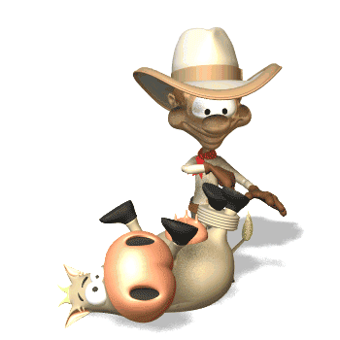
Unit 4: OUR PAST
Lesson 4: WRITE (P.42 – 43)
4. (to) tie:
trói, buộc

Slide 7

Unit 4: OUR PAST
Lesson 4: WRITE (P.42 – 43)
5. straw (uncN):
rơm, rạ

Slide 8
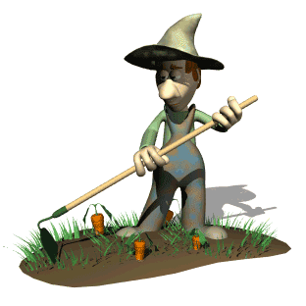


Unit 4: OUR PAST
Lesson 4: WRITE (P.42 – 43)
6. wisdom (UncN):
trí khôn

Slide 9
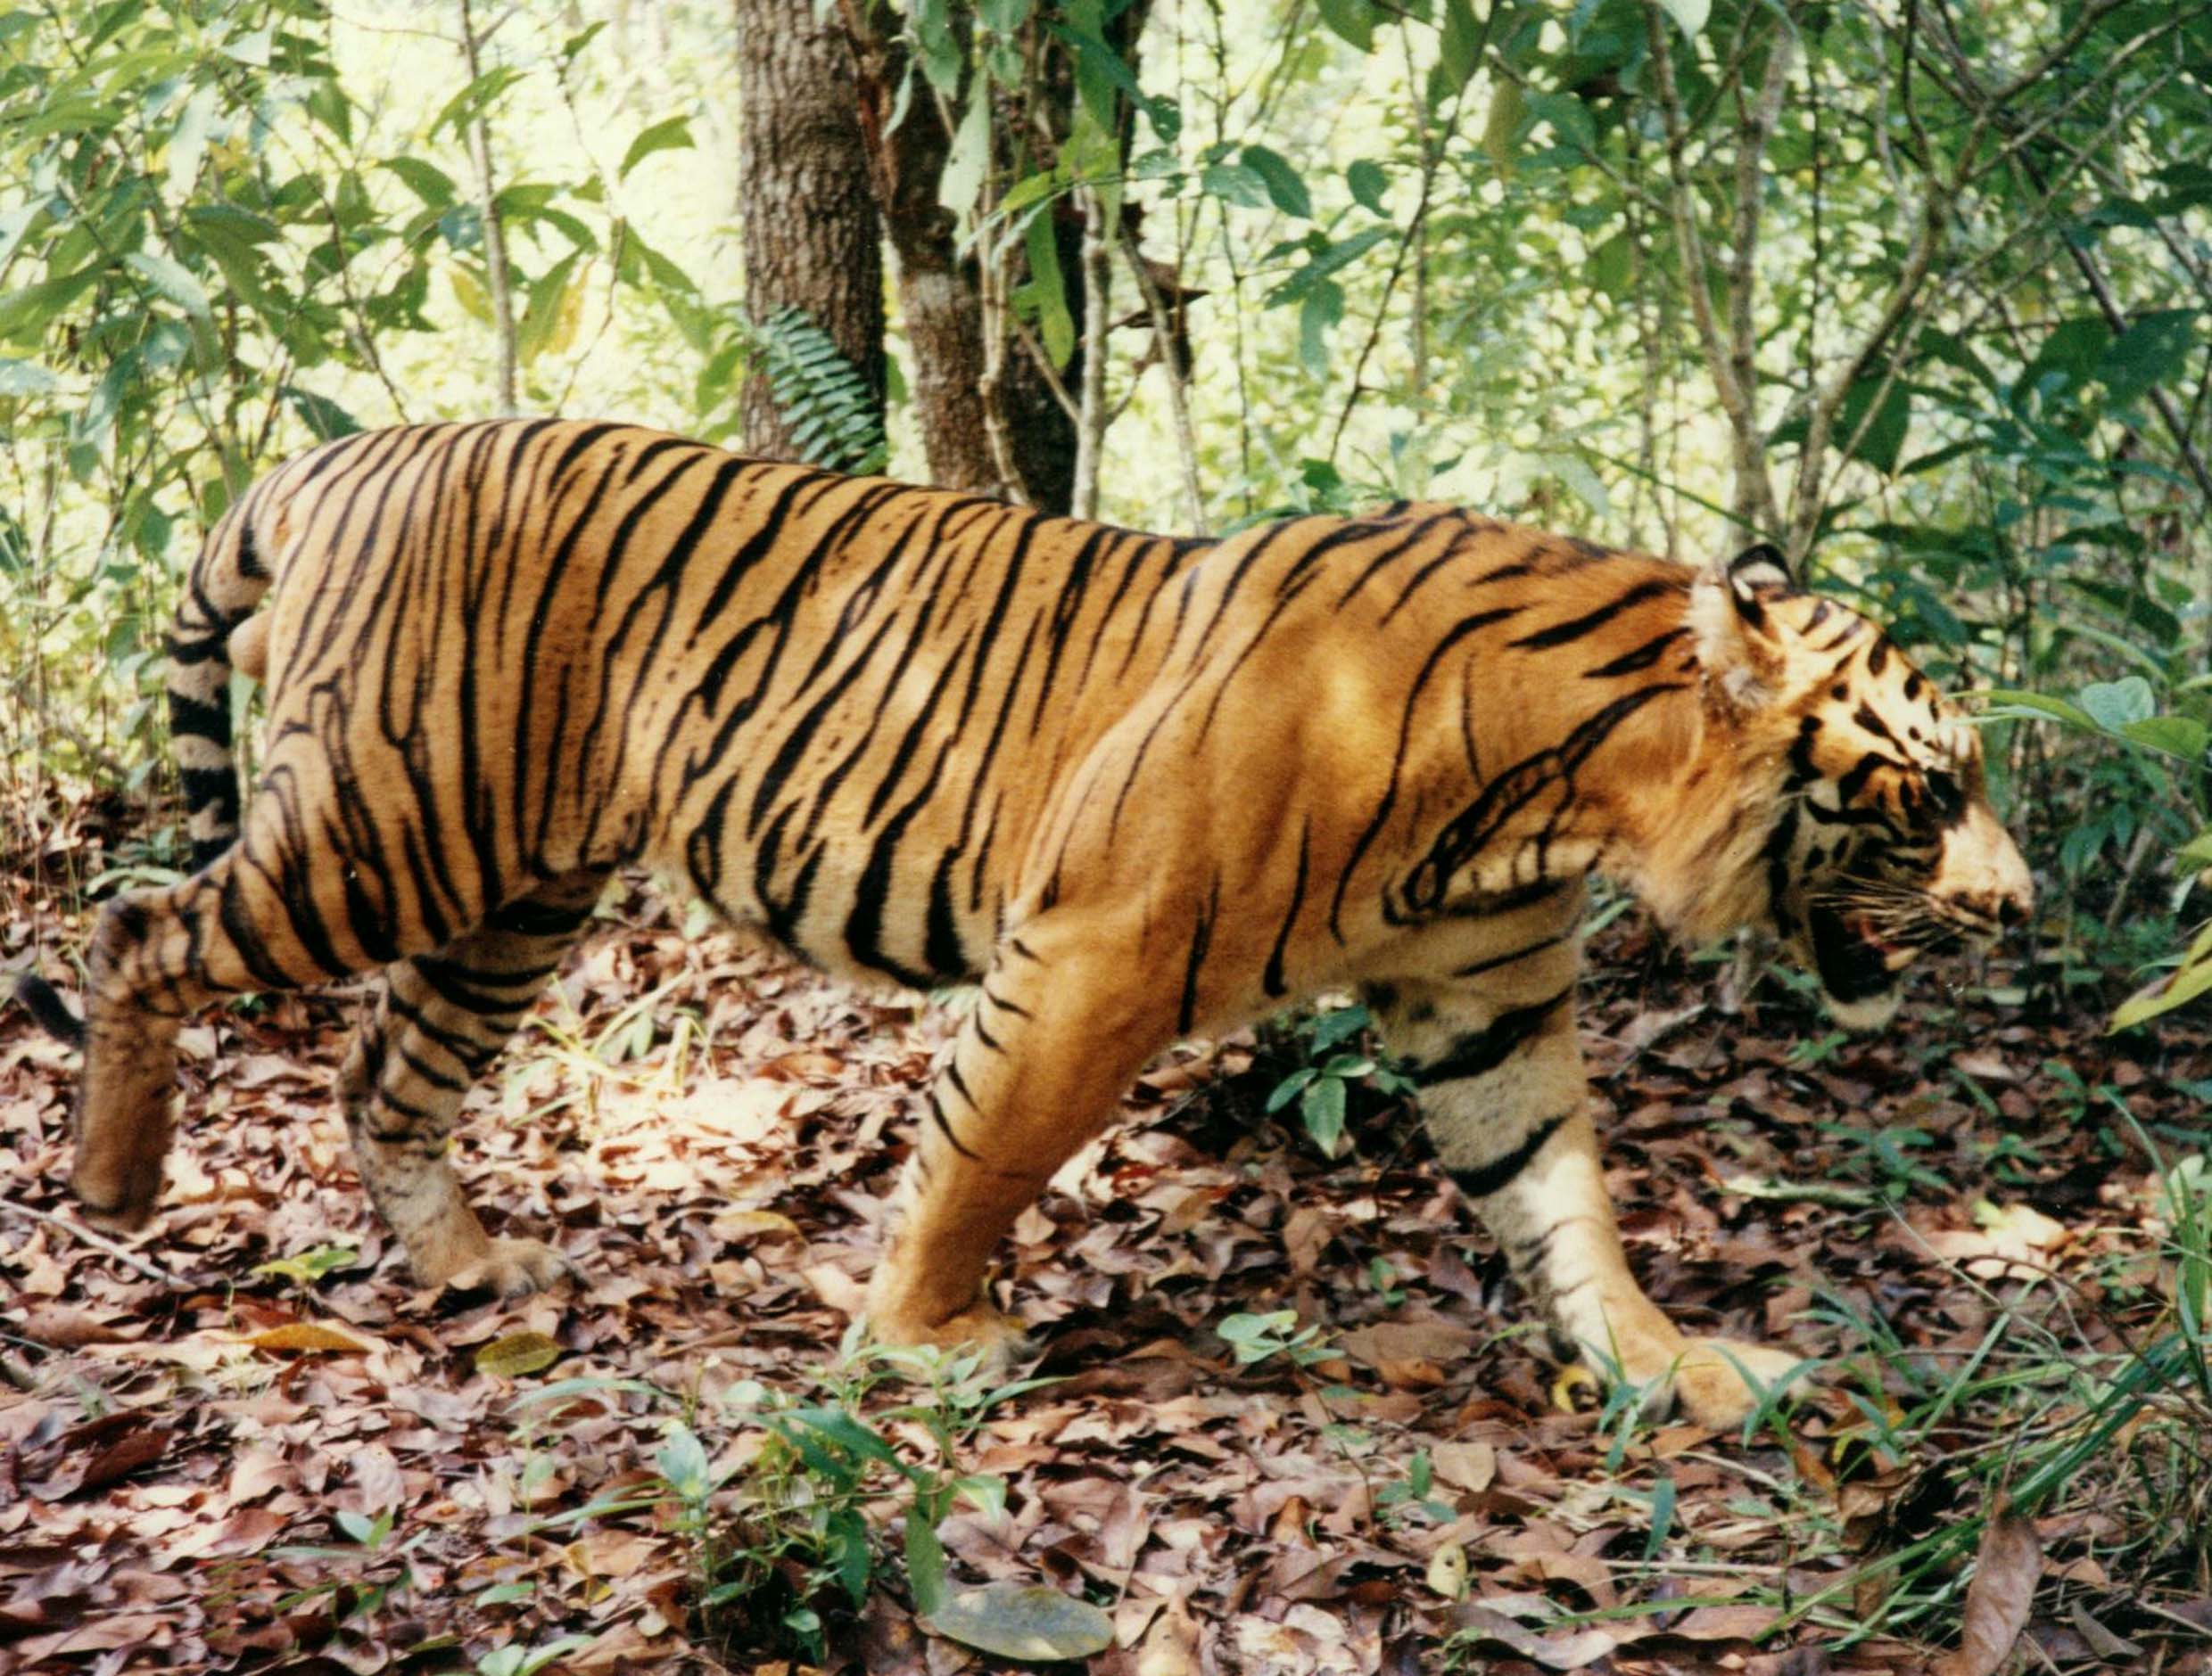
Unit 4: OUR PAST
Lesson 4: WRITE (P.42 – 43)
7. (to) escape:
trốn thoát, thoát ra

Slide 10

Unit 4: OUR PAST
Lesson 4: WRITE (P.42 – 43)
8. a stripe:
sọc, vằn

Slide 11
Unit 4: OUR PAST
Lesson 4: WRITE (P.42 – 43)
New words:
1. (to) graze:
gặm cỏ
2. a master:
ông chủ
3. a servant:
đầy tớ
4. (to) tie:
trói, buộc
5. straw (uncN):
rơm, rạ
6. wisdom (UncN):
trí khôn
7. (to) escape:
trốn thoát, thoát ra
8. a stripe:
sọc, vằn

Slide 12
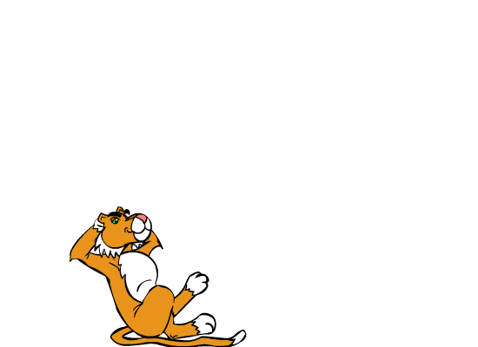
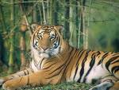

In the old days a tiger .............
Now..........
How does the tiger have got his stripes?

Slide 13
Using the verbs in the box to fill in the blank
HOW THE TIGER GOT HIS STRIPED
One day, as a farmer was in his field and his buffalo (0) __________ nearby, a tiger (1) ________ . The tiger wanted to know why the strong buffalo was the servant and the small man (2) ______ the master. The farmer (3) ________ he had something called the wisdom, but before but he (4) _______ it at home that day. He (5)_______ to get the wisdom, but before that he (6)________ the tiger to the tree with a rope because he didn’t want it to eat the buffalo. When he returned, the farmer brought some straw with him. He said it was his wisdom. He (7) _______ the straw and the fire (8)________ the tiger. The tiger (9) _________, but it still has black stripes from the burn today.
was grazing
appeared
was
said
left
went
tied
lit
burned
escaped
burned
escaped
went
was
appeared
left
lit
tied
was grazing
said

Slide 14
Use the given words to write a story
1. One day / I / field
2. buffalo / graze / tiger / come
3. It / ask / why / strong buffalo / my servant / and I / its master
4. I / tell / tiger / I / have / wisdom
5. tiger / want / see / it
6. I / tell / it / I / leave / wisdom / home
7. Then I / tie / tiger / tree / rope / I / didn’t / want / eat / buffalo
8. I / go / get / straw / and / burn / tiger
9. tiger / escape / still have / black stripes
Example : One day as I was in the field and ……………….

Slide 15
0. One day I was in the field
1. and my buffalo was grazing nearby , a tiger came.
2. It asked me why the strong buffalo was my servant
and I was its master.
3. I told the tiger that I had some wisdom.
4. The tiger wanted to see it.
5. I told it I left the wisdom at home.
6. Then I tied the tiger to a tree with rope because
I didn’t want it to eat my buffalo.
7. I went to get the straw and burned the tiger.
8. The tiger escaped, but it still had black stripes
from the burns today.

Slide 16
Retell the story
One day I was in the field and my buffalo was grazing nearby , a tiger came. It asked me why the strong buffalo was my servant and I was its master. I told the tiger that I had some wisdom. The tiger wanted to see it. I told it I left the wisdom at home. Then I tied the tiger to a tree with rope because I didn’t want it to eat my buffalo. I went to get the straw and burned the tiger. The tiger escaped, but it still had black stripes from the burns today.

Slide 17
HOMEWORK
Learn new words by heart.
Write the paragraph at home.
Prepare Unit 4: Language focus
+ Prepositions of time
+ Used to + V₀
+ Simple past tense

Slide 18
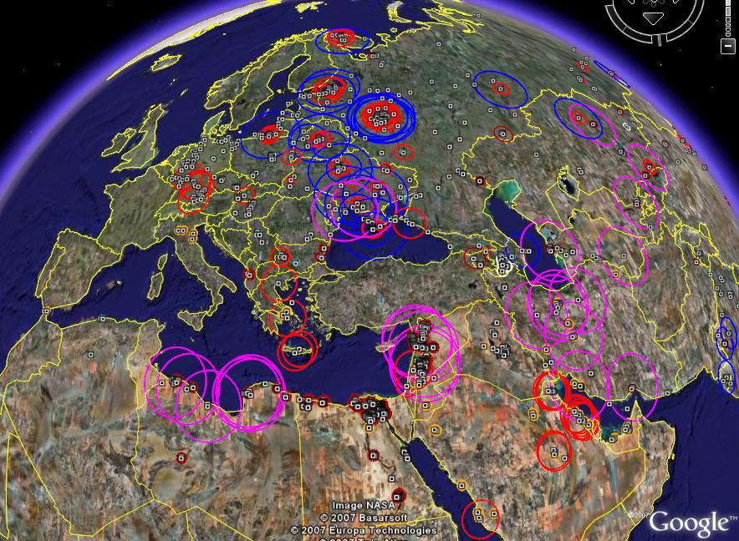
GOODBYE
SEE YOU LATER


