Slide 1
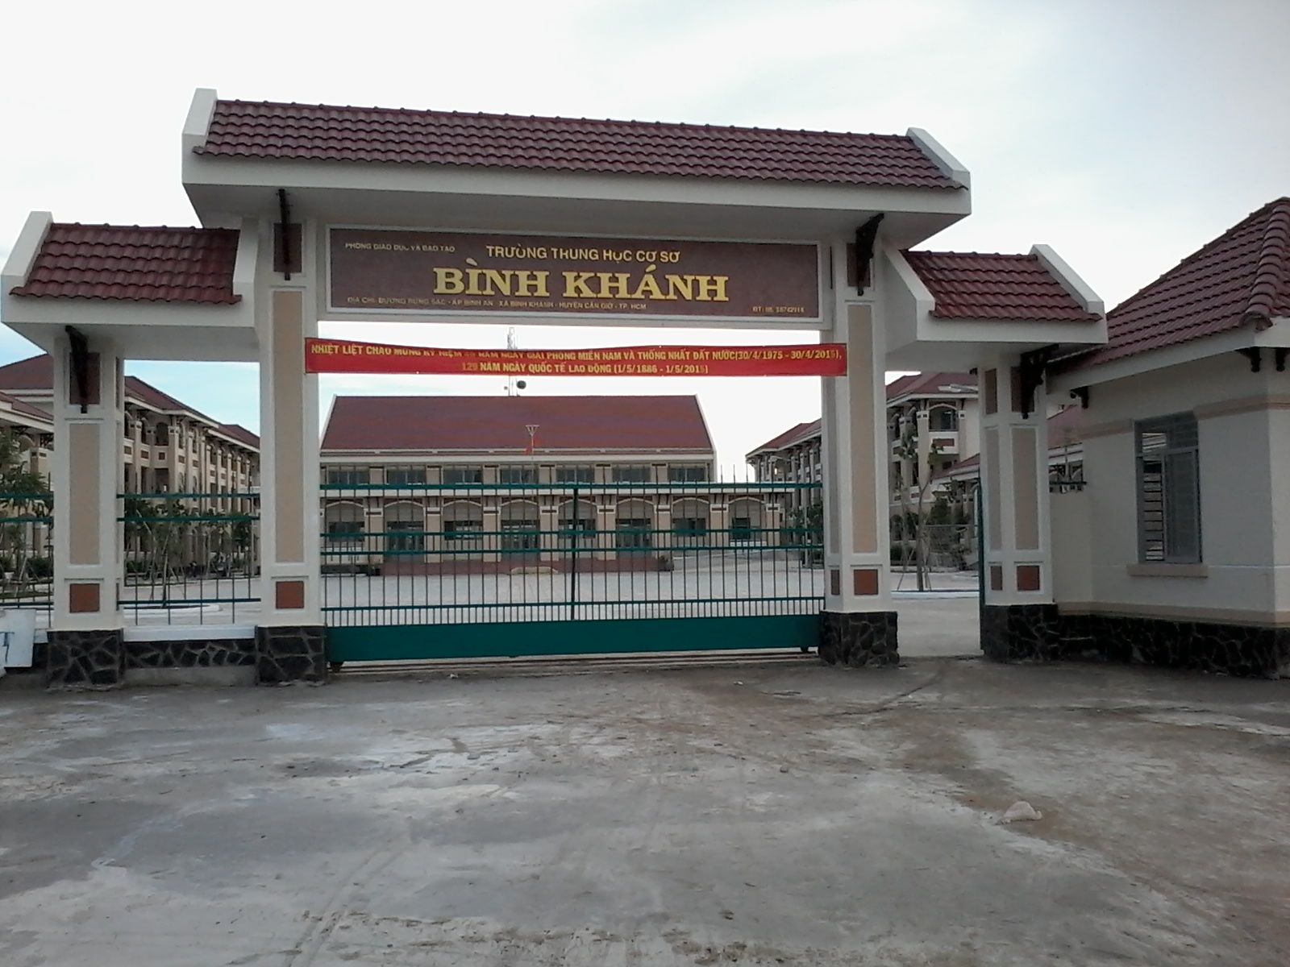



BINH KHANH SECONDARY SCHOOL
ENGLISH 8

Slide 2
Unit 4 : Our past Language focus
I. Past simple
II. Prepositions of time
III. Used to

Slide 3
Unit 4 : Our past Language focus
I. Past simple
1.Write the past simple form of each verb.

Slide 4
1. Write the past simple form of each verb.
Ex: Run => ran
1. Fly
2. Take
3. Go
4. Have
5. Do
6. Be
7. Ride
8. Eat
9. Sit
10. Come
⇨
flew
⇨ was/were
⇨
took
⇨ rode
⇨
went
⇨ ate
⇨
had
⇨ sat
⇨
did
⇨ came

Slide 5
Unit 4 : Our past Language focus
I. Past simple
1.Write the past simple form of each verb.
1a) Look at the pictures then ask and answer.

Slide 6
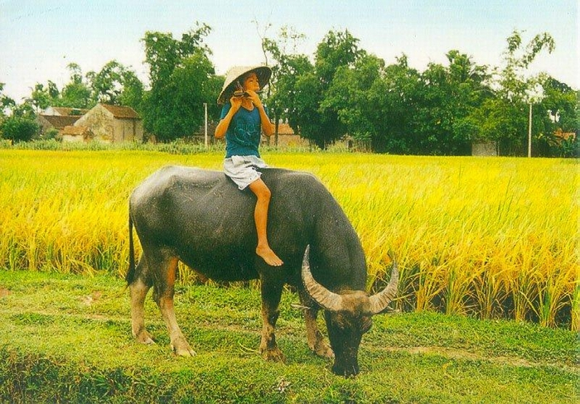
1a) Look at the pictures then ask and answer.
ride on a buffalo
What did you do yesterday ?
I rode on a buffalo

Slide 7

Go to the park
Where did they go?
They went to the park.

Slide 8
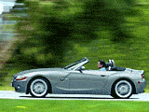
Come home
Did he come home last night ?
Yes, he did.
Yes. He came home last night.

Slide 9
Unit 4 : Our past Language focus
I. Past simple
1.Write the past simple form of each verb.
1a) Look at the pictures then ask and answer.
1b) Complete the dialogue below.

Slide 10
1b) Complete the dialogue below.
Did you eat rice for lunch
Lan: ............................................ ?
Nga: No, I ate noodles.
Ba: How did you get to school?
Nam: ……………………………………
Minh: .............................................. ?
Hoa: I was at home.
d) Chi: Which subject did you have
yesterday?
Ba: ………………..
I rode a bike to school.
Where were you yesterday
I had Math .

Slide 11
Unit 4 : Our past Language focus
I. Past simple
II. Prepositions of time
(in, on, at, after, before, between)
1. Look at the table

Slide 12
*Look at the table
in | November 1997
on | Monday, July 2
at | 6pm
between | 7am & 8am
after | 3pm
before

Slide 13
Unit 4 : Our past Period 25: Language focus
I. Past simple
II. Prepositions of time
(in, on, at, after, before, between)
1. Look at the table
2. Complete the sentences

Slide 14
* Complete the sentences
I’ll see you on Wednesday.
I’m going to Laos ___ January.
We must be there ___ 8.30 and 9.15.
The bank closes ___ 3.pm. If you arrive ___ 3.pm, the bank will be closed.
I’ll be home ___ seven because I want to see the seven o’clock news.
in
between
at
after
before

Slide 15
Unit 4 : Our past Language focus
I. Past simple
II. Prepositions of time
(in, on, at, after, before, between)
III. Used to
1. Look at the pictures

Slide 16
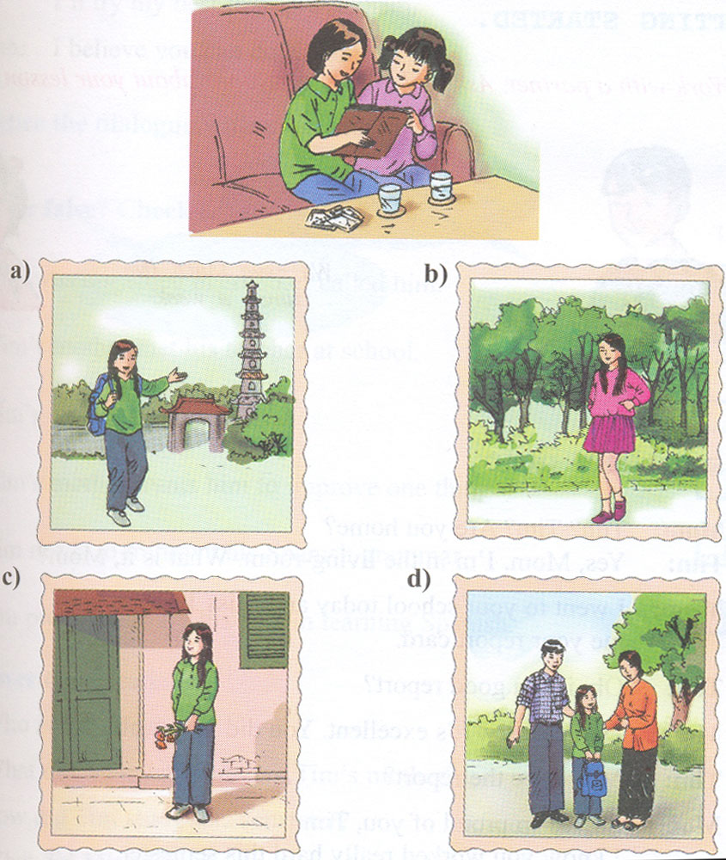
* Look at the pictures.
a/ Nga: Where is it? It’s isn’t in Hanoi.
Hoa: No, it’s Hue. I used to stay there.

Slide 17
Unit 4 : Our past Language focus
I. Past simple
II. Prepositions of time
(in, on, at, after, before, between)
III. Used to
1. Look at the pictures
2. Complete the dialogue

Slide 18
*Complete the dialogue ( live stay have be )
Nga: Where is it? It isn’t Ha Noi.
Hoa: No, it’s Hue. I (0) used to stay there.
Nga: Is that you. Hoa?
Hoa: Yes. I (1) _______ long hair.
Nga: Who is in this photo?
Hoa: That is Loan. She (2) _______
my next-door neighbor
Nga: Are they your parents?
Hoa : No. They’re my aunt and uncle.
They (3) _______ in Hue, too.
used to have
used to be
used to live

Slide 19
Unit 4 : Our past Language focus
I. Past simple
II. Prepositions of time
(in, on, at, after, before, between)
III. Used to
About you?

Slide 20
Talk about you
* What did you use to do last summer vacation?

Slide 21
Home work
Review and practice again
Prepare : “Getting started + Listen and read”- Unit 5 .

Slide 22
Thanks for your attention
Good-bye  See you again

