Slide 1
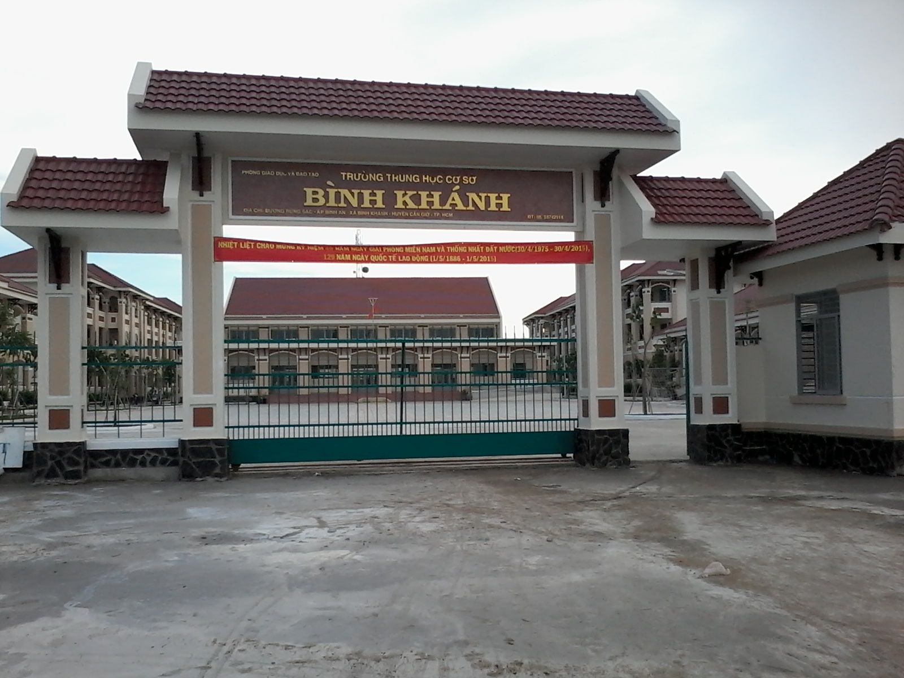



BINH KHANH SECONDARY SCHOOL

Slide 2



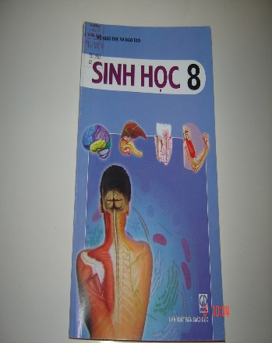


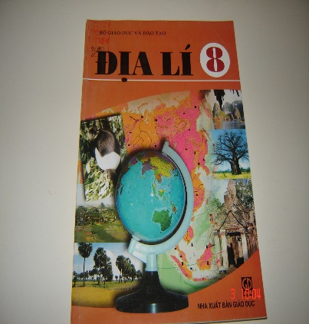

Warm up
What subjects do you learn in grade 8?
Math
Physic
Chemistry
Biology
Literature
History
Geography
English

Slide 3
Unit 5: study habits Lesson 2: speak
Work in groups.
Ask each other about your studies.
Use the questions and words
in the boxes to help you.

Slide 4
Unit 5: study habits Lesson 2: speak
1.When do you do your homework?
(after school; after dinner; late at night; etc)
I do my homework after dinner.
2. Who helps you with your homework?
(your parents; your brothers/ sisters; a friend; etc)
My parents help me with my homework.
3. How much time do you spend on these subjects: Math, Vietnamese, History, English, etc.
(half an hour; two hours; less/more than an hour; etc.)
I spend half an hour on math.

Slide 5
Unit 5: study habits Lesson 2: speak
4. Which subject do you need to improve?
(Biology; Physic; Chemistry; Geography; etc.)
I need to improve my Chemistry
5. What do you do to improve your English?
(do grammar exercises; read English stories; etc.)
I often do grammar exercises

Slide 6
Unit 5: study habits Lesson 2: speak
Consolidation

Slide 7
Unit 5: study habits Lesson 2: speak
read English stories
speak English to friends
listen to the radio
How to improve
your English?
watch English programs on TV
do excercises
read English newspapers/ magazines
learn by heart new words

Slide 8
Unit 5: study habit Lesson 2: speak
Choose the best answers:
1- My mother is very proud …….. me.
A. about
B. of
C. to
D. with
2- I know you worked really ……… this semester.
A. hardly
B. good
C. hard
D. bad
3- It’s excellent. You did very ……….
A. good
B. well
C. bad
D. badly
4- I’ll try my best ……….. my English pronunciation.
A. improve
B. improving
C. to improve
D. improved
5- Language learners learn words in ………. Ways.
A. same
B. different
C. easy
D. difficult

Slide 9
Unit 5: study habits Lesson 2: speak
Homework:
Write about your study habits.
Practice: speaking
Prepare: Unit 5 - Listen

