Slide 1
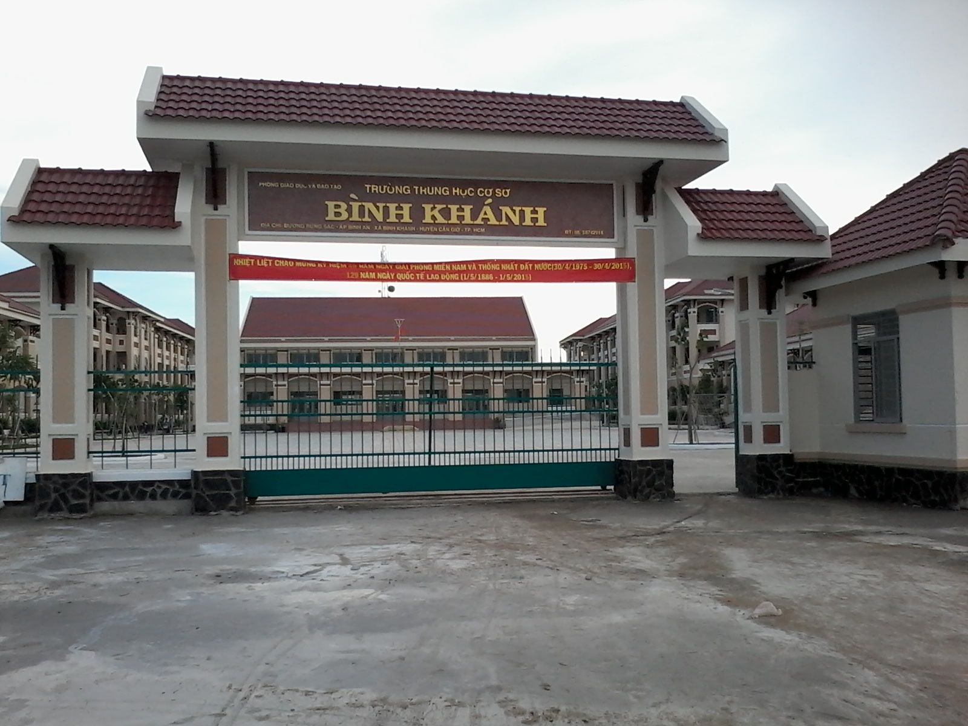



BINH KHANH SECONDARY SCHOOL

Slide 2
WARM-UP
Learn through example sentences
Write each word on one piece of paper and put it in to the pocket to learn whenever
Learn by heart
Ways language learners
learn new words
Write it on the small piece of paper and stick everywhere in the house
Translate it into mother tongue

Slide 3


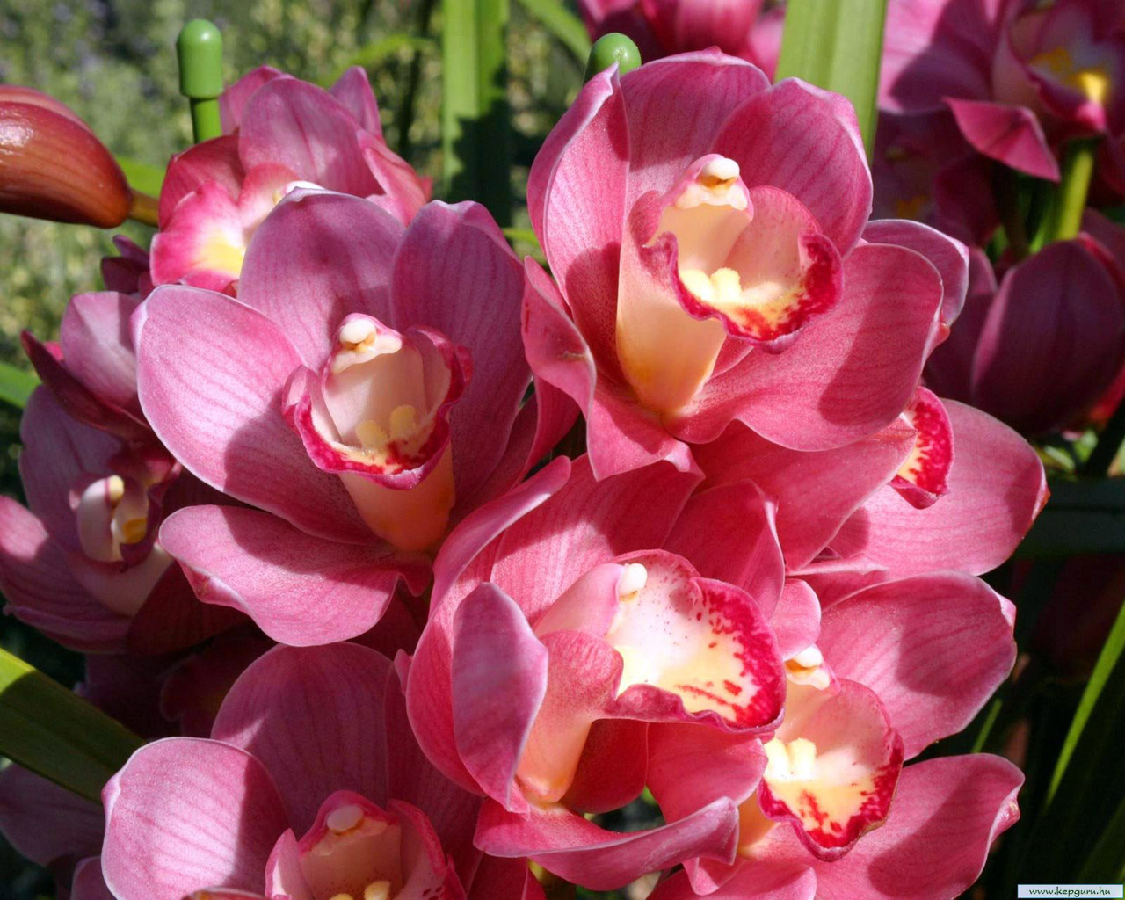
English 8
UNIT 5:
STUDY HABITS
Lesson 4: Reading

Slide 4
UNIT 5 STUDY HABITS
Pre-Reading

Slide 5
UNIT 5 STUDY HABITS
I / Vocabulary :
1. mother tongue (n)
tiếng mẹ đẻ
2. underline (v)
gạch dưới
3. highlight (v)
làm nổi bật
4. come across (v)
tình cờ gặp
5. stick (v)
dán
6. learn by heart (v)
học thuộc lòng
7. revise (v)
ôn lại

Slide 6

Vietnamese is my mother tongue.
Physics and chemistry are my favourite subjects

Slide 7
UNIT 5 STUDY HABITS
Jumbled words
1/ ghilhghti
highlight
2/ csitk
stick
3/ thomer nogtue
mother tongue
4/ dunernile
underline
5/ vseier
revise
6/ moce rcoass
come across

Slide 8
UNIT 5 STUDY HABITS
True / False statements prediction
Guess
a) All language learners write the meaning of the new words in their mother tongue.
T
F
b) Some learners write examples of the words they want to learn.
T
F
c) Every learner tries to learn all the new words they come across.
T
F
d) Many learners only learn the new words that are important.
T
F
4

Slide 9
UNIT 5 STUDY HABITS
While-Reading

Slide 10
UNIT 5 STUDY HABITS
Checking and Correcting
Some
Check
a) All language learners write the meaning of the new words in their mother tongue.
F
b) Some learners write examples of the words they want to learn.
T
c) Every learner tries to learn all the new words they come across.
F
Many learners don’t try
d) Many learners only learn the new words that are important.
T

Slide 11

UNIT 5 STUDY HABITS
Comprehension questions
Lucky numbers

Slide 12
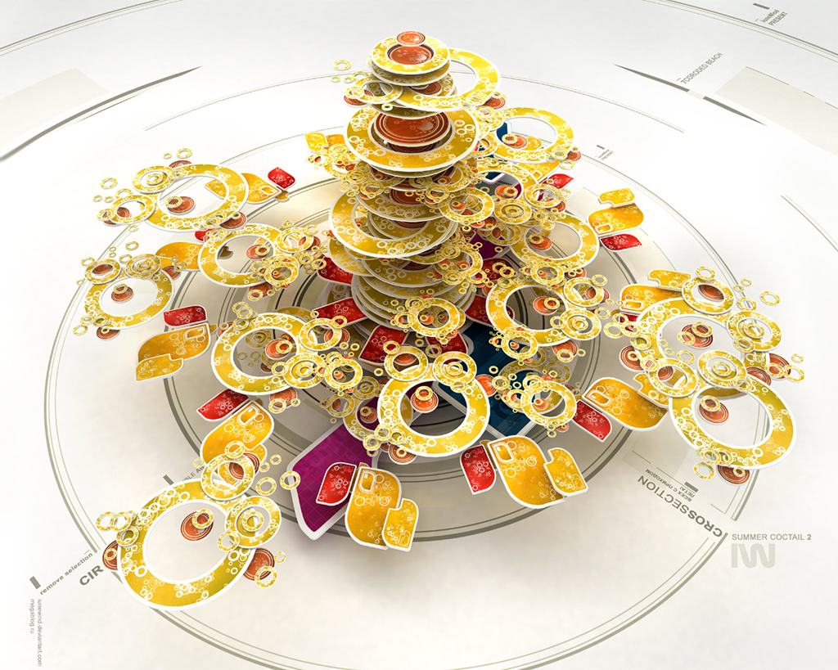
QUE
Lucky numbers
2
3
1
5
4
9
6
8
7

Slide 13

1
a) Do learners learn words in the same way?
No, They learn words in different ways.

Slide 14
2
Lucky number

Slide 15
3
b) Why do some learners write
example sentences with new words?
Because they help them to remember
the use of new words.

Slide 16
4
Lucky number

Slide 17
5
c) What do some learners do
in order to remember words better?
They write examples , put the words and their meanings on stickers , underline or highlight them.

Slide 18
6
d) Why don’t some learners learn all the new words they come across?
They may think they can’t do so. Instead , they learn only important words.

Slide 19
7
Lucky number

Slide 20
8
e) What is necessary in learning words?
Revision is necessary in learning words.

Slide 21
9
f) How should you learn words?
Learners should try different ways of
learning words to find out what is the best.

Slide 22
Model Sentences
Why do language learners write one or two example sentences with each new word?
In order to remember how to use the word in the right way.
In order to
Form: In order to/so as to + bare-inf
Use: Dùng để diễn tả mục đích

Slide 23
UNIT 5 STUDY HABITS
Post-Reading

Slide 24
UNIT 5 STUDY HABITS
Name | Find someone Who..
 | Ways of learning words
 | ... make the list of words their meanings and learn them by heart.
 | ... write sample sentences with new words.
 | ... stick new words somewhere in the house.
 | ... underline or highlight the words.
 | ... read stories in English.
 | ... learn words through songs.

Slide 25
Example:
Nga learns words by making a list of words their meanings and learning them by heart. Nam also reads stories in English...

Slide 26
Homework
Learn by heart vocabulary.
Prepare Lesson 4 : Write (Unit 5)

Slide 27


