Slide 1
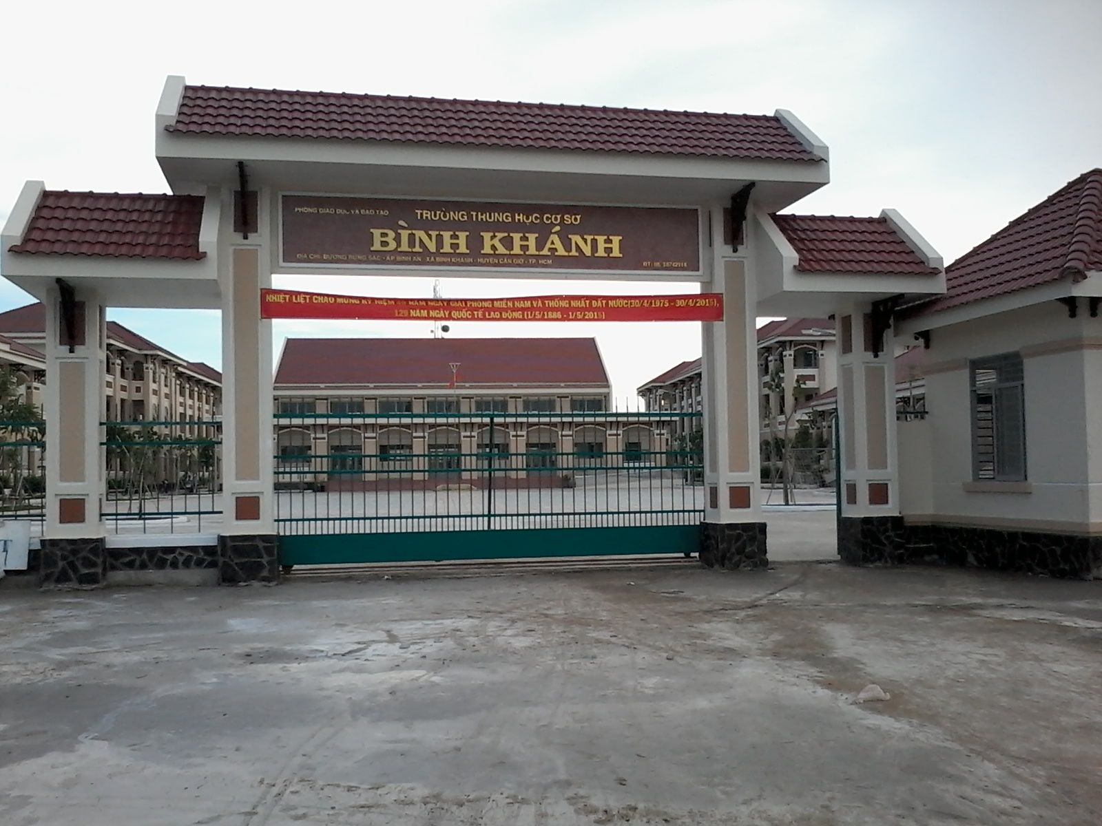



BINH KHANH SECONDARY SCHOOL

Slide 2
Change the adjectives into adverbs
soft
hard
hard
softly
bad
badly
fast
fast
careful
carefully
good
well

Slide 3
Study Habits
Unit 5:
Lesson 6: Language focus

Slide 4
I. Adverbs of manner
She is a slow runner.
She runs slowly.
S
Adj
Noun
S
Verb
Adverb

Slide 5
Adverbs of manner
S + Verb + Adverb
Thanh speaks English fluently.
My father drives carefully.
How did you do the test?
I did the test very well.

Slide 6
1. Complete the dialogues. Use the adverbs of manner in the box.
softly
well
fast
badly
hard
a/ Hoa: Does Mrs. Nga speak English?
Lan: Oh,yes. She speaks English (0) _____.
b/ Hoa: Ba always gets excellent grades.
Lan: That’s because he studies (1) _____.
c/ Hoa: That’s our bus!
Lan: Run (2) _____ and we might catch it.
d/ Hoa: I’m very sorry. I know I behaved (3) _____.
Lan: It’s all right.
e/ Hoa: I can’t hear you, Lan.
Lan: Sorry, but I’m speaking (4) _______ because I have a sore throat.

Slide 7
II. Modal verb: Should
Eg: Ngoc is tired.
→ She should go to bed.
S
V( infinitive)
S + should + V( infinitive)
⇨ Give someone advice

Slide 8
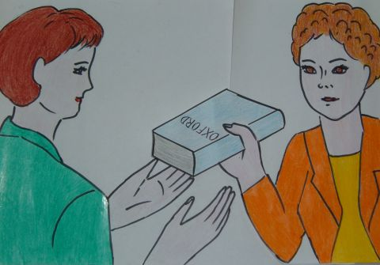
Mrs. Blake
Miss Jackson

Slide 9
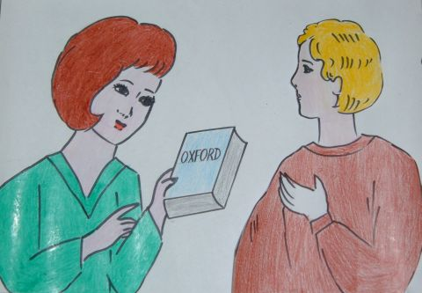

“Can you give Tim this dictionary?”
(“Please give Tim this dictionary”.)
Miss Jackson asked me to
give you this dictionary.
S
O
(or) Miss Jackson told me to
give you this dictionary.

Slide 10
III. Commands and requests in reported speech
S + asked/ told + O + (not) to infinitive
She asked me open the book.
She asked me not to talk in class.

Slide 11
3. Suppose you are Tim’s mother. Report Miss Jackson’s commands and requests
S + asked/ told+ O + ( not) to infinitive
a/ “Please wait for me outside my office.”
b/ “Please give Tim his report card for this semester”.
c/ Can you help Tim with his Spanish pronunciation?”
d/ Can you meet me next week?”

Slide 12
Answers:
a. She asked / told me to wait for her outside her office.
b. She asked/ told me to give you your report card this semester.
c. She asked / told me to help you with your Spanish pronunciation.
d. She asked/ told me to meet her next week.

Slide 13
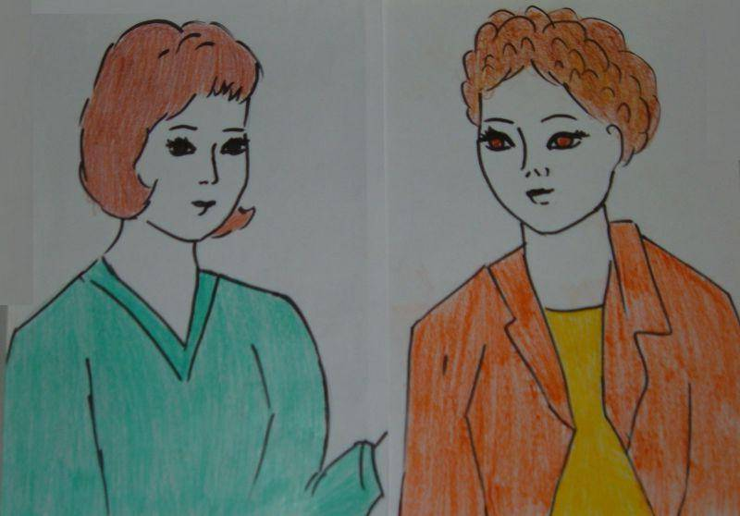
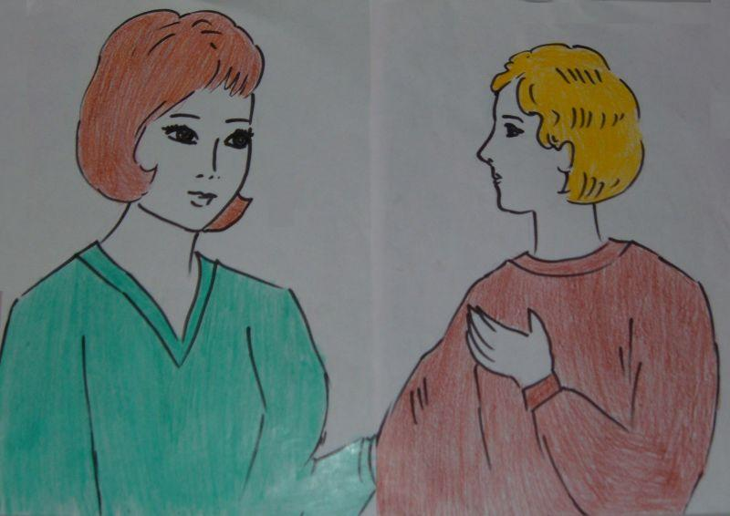
“Tim should work harder on his Spanish pronunciation.”
Miss Jackson said you
should work harder on your
Spanish pronunciation.
S1
S2

Slide 14
IV. Advice in reported speech
S₁+ said/ told (that)+S₂+ should+ V(infinitive)

Slide 15
4. Suppose you are Tim’s mother. Report Miss Jackson’s advice.
a.“Tim should spend more time on Spanish pronunciation.”
b. “Tim should practice speaking Spanish everyday”.
c. “ Tim should listen to Spanish conversations on TV.”
d. “ Tim should practice reading aloud pasages in Spanish.”
e. “ Tim should use this dictionary to find out how to pronounce Spanish words.

Slide 16
* Answers:
a. Miss Jackson said you should spend more time on Spanish pronunciation.
b. Miss Jackson said you should practice speaking Spanish everyday.
c. Miss Jackson said you should listen to Spanish conversations on TV.
d. Miss Jackson said you should practice reading aloud passages in Spanish.
e. Miss Jackson said you should use this dictionary to find out how to pronounce Spanish words.

Slide 17
You go to the doctor with your friend , ask and answer what the doctor told your friend
b. “Open your mouth”
Doctor: ……………………………….
Your friend: What did she say?
You: She………………………………….

Slide 18
You go to the doctor with your friend , ask and answer what the doctor told your friend
c. “Close your eyes.”
Doctor: ……………………………….
Your friend: What did she say?
You: She………………………………….

Slide 19
You go to the doctor with your friend , ask and answer what the doctor told your friend
d. “You should keep your body warm.”
Doctor: ……………………………….
Your friend: What did she say?
You: She………………………………….

Slide 20
You go to the doctor with your friend , ask and answer what the doctor told your friend
e. “You should go to bed early.”
Doctor: ……………………………….
Your friend: What did she say?
You: She………………………………….

Slide 21
Homework
Redo all the exercises in the notebook.
Prepare: Unit 6: Getting Stared & Listen and Read.

