Slide 1
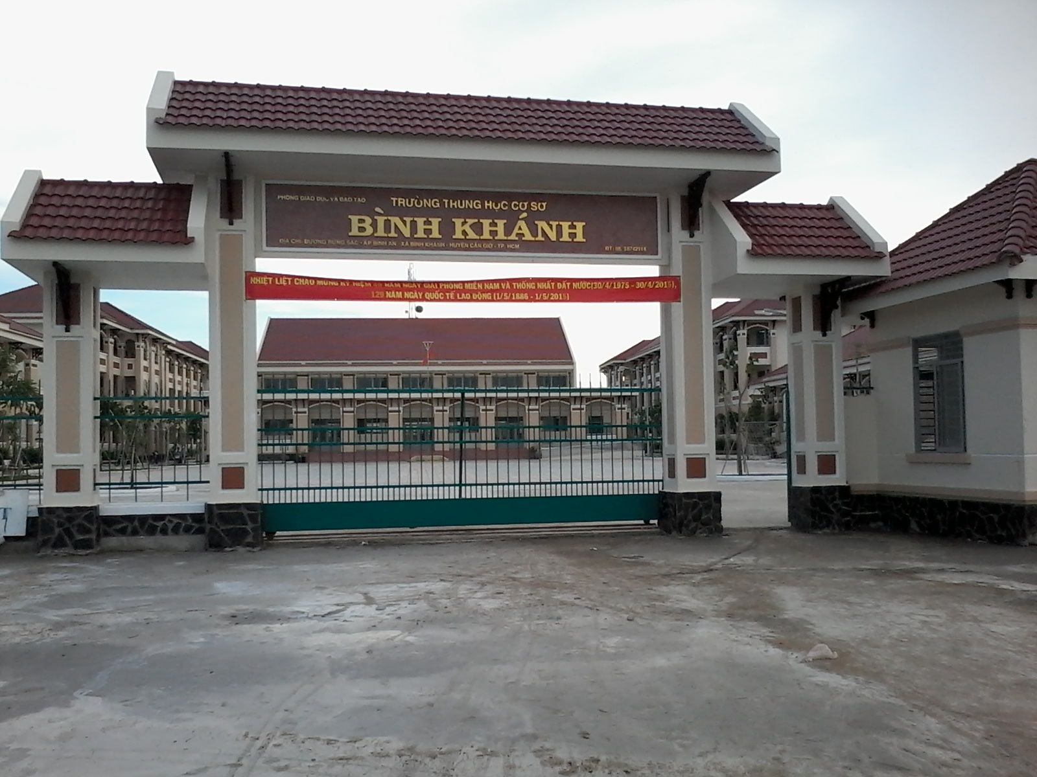



BINH KHANH SECONDARY SCHOOL

Slide 2


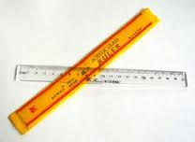



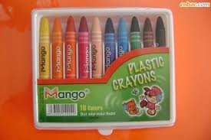

nhanh tay rinh ngay phÇn quµ
LuËt ch¬i
Tõng thµnh viªn trong líp chän mét ch÷ c¸i trong b¶ng ®· cho ®Ó ghÐp thµnh mét tõ TiÕng Anh gåm 5 ch÷ c¸i cã nghÜa t­¬ng ®­¬ng víi tõ “ Help” . Mçi ch÷ ®óng ®­îc mét phÇn th­ëng tõ « ch÷ .Chän sai mÊt quyÒn ch¬i. Mçi lưît ch¬i chØ ®ư­îc chän mét ch÷ c¸i. Trß ch¬i sÏ kÕt thóc khi c¶ 5 « ch÷ ®­îc më.
C
A
M
F
PhÇn thƯ­ëng
PhÇn th­Ưëng
R
H
V
B
PhÇn th­Ưëng
PhÇn th­Ưëng
K
T
PhÇn th­Ưëng
O
G

Slide 3
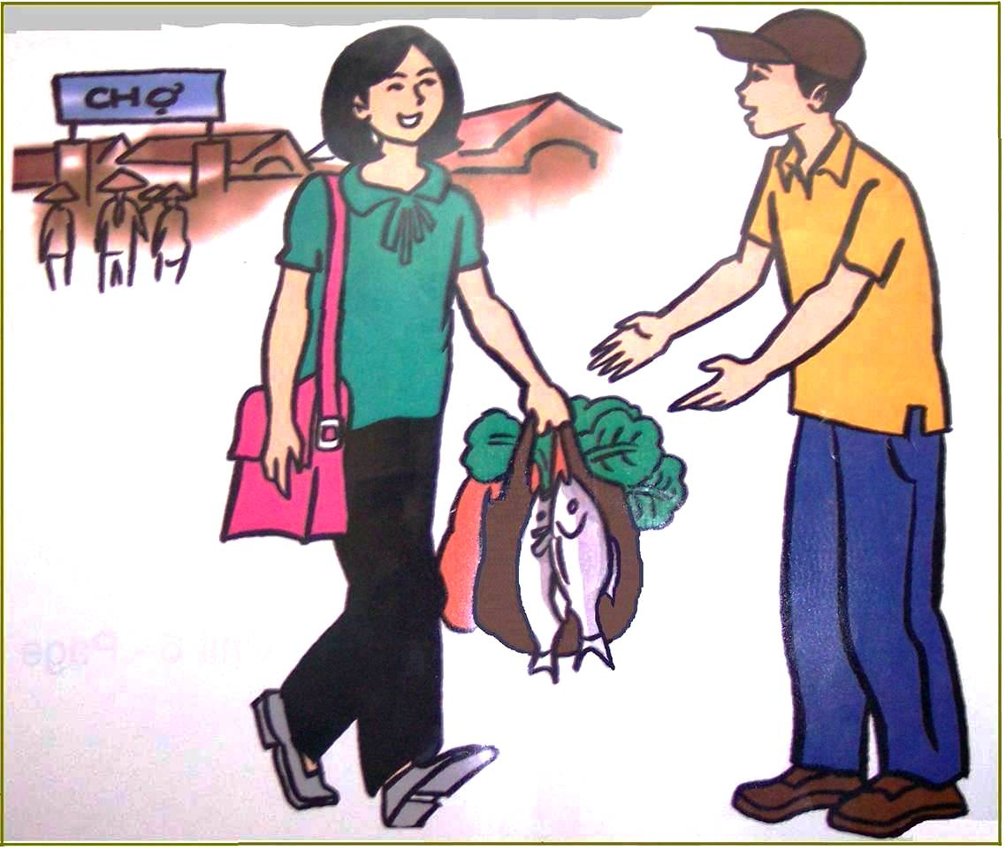
Unit 6- The young Pioneers Club
Lesson 2: Speak
III. Speak
Asking for favors
Responding to favors
Can/Could you help me, please ?
Certainly/Of course/Sure
Can/Could you carry my bag ?
No problem
I need a favor
What can I do for you?
Could you do me a favor?
How can I help you?
What can I do for you?
I need a favor
How can I help you?
Could you do me a favor?

Slide 4
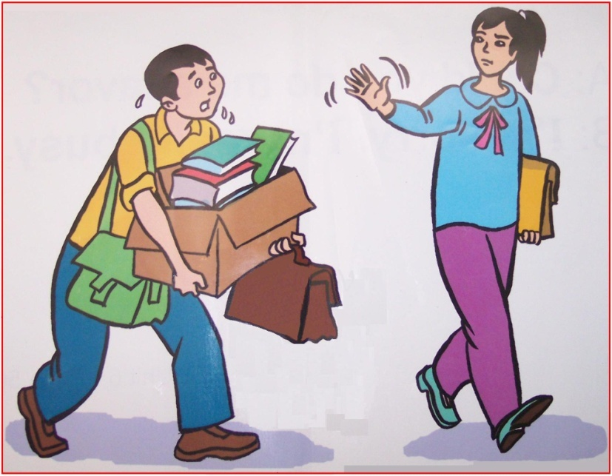
Unit 6- The young Pioneers Club
Lesson 2: Speak
III. Speak
Asking for favors | Responding to favors
Can/Could you help me, please ? Could you do me a favor? I need a favor Can/Could you carry the bag for me ? | Certainly/Of course/Sure No problem What can I do for you? How can I help you?
I’m sorry. I’m really busy.
Could you do me a favor?
I’m sorry. I’m really busy.

Slide 5
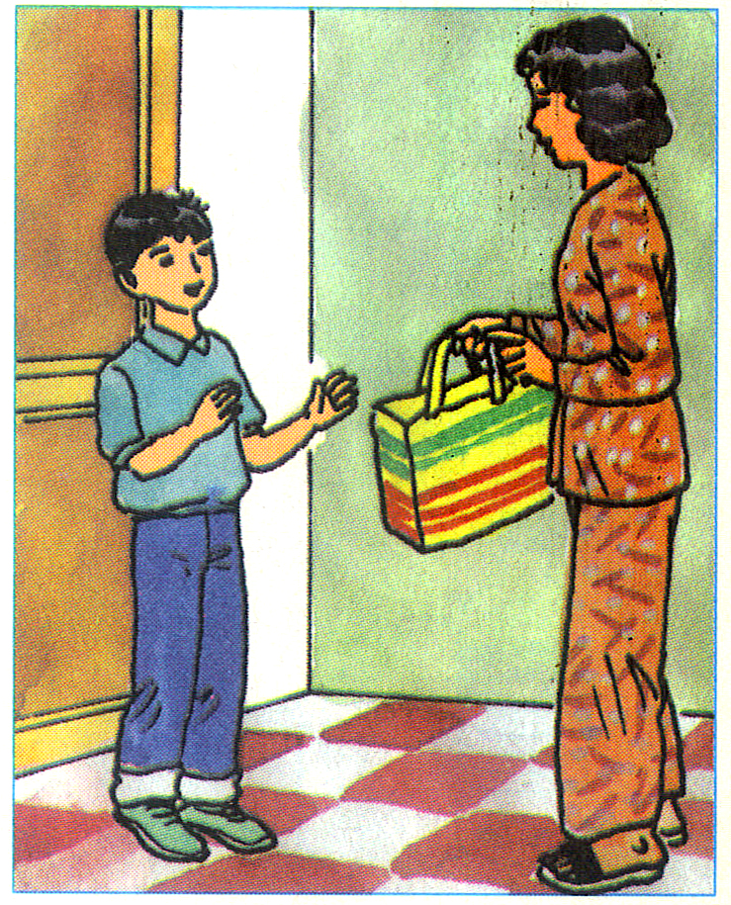
Complete the dialogue:
me a favor
Could you do .....................................?
1
I help you
How can .......................................?
2
............................ buy me some
vegetables?
Can you
No
................problem
4
3
Thank you very much .
5

Slide 6
Unit 6- The young Pioneers Club
Lesson 2: Speak
III. Speak
Offering assistance
Responding to assistance
May I help you?
Do you need any help?
Let me help you.
Yes. Thank you.
Yes. That ‘s very kind of you.
Let me help you.
Yes. Thank you.
May I help you?
Can
Yes. That ‘s very kind of you.
Do you need any help?

Slide 7
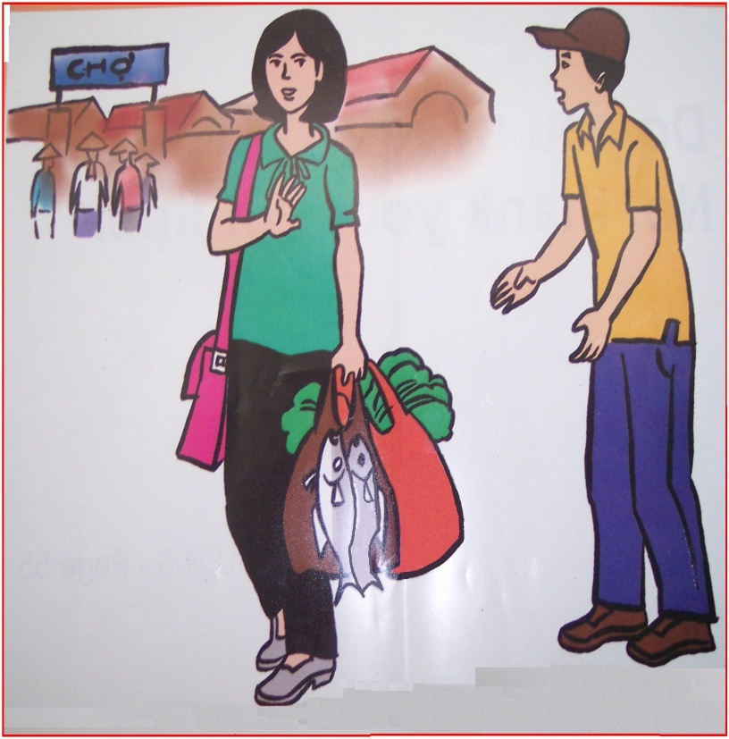
Unit 6- The young Pioneers Club
Lesson 2: Speak
III. Speak
Responding to assistance
May I help you? Do you need any help? Let me help you. | Yes. Thank you. Yes. That ‘s very kind of you.
Offering assistance
No. Thank you. I’m fine.
No. Thank you. I’m fine.
Let me help you.

Slide 8
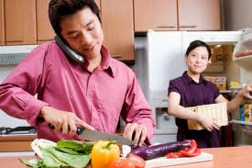
Complete the dialogues:
me help
Let ....................... you
1
2
very kind of you
Yes . That’s .........................
me
Help .......... slice the pepper.
3
help you
Sure. Can I…………….cook rice?
4
Thank you
No. ……………………
5

Slide 9
Unit 6- The young Pioneers Club
Lesson 2: Speak
III. Speak
Mrs. Ngoc: Could you do me a favor, please?
Hoa : Sure. What can I do for you?
Mrs. Ngoc: Can you help me carry my bag?
I’ve hurt my arm.
Hoa : Certainly. I’ll help you.
Mrs. Ngoc: Thank you very much. That’s very kind of
you.

Slide 10
Unit 6- The young Pioneers Club
Lesson 2: Speak
III. Speak
Receptionist: May I help you?
Tourist : Yes. Can you show me the way to the nearest bank?
Receptionist: Sure. Turn right when you get out of the hotel. Turn
Tourist : Thank you very much.
left at the first corner. It’s on your right.

Slide 11
Now use the appropriate phrases in the box to make similar dialogues about some of the following situations with a partner.
WHO | WHAT | WHY
tourist | needs to find a police station | lost money
neighbor | needs help tidying yard | has a broken leg
friend | needs help fixing her bike | has a flat tire
aunt | needs to buy some vegetables | is busy cooking meal

Slide 12
Unit 6- The young Pioneers Club
Lesson 2: Speak
III. Speak
WHO | WHAT | WHY
neighbor | Needs help tidying yard | has a broken leg
Use the word or phrases given to make a similar dialogue
Mrs. Ngoc: Could you do me a favor, please?
Hoa : Sure. What can I do for you?
Mrs. Ngoc: Can you help me carry my bag?
I’ve hurt my arm.
Hoa : Certainly. I’ll help you.
Mrs. Ngoc: Thank you very much. That’s very kind of
you.

Slide 13

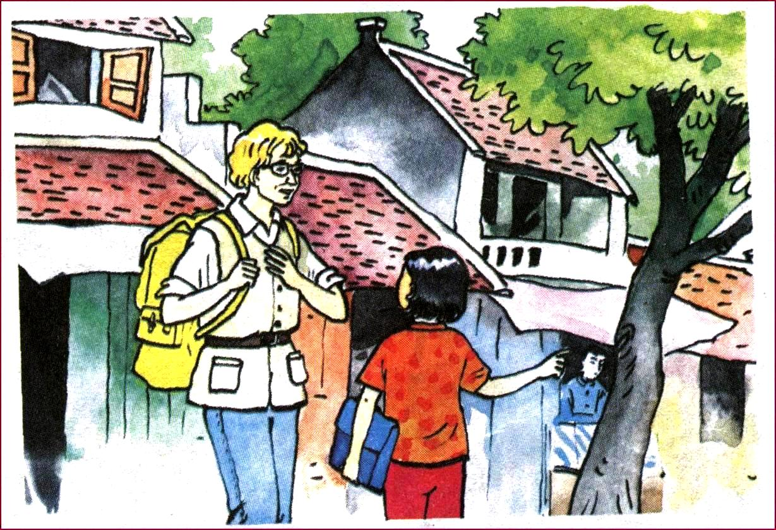
Unit 6- The young Pioneers Club
Lesson 2: Speak
III. Speak
I lost some money. I need
to find the police station

Slide 14

Unit 6- The young Pioneers Club
Lesson 2: Speak
III. Speak
WHO | WHAT | WHY
tourist | needs to find a police station | lost money
Receptionist: May I help you?
Tourist : Yes. Can you show me the way to the nearest bank?
Receptionist: Sure. Turn right when you get out of the hotel.
Turn left at the first corner. It’s on your right.
Tourist : Thank you very much.

Slide 15
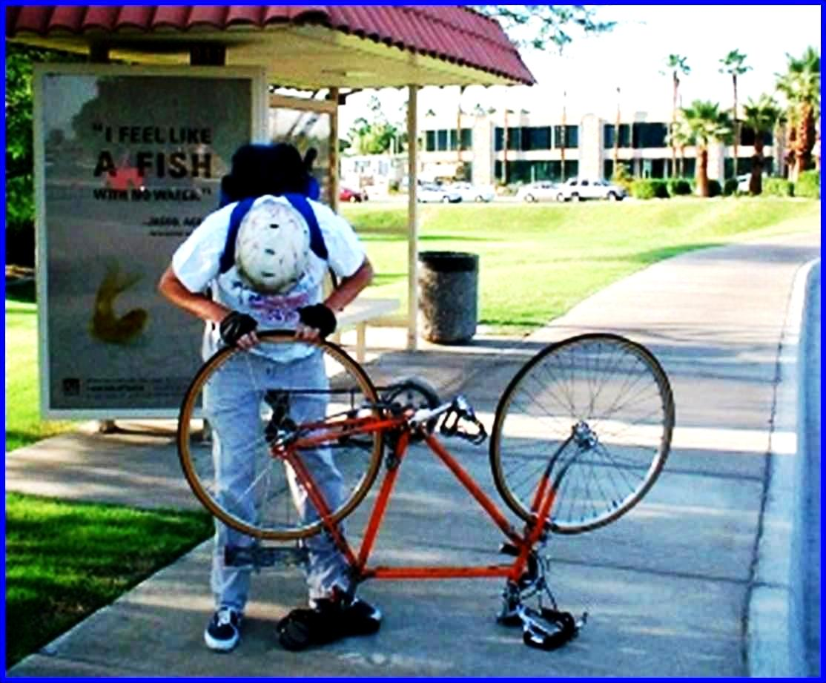
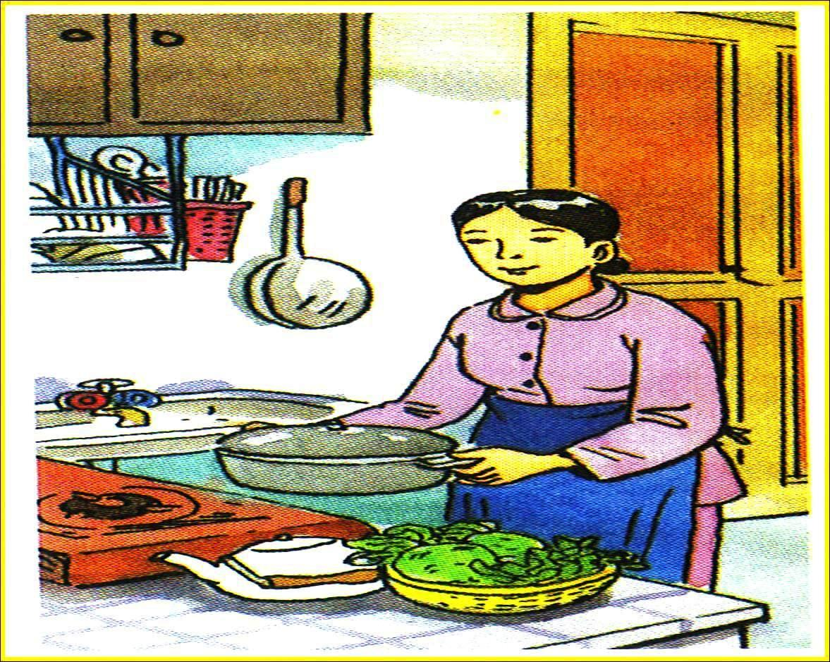
Unit 6- The young Pioneers Club
Lesson 2: Speak
III. Speak
WHO | WHAT | WHY
friend | Needs help fixing her bike | has a flat tire
I need help fixing my bike
I’m sorry. I’m busy.

Slide 16


Unit 6- The young Pioneers Club
Lesson 2: Speak
III. Speak
WHO | WHAT | WHY
friend | Needs help fixing her bike | tire has a flat
Mrs. Ngoc: Could you do me a favor, please?
Hoa : Sure. What can I do for you?
Mrs. Ngoc: Can you help me carry my bag?
I’ve hurt my arm.
Hoa : Certainly. I’ll help you.
Mrs. Ngoc:Thank you very much. That’s very kind of you.

Slide 17
Discussion
Imagine a real life situation and make a dialogue . Then act it out in the class:
Group 1 : Make a dialogue to ask for a favor and respond to the favor
Group 2 : Make a dialogue to offer assistance and respond to assistance

Slide 18
Unit 6- The young Pioneers Club
Lesson 2: Speak
Homework
1 . Learn by heart the English song
2 . Make a dialogue between you and your friend to ask and respond
to a favor, a dialogue to offer and respond to assistance
3 . Prepare the next lesson- Unit 6 - Read

