Slide 1
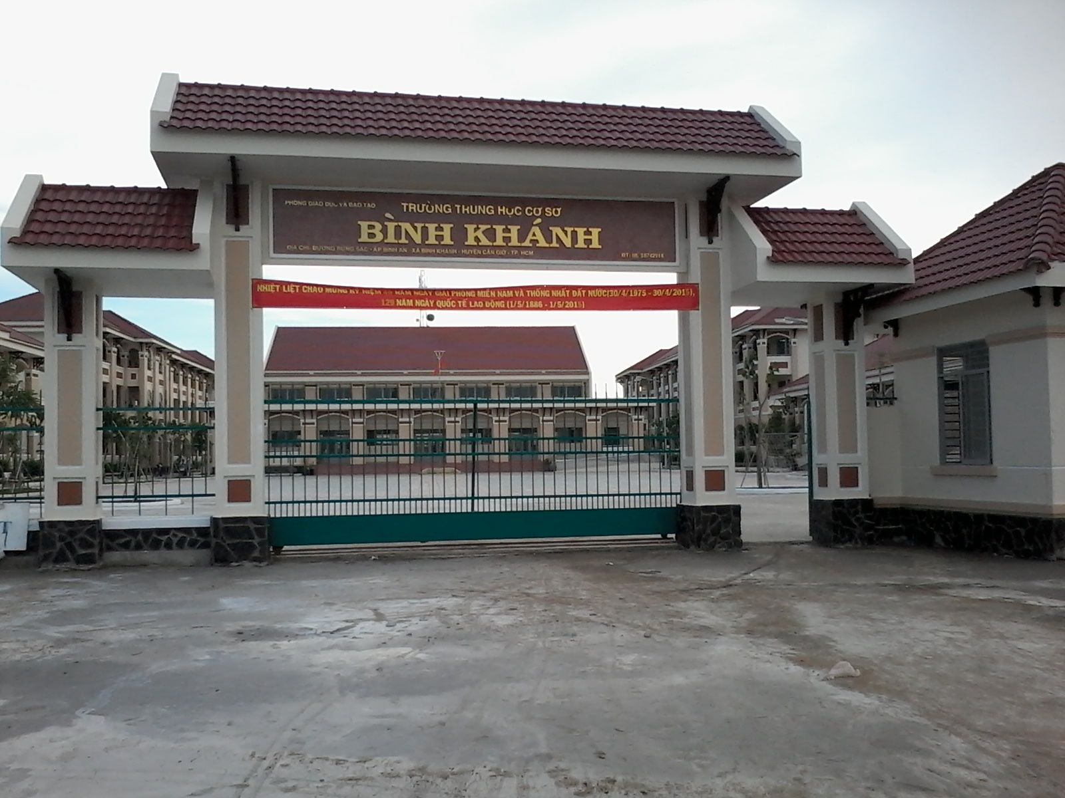

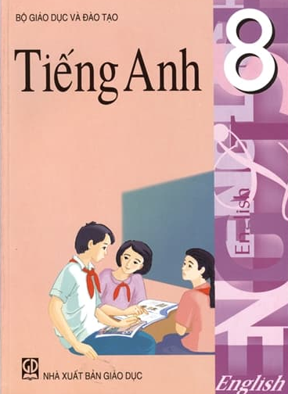

BINH KHANH SECONDARY SCHOOL

Slide 2
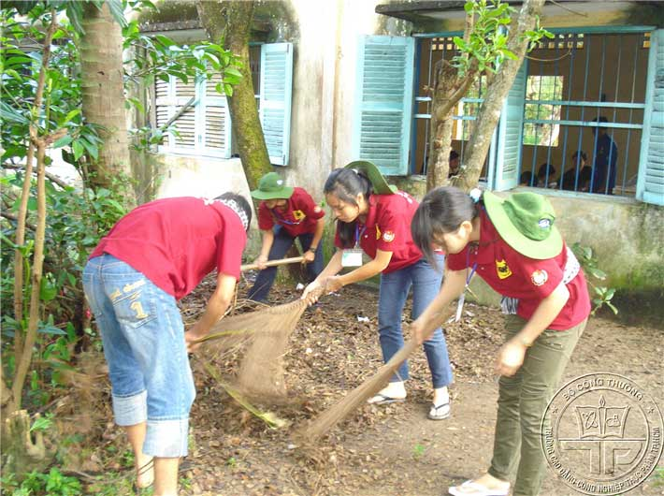
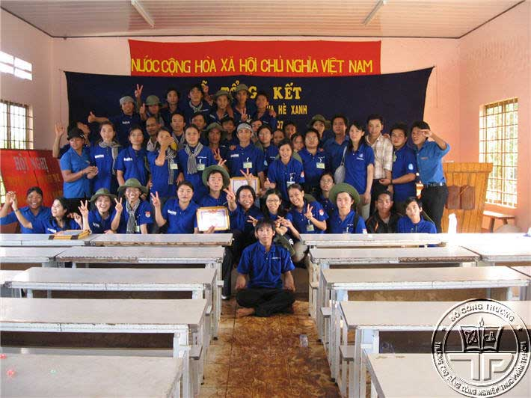
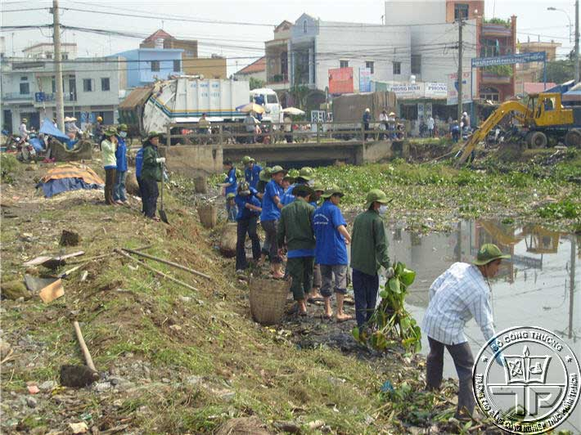
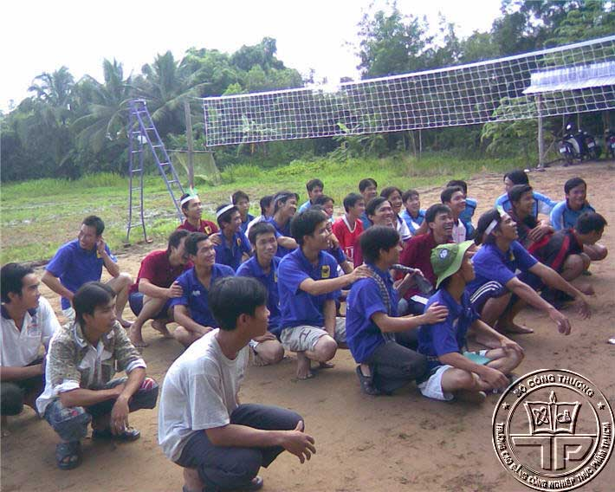
What organization is this?
Ho Chi Minh Communist Youth Union
Đoàn Thanh Niên Cộng Sản Hồ Chí Minh

Slide 3
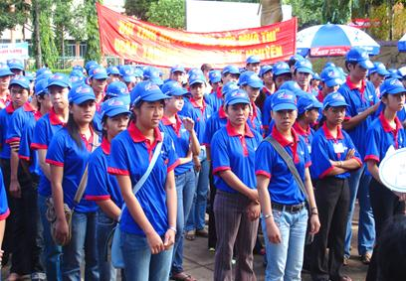
Ho Chi Minh Communist Youth Union

Slide 4
UNIT 6: THE YOUNG PIONEERS CLUB
Lesson 4: READ

Slide 5
Who founded it?
When was it found?
What are activities?
Ho Chi Minh
communist Youth Union
For which age?
What are its aims?

Slide 6
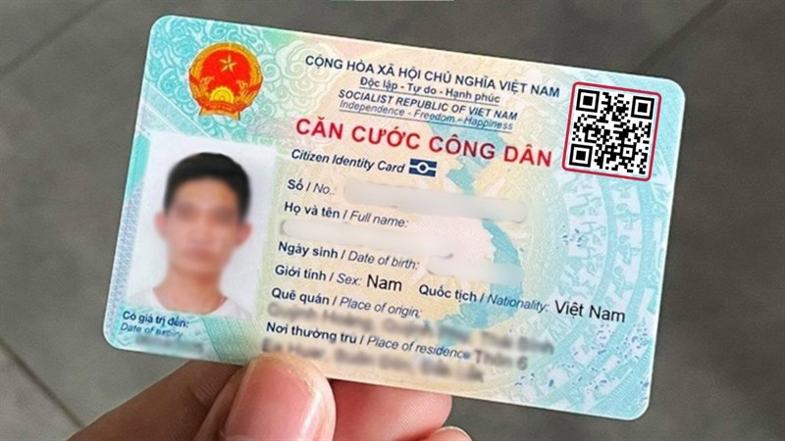
VOCABULARY
citizenship(n):
quyền công dân

Slide 7

The Youth Union
found (v)
sáng lập

Slide 8
Vocabulary:
- citizenship (n) :
quyền công dân
- found (v) :
thành lập, sáng lập
- aim (v)/ (n) :
nhằm mục đích/mục đích
- encourage (v) :
khuyến khích, động viên
- awareness (n) :
sự ý thức
- personality (n) :
nhân cách
- principle (n) :
nguyên tắc
- establish (v) :
thiết lập
- guideline (n) :
đường lối chỉ đạo

Slide 9
Matching
+ citizenship (n) :
đường lối chỉ đạo
+ found (v) :
thiết lập
+ aim (v) :
nguyên tắc
+ encourage (v) :
khuyến khích, động viên
+ awareness (n) :
nhân cách
+ personality (n) :
sự ý thức
+ principle (n) :
nhằm mục đích
+ establish (v) :
thành lập , sáng lập
+ guideline (n) :
tư cách công dân

Slide 10
True / false statements
Ho Chi Minh communist Youth Union is an organization for Vietnamese Youth from 18 to 30 years of age.
The Union was founded on March 26, 1930 by the beloved president Ho Chi Minh.
The Union often hold social activities such as Helping the Handicapped, Cleaning the Environment, Green Summer Volunteers Campaign, and other similar movements.
The activities aim to help the young develop their public awareness and form their personality.
15
F
1931
F
T
T

Slide 11
Ho Chi Minh communist Youth Union is an organization for Vietnamese Youth from 15 to 30 years of age. The Union builds good character, love for the nation, and encourages good citizenship, soft skills and personal fitness.
The Union was founded on March 26, 1931 by the beloved President Ho Chi Minh. It had different names over the years. One of its first name was ‘Vietnam Communist Youth Union’. In December 1976, it was officially named as it is called today: Ho Chi Minh Communist Youth Union. However people normally use the name ‘The Youth Union’ for short.
The Youth Union, together with other youth organizations such as the Young Pioneers Organization, the Vietnam Youth Federation, the Vietnam Students Union, often hold social activities such as Helping the Handicapped, Cleaning the Environment, Green Summer Volunteers Campaign, and other similar movements. These activities aim to help the young develop their public awareness and form their personality.
Ever since the Union was founded, its aims and principles, established by President Ho Chi Minh, have been the guidelines for the young Vietnamese people of today and tomorrow.

Slide 12
1. Fill in the missing information.
1931
The Youth Union was founded in……………….
In ……………………the Youth Union was officially named as it called today.
The Youth Union’s activities aim to help the young develop……………………………………………………
Its aims and principles have been………………… for the young Vietnamese people of today and tomorrow.
December 1976
their public awareness and form their personality.
the guidelines

Slide 13
2. Answer. Then write the answers in your exercise book.
a. At what age can one join the Youth Union?
b. When was the Youth Union founded?
c. What is the complete name of the Youth Union?
d. Can you name some social activities of the Youth Union?
e. What do these activities aim to help?
f. Who established the guidelines for the Vietnamese Youth?

Slide 14



1
2
3
4
5
6
7
8
9
I win!
I win!
A
1
4
8
3
7
6
2
5
1
2
3
6
7
4
8
5
B

Slide 15



a. At what age can one join the Youth Union?
=> Any Vietnamese youth from 15 to 30 years of age can join the Youth Union .
1
2
3
4
5
6
7
8
9
10
TIME

Slide 16
b. When was the Youth Union Founded ?
=>The Youth Union was founded on March 26, 1931.
1
2
3
4
5
6
7
8
9
10
TIME

Slide 17



Slide 18
c. What is the complete name of the Youth Union ?
=> It’s Ho Chi Minh Communist Youth Union
1
2
3
4
5
6
7
8
9
10
TIME

Slide 19
d. Can you name some social activities of the Youth Union ?
=> They are Helping the Handicapped, Cleaning the Environment, Green Summer Volunteers Campaign……
1
2
3
4
5
6
7
8
9
10
TIME

Slide 21
e. What do these activities aim to help?
=> These activities aim to help the young develop their public awareness and form their personality.
1
2
3
4
5
6
7
8
9
10
TIME

Slide 22
f. Who established the guidelines for the Vietnamese Youth?
=> Uncle Ho.
1
2
3
4
5
6
7
8
9
10
TIME

Slide 24
Congratulation !

Slide 25
ANSWERS:
a) Any Vietnamese youth from 15 to 30 years of age can join the Youth Union.
b) The Youth Union was founded in 1931.
c) It’s Ho Chi Minh Communist Youth Union.
d) They are Helping the Handicapped, Cleaning the Environment, Green Summer Volunteers Campaign...
e) These activities aim to help the young develop their public awareness and form their personality.
f) Uncle Ho.

Slide 26





Who's a milionaire?
In…….the Youth Union was
officially named as it is today.
500:5
50:50
B. December 1976
A. December 1977
B. December 1976
C. October 1977
D. October 1976
L
F

Slide 27
Who's a milionaire?
The Union was founded by…
50:50
50:50
A. Vo Nguyen Giap
B. Pham Van Dong
C.Ho Chi Minh
D. Nong Duc Manh
C. Ho Chi Minh
L
F

Slide 28
Who's a milionaire?
The complete name of
the Youth Union is ….
50:50
50:50
A. The students Union
B. The Vietnam
Youth Federation
C. Vietnam communist
Youth Union
D. Ho Chi Minh
communist Youth Union
D. Ho Chi Minh
communist Youth Union
L
F

Slide 29
Who's a milionaire?
Vietnamese Youth from …..years
of age can join the Youth Union
50:50
50:50
A. 15 to 31
B. 18 to 30
C. 18 to 31
D. 15 to 30
D. 16 to 30
L
F

Slide 30
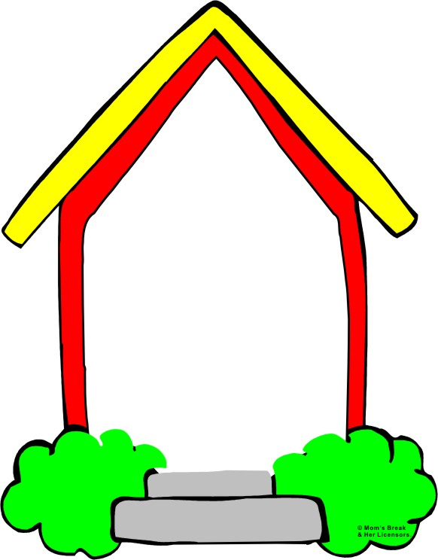
HOMEWORK
Learn new words .
2.Copy exercises
3.Prepare: Write

Slide 31
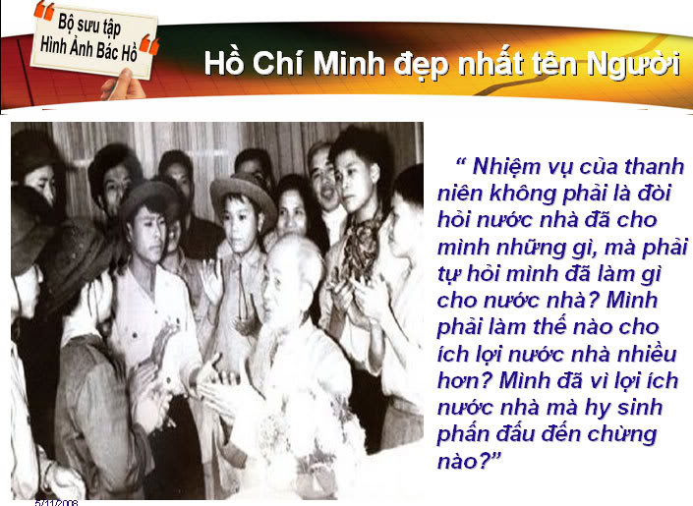

Slide 32
THANK YOU
FOR YOUR ATTENTION !
Goodbye!

