Slide 1
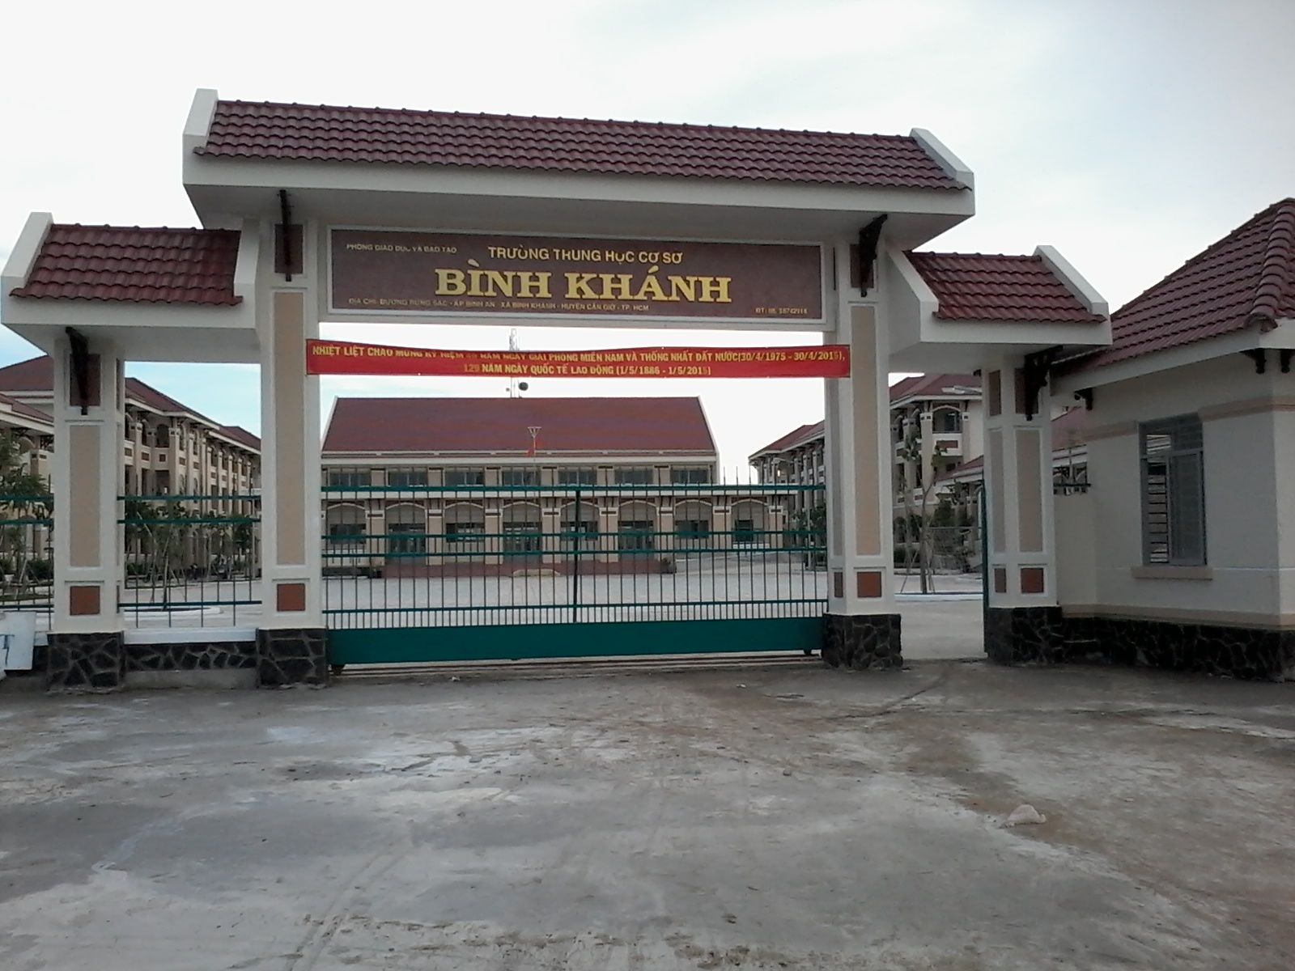



BINH KHANH SECONDARY SCHOOL

Slide 2

LUCKY NUMBERS
1
2
1
2
3
3
4
4
5
5
6
6
7
7
8
8

Slide 3


Lucky number
trở về

Slide 4

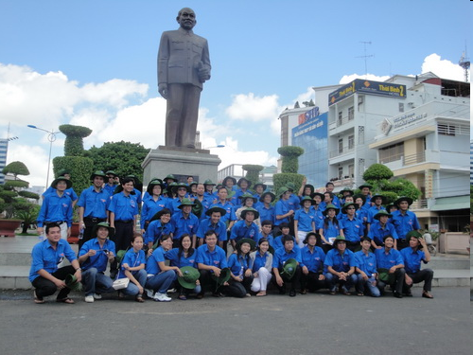

What organization is this?

Slide 5



What is the complete name of the Youth Union ?

Slide 6


What is the name of the activity?

Slide 7
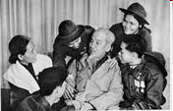

Who established the Youth Union?

Slide 8
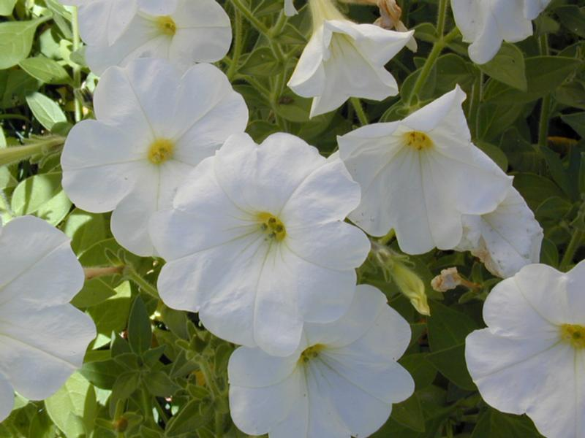
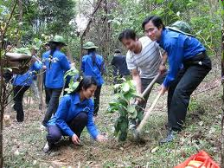

What are they doing?

Slide 9
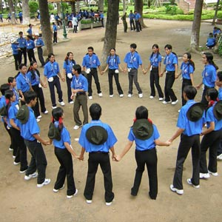
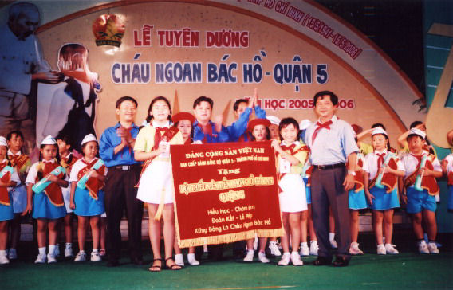
Which organization is this ?
Which organization is this ?
Youth Organization
HoChiMinh Young Pioneer
HoChiMinh Young Pioneer and Youth Organization (Y & Y)
What do the Y & Y often do ?
Let’s begin our lesson today.

Slide 10


Unit 6
THE YOUNG
PIONEERS CLUB
Lesson 5: Write

Slide 11
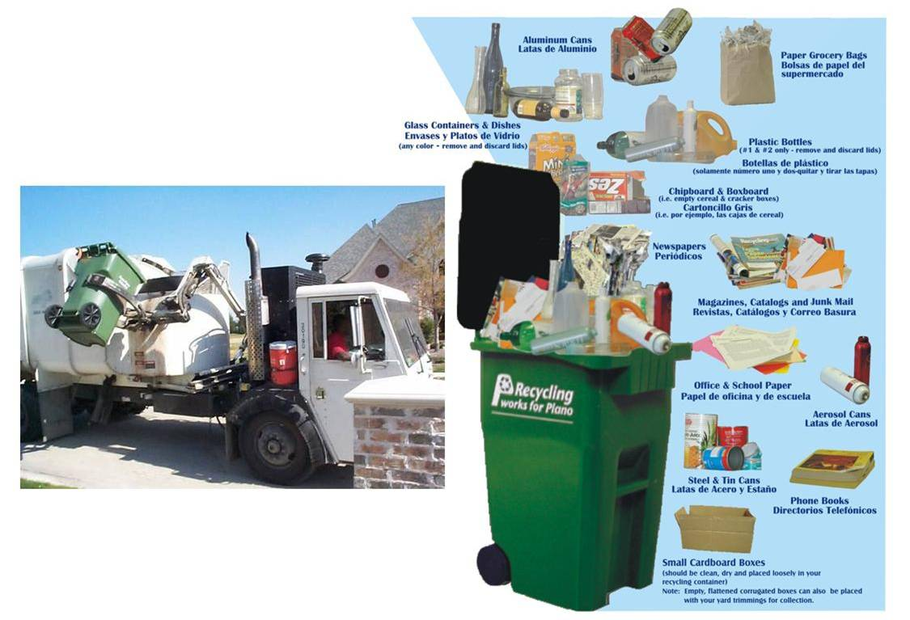
Recycle(v)
Recycling program

Slide 12

Natural resources

Slide 13
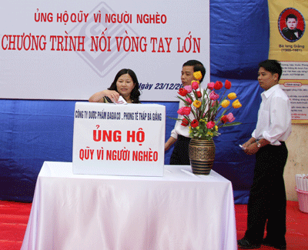
Raise fund

Slide 14
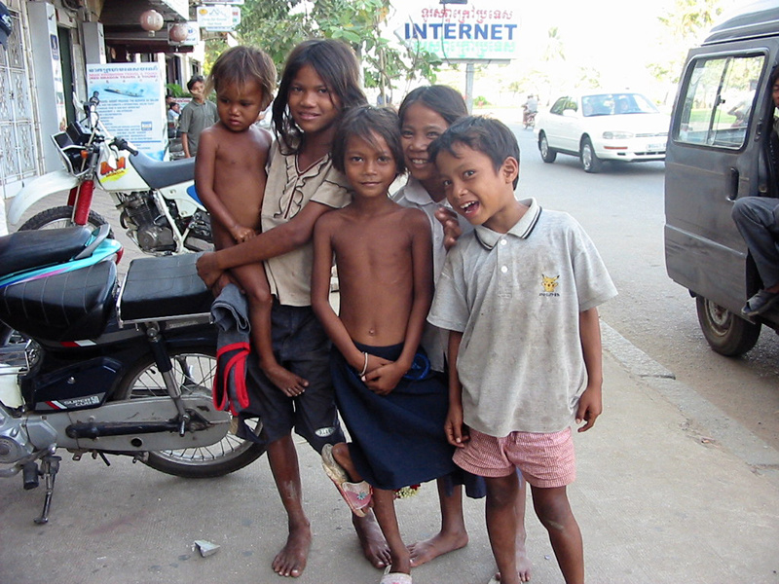
Street children

Slide 15
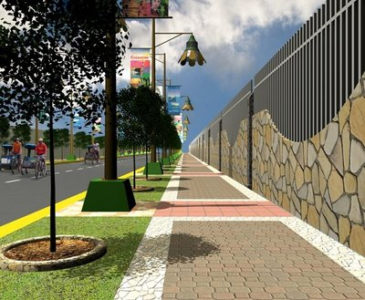
Sidewalk

Slide 16
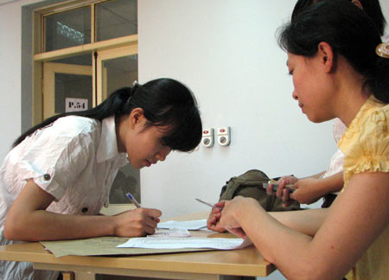
Register

Slide 17


I.Vocabulary:
Recycle (v):
tái chế
Earn (v):
Kiếm tiền
Natural resources (n):
Tài nguyên thiên nhiên
Raise fund:
Gây quỹ
Street children (n):
Trẻ em đường phố
Sidewalk (n):
Vỉa hè
Register (v):
Đăng ký

Slide 18
1.Read the passage and complete the letter
November 21, 2003
NOTICE
To: All Y & Y members of the school.
The Y & Y is planning to help the community by encouraging all members to participate in a recycling program. All you have to do is to collect used glass, paper, and cans, and send them for recycling. By doing this, we can help save natural resources and earn some money for the organization.
If possible, you can participate in other programs such as raising funds for the poor, helping street children and planting trees and flowers along the sidewalks or in the parks.
Join us and register from today.
The Secretary.

Slide 19
This is the letter Nga send to Linh
Dear Linh,
I’m glad to tell you that I’m going to have interesting activities.
The Y&Y is (0) planning to help the (1) __________. I will participate in its(2) ________ program. In this program, we will (3) _______ glass, used paper and cans. We will (4) ________ them for (5) _________.
I hope I can (6) ________natural resources and (7) __________ some money for my school Y&Y in these activities. I also think about (8) ___________ in either (9) ________trees and flowers or (10) _______ street children. It is really interesting, isn’t it?
Write to me soon and tell me all your news.
Love,
Nga
community
recycling
collect
send
recycling
save
raise
participating
planting
helping

Slide 20


QUESTIONS AND ANSWERS
She also thinks about participating in either planting trees and flowers and helping street children .
She hopes she can save natural resources and raise some money for her school Y&Y in these activities.
The Y & Y is planning to help the community by encouraging all members to participate in a recycling program.
4. What does she also think about?
In this program, they will collect glass, used paper and cans. they will send them for recycling
3. What does Nga hope?
1. What is the Y & Y planning to do?
2. What will they do in this program?
8
7
6
4
9
10
5
3
2
0
1

Slide 21
2. Read the dialogue between Hoa and her aunt. Then write Hoa’s letter to her parents telling what she is going to do
Aunt: Hoa, you look very happy today. Anything interesting at school?
Hoa: Yes, Aunt. I’m going to join the Y&Y Green Group
Aunt: Really? What will you do?
Hoa: We are having an environment month.
And, we’re going to clean the banks of the lakes on weekends.
Aunt: Will you do anything else?
Hoa: Oh, yes. We’re going to plant trees and flowers in the school garden and water them every afternoon after class.
Aunt: That sounds excellent.
Hoa: Yes, it is. And, we’re planting young trees and plants to sell to some schools. We hope to give more green color to the city and earn some money for our school Y&Y.
Aunt: You’re really great, Hoa!
Dear Mom and Dad,
………………………………..

Slide 22
Outline
Dear Mom and Dad,
I / happy / tell / I / join the …
The Y & Y is holding /(having)/ environment month (plan)
We / clean / banks …
We / plant / trees.
We /hope/give /green color/ earn/money…
It/interesting /useful/?

Slide 23
Writing
Dear Mom and Dad,
I’m very happy to tell you that I’m going to join the Y & Y Green Group of my school.
The Green Group is holding an environment month plan. We are going to clean the banks of the lakes on weekends. We are going to plant trees and flowers in the school garden and water them every afternoon after class. We hope that we can give green color to the city and earn some money for our school Y & Y.
The program is very interesting and useful, isn’t it?
I will tell you more about the group activities later.
Love,
Hoa

Slide 24



UNIT6 THE YOUNG PIONEERS CLUB
Lesson 5. Write
V. Homework - Learn by heart vocabulary.
- Rewrite the letters at home again
Do exercises in your exercise book( Unit 6 )
Prepare for Language Focus.
Notes:
24

Slide 25


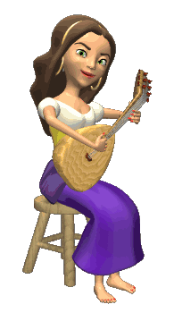








THANK YOU FOR ATTENTION!
GOOD BYE!
the end

