Slide 1
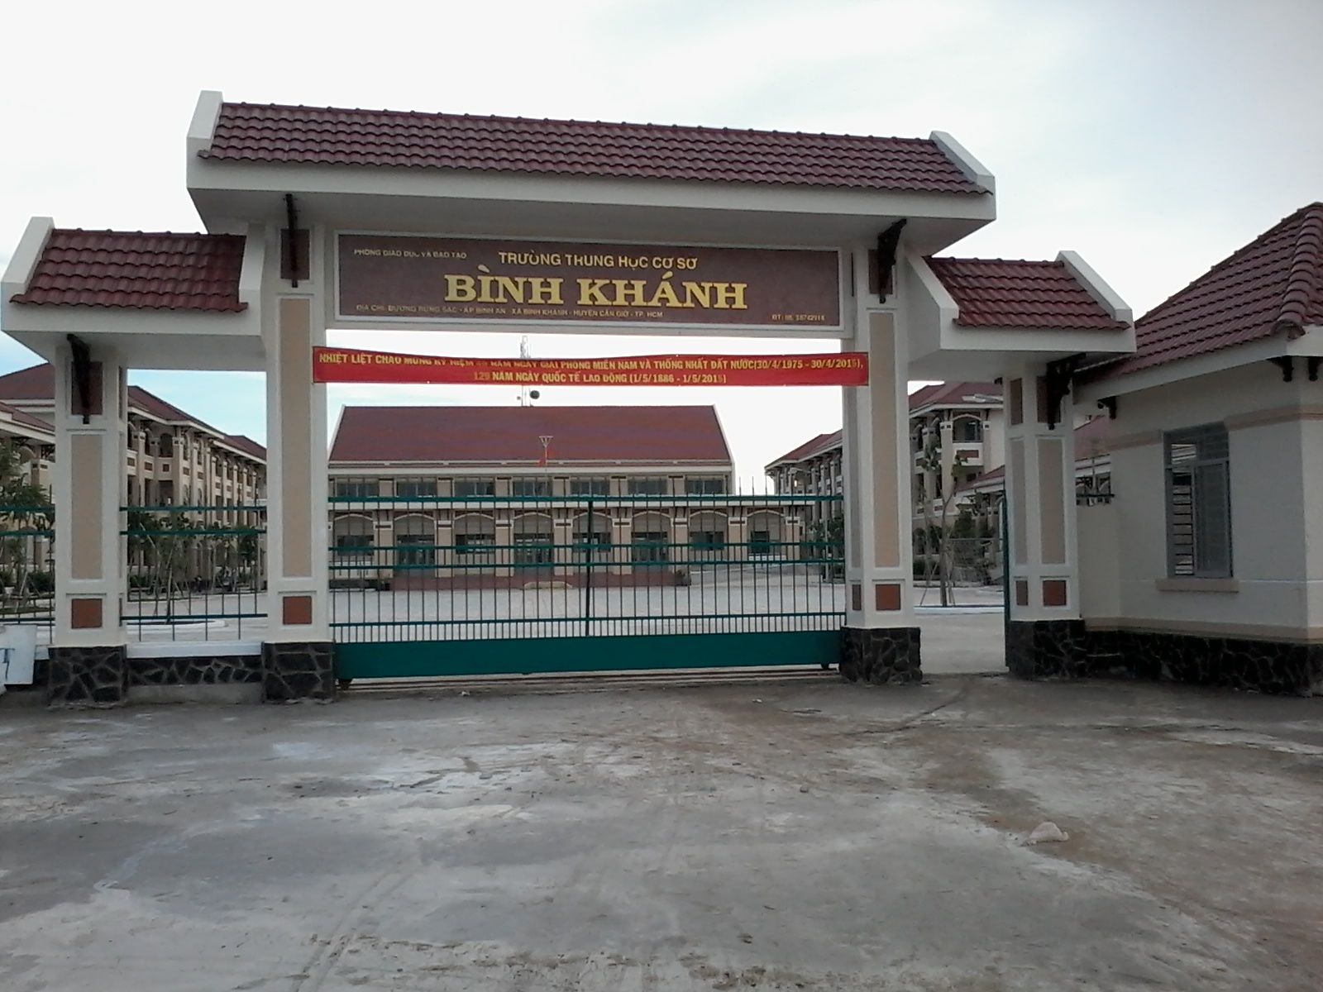



BINH KHANH SECONDARY SCHOOL

Slide 2

listen and say the names of the songs
Song guessing

Slide 3


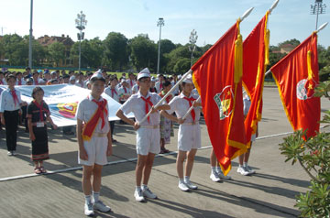

1. Hanh khuc doi thieu nien tien phong
Young Pioneer and Youth Organization
2. Mua he xanh

Slide 4
Unit 6:
THE YOUNG PIONEERS CLUB
Lesson 6: Language focus
Present tense with future meaning
Gerunds
Modals: may, can, could

Slide 5
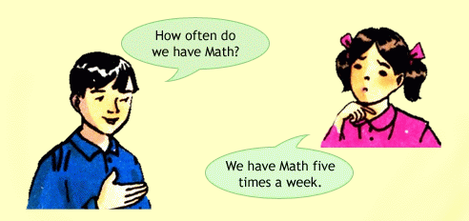
This is Ba
This is Lan
Lan and Ba are member of Y & Y organization. They are talking about the Spring activity program

Slide 6
 Complete the dialogue between Ba and Lan
Where
Ba : ……… (1) do we collect and empty garbage ?
Lan : At Dong Xuan Market.
Ba : ……… (2) do we collect and …..……………. (3)
Lan : On January 9.
Ba : ………….. (4) do we start and ……… (5) ?
Lan : We ……... (6) at 8 am and finish at 5 pm.
When
empty garbage
What time
finish
start
When do we use “Where”?
- To ask for the place
When do we use “When”?
- To ask for the date
When do we use “What time”?
- To ask for the time
Is the date at present or in the future?
- In the future
What tense do we use in the dialogue?
Simple present tense

Slide 7
Notes: We use simple present tense to express an action
that happen in the future
 Simple tense with future meaning

Slide 8
Where do they collect and empty garbage
When do they collect and empty garbage?
What time do they start and finish work?
Activity | Place | Date | Time
Collect and empty garbage | Dong Xuan Market | Jan.9 | 8 am-5 pm
At Dong Xuan Market
They start at 8 am and finish at 5 pm
On January 9

Slide 9
Activity | Place | Date | Time
Plant and water trees along streets Help the elderly and street children Have big gathering to support cultural- sport programs | City centre street City rest home and orphanage Central stadium | Feb.2 Mar.26 Apr.15 | 7am-10am 7am-4pm 5pm-9pm
Model:
When do they ………….? - On ………………………
Where do they………….? - At……………………….
What time do they start and finish work?
- They start at …… and finish at …..

Slide 10
Gerunds
Note:
V + ing = Gerunds
Ex:
1. Ba loves playing soccer
2. Lan likes cooking meals
3. I hate playing soccer
4. They don’t like watching TV
5. She doesn’t like doing homework
Form:
hate
S + like + V-ing
love

Slide 11
 | BA |  |  |  | LAN
 | love | like | Don’t like | hate | love | like | Don’t like | hate
Playing soccer | √ |  |  |  |  |  | √
Washing up |  |  | √ |  |  |  | √
Cooking meals |  |  |  | √ |  | √
Performing music |  | √ |  |  |  | √
gardening |  |  | √ |  |  |  | √
Gathering broken glasses |  | √ |  |  |  | √
Watching TV |  | √ |  |  | √
Camping | √ |  |  |  |  | √
Playing badminton |  |  |  | √ |  |  | √
Doing homework |  | √ |  |  |  |  |  | √

Slide 12
Work with a partner.Look at the table. Talk about our friends’hobbies
Ba loves playing soccer, but he doesn’t like washing up.
Lan doesn’t like playing soccer and she doesn’t like washing up, either.

Slide 13
Ask and answer question with your partner
A: Do you like playing soccer?
B: No. I hate it.
What about you?
A: Yes. I love playing soccer

Slide 14
* Put the correct form of the verbs in banks :
planting
1. She likes ……………… (plant) flowers in the garden.
2. They hate ……………… (do) housework.
3. My mother loves ……………… (play) football.
4. I like ……………… (get) up late on Sunday mornings.
doing
playing
getting

Slide 15
MODALS : CAN, COULD, MAY
EX:
She can cook meals
She could cook meals when she was ten
I can’t play soccer
Can/ Could you help me?
Structure:
(+) S + Modals + V-infi
(-) S + Modals + not + V-infi
(?) Modals + S + V-infi…?

Slide 16
3. Work with a partner. a. Use the expressions in the box to ask for a favor. The practice the dialogues with a partner
help me with this math problem
buy a ticket
water the flower in the garden
take me across the road

Slide 17
A. Woman: Can /Could you help me ,please?
Man: Yes, certainly.
Woman: Can you_____________________?
- help me with this math problem
- buy a ticket
- water the flower in the garden
- take me across the road
buy a ticket (for me)
B. Old woman: Could you do me a favor?
Boy: What can I do for you?
Old woman: Can you______________________?
take me across the road
C. Boy: I need a favor.
Girl: How can I help?
Boy: Could you_____________________________?
help me with this math problem
D. Grandpa: Can you help me ,please?
Niece: Yes, Of course.
Grandpa: Can you___________________________?
water the flowers in the garden

Slide 18
b. Use useful expressions in the boxes to complete the dialogues. Then practice the dialogue with a partner.
A: _____________help you?
B: Yes. Thank you. Could you fill in this form for me?
May I
A: ________________any help?
B: No. Thank you. I’m fine
Do you need
A: Oh. This bag is heavy.
B: Let_______________
A: Yes. That’s ___________________of you.
me help you
very kind

Slide 19
A)
Can you help
Mom : ………………………….. me , Nam ?
Nam : Sure, Mom. ……………………….. for you ?
Mom : I want some potatoes. ……………………… buy
them for me?.
Nam : ………………….. I’ll go and buy soon.
What can I do
Can you
Certainly
B)
Minh : Oh ! It’s too high
Lan : Do …………………….……?
Minh : Yes, . …………………… get that book? It’s too high.
Lan : ………………. Here you are
Minh : Thanks. …………………………… of you.
You need any help
Could you help me
No problem
That’s very kind

Slide 20


HOMEWORK
-Talk about your friends’ hobbies
- Prepare the new lesson

Slide 21




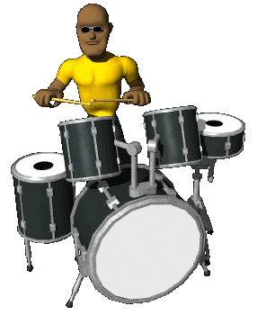
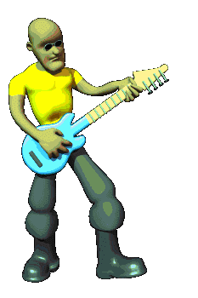


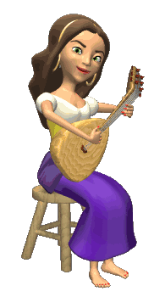

THANK YOU FOR ATTENTION!
GOOD BYE!
the end

