Slide 1
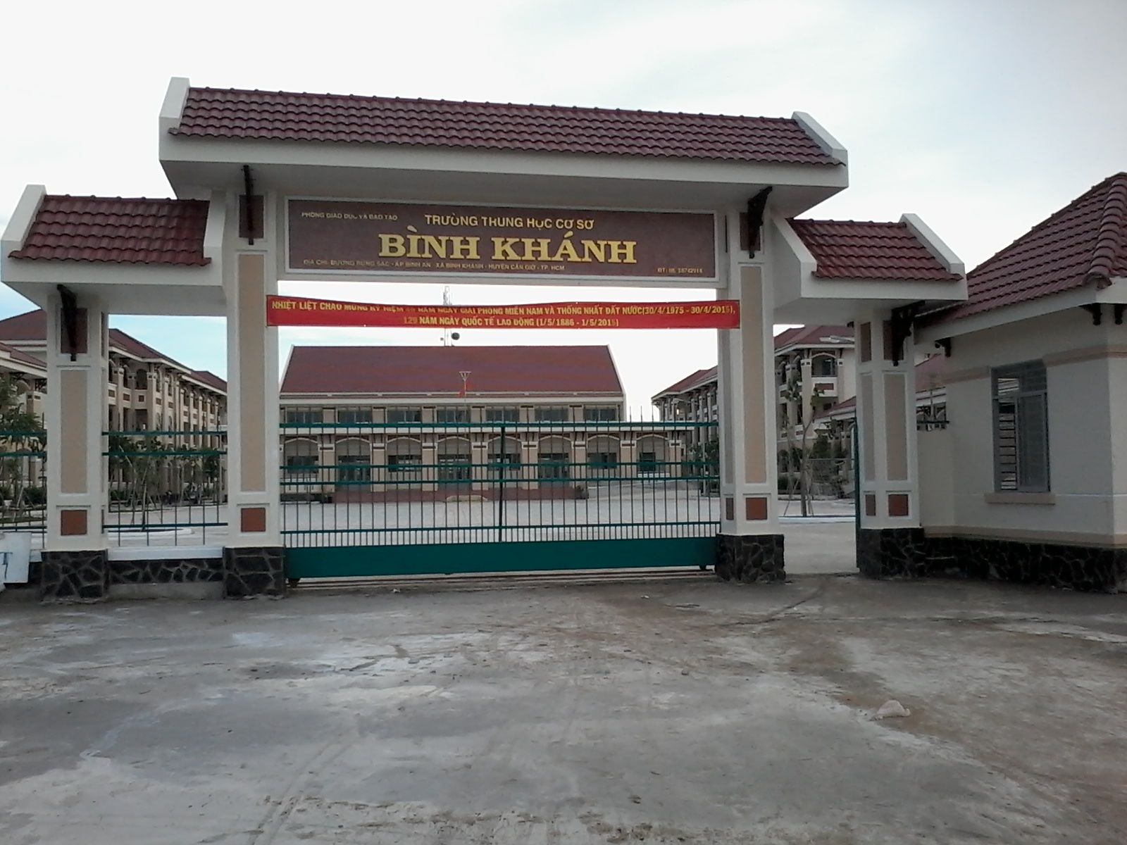



BINH KHANH SECONDARY SCHOOL
ENGLISH 8

Slide 2
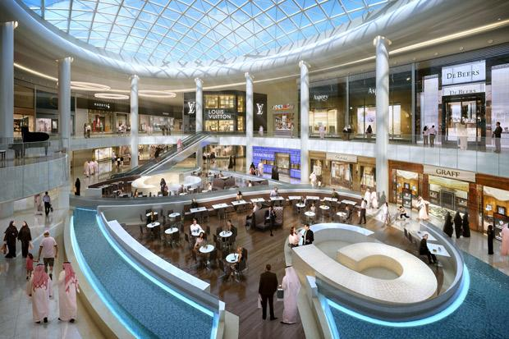
A Shopping Mall
Book store
Restaurant
Clothing store
Movie theaters
grocery stores
Wet market
2. A place where you can buy vegetables and fish .
5. where can you come to see the movies .?
3. A place you can buy clothes. ?
4. A place you can come to eat or drink.?
6. Where can we buy sugar, tea, milk..?
1. A place where you can buy books.
All of them are under 1 roof. We call it a shopping mall.
Let’s go into the mall . Buy and play. Follow me, please.j

Slide 3
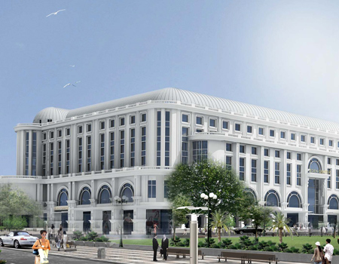
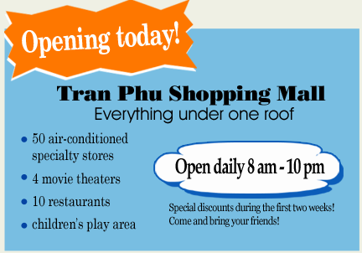

roof
Tran Phu Shopping mall
Tran Phu Street

Slide 4
Unit 7: My neighborhood
Period 45 Lesson 3: READ (P.67,68)
What happens in Nam’s neighborhood ?
I_Vocabulary
Opening today !
Tran Phu Shopping Mall
Everything under one roof
gian hàng có điều hòa
Mái nhà
50 air-conditioned
specialty stores
4 movie theaters
10 restaurants
children’s play area
Open daily 8 am-10 pm
giảm giá
Special discounts during the first two weeks!
Come and bring your friends!

Slide 5

Unit 7: My neighborhood (Read)
A new shopping mall is opening in Nam’s neighborhood today. It is very different from the present shopping area. All the shops are under one roof. That will be convenient, especially during the hot and humid summer months. Customers will shop in comfort and won’t notice the weather.
Some people in the neighborhood, however, are not happy about the changes. The owners of the small stores on Tran Phu Street think the mall will take their business. Some of the goods in the new stores will be the same as the ones in the small shops, but the stores in the mall will offer a wider selection of products, some are at cheaper prices.
The residents and store owners have been concerned about the new mall for a few months. They have organized a community meeting in order to discuss the situation.
I- Vocabulary
‘
- be concerned about ( adj)
= worried- lo lắng
‘
- air conditioned( adj)
= có lắp điều hòa nhiệt độ
‘
= khu thương mại
- a shopping mall ( n)
convenient (adj)
‘
easy and comfortable
= tiện lợi, tiện nghi
‘
= lấy đi lợi nhuận
- take one’s business( v)
‘
‘
nhiều sự lựa chọn các sản phẩm
- a wider selection of products(n)
= more goods to choose
‘
cư dân
- resident (n)
= people in the neighborhood

Slide 6
UNIT 7
My Neighborhood
Lesson 3: Read P.67- 68
MATCHING
convenient (n)
air- conditioned (adj)
a shopping mall (n)
take one’s business (v)
residents(n)
a wider selection of product (n)
be concerned about (adj)
a. nhiều sự lựa chọn
sản phẩm
b.dân cư
c. lo lắng
d. có trang bị máy
điều hòa
e. khu thương mại
f.lấy đi lợi nhuận của...
g. thuận tiện
Key:
1- g 2- d 3 - e 4- f 5- b 6- a 7-c

Slide 7
Read the sentences then guess if they are “true” (T) or “false” (F)
Now check the answer T or F and correct F sentences
Right
 |  | The mall is open six days a week.
 |  | There are more than 50 stores in the mall.
 |  | Everyone in the neighborhood is pleased about the new mall.
 |  | It will be more comfortable to shop in the mall than in the present shopping area.
 |  | Some of the stores on Tran Phu Street may have to close.
a*
F
daily./ everyday
six days a week.
b*
F
more than
50 stores in the mall.
F
Not everyone
Everyone
Some people in the neighborhood aren’t happy about the changes
c*
T
d*
e*
T
Your guess befrore reading
a.
F
F
F
d.
F
e.
F
T
b.
T
c.
T
T
T
Read
Questions

Slide 8

Unit 7: My neighborhood (Read)
A new shopping mall is opening in Nam’s neighborhood today. It is very different from the present shopping area. All the shops are under one roof. That will be convenient, especially during the hot and humid summer months. Customers will shop in comfort and won’t notice the weather.
Some people in the neighborhood, however, are not happy about the changes. The owners of the small stores on Tran Phu Street think the mall will take their business. Some of the goods in the new stores will be the same as the ones in the small shops, but the stores in the mall will offer a wider selection of products, some are at cheaper prices.
The residents and store owners have been concerned about the new mall for a few months. They have organized a community meeting in order to discuss the situation.
Opening today !
Tran Phu Shopping Mall
Everything under one roof
* 50 air-conditioned
specialty stores
* 4 movie theaters
* 10 restaurants
* children’s play area
Open daily 8 am-10 pm
Special discounts during the first two weeks!
Come and bring your friends!
67
prediction

Slide 9
Unit 7: My neighborhood
Lesson 3: Read
The answers of the questions:
Read and answer 4 questions
a* What is special about the new shopping mall?
 a, All the shops are under one roof.
b* What fascilities are available in the shopping mall?
 b, They are 50 air-conditioned specialty stores,10 restaurants, 4 movie theaters and a children’s play area.
c* What do the small store owners think about the new shopping mall?
 c, They think the mall will take their business.
d* What kinds of goods will the stores in the mall offer?
d, The stores in the mall will offer a wider sellection of products,
some at cheaper prices.

Slide 10
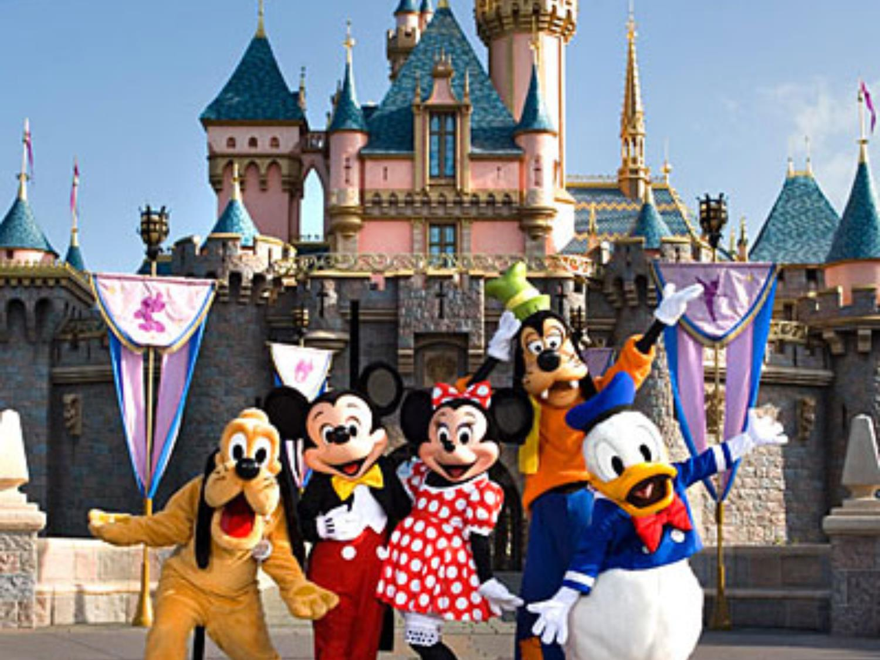
LET’S PLAY A GAME
LET’S

Slide 11




Who's a millionaire?
A new……..is opening in Nam’s neighborhood today
50:50
A. shop
A. shopping mall
B. shopping mall
C. restaurant
D. market

Slide 12
Who's a milionaire?
Shopping is very………during the hot and humid weather.
50:50
A. expensive
B. cheap
C. tired
D. convenient
D. convenient

Slide 13
Who's a milionaire?
The owners of the small stores think the mall will take their…….
50:50
A. money
B. products
C. business
C. business
D. goods

Slide 14
Who's a milionaire?
The stores in the mall will offer a ……..of products.
50:50
A. little selection
B. wider selection
B. wider selection
C. smaller selection
D. many selections

Slide 15
Who's a milionaire?
Store owners have been ……..about the new mall for a few months.
50:50
A. concerned
A. concerned
B. happy
C. interested
D. comfortable

Slide 16
Use the words to fill in the gaps.
Order; take, different, concerned
It is very……... from the present shopping area.
The owners of the small stores on Tran Phu Street think the mall will …....their business.
The residents and stores owners have been….... about the new mall for a few months.
They have organized a community meeting in .... to discuss the situation.

Slide 17
Use the words to fill the gaps.
It is very ….. .. … … from the present shopping area.
The owners of the small stores on Tran Phu Street think the mall will their .
The residents and stores owners have been ………… about the new mall for a few months.
They have organized a community meeting in ……… to discuss the situation.
different
take their business
concerned
order

Slide 18
Main points:
A new shopping mall will be build in your neighborhood .
-Do you like it ?
-What do you think about that ?
Advantages + A wider selection of products + no care about the bad weather | Disadvantages +Expensive goods with same quality. + difficult for small store’s business

