Slide 1
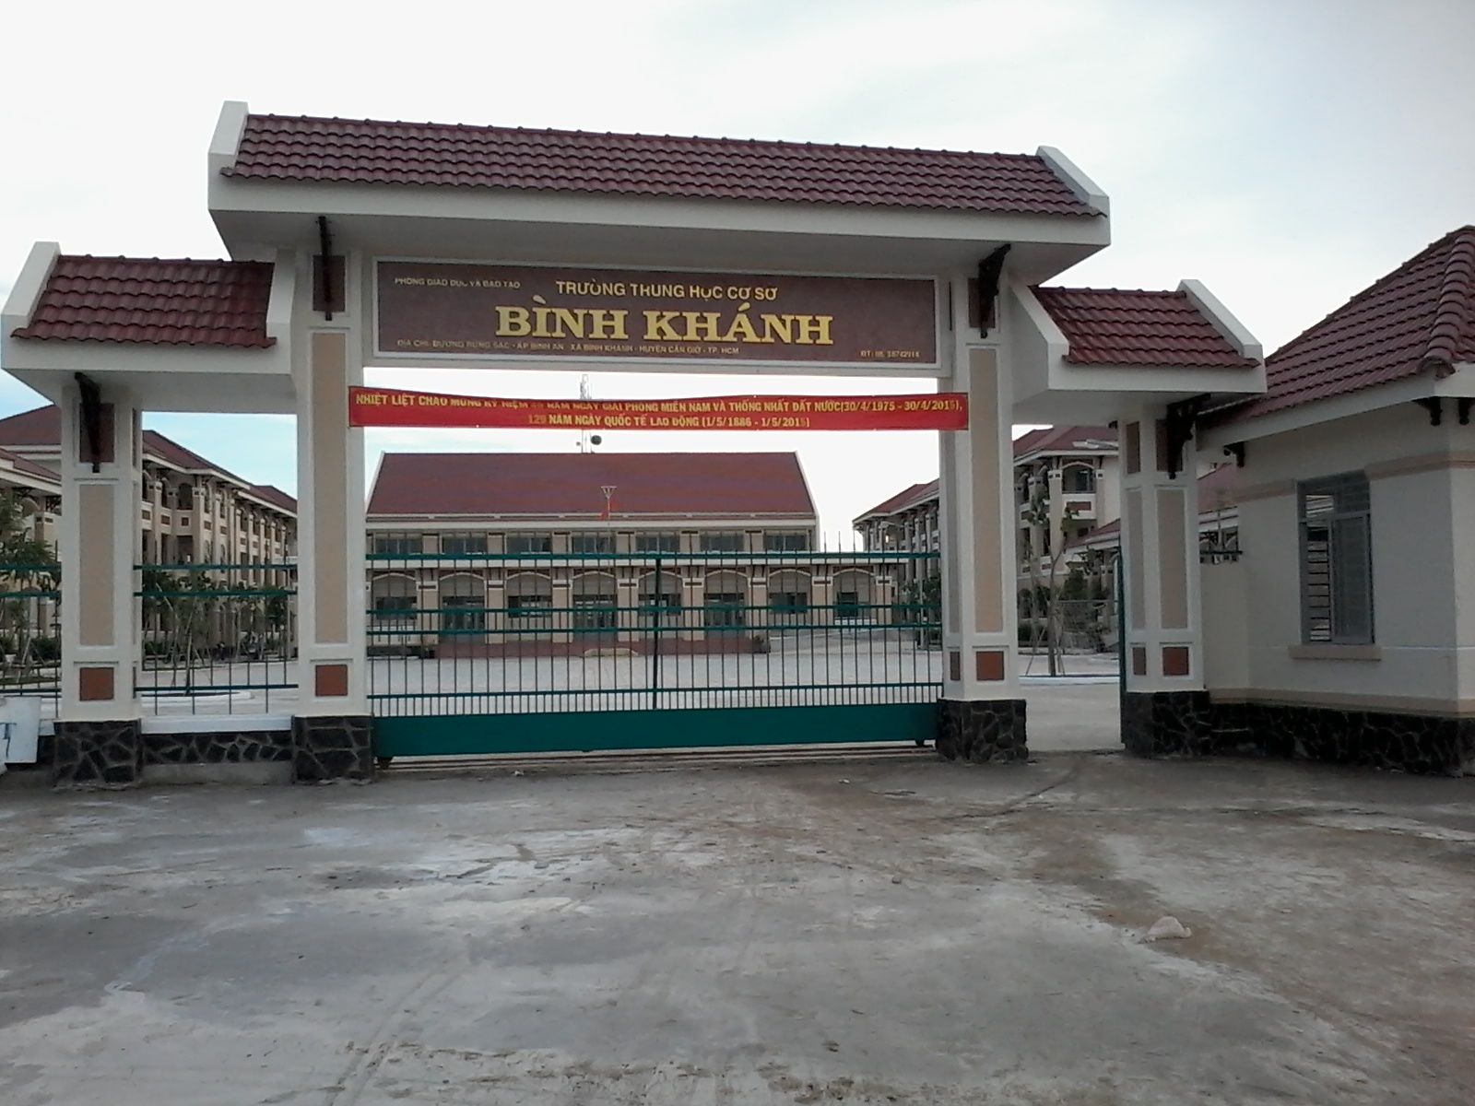



BINH KHANH SECONDARY SCHOOL
ENGLISH 8

Slide 2
Unit 7. Write
I. Vocabulary:
hardware store (n) :
cửa hàng sắt
effect (n)
ảnh hưởng
discuss (v):
thảo luận
Contact with (v) :
liên lạc với
II.Practice:

Slide 3
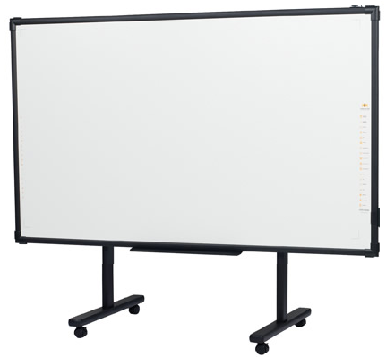
1. Read the community notice
Tran Phu Street Residents and Store Owners
MEETING TO DISCUSS EFFECTS OF NEW MALL
Date: May 20 Time: 8.00 pm
Place: Binh’s Hardware Store, 12 Hang Da Street.
Please contact Pham Van Tai at the above address for more information.
1.
Who holds the meeting?
2.
Why do they hold the meeting?
3.
What’s the date and the time of the meeting?
4.
Where do they hold the meeting?
5.
Who’s the person to contact?

Slide 4






1. Read the community notice
Tran Phu Street Residents and Store Owners
MEETING TO DISCUSS EFFECTS OF NEW MALL
Date: May 20 Time: 8.00 pm
Place: Binh’s Hardware Store, 12 Hang Da Street.
Please contact Pham Van Tai at the above address for more information.
2. Form of the community notice
1.
5.
2.
4.
3.

Slide 5
3. Write the notice
The school English Speaking Club is going to hold a speaking contest to celebrate the Teachers’ Day. The contest will be at the Hall 204, Building G, from 7.30 pm to 10 pm on November 15th. The person to contact is Tran Thi Thu Hang of class 8H.
The School English Speaking Club.
1. The holder
2. The content
HOLDING A SPEAKING CONTEST TO CELEBRATE THE TEACHERS’ DAY
3. The date and time
Date: November 15th Time: from 7.30 pm to 10 pm.
4. The place
Place: Hall 204, Building G
5. The person to contact
Please contact Tran Thi Thu Hang of class 8H at the above address for more information.

Slide 6

HOMEWORK
Learn the new words by heart.
2. Complete exercises.
3. Prepare: Language focus.

