Slide 1
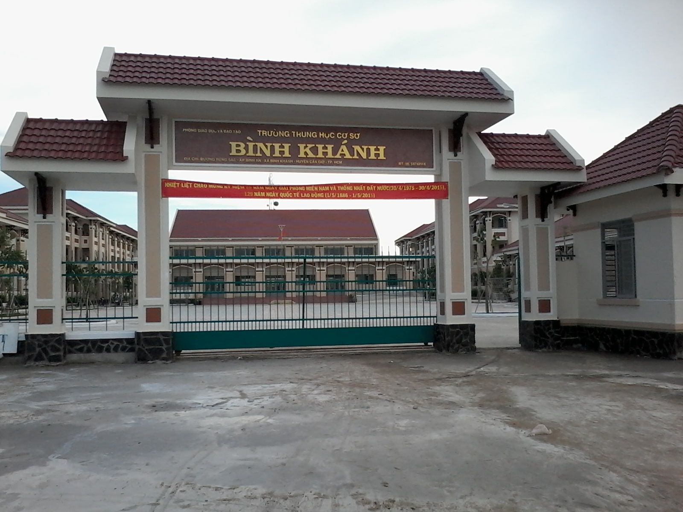



BINH KHANH SECONDARY SCHOOL
ENGLISH 8

Slide 2
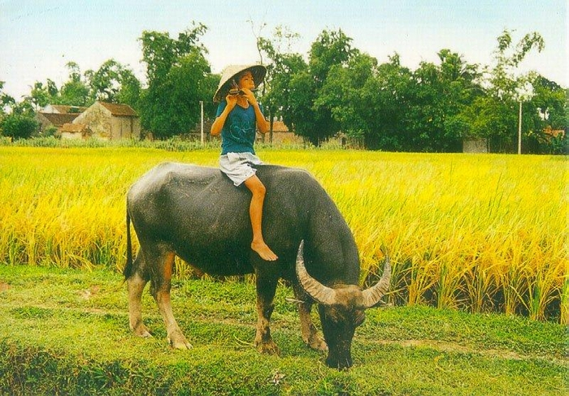
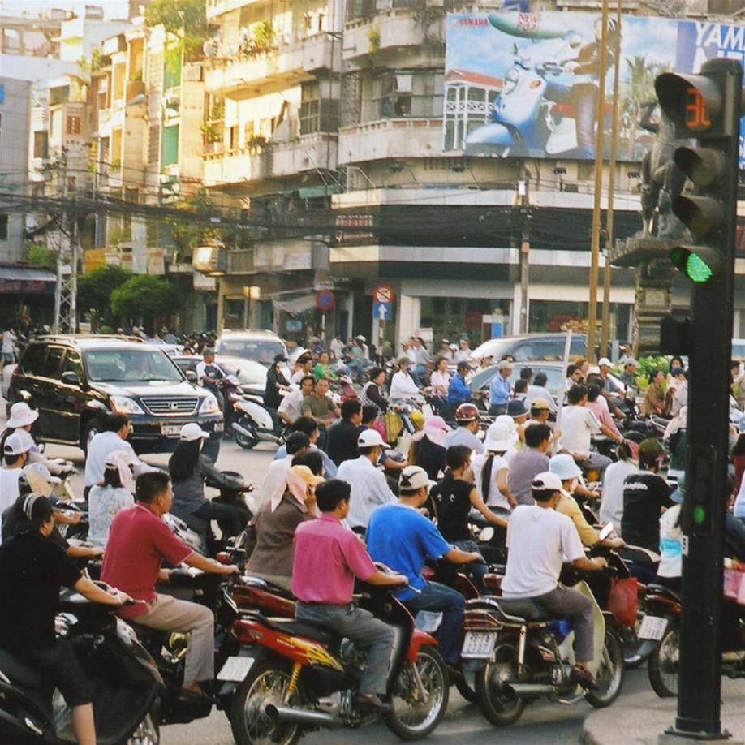
Notes:
Divide the class into 2 teams
Faster with more correct words wins the games

Slide 3
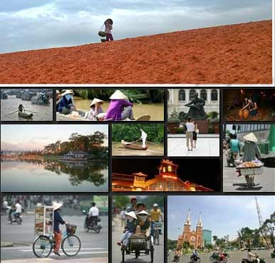

UNIT 8: COUNTY LIFE AND CITY LIFE
LESSON 3: READ

Slide 4

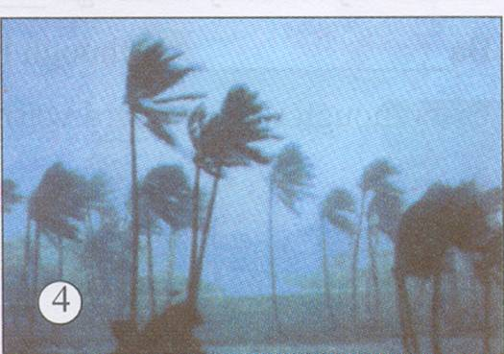
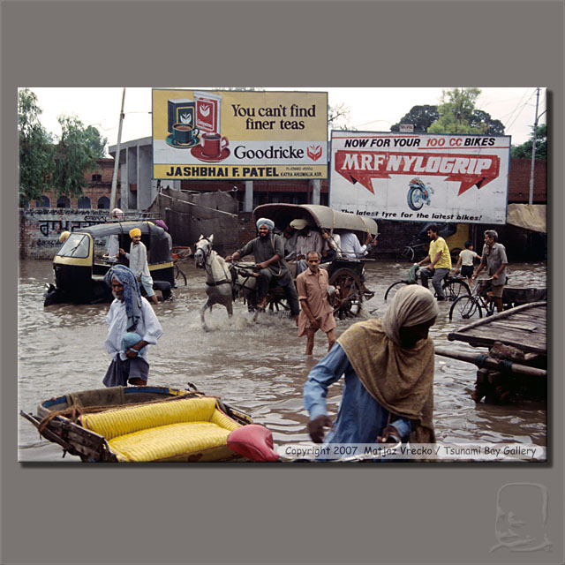


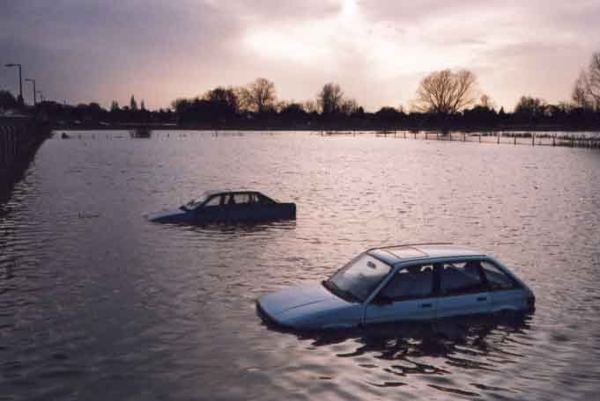
UNIT 8: COUNTRY LIFE AND CITY LIFE
Period 46: READ
I. Vocabulary:
-rural (adj):
thuộc nông thôn
# urban (adj):
thuộc đô thị , thành phố
- typhoon (n):
trận bão lớn
- flood (n) :
trận lụt
- drought (n) :
nạn hạn hán
- strain (n):
sự quá tải (về dân số)

Slide 5
WHAT AND WHERE
flood
rural
drought
typhoon
urban
strain

Slide 6
UNIT 8: COUNTRY LIFE AND CITY LIFE
Period 46: READ
I. Vocabulary:
-rural (adj):
thuộc nông thôn
- urban (adj):
thuộc đô thị , thành phố
- typhoon (n):
trận bão lớn
- flood (n) :
trận lụt
- drought (n) :
nạn hạn hán
- strain (n):
sự quá tải (về dân số)
II. Brainstorming

Slide 7

Brainstorming
lack of water
little money
floods
difficulties for a farmer’s life
hard work
droughts
no electricity
typhoons

Slide 8
UNIT 8: COUNTRY LIFE AND CITY LIFE
Period 46: READ
I. Vocabulary:
-rural (adj):
thuộc nông thôn
- urban (adj):
thuộc đô thị , thành phố
- typhoon (n):
trận bão lớn
- flood (n) :
trận lụt
- drought (n) :
nạn hạn hán
- strain (n):
sự quá tải (về dân số)
II. Brainstorming
III. Pre-questions
1. Why do they want to go to the city?
2. What problem may arise when so many people move to the city?

Slide 9
Answer the questions
1. Why do they want to go to the city?
Because they believe that well-paying jobs are
plentiful in the city
2. What problem may arise when so many people
move to the city?
The increase in population has led to overcrowding in
many cities
A strain on schools and hospitals, water, and electricity supplies
Increased pollution

Slide 10
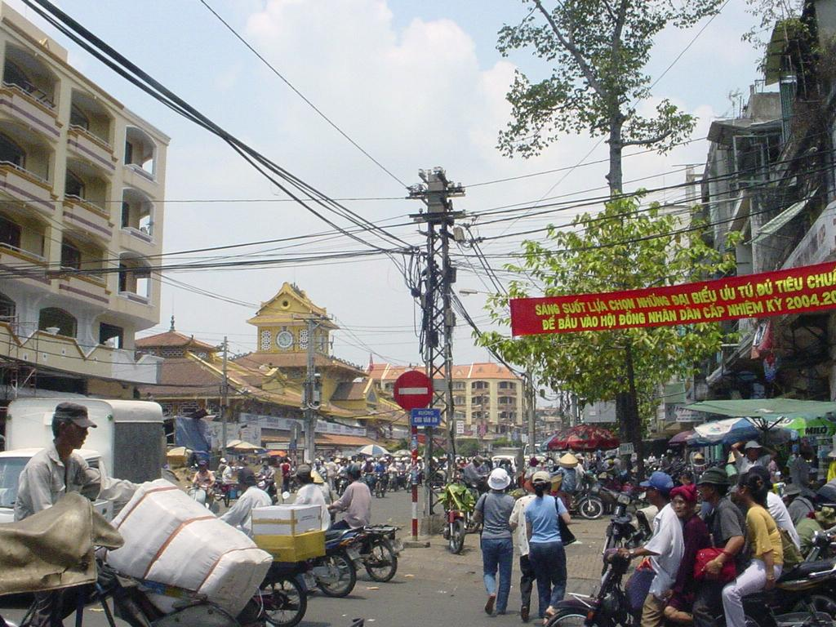


Country life:
Droughts
weather
hard work
no vacation
insects destroy
Move to live in the city
City life
good job
get more money
Better facilities

Slide 11
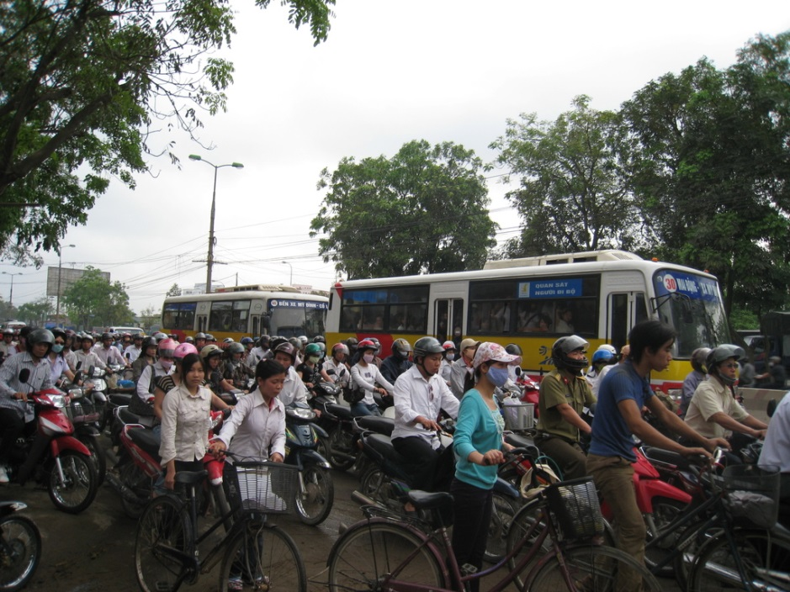
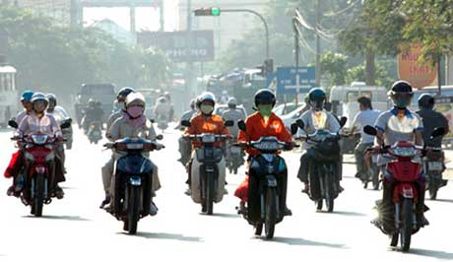
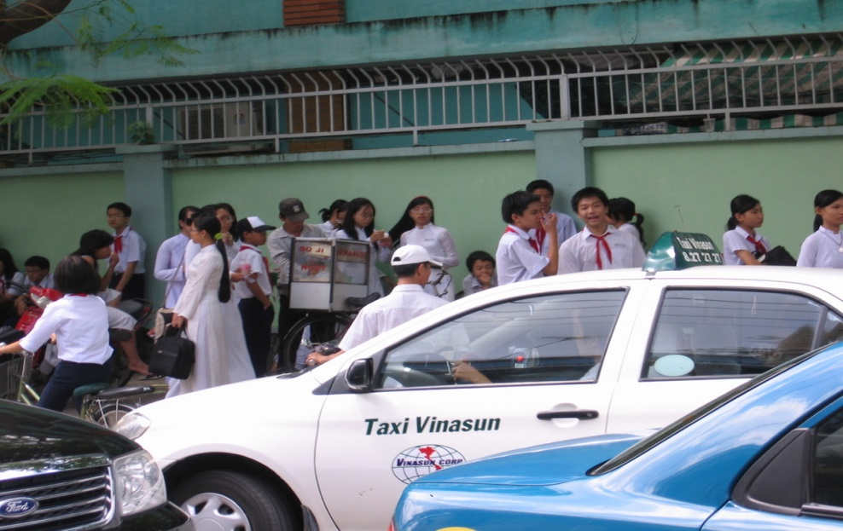
overcrowded
Population increase
Strains on social services

Slide 12
READ
Many people from rural area are leaving behind their traditional way of life and moving to the city. They believe that well-paying jobs are plentiful in the city.
At home on the farm, life is always a struggle with nature. Typhoons, floods, or droughts can easily destroy a harvest and leave the farmer with little or no money until the following year. Often farmers look for other work when they need more money for their family.
The increase in population, however, has led to overcrowding in many cities. This puts a strain on schools and hospitals, as well as water and electricity supplies. Increased pollution is another unpleasant result.
There is also a human side to this tragedy. Families sometimes have to live apart. In these cases, children may live at home with relatives, while their parents go and live in an urban area.
Governments all over the world are trying to provide facilities for these migrants, but it can be quite a problem.

Slide 13
1. Complete the summary. Use information from the passage.
People from the countryside are (1) ________their (2) ________ to go and live in the (3)_____. Farming can sometimes be a difficult life and these people from (4) ______areas feel the (5) ___offers more opportunities. However, many people coming to the city create(6) _______. There may not be enough(7) _______or(8) ________, while water and electricity supplies may not be adequate. This is a(9) ________facing governments around the(10) _________
leaving
home
city
rural
city
problem
school
hospital
problem
world

Slide 14
UNIT 8: COUNTRY LIFE AND CITY LIFE
Period 46: READ
I. Vocabulary:
-rural (adj):
thuộc nông thôn
- urban (adj):
thuộc đô thị , thành phố
- typhoon (n):
trận bão lớn
- flood (n) :
trận lụt
- drought (n) :
nạn hạn hán
- strain (n):
sự quá tải (về dân số)
II. Brainstorming
III. Pre-questions
IV. Complete the summary
1. leaving
2. home
3. city
4. rural
5. city
6. problem
7. schools
8. hospitals
9. problem
10. world
V. Find the word in the passage that means:

Slide 15

2. Find the word in the passage that means:
rural
of the country side =
as many as needed =
become greater or large =
a great pressure =
a terrible event =
of the city or city life =
plentiful
increase
strain
tragedy
urban

Slide 16

UNIT 8: COUNTRY LIFE AND CITY LIFE
Period 46: READ
I. Vocabulary:
-rural (adj):
thuộc nông thôn
- flood (n) :
trận lụt
- urban (adj):
thuộc đô thị , thành phố
nạn hạn hán
- drought (n) :
- typhoon (n):
trận bão lớn
- strain (n):
sự quá tải (về dân số)
II. Brainstorming
III. Pre-questions
IV. Complete the summary
1. leaving
2. home
3. city
4. rural
5. city
6. problem
7. schools
8. hospitals
9. problem
10. world
V. Find the word in the passage that means:
rural
a great pressure =
a terrible event =
of the city or city life =
of the country side =
as many as needed =
become greater or large =
strain
plentiful
tragedy
increase
urban
* If you were a Minister, what would you do for farmers?

Slide 17
III. Post reading
* If you were a Minister, what would you do for farmers?
Build streets, theaters, stadium in the country
Build schools, hospitals
Build factory
Provide clean water, electricity, facilities

Slide 18
Home works
UNIT 8: COUNTRY LIFE AND CITY LIFE
Period 46: READ
I. Vocabulary:
-rural (adj):
thuộc nông thôn
- flood (n) :
trận lụt
- urban (adj):
thuộc đô thị , thành phố
nạn hạn hán
- drought (n) :
- typhoon (n):
trận bão lớn
- strain (n):
sự quá tải (về dân số)
II. Brainstorming
III. Pre-questions
IV. Complete the summary
1. leaving
2. home
3. city
4. rural
5. city
6. problem
7. schools
8. hospitals
9. problem
10. world
V. Find the word in the passage that means:
rural
a great pressure =
a terrible event =
of the city or city life =
of the country side =
as many as needed =
become greater or large =
strain
plentiful
tragedy
increase
urban
Write 5 things that the government should do for the rural areas
Prepare lesson 5 (Write)

Slide 19
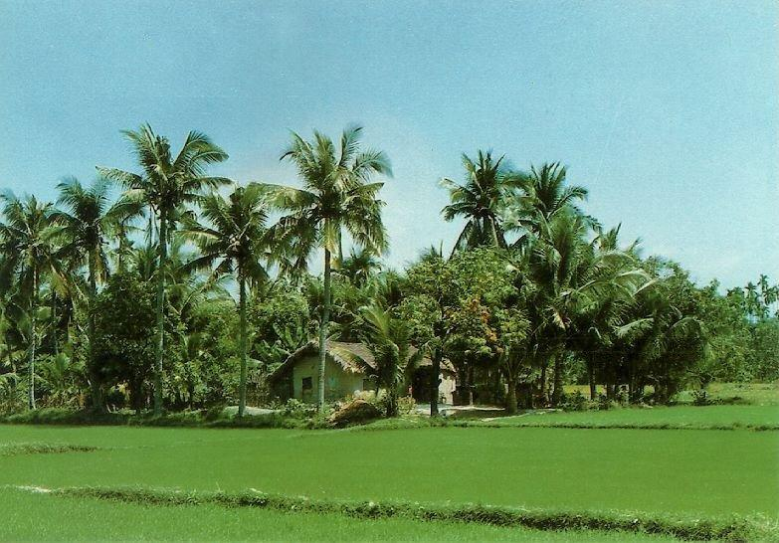
Thank you for your attendance and goodbye!

