Slide 1
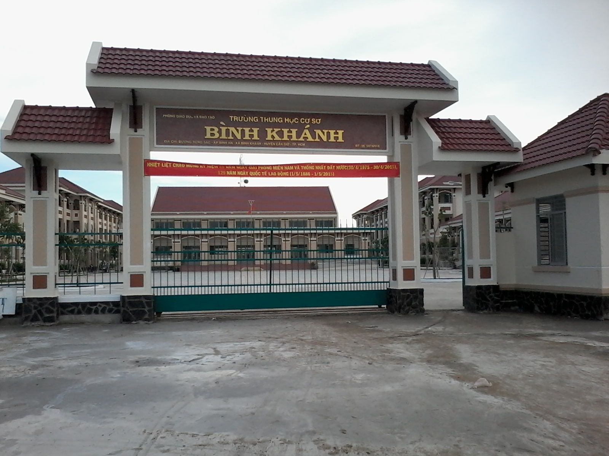



BINH KHANH SECONDARY SCHOOL
ENGLISH 8

Slide 2
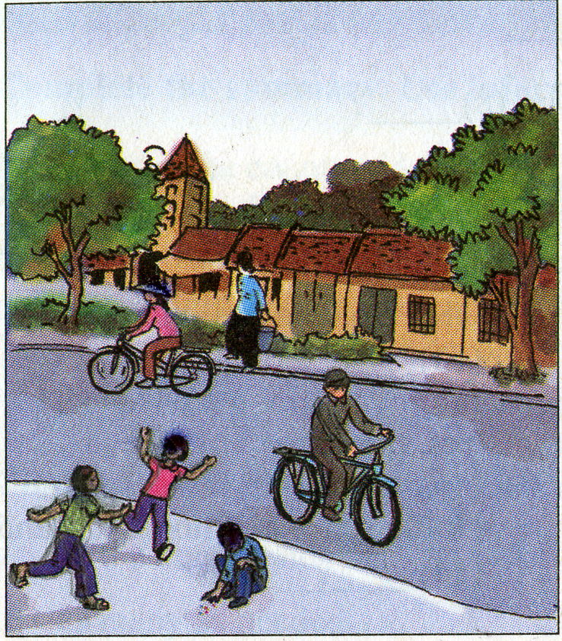
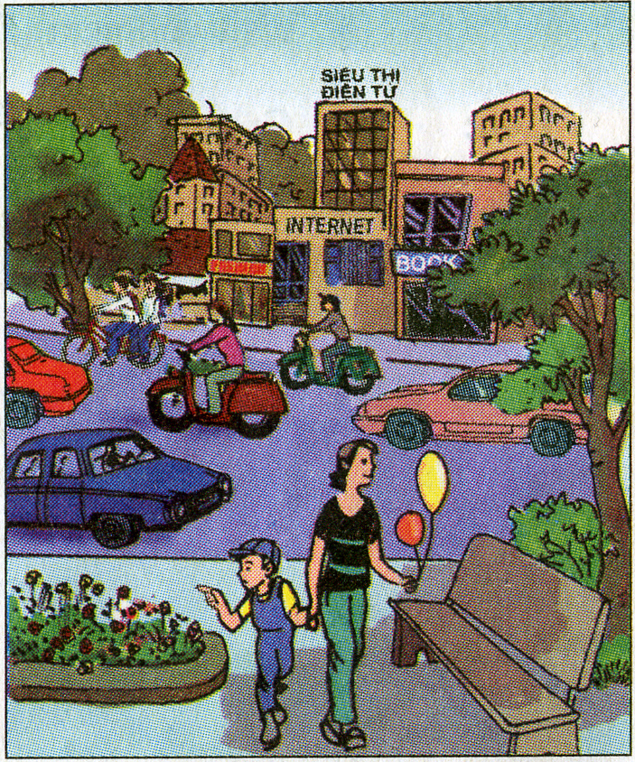
Unit 8: COUNTRY LIFE AND CITY LIFE
Period 49: Language focus
1. Look at the pictures ,find the differences between the two pictures
5 years ago
now
Simple town
Busy, beautiful town
Small houses
High buildings
Bicycles
Motorbikes, cars, taxis
Narrow roads
beautiful and wide roads

Slide 3
Unit 8: COUNTRY LIFE AND CITY LIFE
Period 49: Language focus
1. Look at the pictures ,find the differences between the two pictures
2. Talk about the changes of the town.

Slide 4
2.Talk about the changes of the town.
5 years ago
now
a.Example:
The town is becoming busier.
The town is getting more beautiful.
* say the changes , we use the present progressive tense with become/ get + adj ( comparative)
* Form: {
S
+ is/ am/ are
+ getting/ becoming
+ ADJ(comparative)}
b. Practice speaking about the changes of the town with the word prompts.
Busy tall beautiful modern noisy dirty expensive

Slide 5

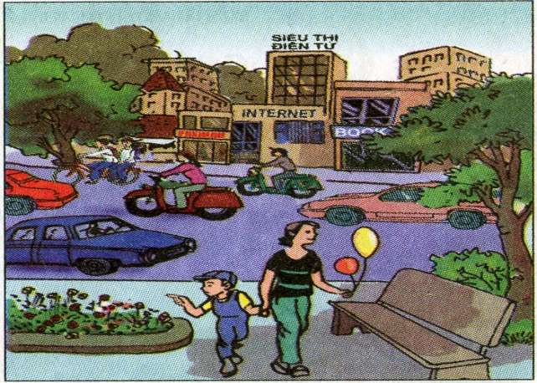
2.Talk about the changes of the town.
a.Example:
The town is becoming busier.
The town is getting more beautiful.
* say the changes of the town , we use the present progressive tense with . " become / get + adj ( comparative)
* Form: { S + is/ am/ are + getting/ becoming + ADJ(comparative)}
b. Practice speaking about the changes of the town with the word prompts.
Busy tall beautiful modern noisy dirty expensive
+ Possiple answer
- Vehicles are getting more modern
- The houses are becoming taller and more modern
- Urban views are becoming more beautiful
- The traffice is getting busier
- The price is getting more expensive
- The roads are becoming wider and more beautiful
- The air is becoming dirtier

Slide 6
Unit 8: COUNTRY LIFE AND CITY LIFE
Period 49: Language focus
1. Look at the pictures ,find the differences between the two pictures
2. Talk about the changes of the town.
a.Example:
The town is becoming busier.
The town is getting more beautiful.
* say the changes of the town , we use the present progressive tense with . " become / get + adj ( comparative)
* Form: { S + is/ am/ are + getting/ becoming + ADJ(comparative)}
b. Practice speaking about the changes of the town with the word prompts.
+ Possiple answer
- Vehicles are getting more modern
- The houses are becoming taller and more modern
- Urban views are becoming more beautiful
- The traffice is getting busier
- The price is getting more expensive
- The roads are becoming wider and more beautiful
- The air is becoming dirtier
3. Talk about changes in your hometown (work in groups of 6)
4. Do language focus 3 ( page 78)
Complete the sentenecs. Use the verbs and adjectives in the boxes

Slide 7
+ Complete the sentenecs. Use the verbs and adjectives in the boxes
Better
Clean
Cold
Dark
Tall
weak
get
become
get
become
more expensive
are getting/ becoming taller
a. The boys …………………………………………………...............
is getting/ becoming weaker
b. The old men ………………………………………………………..
c. We should go home. It …………………………………………….
is getting/ becoming darker
d. The weather …………………………………………………………
is getting/ becoming colder
are getting/ becoming better
e. The students ………………………………………………………..
is getting/ becoming cleaner
f. The school yard ……………………………………………………………

Slide 8
Unit 8: COUNTRY LIFE AND CITY LIFE
Period 49: Language focus
1. Look at the pictures ,find the different of 2 pictures
2. Talk about the changes of the town.
a. EX: The town is becoming busier.
* say the changes of the town , we use the present progressive tense with . " become / get + adj ( comparative)
*Thank you. Good bye*
* Form: { S + is/ am/ are + getting/ becoming + ADJ(comparative)}
b. Practice speaking about the changes of the town with the word prompts.
+ Possiple answer
- Vehicles are getting more modern
- Urban views are becoming more beautiful
- The houses are becoming taller and more modern
- The traffice is getting busier
- Urban views are becoming more beautiful
- The roads are becoming wider and more beautiful
- The air is becoming dirtier
3. Talk about changes in your hometown (work in groups of 6)
4. Complete the sentenecs. Use the verbs and adjectives in the boxes
- The boys are getting taller
- The old man is becoming weaker
+ At home:
- Practice speaking about changes
in your hometown. Then write it up
- Prepare for: language focus 4,5
- We should go home.It is becoming darker
- The weather is becoming colder
- The students are getting better
- The school yard is getting cleaner

