Slide 1



Slide 2




NEW WORDS
LESSON 7
LISTENING

Slide 3
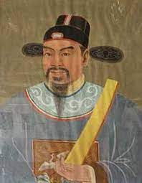
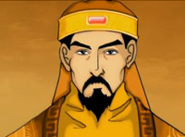
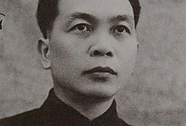
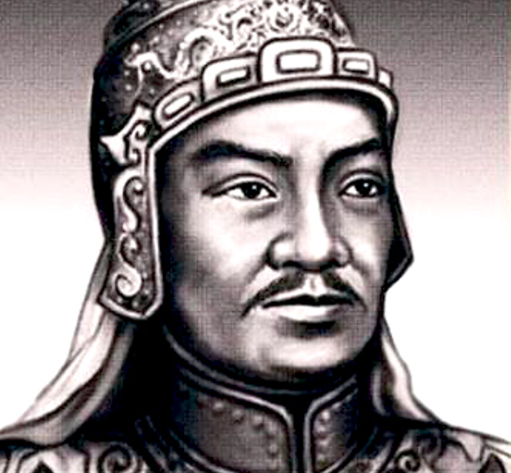
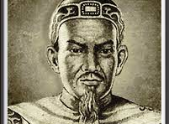
A
B
WARM-UP
1. Do you know the names of the greatest generals of Vietnam?
2. Match the names with the pictures.
Ngô Quyền
D
Lý Thường Kiệt
Võ Nguyên Giáp
Quang Trung
Ngô Quyền
Lý Thường Kiệt
Trần Hưng Đạo
C
Võ Nguyên Giáp
E
Quang Trung
Trần Hưng Đạo

Slide 4
VOCABULARY

Slide 5



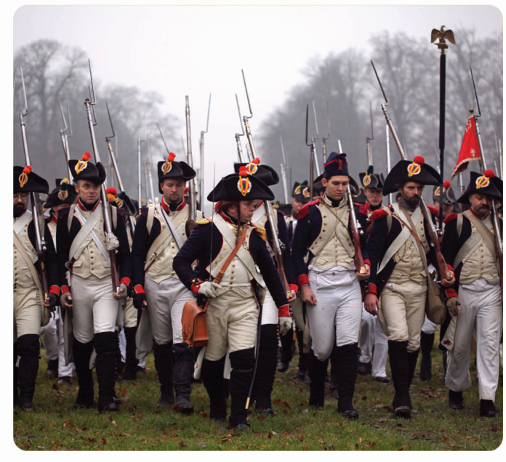
(n) army
/ˈɑːmi/
Ms Phương
Zalo: 0966765064
quân đội
My uncle worked in the army 30 years ago.
Bác mình đã làm việc trong quân đội 30 năm trước.

Slide 6
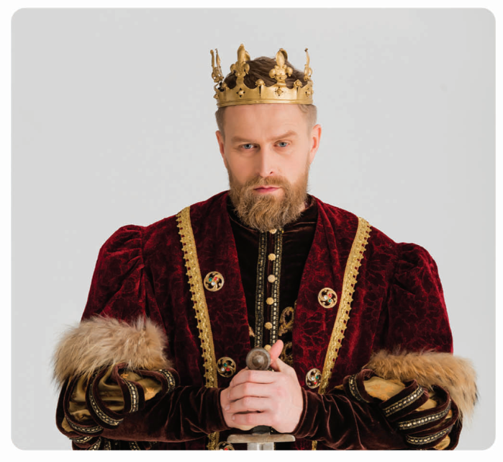
(n) king
/kɪŋ/
Ms Phương
Zalo: 0966765064
nhà vua
Hung King was the first king of Vietnam.
Vua Hùng là vị vua đầu tiên của Việt Nam.

Slide 7
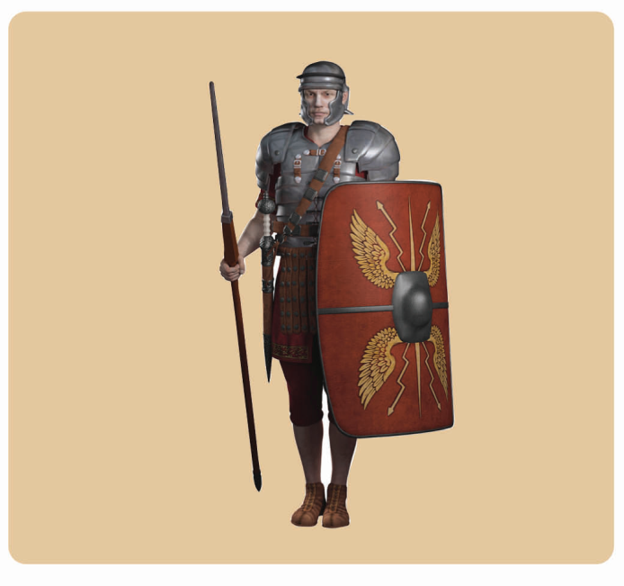
(n) soldier
/ˈsəʊldʒə(r)/
Ms Phương
Zalo: 0966765064
người lính
A lot of soldiers died in the battle.
Rất nhiều người lính đã hy sinh trong trận đấu này.

Slide 8
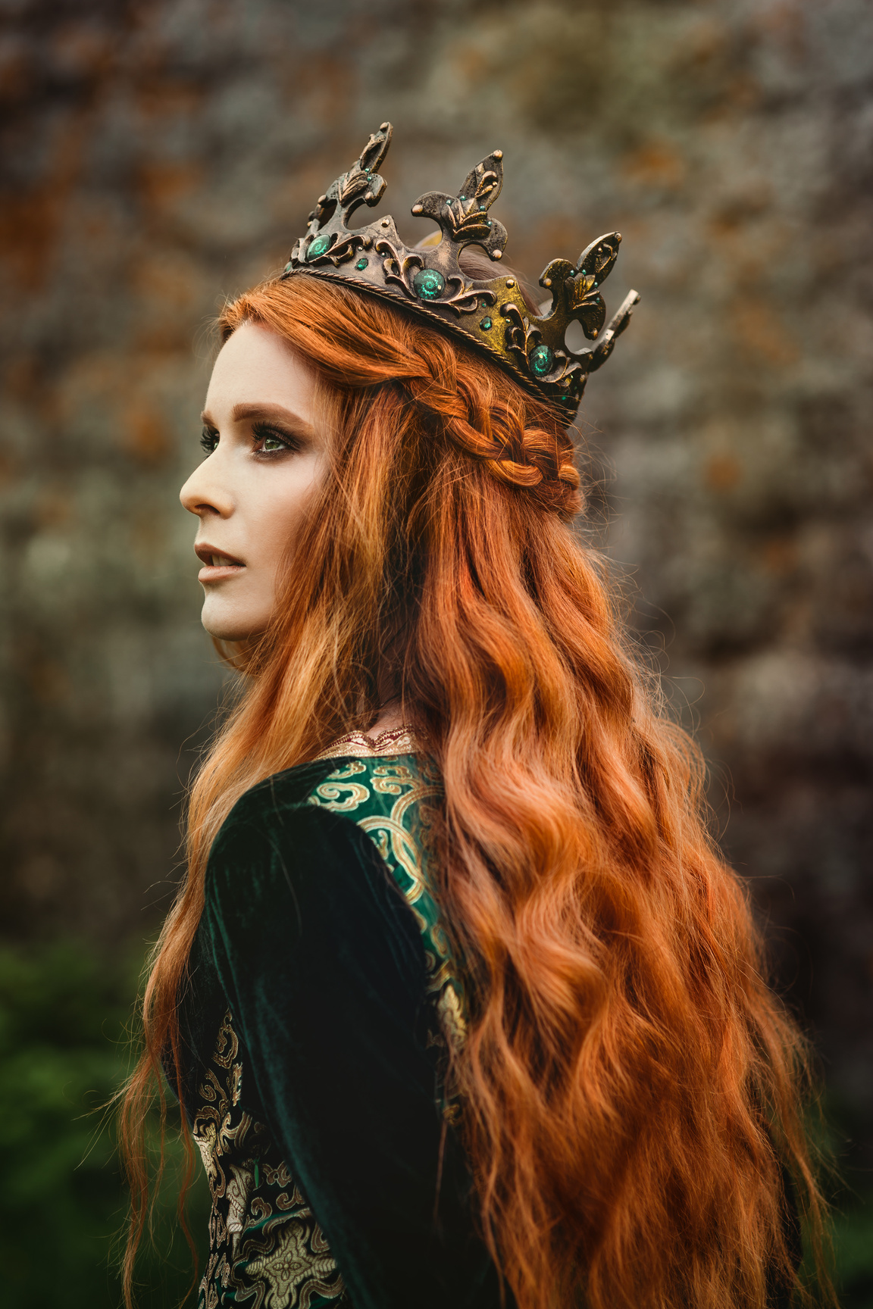
(n) queen
/kwiːn/
Ms Phương
Zalo: 0966765064
hoàng hậu
That queen was so beautiful.
Vị hoàng hậu đó rất đẹp.

Slide 9
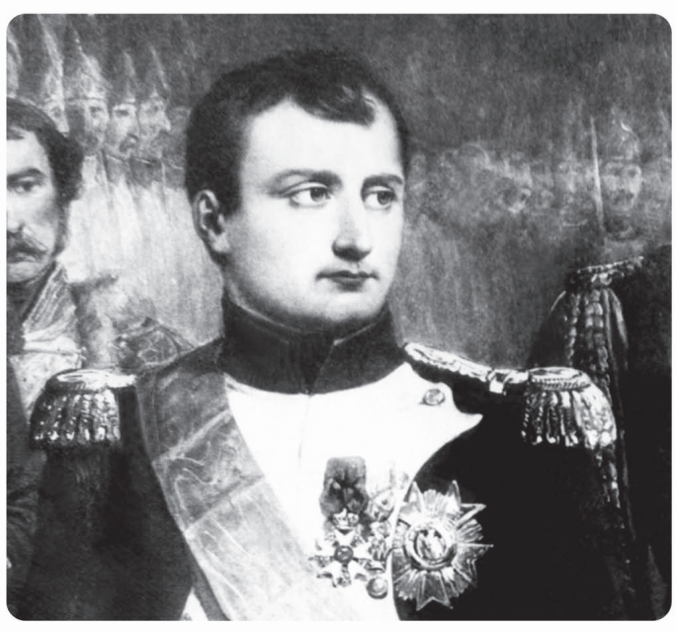
(n) general
/ˈdʒenrəl/
Ms Phương
Zalo: 0966765064
vị tướng
Vietnamese people really admire general Vo Nguyen Giap.
Người Việt Nam rất ngưỡng mộ đại tướng Võ Nguyên Giáp.

Slide 10
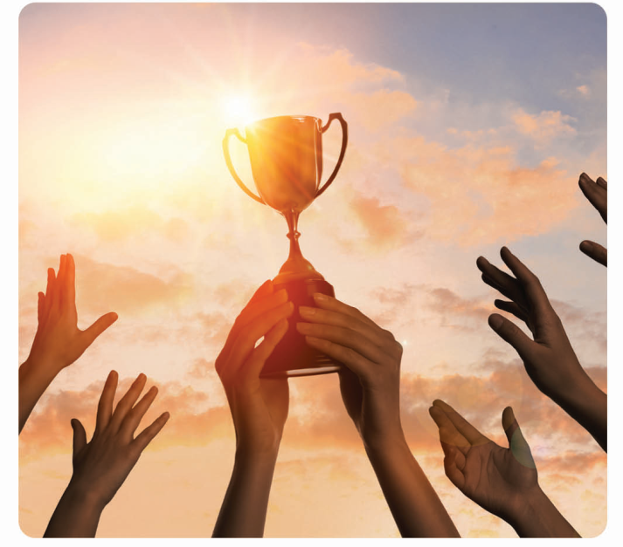
(v) win
/wɪn/
Ms Phương
Zalo: 0966765064
chiến thắng
My team won competition yesterday.
Đội của tôi đã thắng trong cuộc thi đấu ngày hôm qua.

Slide 11
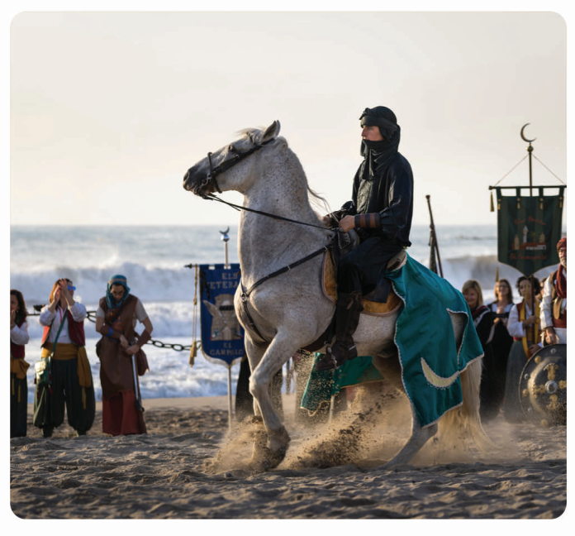
(n) invader
/ɪnˈveɪdə(r)/
Ms Phương
Zalo: 0966765064
kẻ thù
The invader was very powerful.
Kẻ thù này rất hung mạnh.

Slide 12
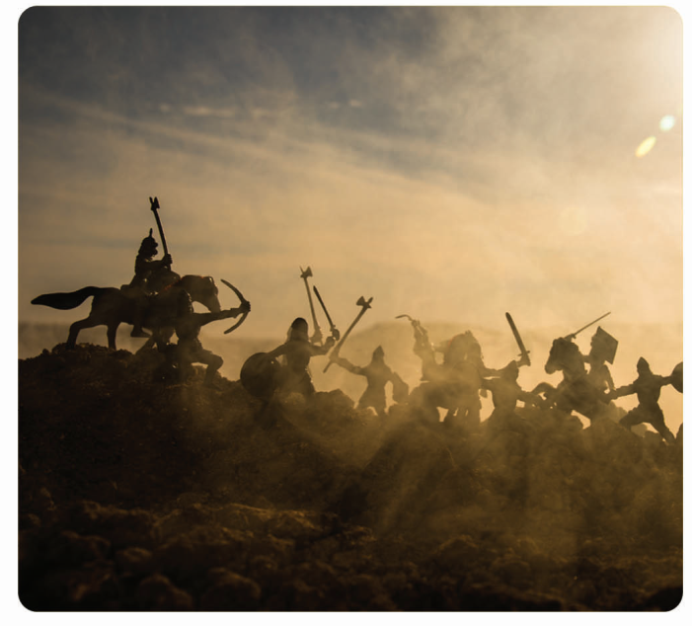
(n) battle
/ˈbætl/
Ms Phương
Zalo: 0966765064
trận đấu
Our country won in the battle.
Đất nước chúng tôi đã thắng trong trận đấu đó.

Slide 13
king
Ms Phương
Zalo: 0966765064
SHOW

Slide 14
battle
Ms Phương
Zalo: 0966765064
SHOW

Slide 15
invader
Ms Phương
Zalo: 0966765064
SHOW

Slide 16
queen
Ms Phương
Zalo: 0966765064
SHOW

Slide 17
win
Ms Phương
Zalo: 0966765064
SHOW

Slide 18
general
Ms Phương
Zalo: 0966765064
SHOW

Slide 19
soldier
Ms Phương
Zalo: 0966765064
SHOW

Slide 20

army
SHOW

Slide 21

New words
a. Fill in the blanks. Listen and repeat.
army king soldier queen
Ms Phương
Zalo: 0966765064
1
2
3
4
army
king
queen
soldier
___________________
___________________
___________________
___________________

Slide 22
b. Circle the correct definitions for the underlined words. Listen and repeat.
The English and Frend armies fought the Battle of Hastings in 1066.
a fight between two soldiers B. a fight between two armies
2. Napoleon Bonaparte was a famous French general. His army won many battles.
a leader of an army B. the leader of a country
3. It’s 3-0 and there are only five minutes left. I think my team is going to win!
be in the first placec B. be in the last place.
4. Our sodiers fought very well against the invaders and saved our town.
A. an attacking army from another country B. house buiders.
Ms Phương
Zalo: 0966765064

Slide 23
Ms Phương
Zalo: 0966765064
HIDDEN PICTURE

Slide 24

Watch the trailer of a film.
1. Do you know the name of the film?
2. If you saw it, do you like it?
3. Do you think the film is boring or interesting?
Ms Phương
Zalo: 0966765064

Slide 25
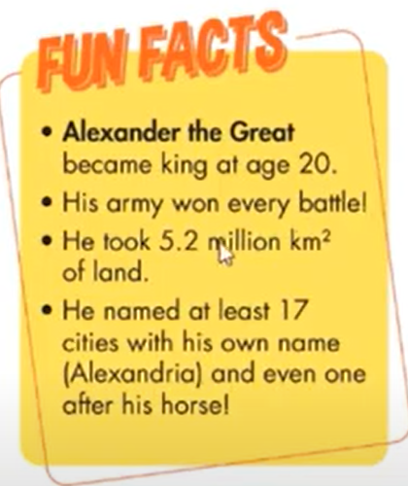
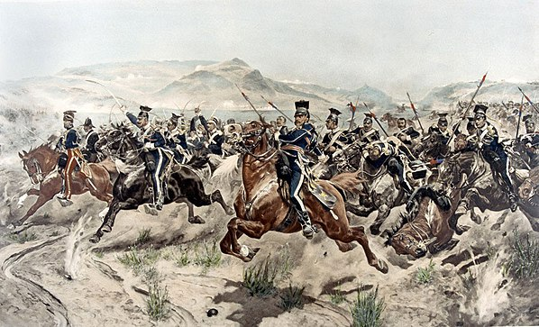


Listening
a. Listen to Jim and Lisa talking about the movie Alexander and Great. Who liked the movie?
Ms Phương
Zalo: 0966765064
b. Now,listen and tick what each person said.
 | history project | movie was boring | won many battles | great soldiers
Lisa
Jim

Slide 26
Listen again and practice with your partner.
Lisa: Hi, Jim, how are you? Jim: I'm good, thanks, Lisa. How about you? Lisa: I'm great. Hey, did you watch the movie for our history project? Jim: Yeah, I did. I thought Alexander was cool but the movie was too long. I thought it was boring. Lisa: I thought it was great. He was a great king. And, I didn't know he won so many battles. I thought it was really interesting. Jim: Yeah, Alexander was really clever. He always knew how to win. Lisa: And his soldiers were great. They were so good at fghting. Jim: Yeah, they were a big help!
Ms Phương
Zalo: 0966765064

Slide 27
Useful language
Listen then practice.
Who was Alexander the Great? He was famous Greek general
Whe was he born? He was born in 356 BC
What is he famous for? He fought many battles in Egypt, Asia and India.
Ms Phương
Zalo: 0966765064

Slide 28
Ms Phương
Zalo: 0966765064
WRAP-UP

Slide 29
Unit 7
MOVIE
Lesson 7: New words
army(n) quân đội
king (n) nhà vua
soldier (n): tồi tệ
queen (n: nữ hoàng
invader (n) : kẻ thù
win (v) : chiến thắng
battle(n): trận đấu
Ms Phương
Zalo: 0966765064

Slide 30
HOMEWORK
Learn
Learn new words by heart.
Practice
- Practice talking about famous kings, queens, and battles from your country.
Listen and fill in
- Listening: Listen and fill in the blanks. (Workbook - page 42)
Prepare
- Prepare for the next lesson: Unit 7: Lesson 3 - Reading, Speaking, Writing on page 61
Study
- Study: What do you know about the story of Quang Trung...

