Slide 1
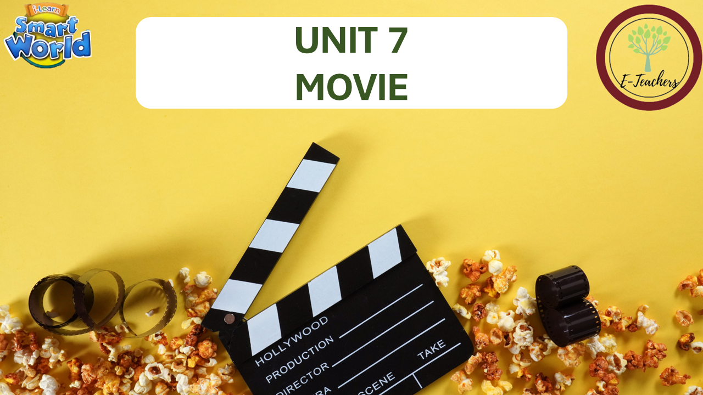


Slide 2



LESSON 9
REVIEW

Slide 3
WORD | CLASS | MEANING
Ms Phương
Zalo: 0966765064
n
kịch
drama
horror
n
phim kinh dị
action
n
phim hành động
adj
phim hoạt hình
animated
comedy
n
phim hài
science fiction
n
phim khoa học viễn tưởng
awful
adj
tệ

Slide 4
WORD | CLASS | MEANING
Ms Phương
Zalo: 0966765064
boring
adj
nhàm chán
exciting
adj
thú vị
adj
tuyêt vời
fantastic
adj
hài hước
funny
terrible
adj
kinh khủng
great
adj
tuyệt
adj
buồn
sad

Slide 5
WORD | CLASS | MEANING
Ms Phương
Zalo: 0966765064
n
quân đội
army
battle
n
trận đấu
general
n
vị tướng
king
n
nhà vua
queen
n
nữ hoàng
soldier
n
người lính
v
chiến thắng
win

Slide 6
WORD | CLASS | MEANING
Ms Phương
Zalo: 0966765064
invader
n
kẻ thù
v
attack
tấn công
v
xảy ra
happen
president
n
tổng thống, chủ tịch
n
người lãnh đạo
leader

Slide 7
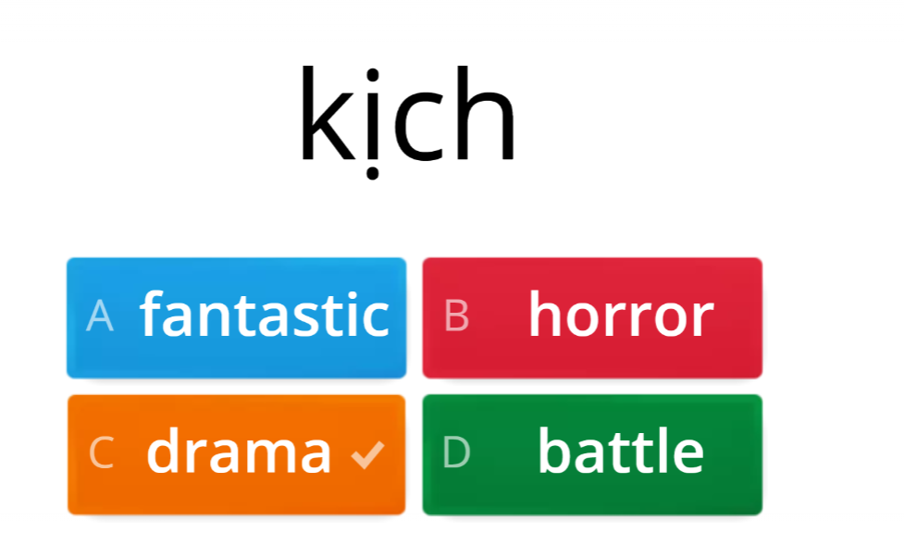

Review vocabulary Unit 7
Ms Phương
Zalo: 0966765064
https://wordwall.net/resource/23980783

Slide 8
GRAMMAR REVIEW
Prepositions of time : giới từ chỉ thời gian
In + buổi trong ngày/tháng/năm/thế kỷ/thập kỷ
On + ngày
At + giờ cụ thể
At + cụm từ ( at the moment, at present, at the same time, at lunch, at noon, at midnight, at night, at the weekend)
Ms Phương
Zalo: 0966765064

Slide 9
2. Thì quá khứ với động từ tobe “ was, were”
Ms Phương
Zalo: 0966765064
Loại câu | Câu khẳng định (+) | Câu phủ định (-) | Câu nghi vấn (?)
Cấu trúc | S + was / were + N/adj | S + was / were + not + N/adj | (Wh) was / were + S + N/adj?
Ví dụ | It was rainy yesterday. | It was not rainy yesterday. | Was it rainy yesterday?
Dấu hiệu nhận biết
Thì quá khứ đơn có những dấu hiệu nhận biết thông qua cáctrạng từ chỉ thời gian như: yesterday, last year/ month/ week … , ago, in + mốc thời gian trong quá khứ …

Slide 10


Listening
You will hear a boy giving a presentation about a movie he saw. Listen and fill in the blanks. You will hear the information tiwce.
0
______________________
My fantastic Best Friend
Ms Phương
Zalo: 0966765064
Name of movie
1
Thursday
______________________
Day he watched
Book by the author:
Birch
2
K.J_____________________
Movie was:
funny
3
very______________________
seven/7
Movie started at:
4
_____________o’clock.
What he liked the most about it:
music
5
the________________

Slide 11
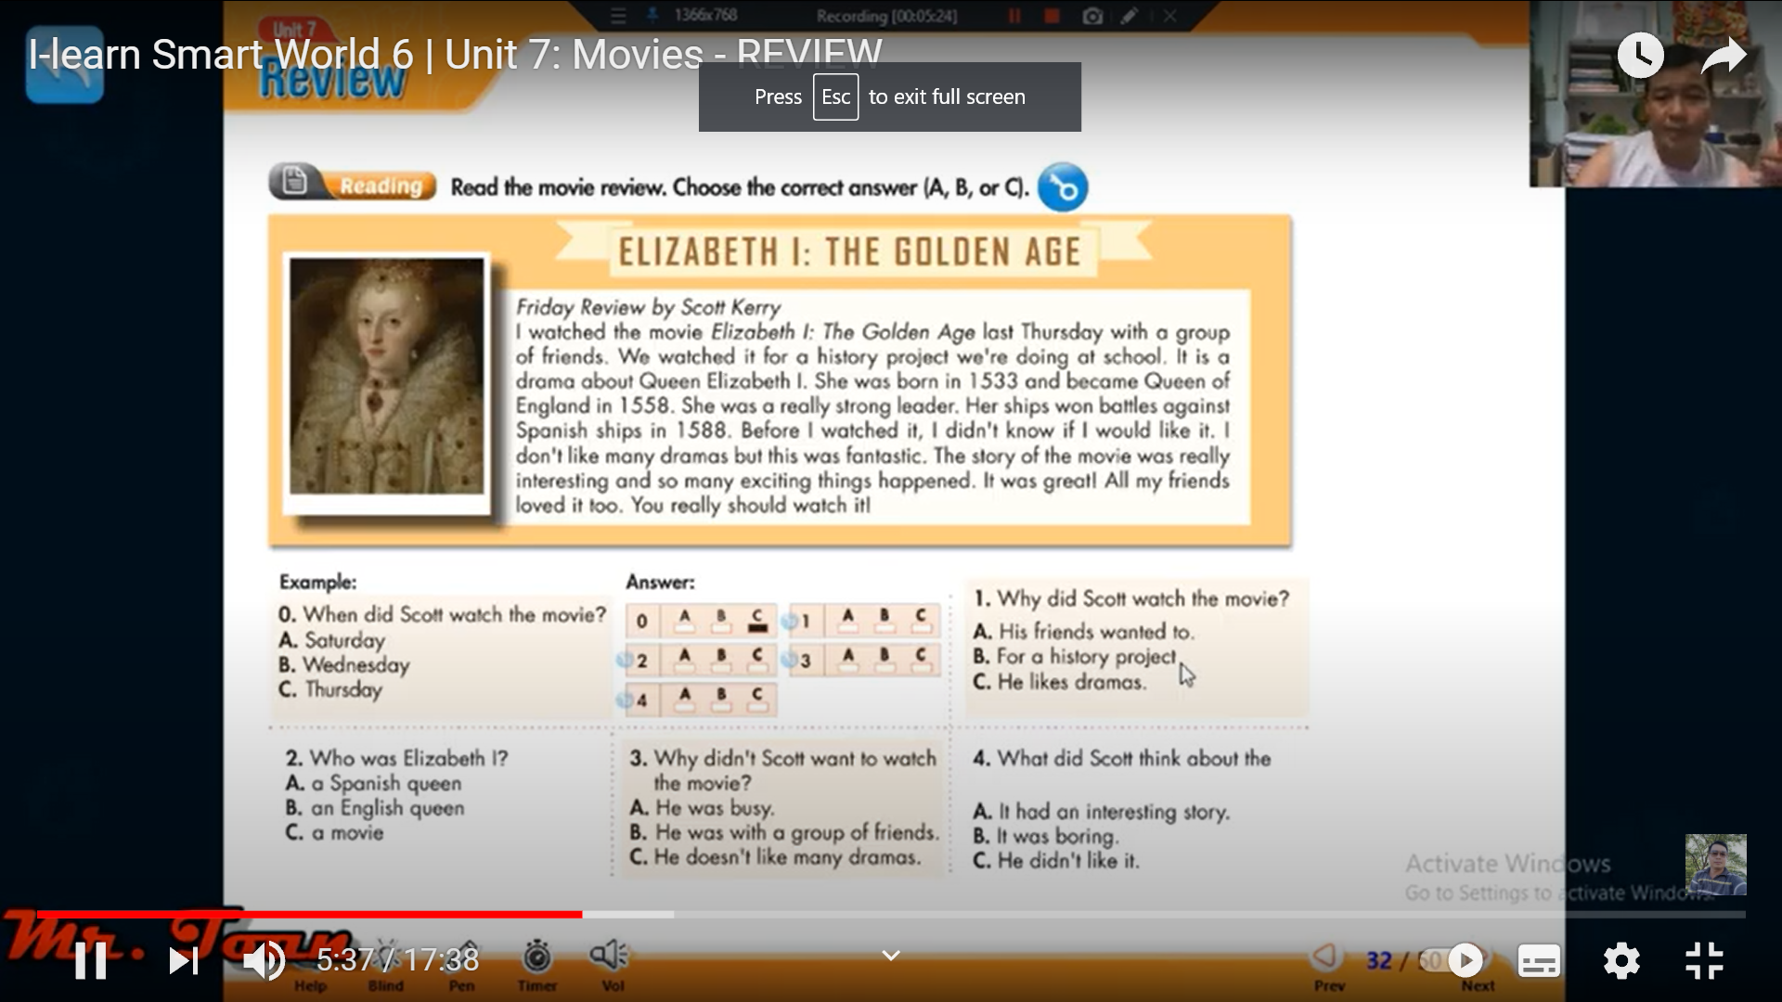
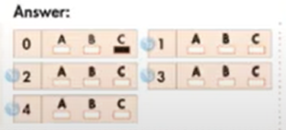
READING
Read the movie review. Choose the correct answer. ( A, B, or C)
Friday Review by Scott Kerry
I watched the movie Elizabeth I. The Golden Age last Thursday with a group of friends. We watched it for a history project we’re doing at school. It is a drama about Queen Elizabeth I. She was born in 1533 and became Queen of England in 1588. She was a really strong leader. Her ships won battles against Spanish ships in 1588. Before I watched it, I didn’t know if I would like it. I don’t like many dramas but this was fantastic. The story of the movie was really interesting and so many exciting things happened. It was great! All my friends love it too. You really should watch it.
Ms Phương
Zalo: 0966765064
Example:
0. When did Scott watch the movie?
Saturday
B. Wednesday
Thursday.

Slide 12
3. Why didin’t Scott want to watch the movie?
It had an interesting
It was boring
He didn’t like it.
1. Why did Scott watch the movie?
His friends wanted to
For a history project
He likes dramas.
Ms Phương
Zalo: 0966765064
2. Who was Elizabeth?
an Spanish queen
a English queen
a movie
4. What did Scott think about the movie?
It had an interesting story.
It was boring
He didn’t like it.

Slide 13
Vocabulary
Match the words with the decription.
horror general science fiction
sad soldiers exciting comedy
Ms Phương
Zalo: 0966765064
horror
This kind of movie is very scary.
When you watch this kind of movie, you will laugh a lot.
This a movie about life in the future.
When people feel like this, they may cry.
This word means very, very interesting.
An army is a large group of these people
This person is the leader of an army.
_______________
comeny
_______________
science fiction
_______________
sad
_______________
exciting
_______________
soldiers
_______________
general
_______________

Slide 14

Grammar
Underline the mistake in each sentence. Write the correct word on the line.
The movie is at Saturday at three o’clock.
This movie weren’t very good. In fact, it was terrible.
Quang Trung were a famous Vietnamese king.
The movie is on in the evenings. It starts in seven o’clock.
They was in the movie theater last night.
Napoleon win forty-three battles and I think he was a great general
Did you see Flying Fantastic? How wasn’t it?
on
Ms Phương
Zalo: 0966765064
_________
wasn’t
_________
was
_________
at
_________
were
_________
won
_________
was
_________

Slide 15
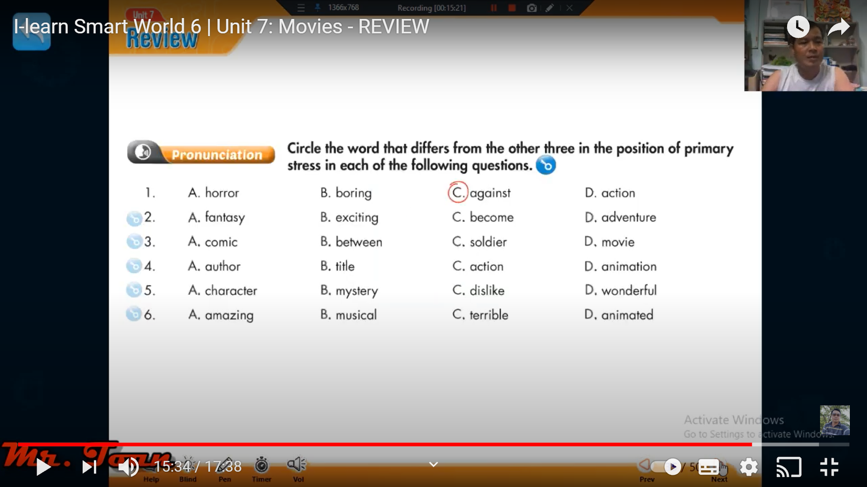
PRONUNCIATION
Ms Phương
Zalo: 0966765064

Slide 16
Ms Phương
Zalo: 0966765064
WRAP-UP

Slide 17

HOMEWORK
- Write the answers in their notebooks
- Do exercises: Reading/ writing on page 43 (workbook)
- New lesson: Unit 8: The World around Us.

