Slide 1




Welcome to our class

Slide 2

It’s a noun. You can buy it at a stationery
Notes:
2
2

Slide 3
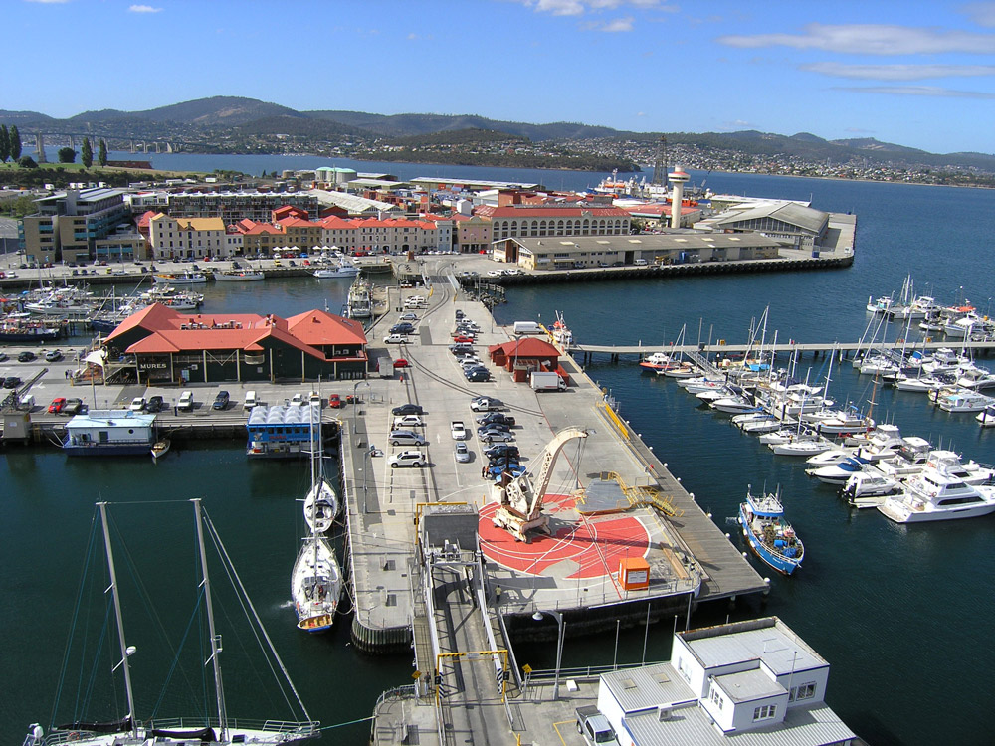
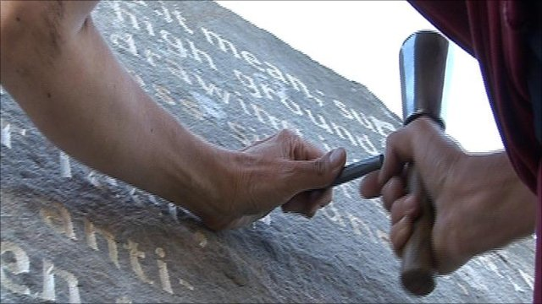
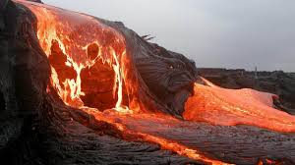
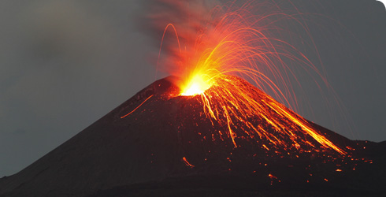
UNIT 12: A VACATION ABROAD
Lesson 4: READ (P. 116 - 117)
I. Vocabulary:
- volcano (n)
núi lửa
- pour out (v)
tuôn trào, đổ ra
- lava (n)
dung nham
- prison (n)
nhà tù
- carve (v)
chạm, khắc
- valley (n)
thung lũng
- wharf (n)
cầu cảng

Slide 4
Mrs. Quyen and her husband are traveling around America. They have just visited many famous places.

Slide 5
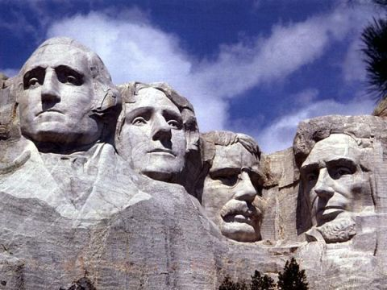
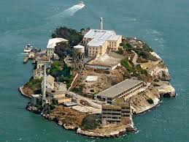
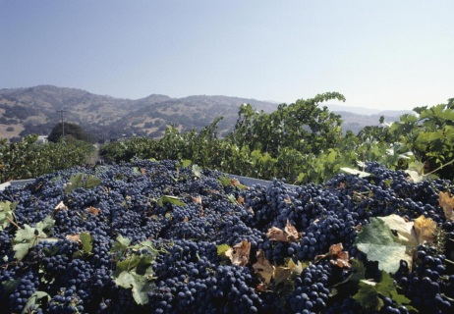
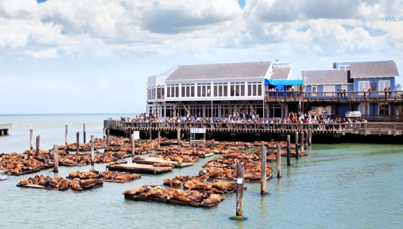
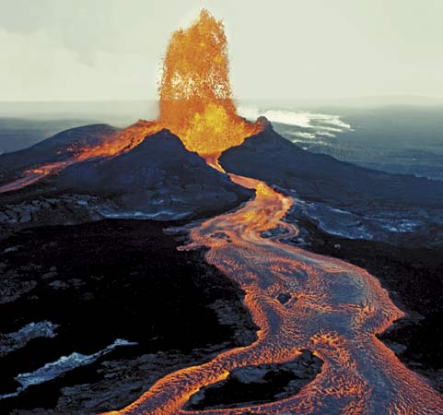
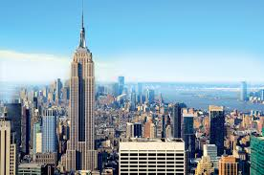
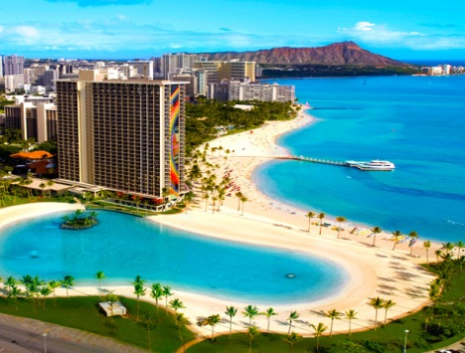
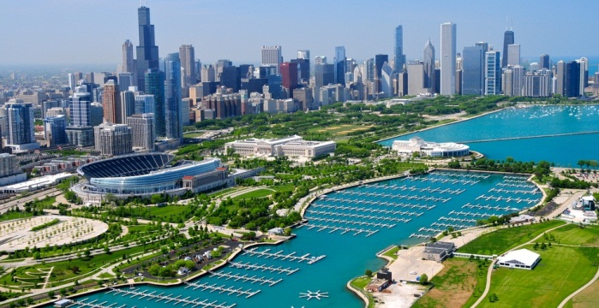
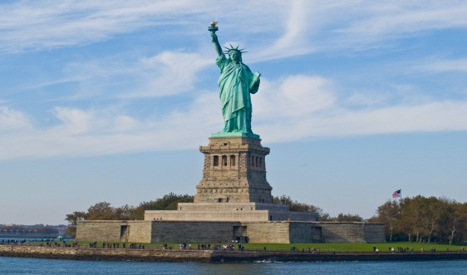
Hawaii
San Francisco
Mount Rushmore
Chicago
New York
A. Heads of 4 presidents
F. Famous prison
B. Napa Valley
G. Fisherman’s Wharf
C. Kilauea Volcano
H. Empire State Building
D. Waikiki Beach
E. Lake Michigan
I. The Statue of Liberty

Slide 6
UNIT 12: A VACATION ABROAD
Lesson 4: READ (P. 116 - 117)
I. Vocabulary:
- volcano (n)
núi lửa
- pour out (v)
tuôn trào, đổ ra
- lava (n)
dung nham
- prison (n)
nhà tù
- carve (v)
chạm, khắc
- valley (n)
thung lũng
- wharf (n)
cầu cảng
II. Read:
1. Matching:

Slide 7
Hawaii
San Francisco
Mount Rushmore
Chicago
New York
A. Heads of 4 presidents
F. Famous prison
B. Napa Valley
G. Fisherman’s Wharf
C. Kilauea Volcano
H. Empire State Building
D. Waikiki Beach
E. Lake Michigan
I. The Statue of Liberty

Slide 8
UNIT 12: A VACATION ABROAD
Lesson 4: READ (P. 116 - 117)
I. Vocabulary:
- volcano (n)
núi lửa
- pour out (v)
tuôn trào, đổ ra
- lava (n)
dung nham
- prison (n)
nhà tù
- carve (v)
chạm, khắc
- valley (n)
thung lũng
- wharf (n)
cầu cảng
II. Read:
1. Matching:
2. Writing:

Slide 9
Write what Mrs. Quyen did and saw in each of these places.
PLACE | WHAT SHE DID AND SAW
A. Hawaii
B. New York
C. Chicago
D. Mount Rushmore
E. San Francisco
Went swimming, visited Kilauea Volcano
Went shopping, bought lots of souvenirs
Saw Lake Michigan.
Saw the heads of 4 American Presidents.
Visited Fisherman's Wharf, the Napa Valley and Alcatraz prison.

Slide 10
UNIT 12: A VACATION ABROAD
Lesson 4: READ (P. 116 - 117)
I. Vocabulary:
- volcano (n)
núi lửa
- pour out (v)
tuôn trào, đổ ra
- lava (n)
dung nham
- prison (n)
nhà tù
- carve (v)
chạm, khắc
- valley (n)
thung lũng
- wharf (n)
cầu cảng
II. Read:
1. Matching:
2. Writing:
3. Answer the questions:

Slide 11
ANSWER THE QUESTIONS
a) How did Mrs. Quyen go to Kilauea Volcano?
b) Where in San Francisco did Mrs. Quyen see the famous prison?
c) What is special about Mount Rushmore?
d) What is the other name of Chicago?
e) What did Mrs. Quyen do while her husband was visiting the Statue of Liberty?

Slide 12




Lucky or Unlucky number
7
1
6
2
8
5
3
4

Slide 13
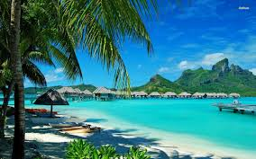
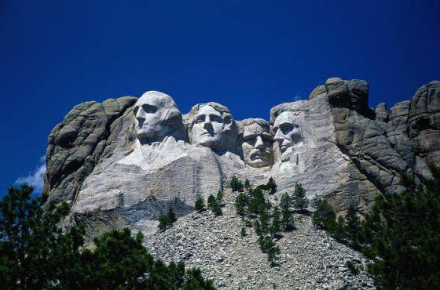
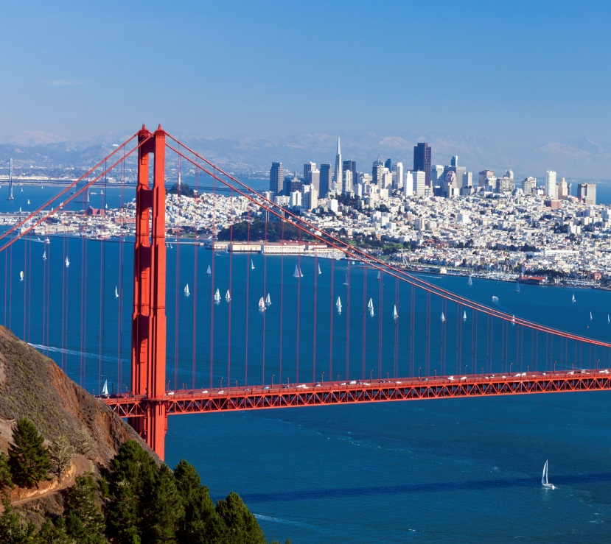
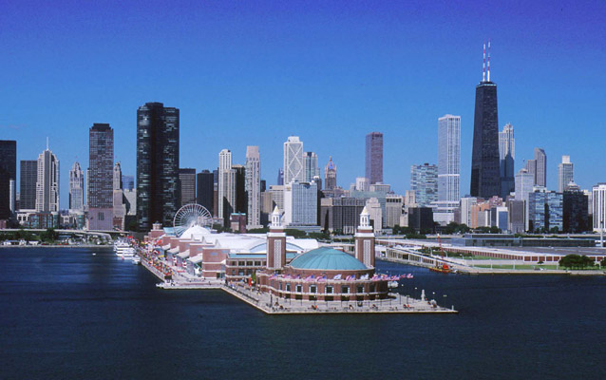
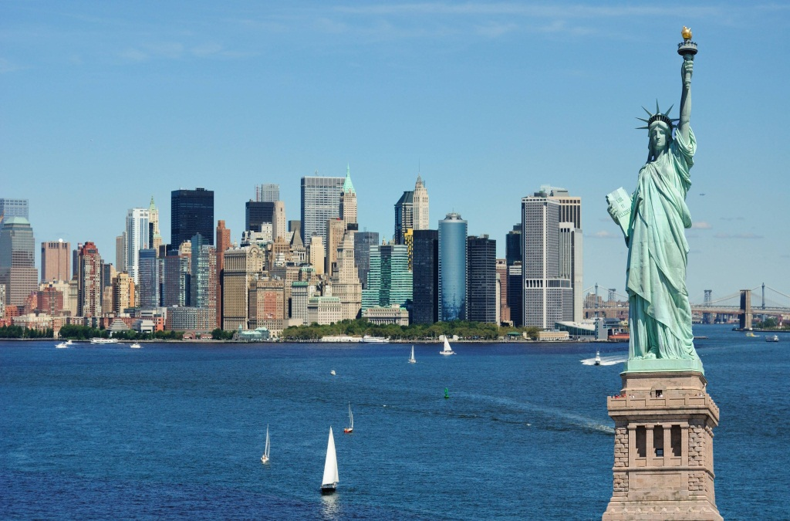

Slide 14

HOMEWORK
1. Learn by heart the vocabulary.
2. Rewrite the answers in the notebook.
3. Retell the text.
4. Prepare well for Part Write

Slide 15

Goodbye
THANK YOU FOR YOUR ATTENTION!

Slide 16


b) Where in San Francisco did Mrs.Quyen see the famous prison?
She saw the famous prison on the island of Alcatraz.

Slide 17

UNLUCKY!
- £1000

Slide 18


LUCKY!
You win £1000
Notes:
18

Slide 19
a) How did Mrs.Quyen go to Kilauea Volcano?
She went there by plane

Slide 20
UNLUCKY!
Terrible sorry!
Your Money is 000000

Slide 21
e) What did Mrs.Quyen do while her husband was visiting the Statue of Liberty?
She went shopping.
Notes:
21

Slide 22
c) What is special about Mount Rushmore?
It is a mount where the heads of 4 American Presidents are carved into the rock.

Slide 23
d) What is the other name of Chicago?
It is called “The Windy City”.

Slide 24
WHAT AND WHERE?
WHARF
POUR OUT
VALLEY
VOLCANO
CARVE
LAVA
PRISON
Notes:
24
24

