Slide 1
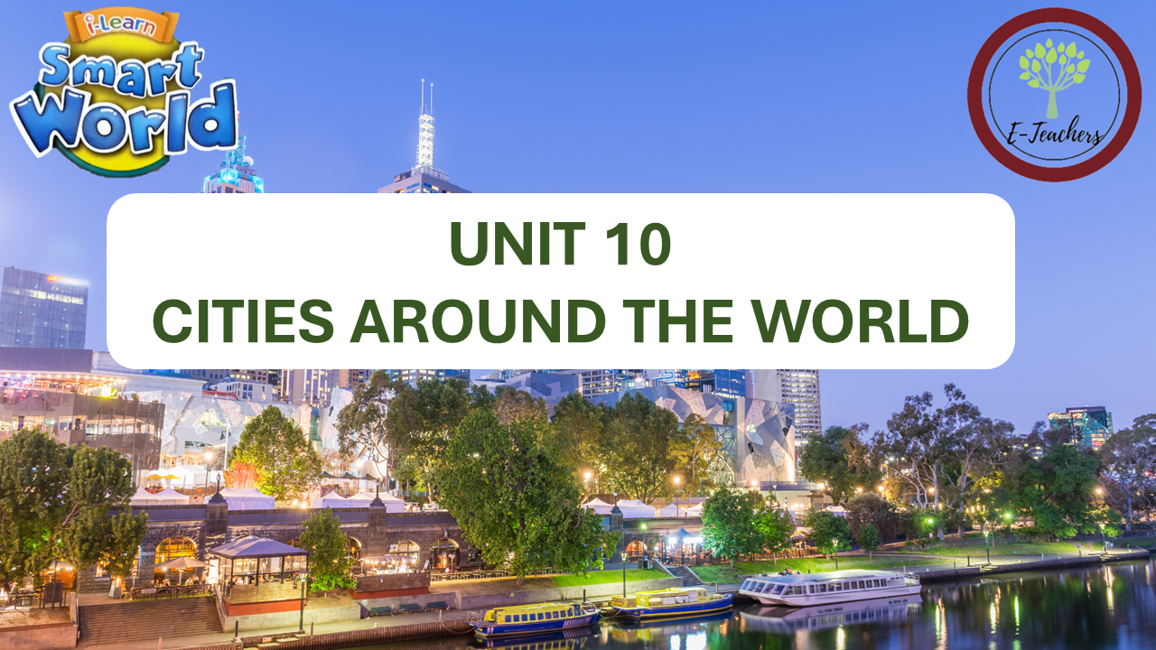

Slide 2




NEW WORDS
LESSON 1
LISTENING

Slide 3
WARM UP

Slide 4
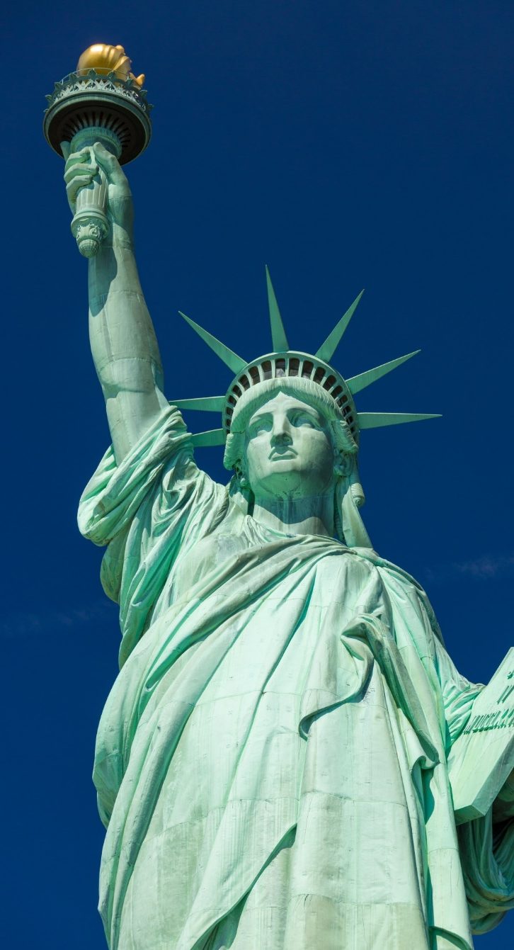
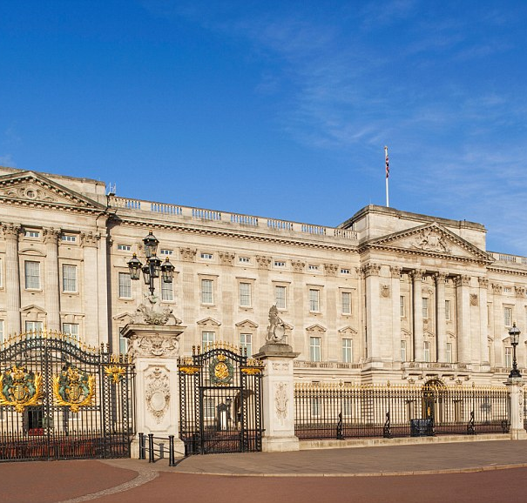
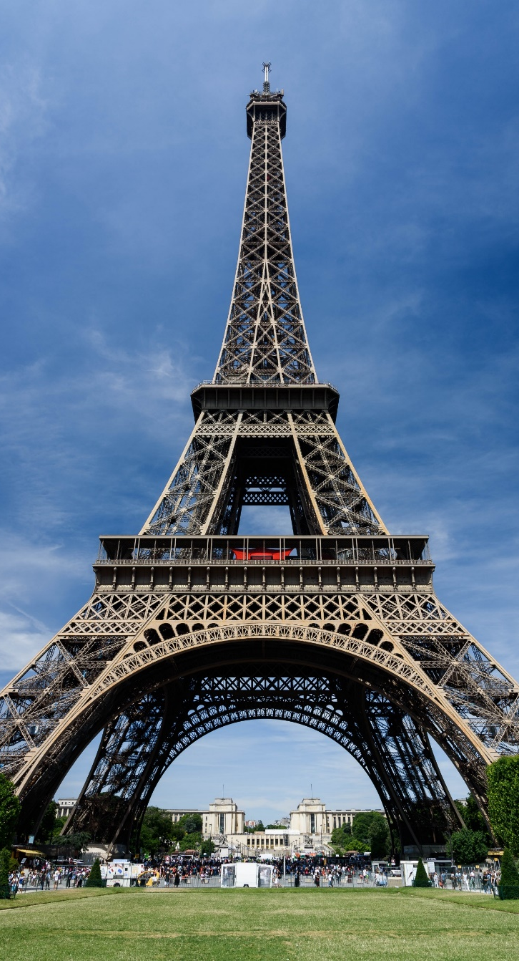
Do you know the name of the places?

Slide 5
VOCABULARY

Slide 6

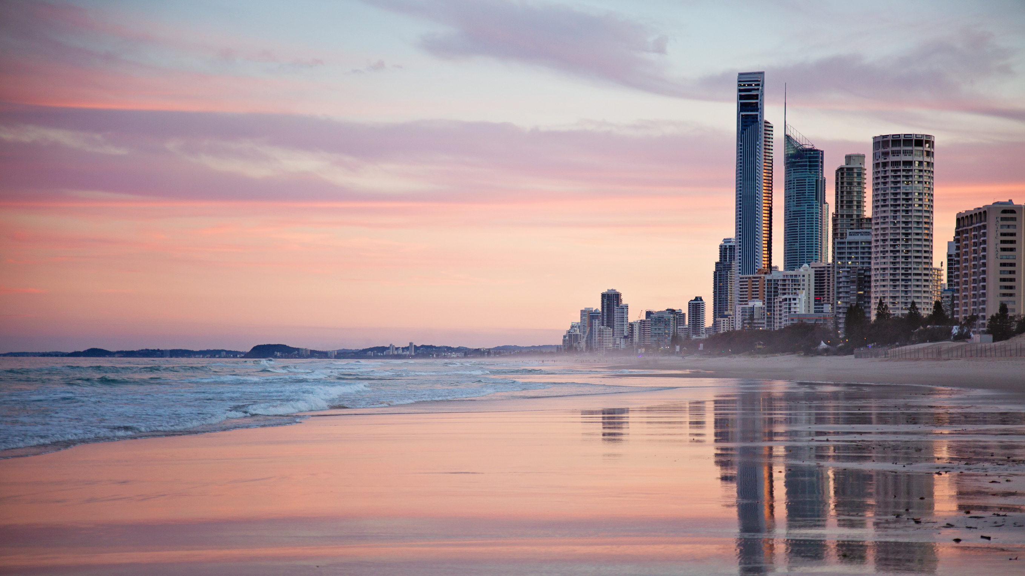

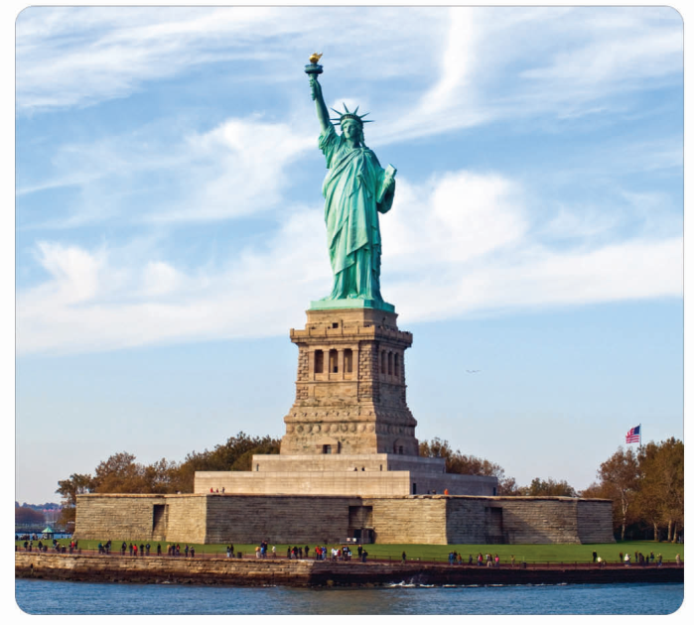

statue
/ˈstætʃuː/
(n) tượng đài
This statue is made of bronze.

Slide 7
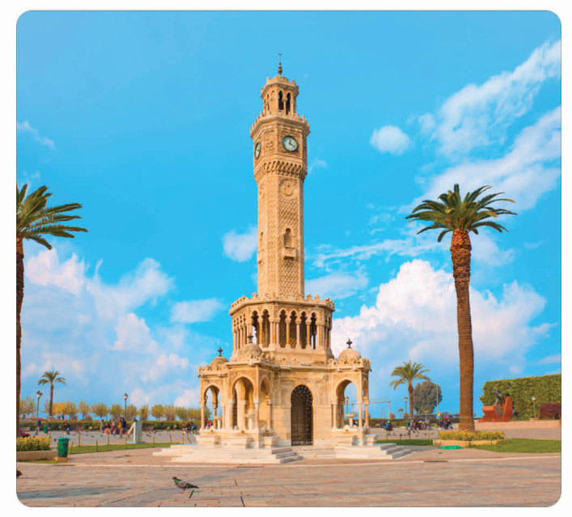
tower
/ˈtaʊə(r)/
(n) tòa tháp
How tall is that tower?

Slide 8
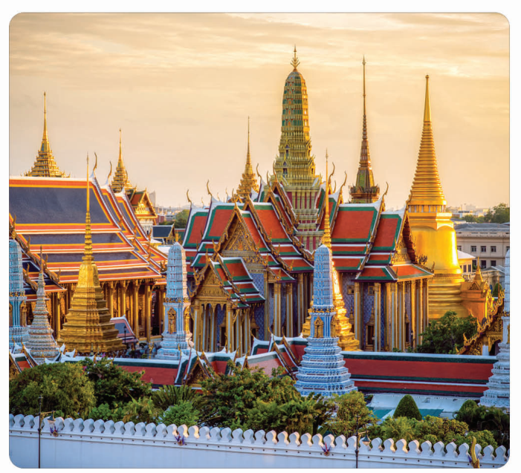
palace
/ˈpæləs/
(n) cung điện
The palace was heavily guarded.

Slide 9
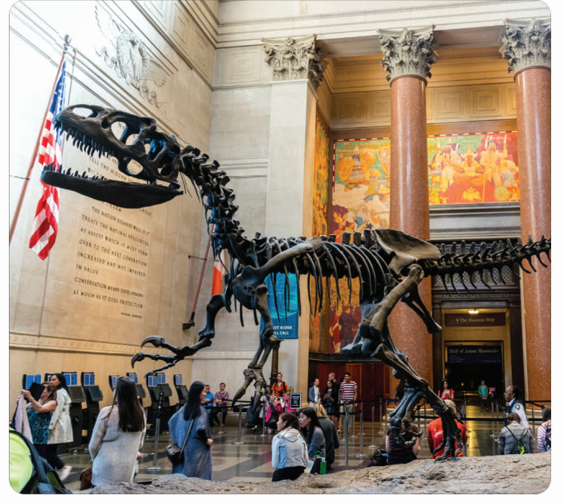
museum
/mjuˈziːəm/
(n) viện bảo tàng
The museum has some interesting new exhibits from India.

Slide 10
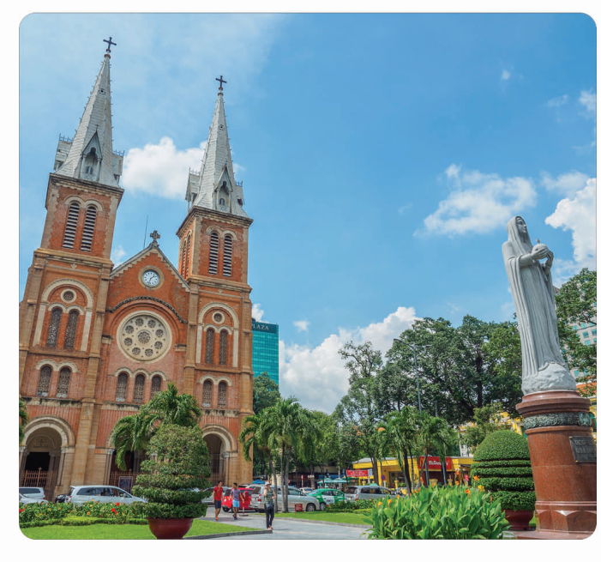
cathedral
/kəˈθiːdrəl/
(n) nhà thờ
This soldier was looking at the cathedral and crossing himself.

Slide 11
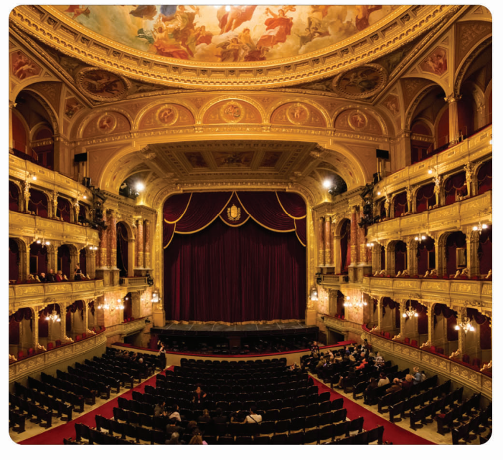
opera house
/ˈɒprə haʊs/
(n) nhà hát
He gave a concert at the opera house.

Slide 12
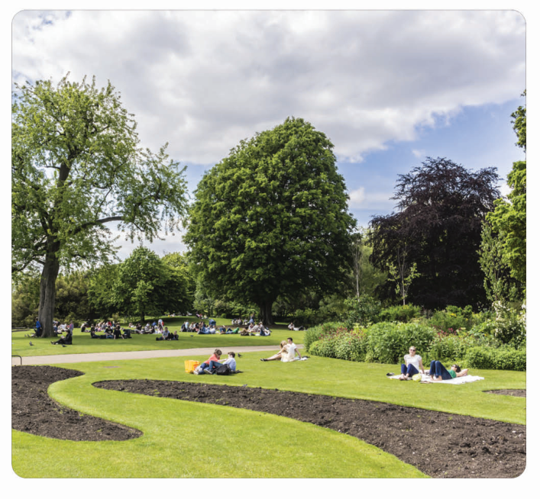
park
/pɑːk/
(n) công viên
There are many people in the park.

Slide 13
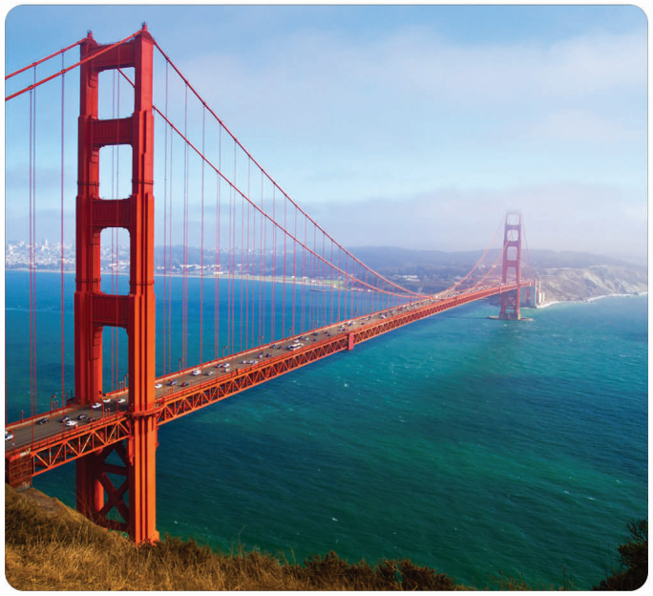
bridge
/brɪdʒ/
(n) cây cầu
They have built a new bridge in this city.

Slide 14
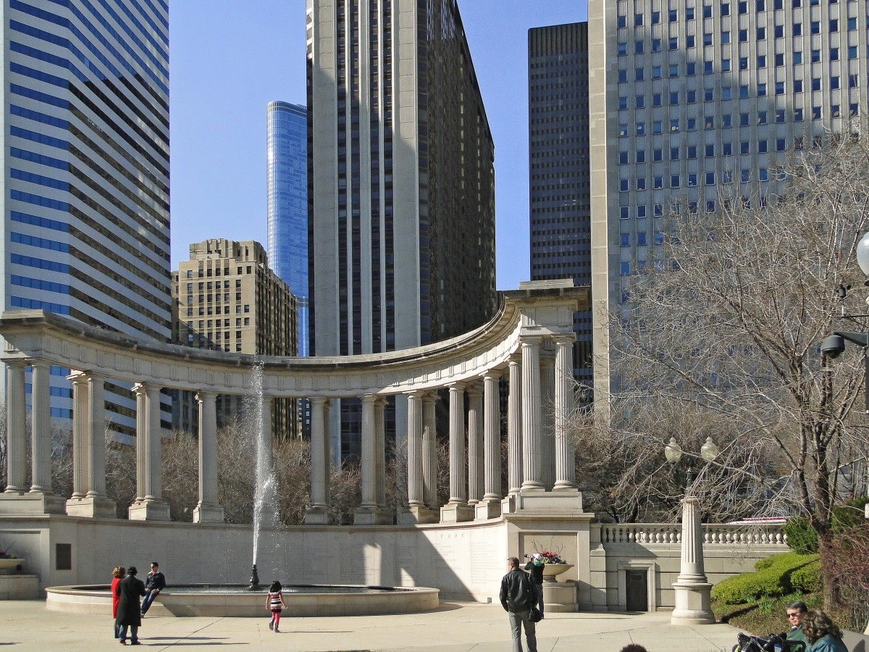
square
/skweə(r)/
(n) quảng trường
The square was covered with flags and flowers.

Slide 15

1
2
3
4
statue
cathedral
square
tower
Close your eyes and guess what is the missing word?
5
6
7
8
9
museum
park
palace
opera house
bridge

Slide 16
New words
a. Write the letters in the boxes. Listen and repeat.
A
C
B
1.
A
statue
2.
D
museum
C
palace
3.
D
F
4.
B
tower
E
5.
F
opera house
6.
E
cathedral
G
H
7.
H
bridge
8.
G
park

Slide 17
b. Think of three famous landmarks in your country. Tell your partner about them.
There’s a famous palace called Reunification Palace in Ho Chi Minh City.
three famous landmarks

Slide 18
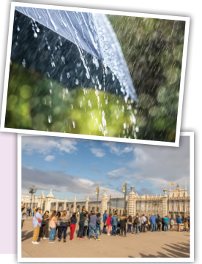
Listening
Listen to Kathryn and Tom talking about a vacation. Are they both going on vacation? Yes/No
Now, listen and answer the questions.
When is the palace busy? _____________
Does Kathryn have tickets for the opera? _____________
What is near the opera house? _____________
Where can Kathryn go if the weather is bad? _____________
on weekends.
no
the park
her hotel

Slide 19
Tom: What are you going to do in Amsterdam? Kathryn: First, I'm going to visit the Royal Palace. Tom: It's very busy on weekends. Kathryn: Really? Well, if it's too busy, I'll walk around Dam Square. Tom: Good idea, the square is beautiful. Are you going to the opera? Kathryn: Yes, of course. Tom: Do you have tickets? It's very popular.
Kathryn: Oh no, I thought it was free! What can I do if I can't get tickets? Tom: There's a really nice park near the opera house. Kathryn: Great! If I can't get tickets, I'll take photos in the park. Tom: What will you do if the weather's bad? Kathryn: I'll just stay in my hotel!

Slide 20
Conversation Skill
Showing interest
Để muốn thể hiện bạnd đang lắng nghe ai đó thường nói
Uh huh, I see
- Để thể hiện sự ngạc nhiên
Really?
- Listen and repeat.

Slide 21
WARP UP

Slide 22

Unit 10
CITIES AROUND THE WORLD
Lesson 1: New words + Listening
statue(n) tượng đài
tower(n) tòa tháp
palace(n): cung điện
museum(n): viện bảo tàng
cathedral(n) : nhà thờ
opera house(n) : nhà hát
bridge(n) cầu
square (n) : quảng trường

Slide 23

HOMEWORK
Learn new words about Cities around the World
- Write some sentences about your favorite landmarks in Vietnam.
- Do exercises in the New Words part on page 56 (WB).
- Prepare for the new lesson – Grammar on page 79 (SB).

