Slide 1


UNIT 8
THE WORLD AROUND US

Slide 2




NEW WORDS
LESSON 4
READING

Slide 3

WARM-UP

Slide 4
VOCABULARY

Slide 5



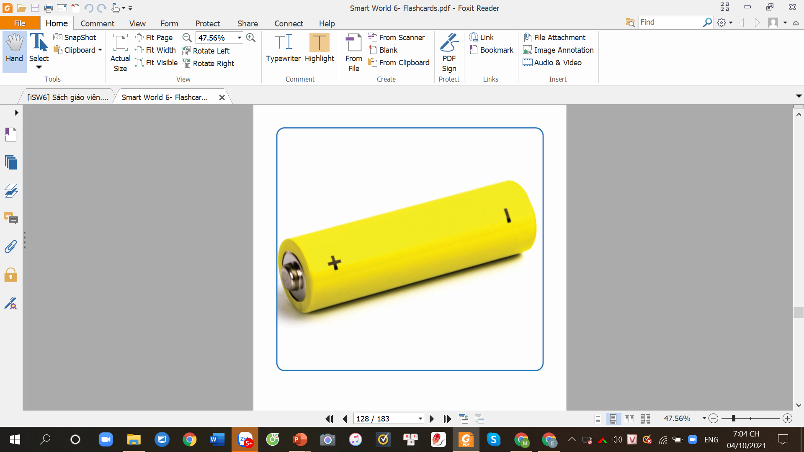
batterry
/ˈbætəri/
pin
I need a battery to charge my phone.

Slide 6
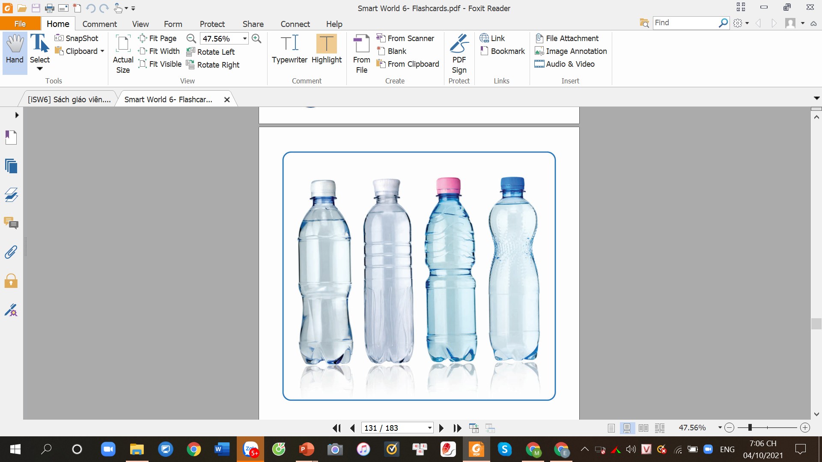
bottled water(n)
/ˈbɒtld ˈwɔːtə/
Nước đóng chai.
You should bring some bottled waters when you travel somewhere.

Slide 7
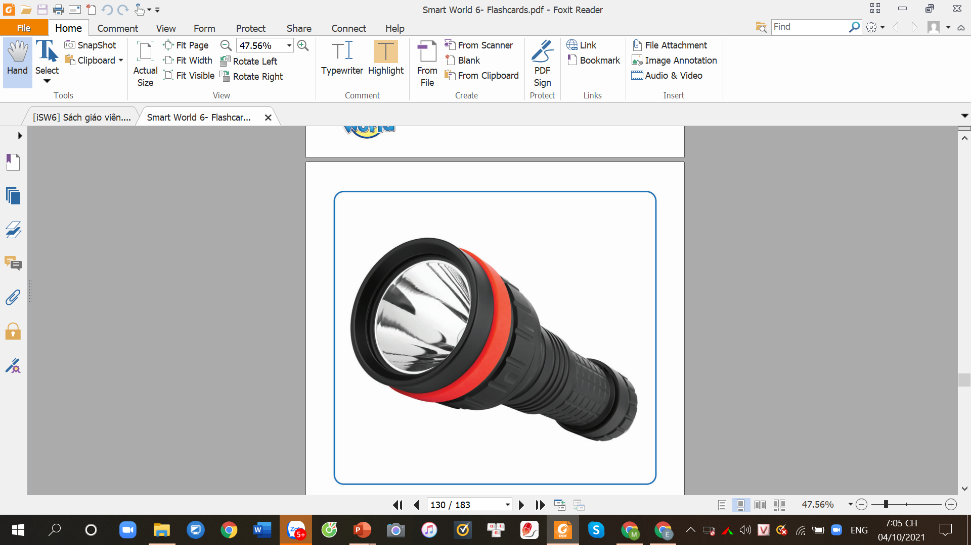
flashlight(n)
/ˈflæʃlaɪt/
Đèn pin
We have to bring a flashlight because it’s so dark outside.

Slide 8
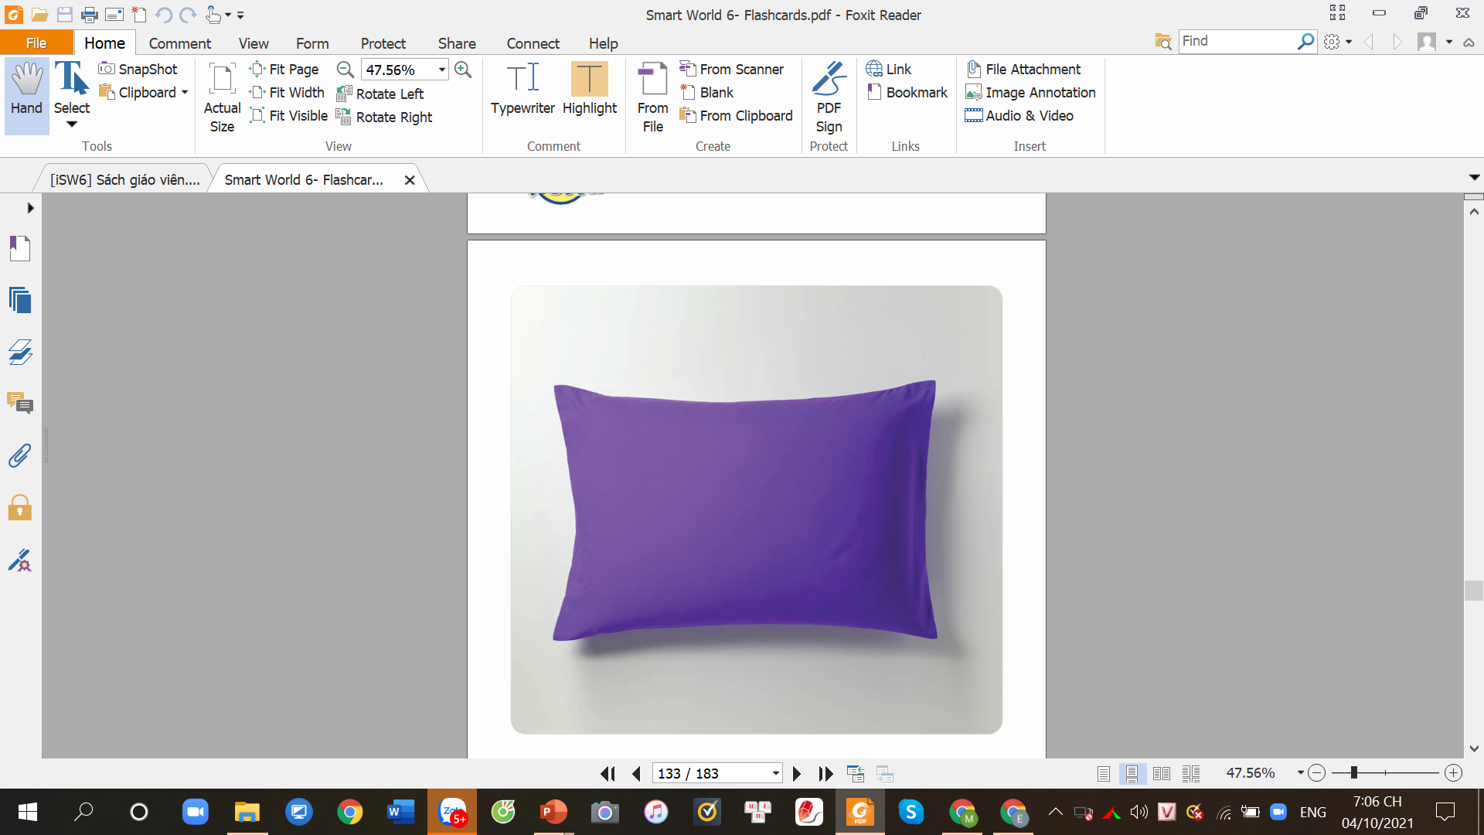
pillow (n)
/ˈpɪləʊ/
cái gối
The purple pillow is so soft.

Slide 9
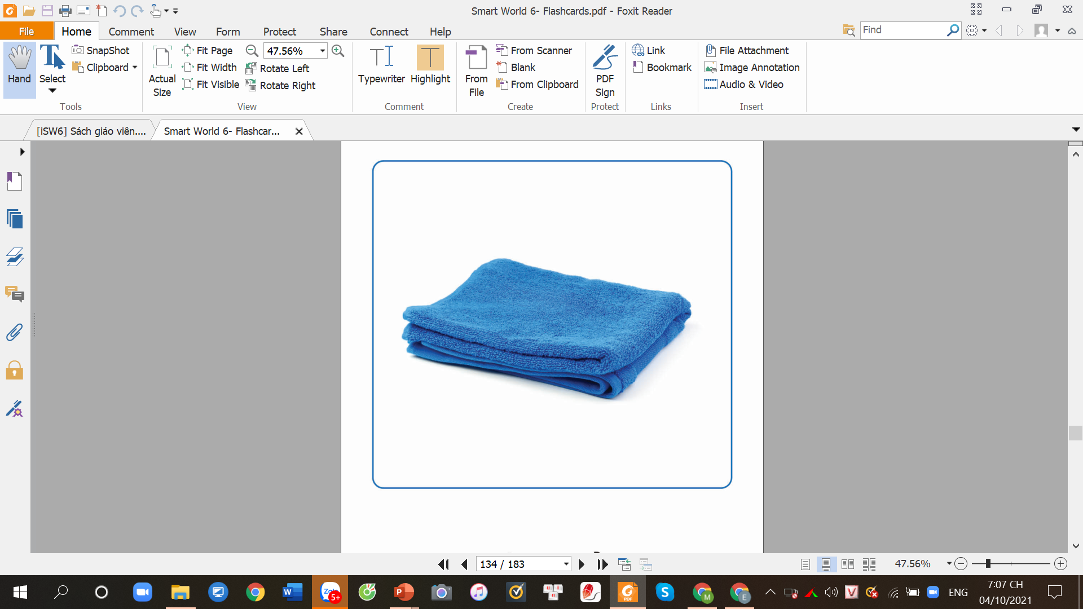
towel (n)
/ˈtaʊəl/
Khăn tắm
I want to buy a tower for the trip to the beach next week.

Slide 10
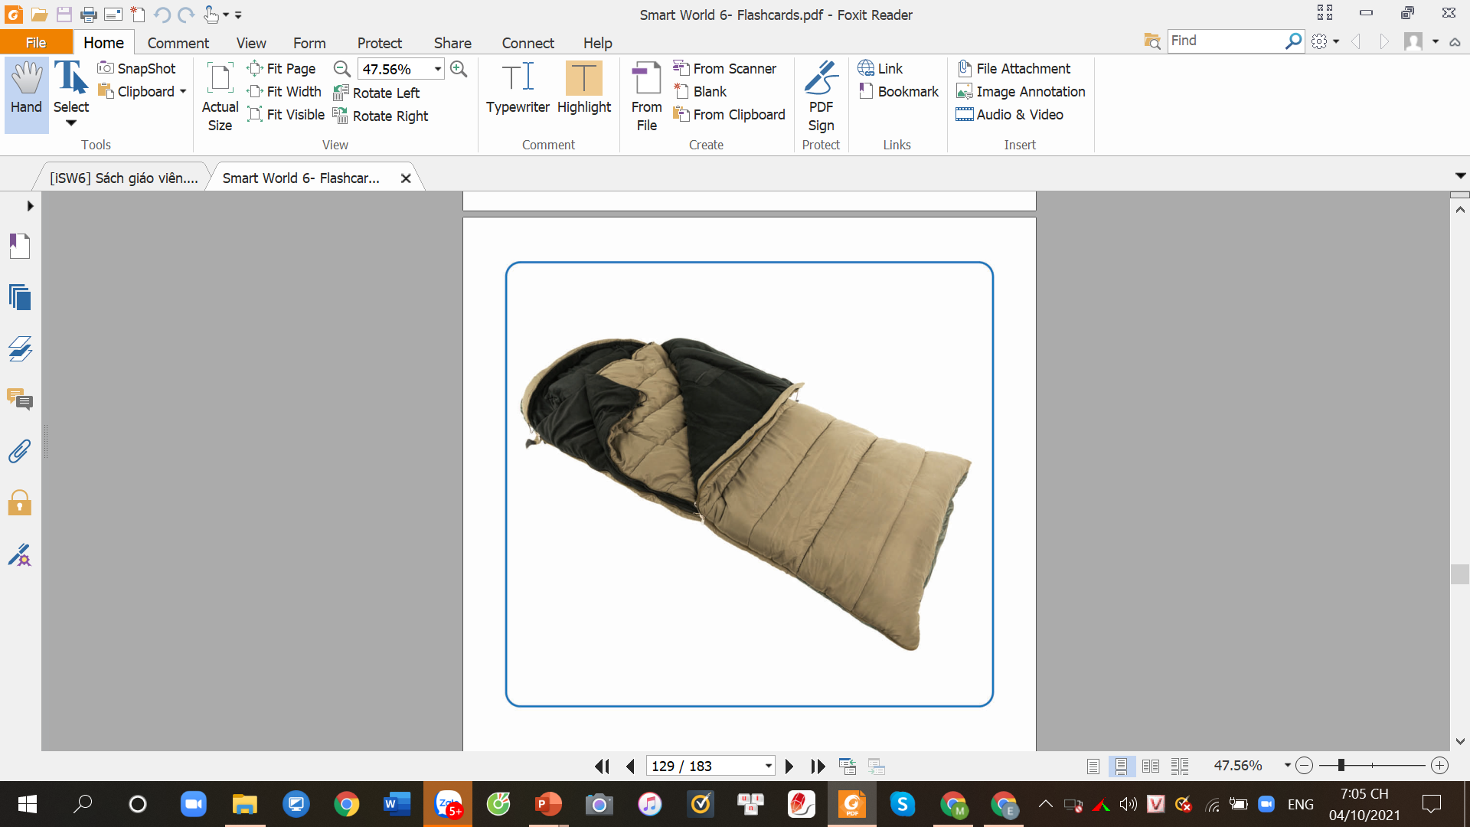
sleeping bag(n)
/ˈsliːpɪŋ bæg/
Túi ngủ
Sleeping bag is essential thing for traveling.

Slide 11
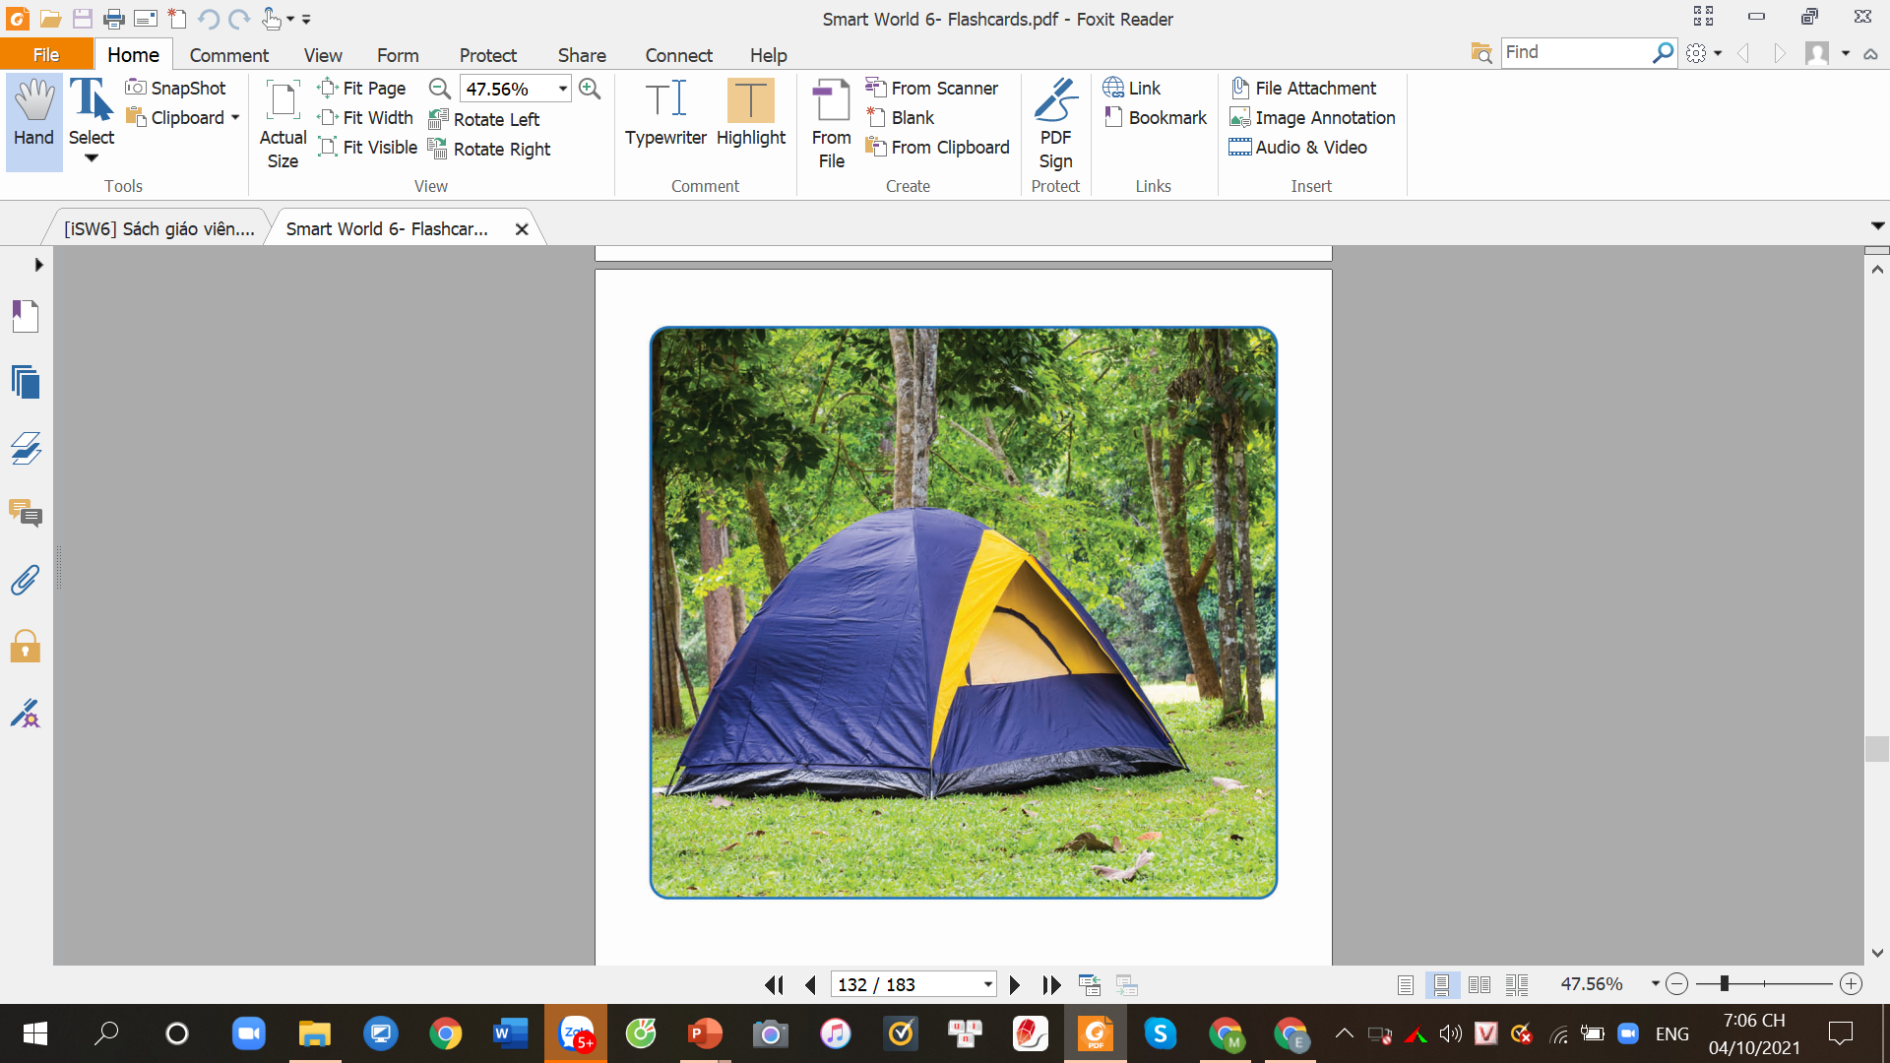
tent (n)
/tent/
cái lều
Sleeping bag is essential thing for traveling.

Slide 12
1
2
4
3
battery
flashlight
tower
sleeping bag
5
6
7
pillow
bottled water
tent

Slide 13

New words
a. Fill in the blanks. Listen and repeat.
sleeping bag flashlight bottled water tent battery pillow towel
battery
2____________
1____________
battery
flashlight
bottled water
3____________
pillow
2____________
4____________
towel
sleeping bag
tent
5____________
6____________
7____________

Slide 14
Discuss with your friends and answer the question.
What do you use a flashlight/a bottled water for?
Then fill in the blanks.
Question: What do you use a.....for? | Suggested answers
a flashlight
a bottled water
a tower
a speeping bag
a tent
a battery
a pillow
to see when it’s dark.
to drink when you’re thirsty
to dry after talking a bath.
to sleep when it’s cold
to rest if you’re tired.
to charge your devices.
to sleep more comfortably

Slide 15
b. What do you use these things for? Ask and answer.
Using the information form the table below and practice with your partner.
What do you use a flashlight for?
To see when it’s dark.

Slide 16
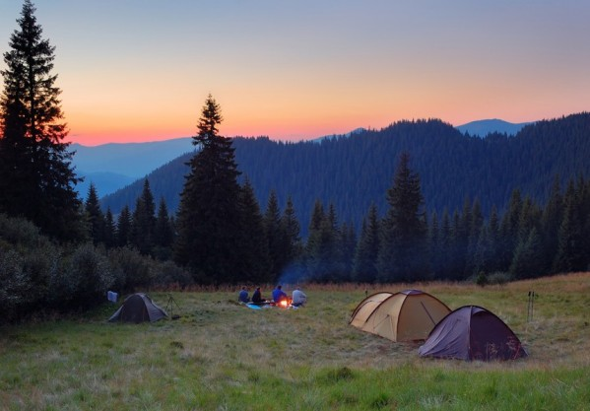
Look at the picture and guess what are they doing?
Have you ever had a camping trip with your family and friends?

Slide 17




Work in group and list all things you should bring to a camping trip.
Things for a camping trip

Slide 18
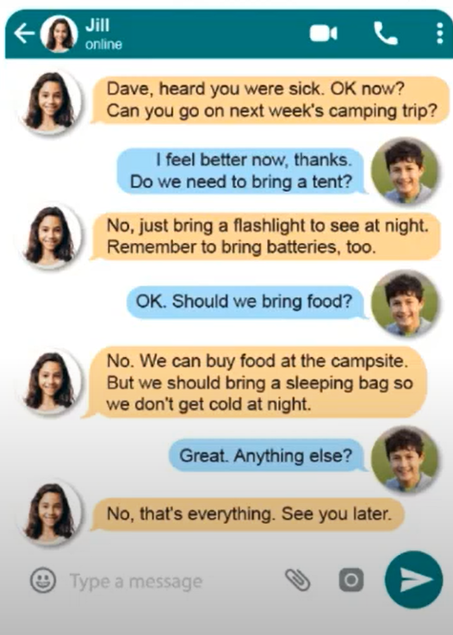
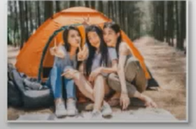
Reading
a. Two friends are messaging about their camping trip. Circle the things on the list Jill and Dave need to bring.
sleeping bag | pillow | money | towel
bottled water | battery | food | camera
cell phone | flashlight | notebook | tent
Wilmslow School Summer Camp List
Dave, heard you were sick. Ok now? can you go on next week’s camping trip?
I feel better now, thanks!
Do we need to bring a tent?
No, just bring a flashlight to see at night. Remember to bring batteries, too.
b. Read the messages again and answer the questions.
Ok. Should I bring food?
1. When is their camping trip?
next week
________________________________
Now, we can buy food at the campsite. But we should bring a sleeping bag so we don’t get cold at night.
2. What was wrong with Dave?
He was sick.
________________________________
Great! Anything else?
3. What do they need for their flashlight?
They need batteries.
________________________________
No, that’s everything. See you later.
4. What don’t they need to bring?
They don’t need to bring any food.
________________________________

Slide 19
WARP-UP

Slide 20
Unit 8
THE WORLD AROUND US
Lesson 4: New words + Reading
battery (n) pin
flashlight(n) đèn pin
tent(n): cái lều
bottled water(n): nướ đóng chai
sleeping bag (n) : túi ngủ
towel(n) : khăn tắm
pillow (n) : gối

Slide 21
Unit 8
THE WORLD AROUND US
bring (v) mang
need + to V(v) cần làm gì..
remember + to V(n): nhớ làm gì

Slide 22
CHECKING MEMORY
n
pin
1. battery
n
đèn pin
2.flashlight
3. tent
n
cái lều
4. bottled water
n
nước đóng chai
5. sleeping bag
n
túi ngủ
6.towel
n
khăn tắm

Slide 23
CHECKING MEMORY
n
cái gối
7. pillow
v
mang
8.bring
9. remember + to V
v
nhờ làm gì

Slide 24
HOMEWORK
Learn new words by heart.
- Talk about things you need for a trip.
- Practice asking and answering what things they use these things for.
- Do homework: a, b and listening on page 46 in workbook.
- Prepare for the next lesson: Grammar on page 66.
- Ask them to think of what things we should bring with for a picnic/ camping/ trip.

