Slide 1
WELCOME
TO OUR CLASS
ENGLISH 7
2020
March 31

Slide 2
Crossword
1
D I D
2
T E L L
3
I R O N
4
L I S T E N
5
D R I N K
6
W A S H E D
7
T A L K

Slide 3
1. Past simple of “do”

Slide 4
2. Present simple of “told”

Slide 5
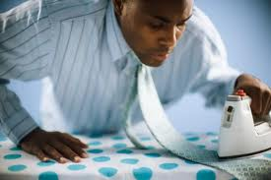
3

Slide 6
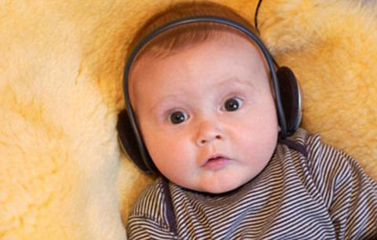
4

Slide 7
5. Present simple of “ drank”

Slide 8
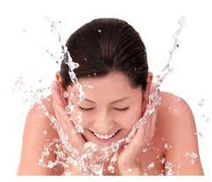
6
Past simple

Slide 9
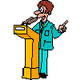
7

Slide 10
UNIT10:
HEALTH AND HYGIENE
ENGLISH 7
2020

Slide 11
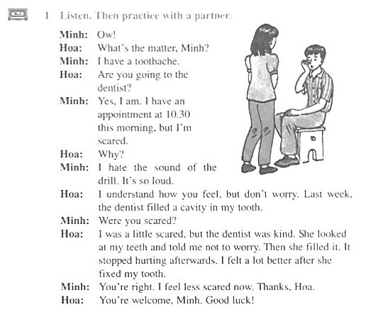

B1: A BAD TOOTHACHE
LISTEN THEN PRACTICE WITH A PARTNER

Slide 12
B1: A BAD TOOTHACHE
VOLCABULARY
Có chuyện gì vậy ?
what’s the mater = what’s wrong
toothache (n)
drill
dentist (n)
appointment (n)
scared of (adj) = afraid of(adj)
fill(v)
cavity(n)
stop + Ving
afterward = Then
Đau răng
Máy khoan
Nha sĩ
Cuộc hẹn
Lo lắng
Trám (răng)
Lỗ sâu răng
Dừng
Sau đó

Slide 13
Answer the questions
a/ What is wrong with Minh?
b/ Does Minh like going to the dentist? How do you know?
c/ Why did Hoa go to the dentist last week?
d/ What did the dentist do?
He has a toothache
No, he doesn’t. He hates the sound of the drill.
Because she had a cavity in her tooth.
She looked Hoa’s teeth and told her not to worry

Slide 14
Discuss.
e/ What did you do the last time you had a bad toothache?
f/ Are you scared of seeing the dentist?
I went to see a dentist and he filled a cavity in my toothache
Yes, I am /No, I am not.

Slide 15
Structure
Why ?
Because
Câu hỏi Why thường được dùng để hỏi lí do hay nguyên nhân.
e.g: Why is he going to the library this afternoon?
Why did they borrow this book?
Why doesn’t she buy herself a bag?
Why + do/does/did + S + V1 + O/ A?
Why + be + S .........?
Để trả lời cho câu hỏi với WHY, chúng ta có thể dùng:
Because + clause (mệnh đề)
e.g: Why are you on the diet? – Because I want to lose weight.
Why does he study hard? – Because he want to pass the exams

Slide 16
Fill in the blanks with suitable prepositions
of
1/ My mother takes scared ............... the family.
2/ She smiled ..................the child and said «hello»
3/ I’m really worried...................... my brother.
4/ Milk is good ................. your health.
5/ Most children scared................seeing the dentist.
6/ The dentist looked ...............my teeth.
7/ Minh has an appointment..............10:30 this moring.
8/ Dr Lai filled the cavity.....................Minh’s tooth.
at
about
for
of
at
at
in

Slide 17
Make questions with Why and answer with Because
1/ he/ be scared?// hate the sound of the drill
Why ...........................................................................
Because........................................................................
2/ children/ often have a toothache?// eat lots of candy.
...................................................................................
...................................................................................
3/ you/ be late for class yesterday?// miss the first bus
......................................................................................
......................................................................................
4/ she/ go to the doctor?// have a headache
........................................................................................
.......................................................................................

