Slide 1
on the right of
on the left of
between
PREPOSITIONS
OF PLACE
near
beside
next to
in the middle of
in front of
behind
opposite

Slide 2


UNIT 3: AT HOME
Write

Slide 3
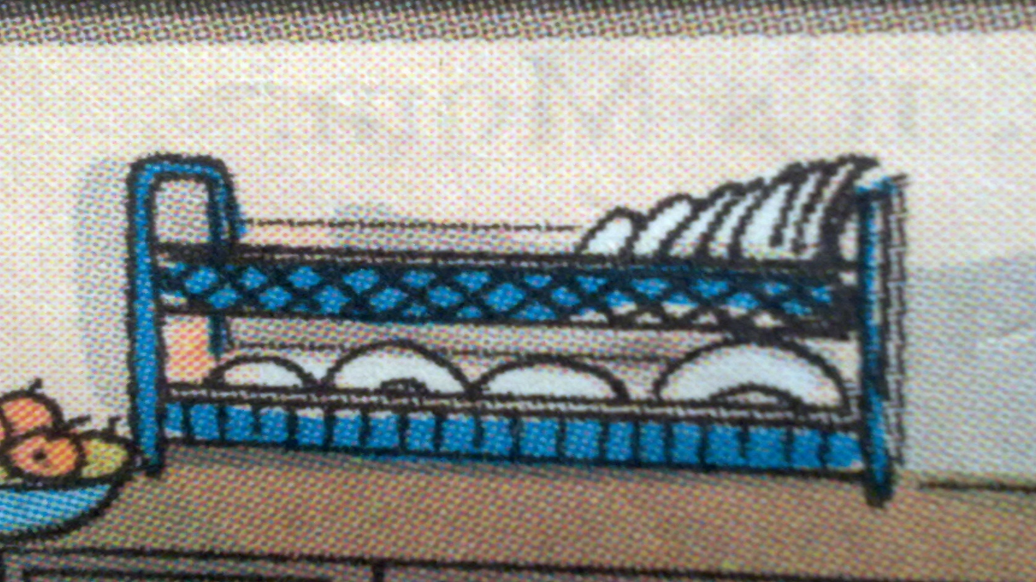
Disk rack (n)

Slide 4
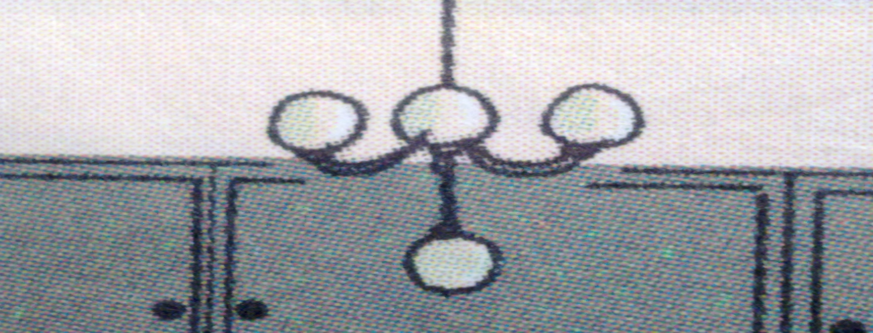
Lighting fixture

Slide 5
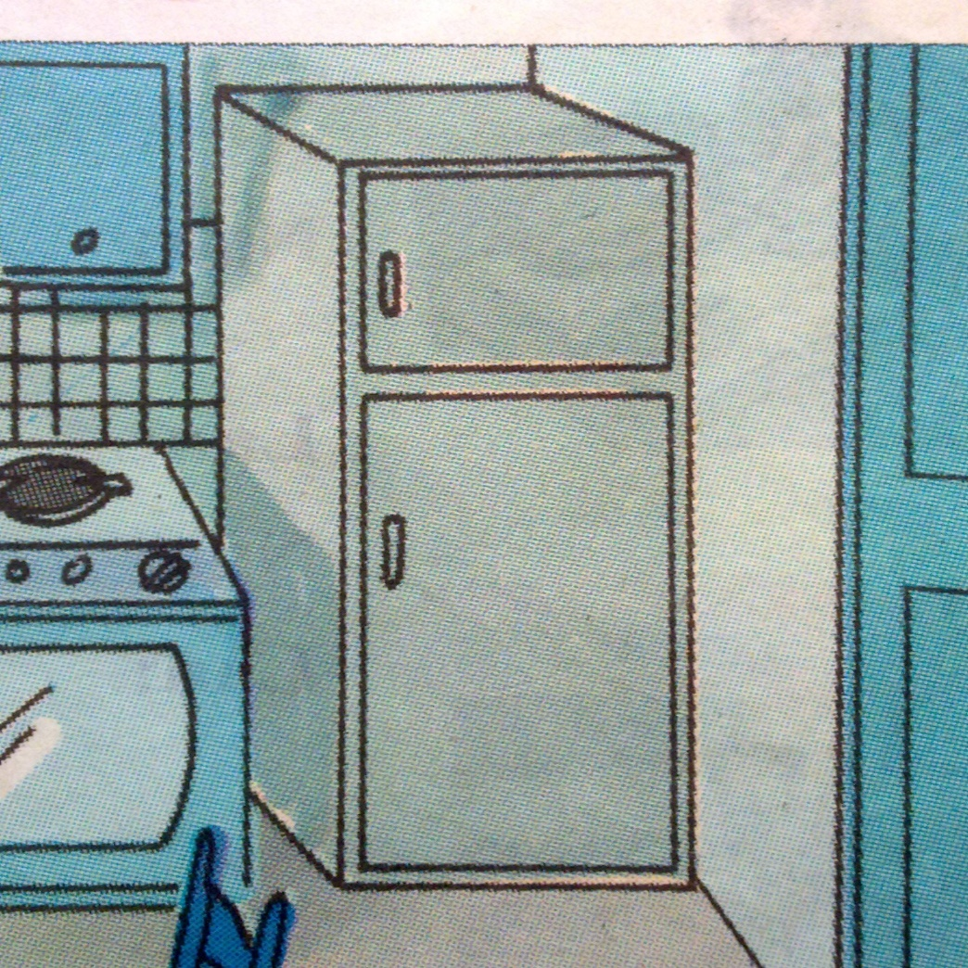
Refrigerator

Slide 6
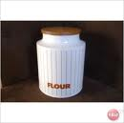

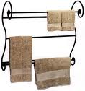
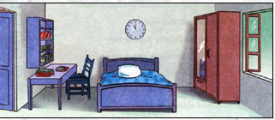
UNIT 3: AT HOME
Write
I. NEW WORDS:
- above (prep)
- beneath(prep)
- jar (n)
 a jar of flour
- towel rack (n)
- wardrobe (n)
- folder (n)

Slide 7
UNIT 3: AT HOME - Write
I. NEW WORDS:
1. folder /ˈfəʊldə(r)/(n): bìa kẹp hồ sơ, tài liệu
2.wardrobe /ˈwɔːrdrəʊb/ (n): tủ đựng quần áo
3. towel /'taʊəl/(n): khăn lau, khăn tắm
4. rack/ræk/(n) : giá (để đồ đạc)
→towel rack (n): giá treo khăn
→dish rack (n) : giá để bát đĩa
5. beneath /bi'ni:ːθ/(prep): ở dưới, xuống dưới
6. fixture /'fikstʃə/(n) : vật/ đồ đạc cố định
→ lighting fixture (n): đèn cố định, đèn chùm

Slide 8
7. to empty /'empti/(v): làm cho rỗng, đổ, trút ra
→ empty (adj): rỗng trống rỗng
8. tidy /ˈtaɪdi/(adj): gọn gàng
→ to tidy (v) : làm cho sạch sẽ, gọn
gàng, dọn dẹp.
9. to dust/dʌst/(v): phủi bụi
→ dust (n): bụi
10. jar (n): lọ,bình

Slide 9
Matching
1. tower rack
2. beneath
3. jar
4.wardrobe
5. above
6. folder
a. lọ, chai
b. bìa hồ sơ
c. bên trên
d. bên dưới
e. giá để khăn
f. tủ quần áo

Slide 10
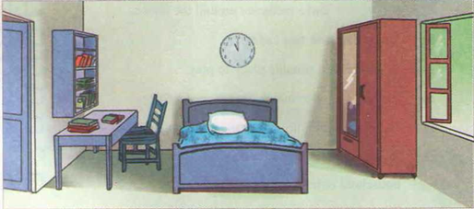
II. WRITE.
Task 1: Read the description of Hoa’s room.
This is Hoa’s bedroom. There is a desk on the left of the room. On the desk there are many folders, and above the desk there is a bookshelf. There is a bed near the desk. On the right side of the room, there is a window. There is a wardrobe beside the window. The wardrobe is opposite the desk.

Slide 11
Task 2. Now write a description of this kitchen.
This / Hoa’s kitchen.
There / refrigerator / right corner / room.
Next to / refrigerator / stove and oven.
On the other side / oven / sink / next to / sink / towel rack.
Dish rack / counter / to the right / window / beneath / shelves.
On / counter / beneath / window / jars / sugar / flour / tea.
In the middle / kitchen / table / four chairs.
Lighting fixture / above / table / beneath / lighting fixture / vase with flowers.

Slide 12
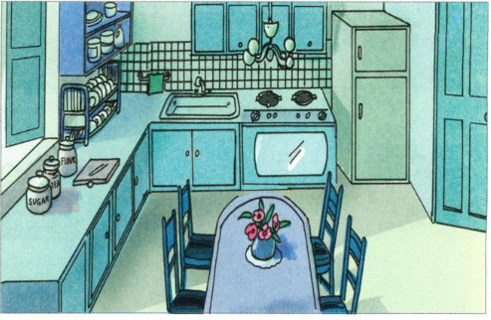
Task 2. Now write a description of this kitchen.
This / Hoa’s kitchen.
→This is Hoa’s kitchen.

Slide 13
There / refrigerator / right corner / room.
→There is a refrigerator in the right
corner of the room.

Slide 14
Next to / refrigerator / stove and oven.
→Next to the refrigerator is a stove and oven.

Slide 15
On the other side / oven / sink / next to / sink / towel rack.
→On the other side of the oven there is a sink
and next to the sink is a towel rack.

Slide 16
Dish rack / counter / to the right / window / beneath / shelves.
→The dish rack is on the counter to the right of the window and beneath the shelves.
On / counter / beneath / window / jars / sugar / flour / tea.
On the counter beneath the window there are jars of sugar, flour and tea.
In the middle / kitchen / table / four chairs.
In the middle of the kitchen there is a table and four chairs.

Slide 17
Lighting fixture / above / table / beneath / lighting fixture / vase with flowers.
The lighting fixture is above the table and beneath the lighting fixture is a vase with flowers.

Slide 18
Task 3: Write a description of a room in your house.
Refer to the above paragraphs.
MY ROOM
My room is on the second floor. It’s quite a big room. It’s very light because there are two windows overlooking the garden. My desk is between the two windows and my bed is against the wall opposite the desk. There’s an armchair near the desk and behind the armchair there’s a wardrobe. Opposite them, there’s a chest of drawers with bookshelves next to it. I’m very pleased with my room.

Slide 19
III. CONSOLIDATION
Choose the best option to complete these following sentences.
wardrobe
1. We put our clothes in the _________.
cupboard wardrobe freezer sink
2. There is an oven __________ to the refrigerator.
beside on next at
3. There is a table lamp _____ the desk.
on next between above
4. The disk rack is __________ the shelves
beneath next above between
5. On the left side ____ the stove there is a sink.
on of at behind
next
on
beneath
of

Slide 20
HOMEWORK
Write a description of your bedroom/ living room.
Learn by heart. “New words”
Prepare “ Language focus/ Page 34 SGK.

