Slide 1


Slide 2
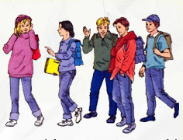
UNIT 2: CLOTHING
5 - READ

Slide 3
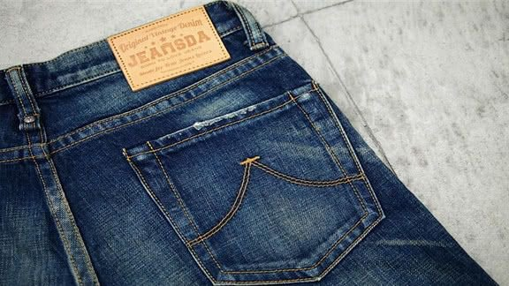
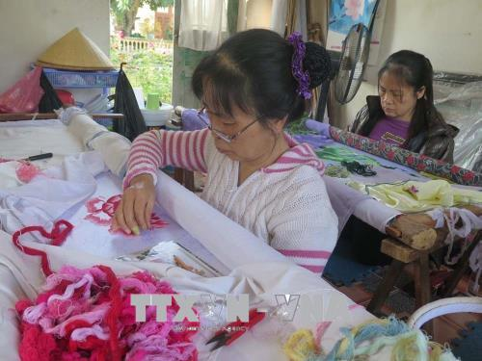
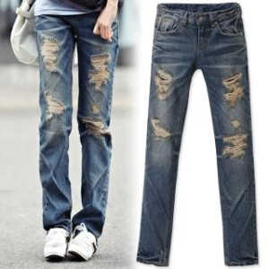
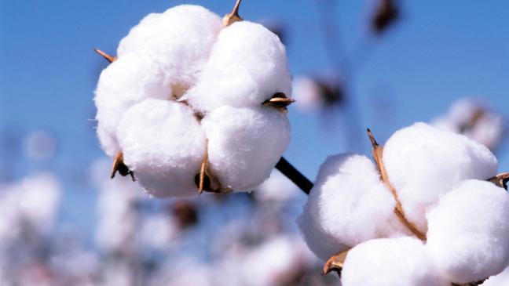
UNIT 2: CLOTHING – READ
I. NEW WORDS
- name after (v):
đặt tên theo
- sailor (n):
thủy thủ
- be made from (v):
được làm từ
- cotton (n):
bông, sợi bông
- wear out (v):
rách, sờn
- embroider (v):
thêu
- style (n):
kiểu, kiểu dáng
- label (n):
nhãn hiệu
- sale (n):
doanh thu, số lượng bán ra
- economic (a):
thuộc kinh tế

Slide 4

UNIT 2: CLOTHING – READ
II. READ
The word jeans comes from a kind of material that was made in Europe.
The material called jean, was named after sailors from Genoa in Italy,
because they wore clothes made from it. jean cloth
was made completely from cotton and workers at that time loved
wearing it because the material was very strong and did not wear out
Easily. , many university and college students wore jeans.
Designers made different styles of jeans to match the 1960s’ fashions:
Embroidered jeans, painted jeans and so on. more and more
people started wearing jeans because they became cheaper.
jeans finally became high fashion clothing, when famous designers
started making their own styles of jeans, with their own labels on them.
Sales of jeans went up and up. But the worldwide economic
situation got worse and the sales of jeans stopped growing. However,
jeans have never been out of fashion, and today young generation is still
fond wearing them.
In the 18th century
In the 18th century
In the 1960s
In the 1960s
In the 1970s
In the 1970s
In the 1980s
In the 1980s
in the 1990s
in the 1990s

Slide 5
UNIT 2: CLOTHING – READ
II. READ
a) Fill in the missing dates and words:
18th century
jean cloth
………… :Workers liked to wear ………… because the material
made from cotton was very strong and could hardly wear out.
2. ……. : A lot of university and college ………. wore jeans.
3. …… : Jeans became …........ so many, many people began wearing
jeans.
4. ……. : Jeans became high ……… clothing.
5. …… : The …... of jeans stopped going up.
1960s
students
1970s
cheaper
1980s
fashion
1990s
sale

Slide 6



b) Answer the following questions.
UNIT 2: CLOTHING – READ
II. READ
1. Where does the word jeans come from ?
It comes from a kind of material that was made in Europe.
2. What were the 1960s’ fashions ?
The 1960’s fashions were embroidered jeans, painted jeans and so on.
3. Why did more and more people begin wearing jeans in the 1970s ?
Because they became cheaper.
4. When did jeans at last become high fashion clothing?
Jeans at last became high fashion clothing in the 1980s.
5. Why did the sale of jeans stop growing?
Because the worldwide economic situation got worse in the 1990s.

Slide 7
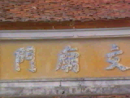
Homework
- Learn new words by heart.
Read and translate the text.
- Prepare Unit 2: Write
+

Slide 8
Thank you for
your attention!

