Slide 1
UNIT 1:MY FRIENDS
LESSON: READ

Slide 2
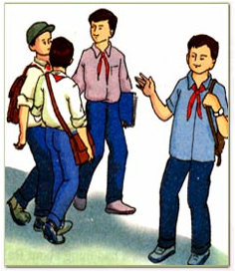
1. Read the text and pick out the new words.
Ba is talking about his friends.
I am lucky enough to have a lot of friends. Of all my friends, Bao, Khai, and Song are the ones I spend most of my time with. Each of us, however, has a different character.
Bao is the most sociable. He is also extremely kind and generous. He spends his free time doing volunteer work at a local orphanage, and he is a hard-working student who always gets good grades.
Unlike Bao, Khai and Song are quite reserved in public. Both boys enjoy school, but they prefer to be outside the classroom. Song is our school’s star soccer player, and Khai likes the peace and quiet of the local library.
I am not as outgoing as Bao, but I enjoy telling jokes. My friends usually enjoy my sense of humor. However, sometimes my jokes annoy them.
Although we have quite different characters, the four of us are very close friends.
2. Does Ba talk about his friends’ appearances or characters?

Slide 3
Choose the correct answer
Ba talks about of his friends.
A. three B. all C. four D. none
2. Bao’s volunteer work.
A. helps him make friends B. causes problem at exam C. doesn’t affect his school D. takes up a lot of time
3. Khai and Song .
A. like quiet places B. don’t talk much in public C. dislike school D. enjoy sports
4. Ba ‘s friends sometimes his jokes.
A. answer B. do not listen C. laugh at D. get tired of

