Slide 1

TEACHER : LÊ THANH HÀ

Slide 2
Wednesday , September, 8th , 2021
STARTER UNIT
Lesson 1
Vocabulary – Free time

Slide 3
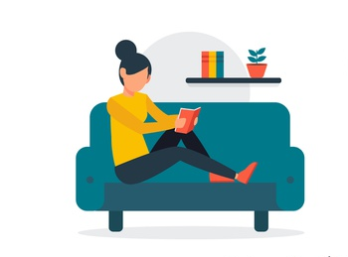
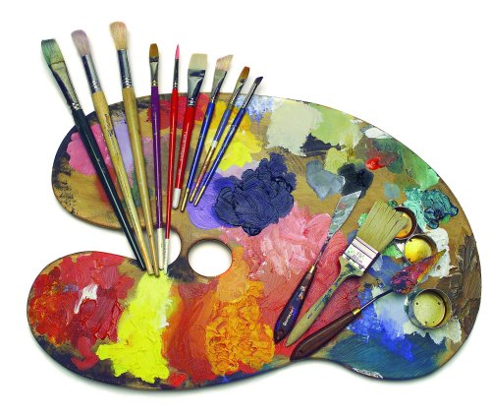
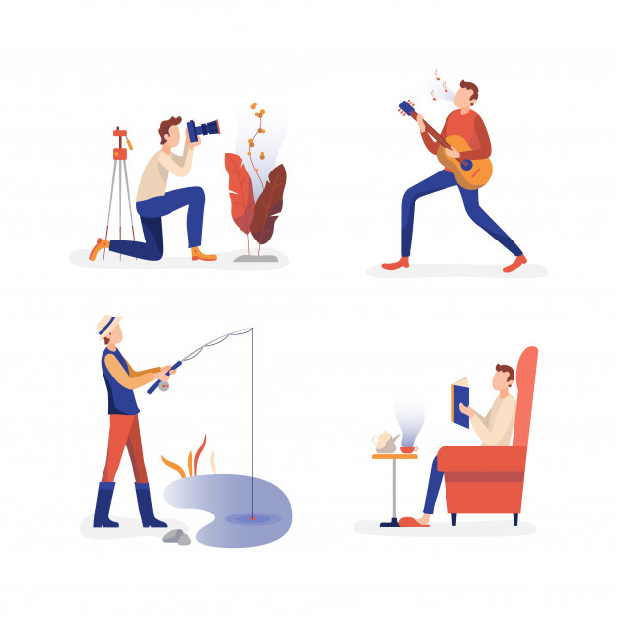
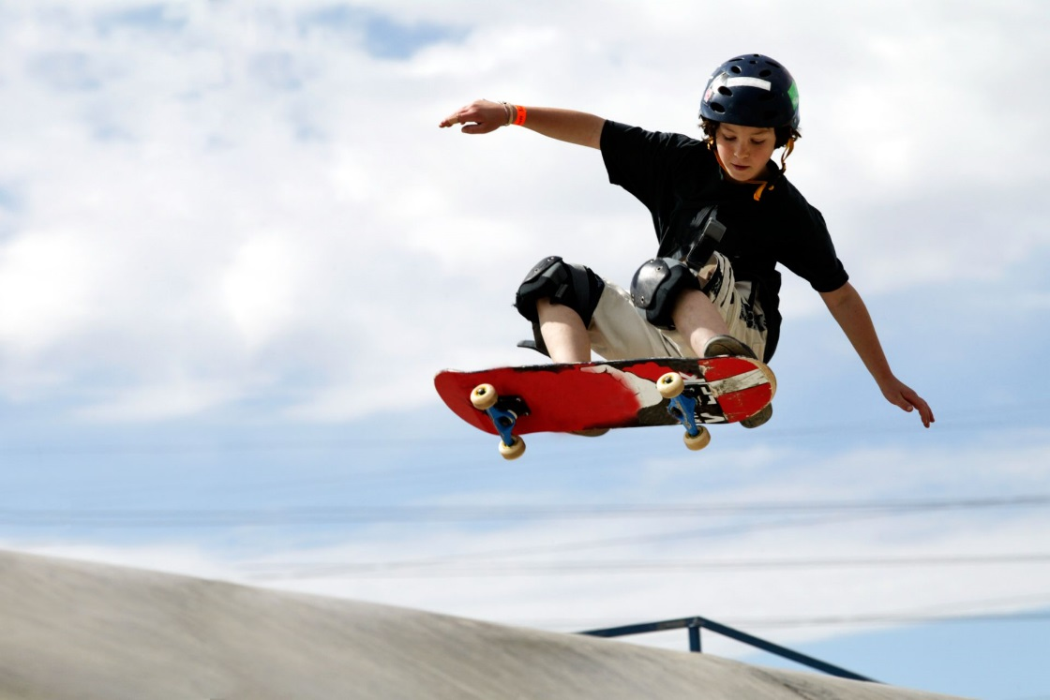
STARTER UNIT
Lesson 1
Vocabulary – Free time

Slide 4
What do you do
in your free time?

Slide 5
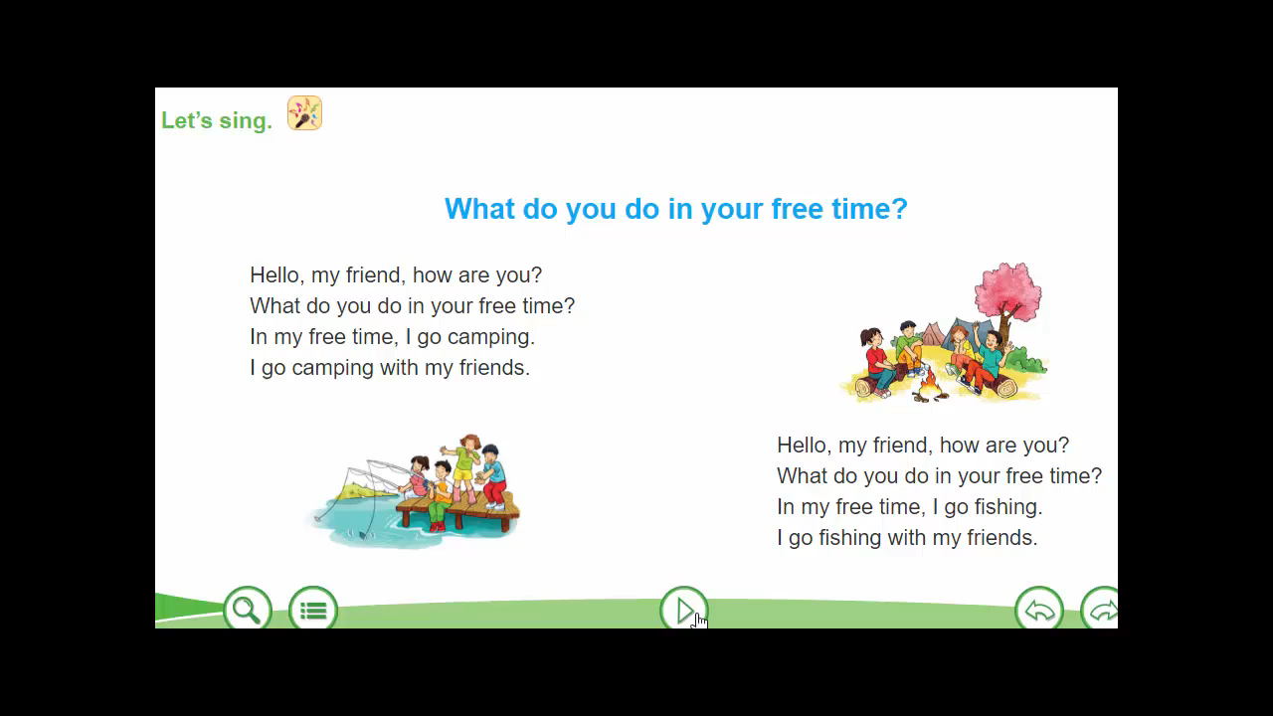

Slide 6

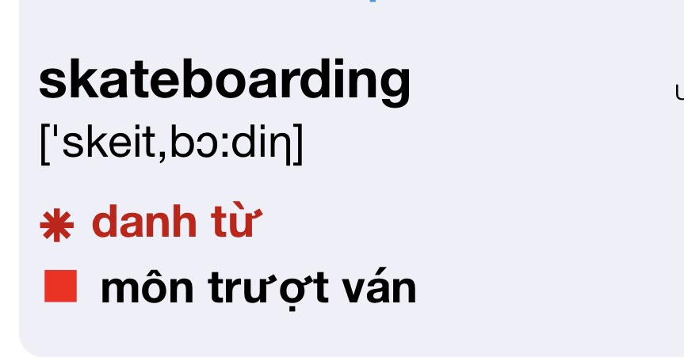
New words

Slide 7
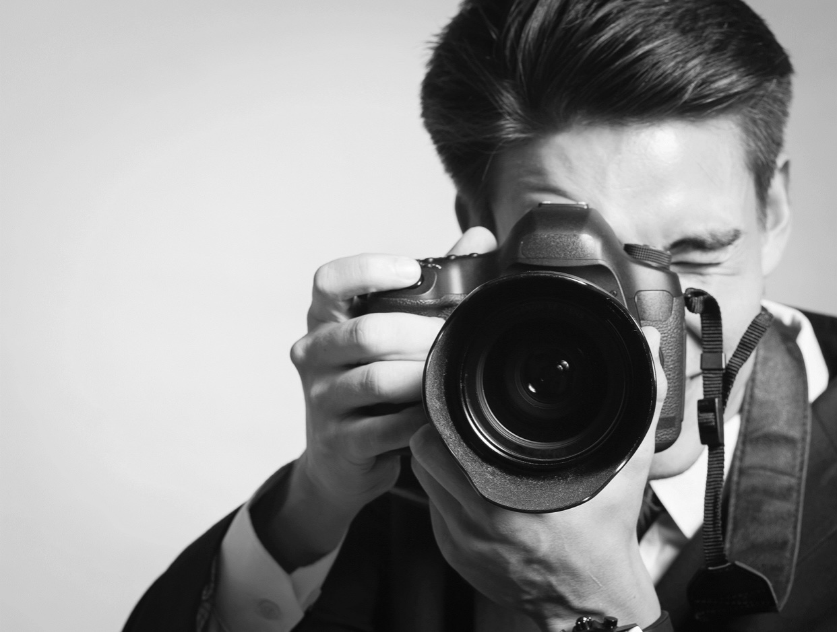
photography(n) /fəˈtɑː.ɡrə.fi/ : nghề nhiếp ảnh

Slide 8

art (n) /ɑːrt/

Slide 9
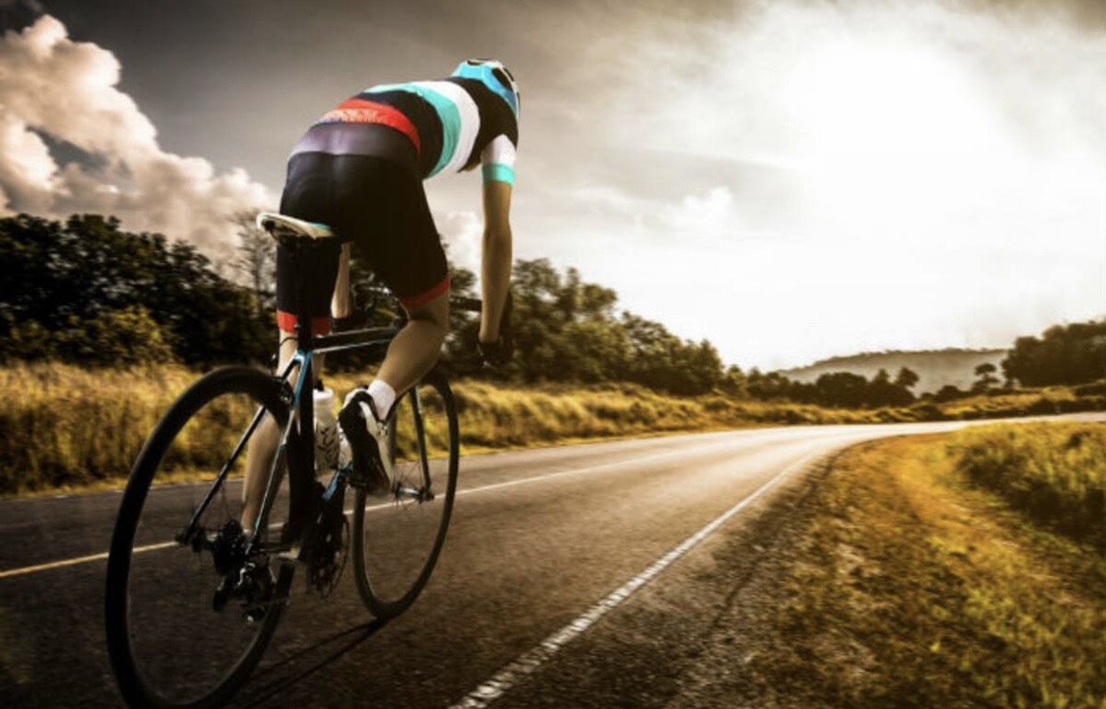
cycling (n) /ˈsaɪ.klɪŋ/: môn đạp xe

Slide 10
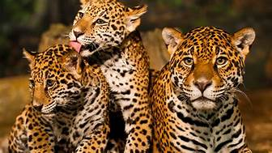
Animals
(n)
Động vật

Slide 11
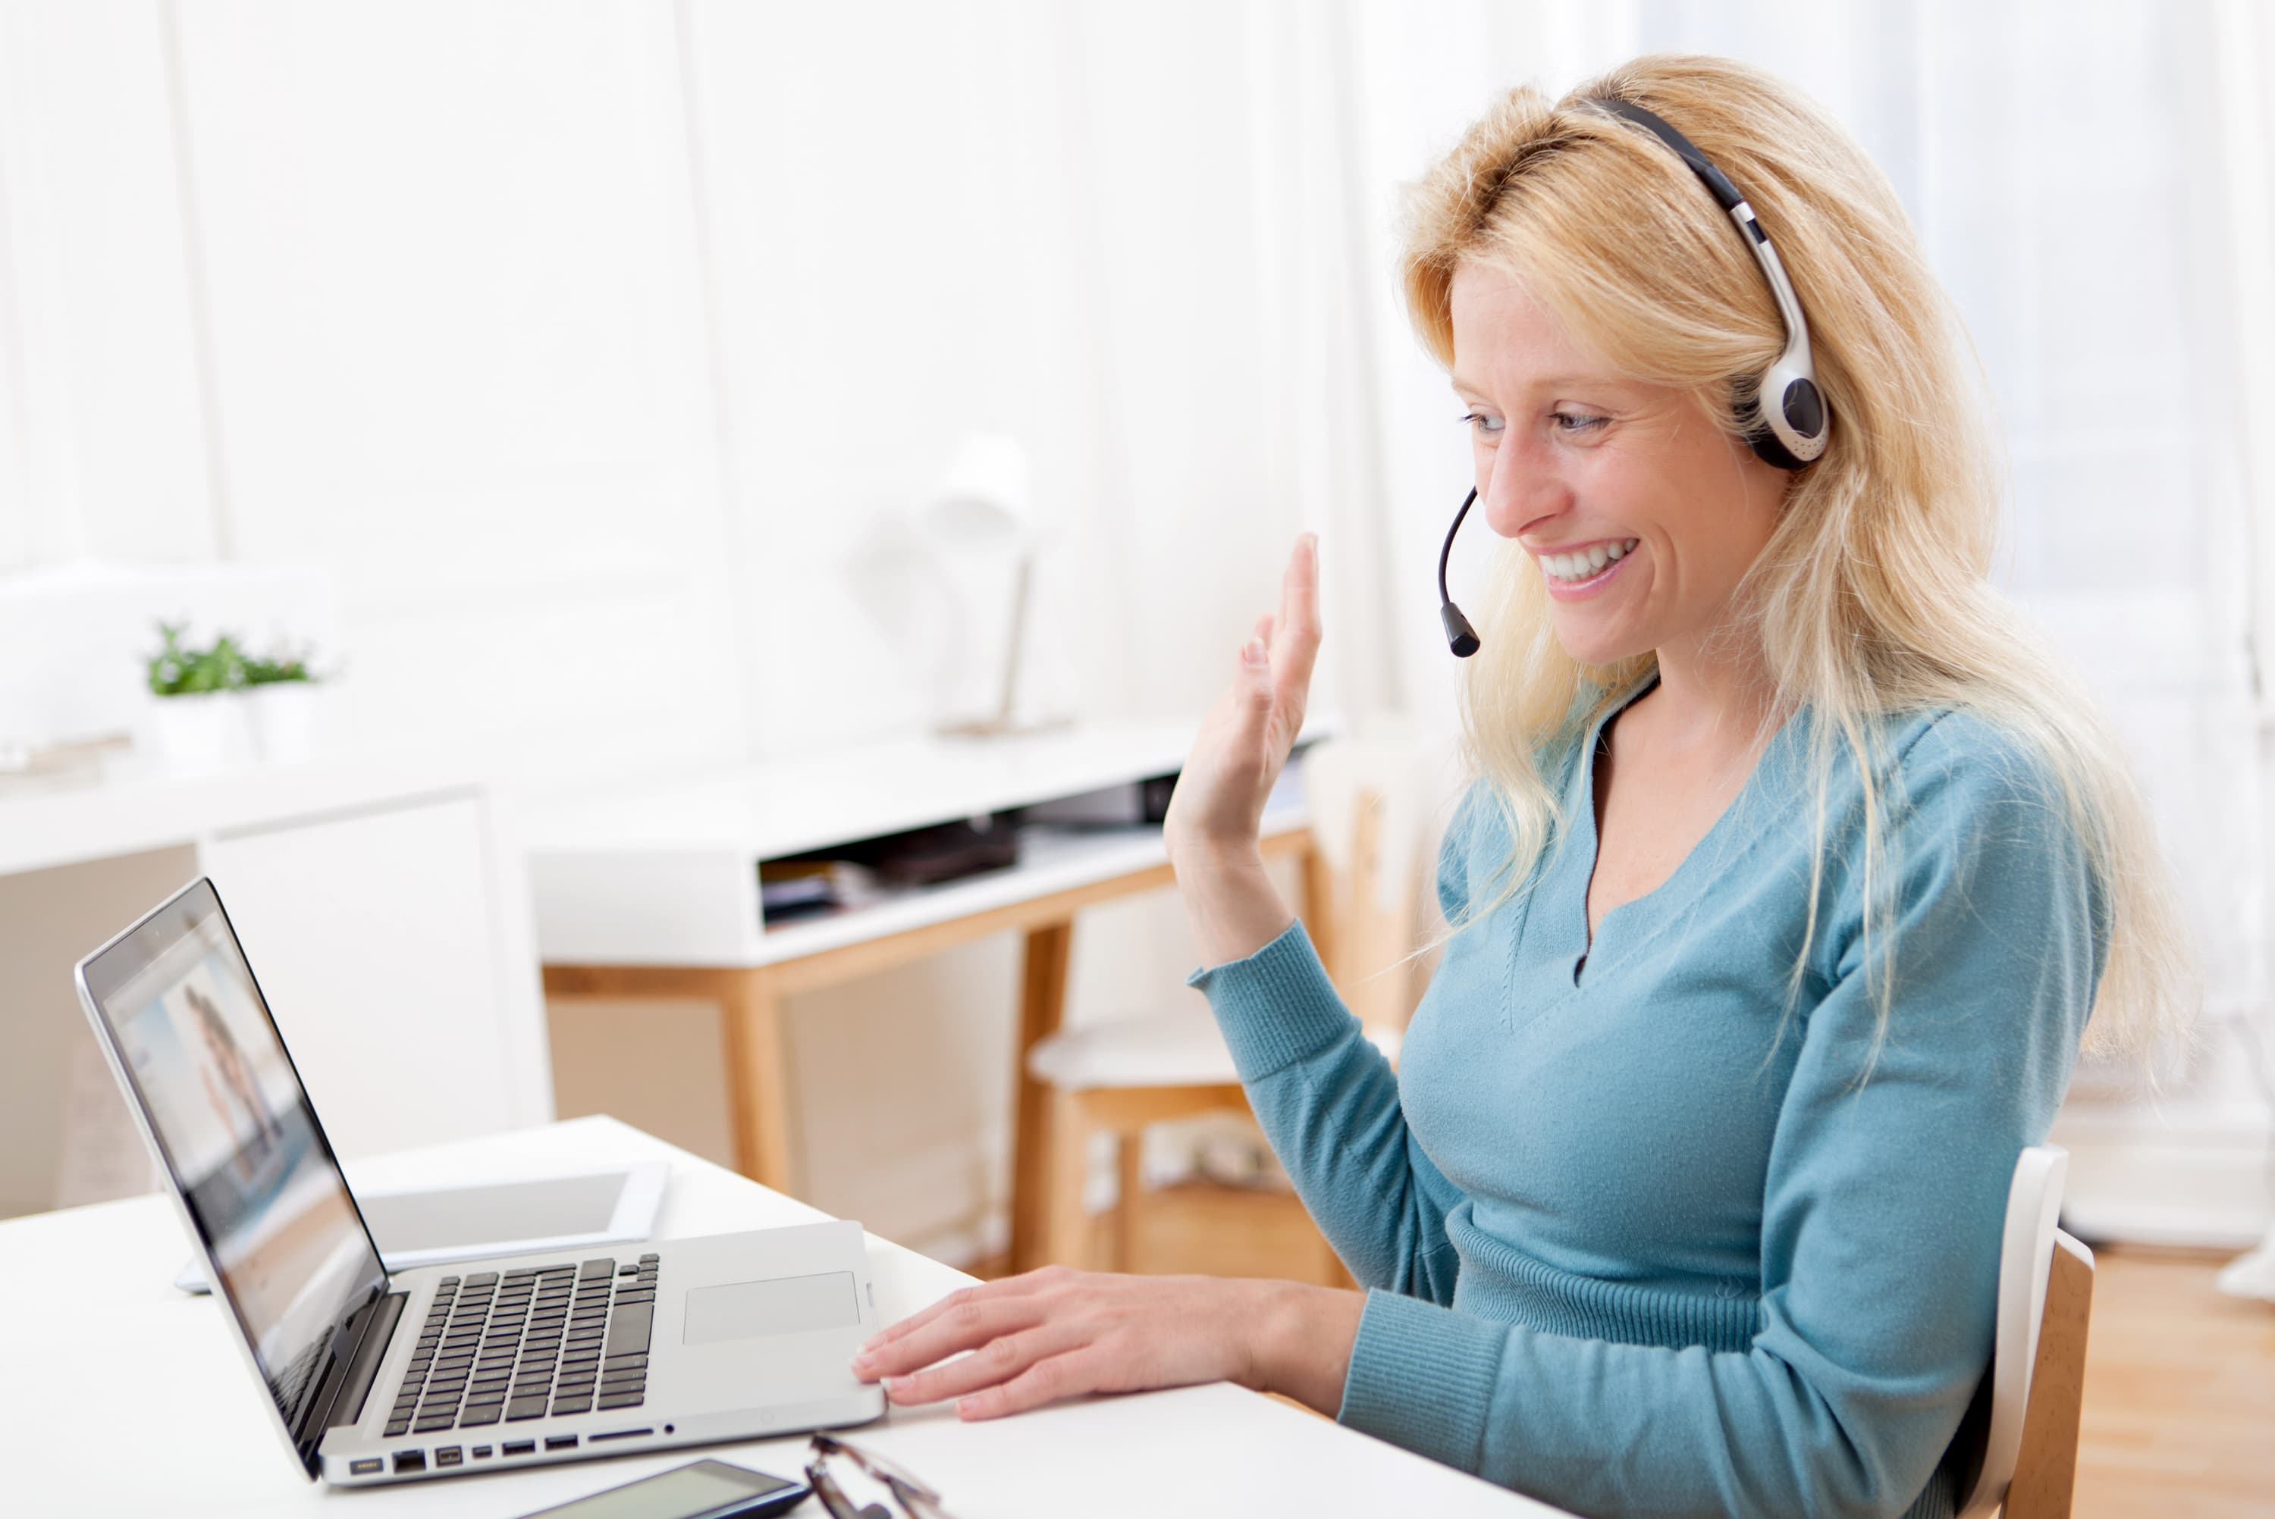
chatting online:

Slide 12

film

Slide 13
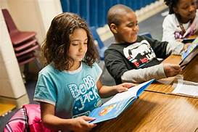
Reading books (n) : đọc sách

Slide 14
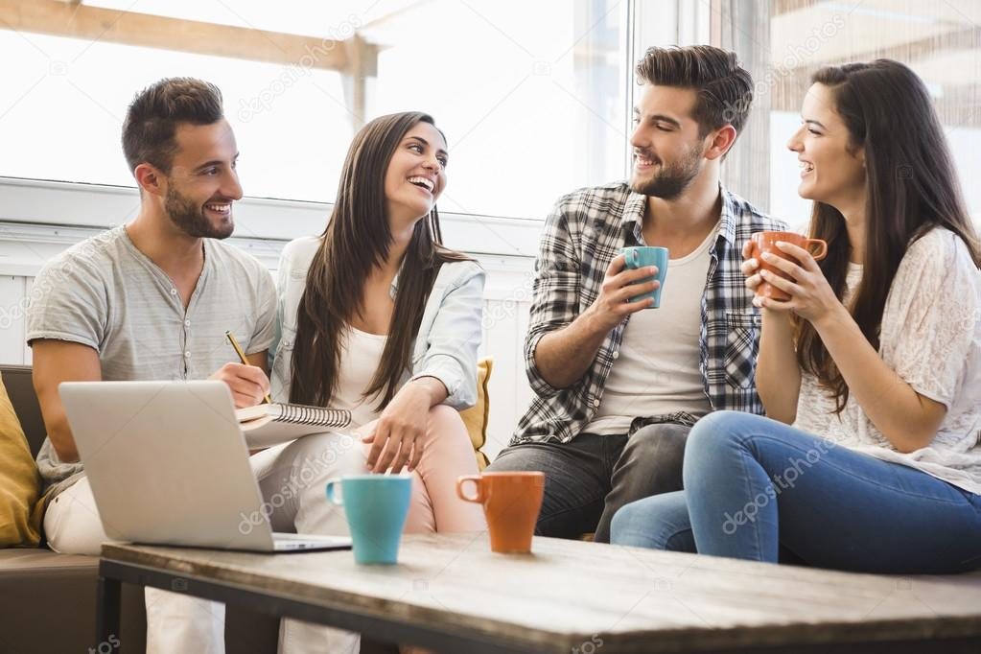
Meeting (n) : gặp gỡ

Slide 15
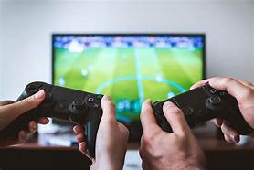
Video games( n): trò chơi điện tử

Slide 16
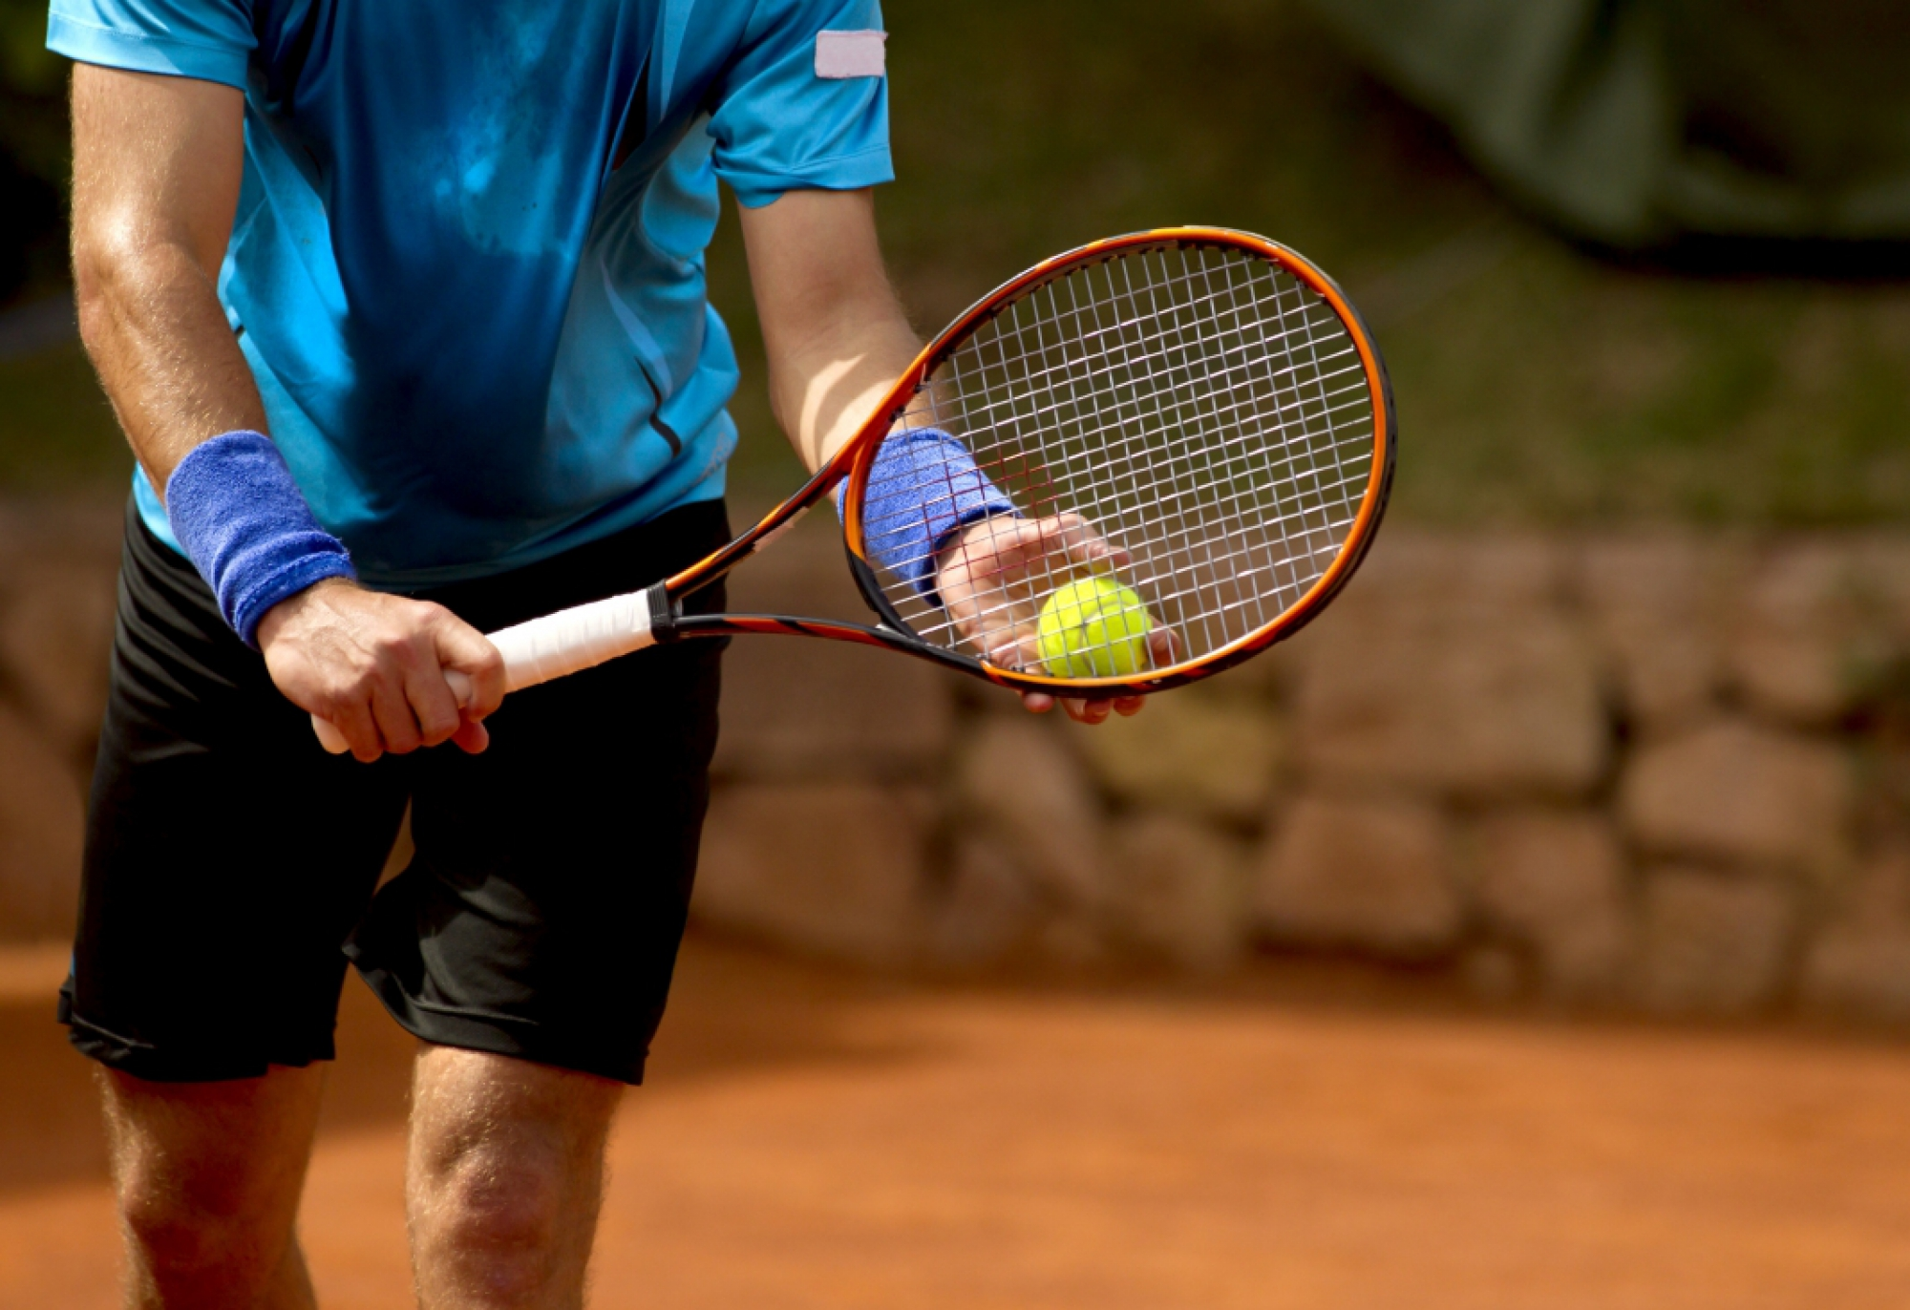
Sports
(n)
Thể thao

Slide 17

Shopping (n) : mua sắm

Slide 18
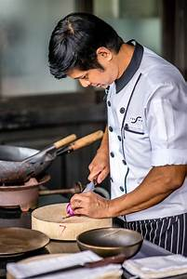
cooking (n) : nấu ăn

Slide 19
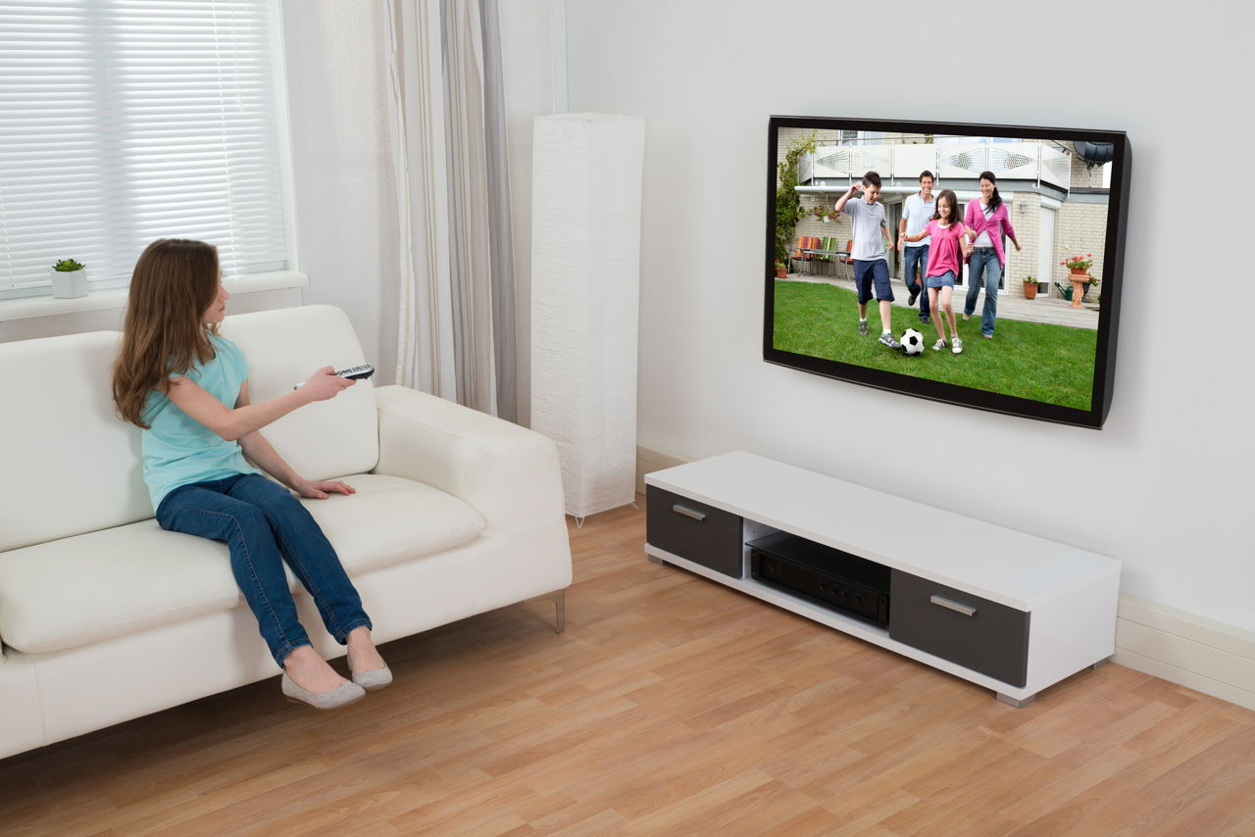
watching TV (n) : xem TV

Slide 20


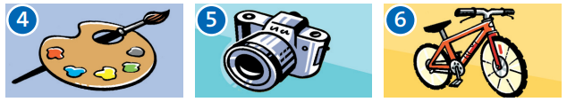
Exercise 1 (P.6)
chatting online
reading
meeting friends
art
photography
cycling

Slide 21


sport
animals
music
video games
watching TV
films

Slide 22

skateboarding
cooking
shopping

Slide 23
New words
.Be good at: giỏi về cái gì
Ex: My mother is good at cooking.
.Be interested in: /ˈɪn.trɪ.stɪd/ : quan tâm
Ex: I am interested in playing video games.
.favorite (a) /ˈfeɪ.vər.ət/ : ưa thích
a person or thing that is best liked

Slide 24
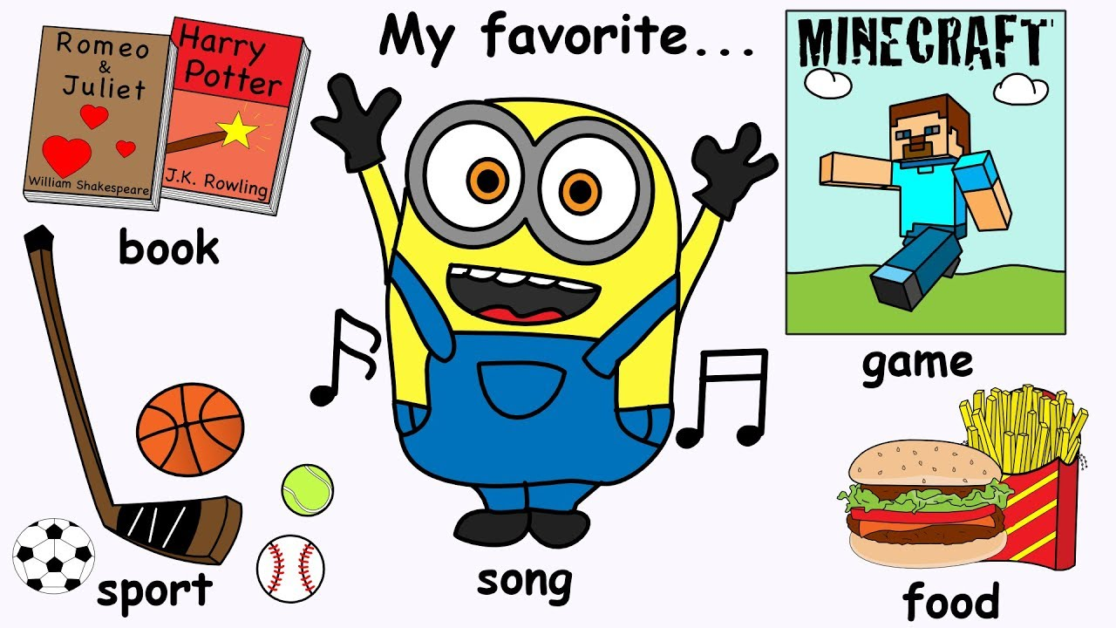

Slide 25
New words
.Be in to : thích cái gì
Ex: I am in to sports.
.like (v) : thích
Ex: I like reading
Be in to something = like something

Slide 26
NEW WORDS
NOUNS
skate boarding 10.video game
Photography 11.watching TV
Art 12.Cooking
Cycling 13.shopping
Animals 14. films
Chatting online ADJECTIVES
Reading 15. be interested in
Meeting friends 16.be in to
Sports 17. favorite
                18. be good at

Slide 27
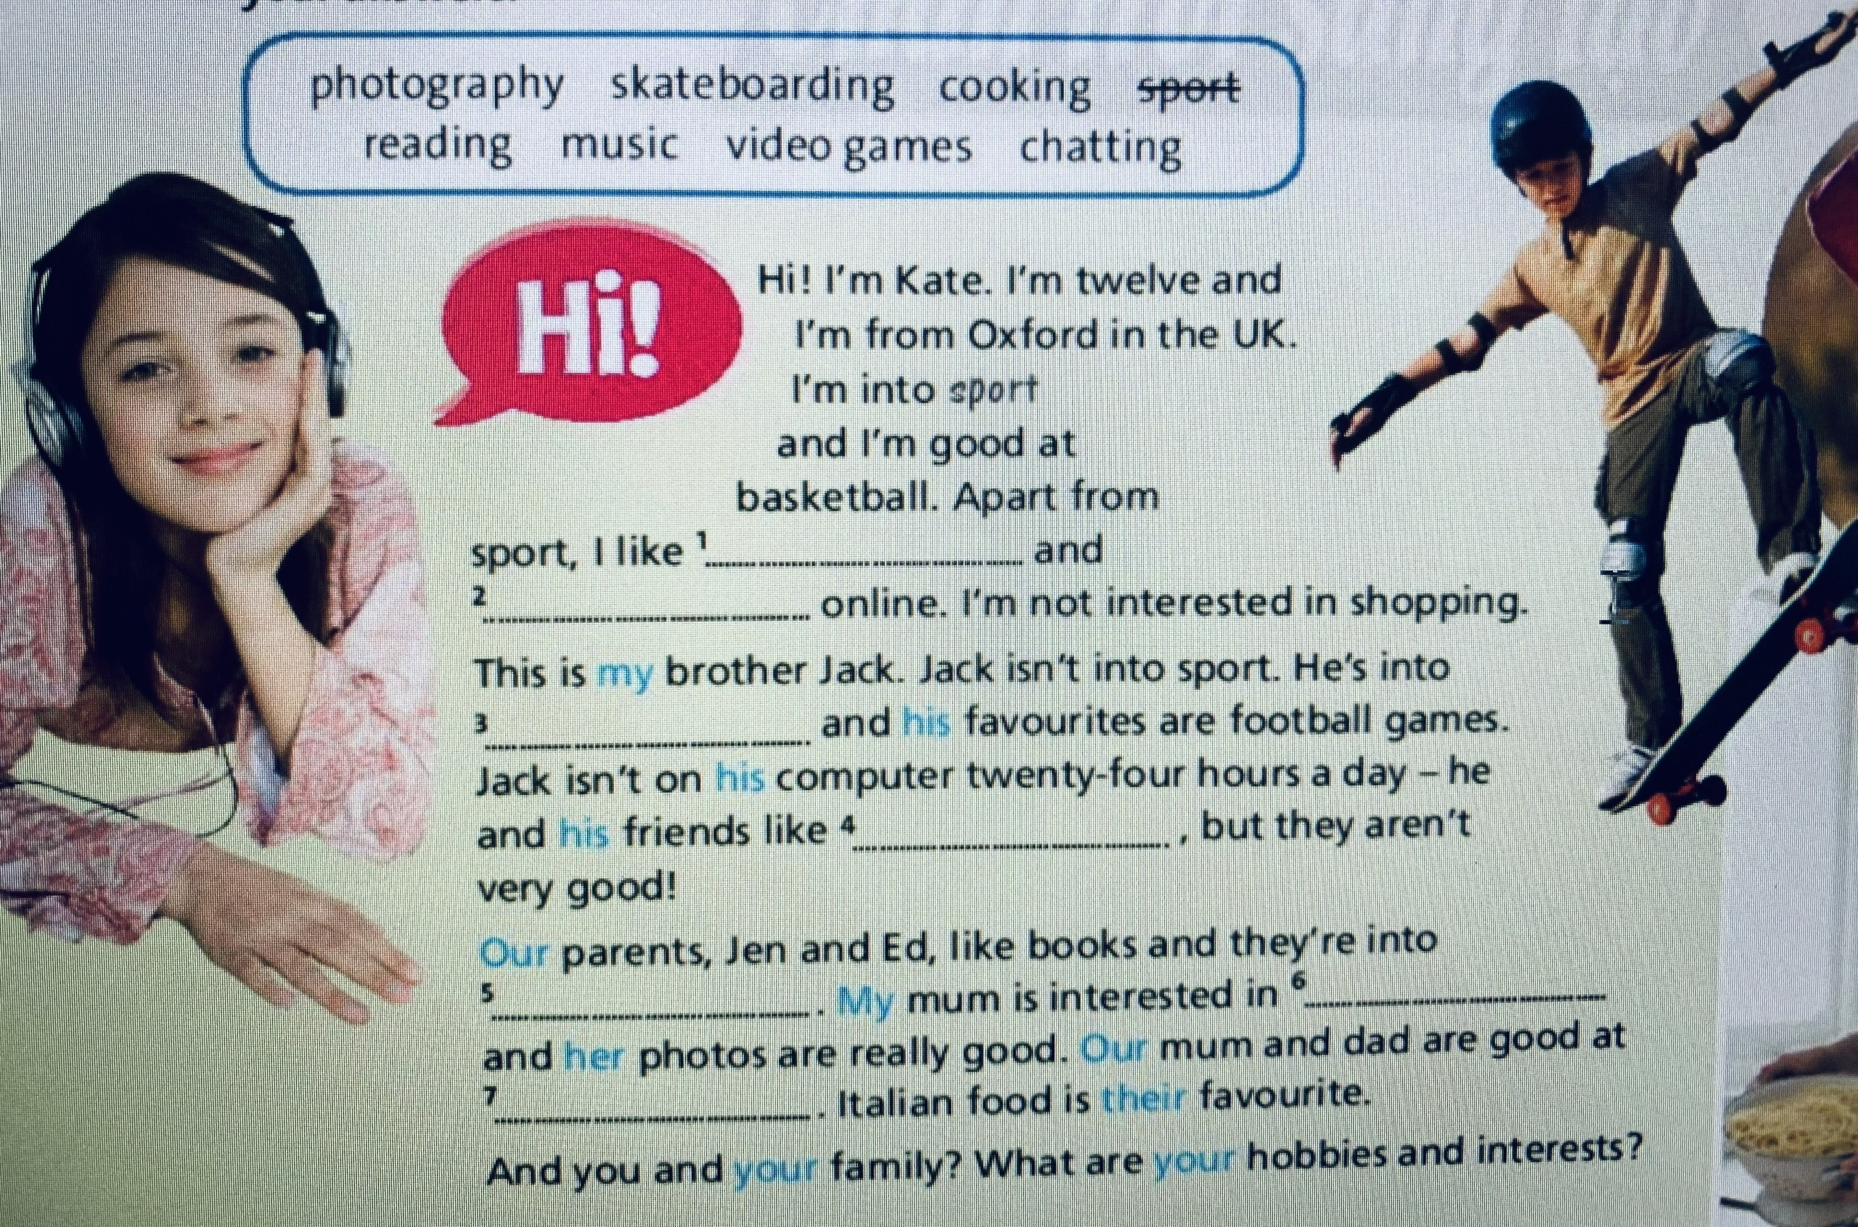

Slide 28
Exercise 2 (P.6)
Hi! I’m Kate. I’m twelve and I’m from Oxford in the UK. I’m into sport and I’m good at basketball. Apart from sport, I like 1…………. and 2……………. online. I’m not interested in shopping. This is my brother Jack. Jack isn’t into sport. He’s into 3………………… and his favourites are football games. Jack isn’t on his computer twenty-four hours a day – he and his friends like 4…………………. , but they aren’t very good!
music
chatting
video games
skateboarding

Slide 29
Our parents, Jen and Ed, like books and they’re into 5…………….My mum is interested in 6…………………and her photos are really good. Our mum and dad are good at 7……………….. . Italian food is their favourite.
And you and your family? What are your hobbies and interests?
reading
photography
cooking

Slide 30
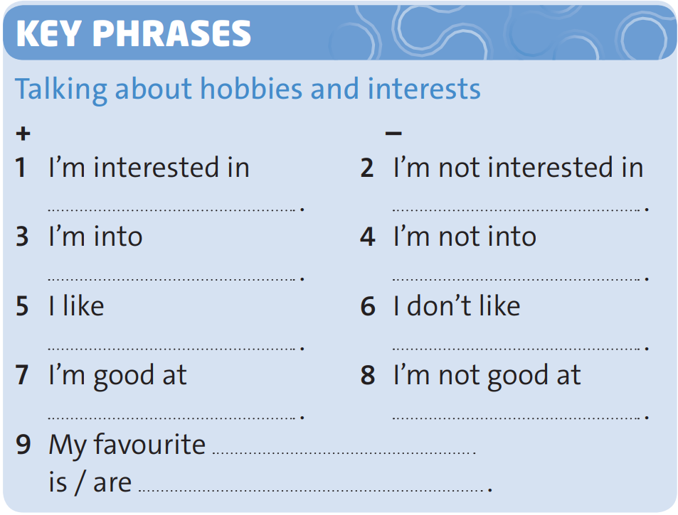
Exercise 3 (P.6)
music
cycling
films and watching TV
reading
shopping and meeting friends
chatting online
skateboarding
art
animals, dogs

Slide 31
Exercise 4 (P.6)
Talking about hobbies and interests.
What are you good at?
What are you intereted in ?
What is your favorite food / sports/ drink/subject ?
What are you inten ?
5. What do you like doing?
6. Do you play any sports?

Slide 32
Homework
Learn new words of the today lesson.
Prepare for the next lesson - Language focus: the Verb " To be“
What are the 3 forms of the verb to be in present?

