Slide 1


Slide 2
PERSONAL INFORMATION
UNIT 2
Telephone numbers(A1,2,3)
A

Slide 3
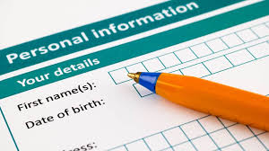
personal information(n): thông tin cá nhân
I. NEW WORDS:

Slide 4
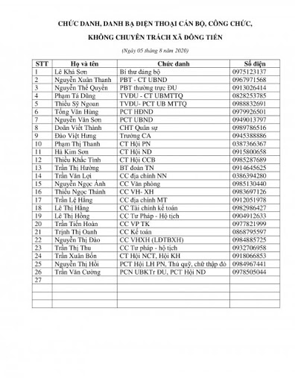
telephone directory(n): danh bạ điện thoại

Slide 5
telephone number (n) : số điện thoại
My telephone number is 8 545 546.

Slide 6

call (v) : gọi , gọi điện thoại

Slide 7
early # late (adj/adv) : sớm # trễ
I always get up early.
I never get up late.

Slide 8
I.New words:
- personal information (n)
thông tin cá nhân
- telephone directory (n)
danh bạ điện thoại
- telephone numbers (n)
số điện thoại
- call (v)
gọi điện thoại
- early # late (adv)
sớm # trễ

Slide 9
Note:
In English we usually say telephone number like this:
0 = oh (zero is sometimes also used)
63 = six three (NOT sixty-three)
66 = double six
666 = six double six
Ex: 8 237 789
Stop after reading the area code (8) and then read after three numbers

Slide 10
II.Structure:
Ask and answer about someone’s telephone number:
E.g: What is your telephone number?
→ 8 235 876
*Form:
What is your/ his/ her telephone number?
→ (It is+) telephone number

Slide 11
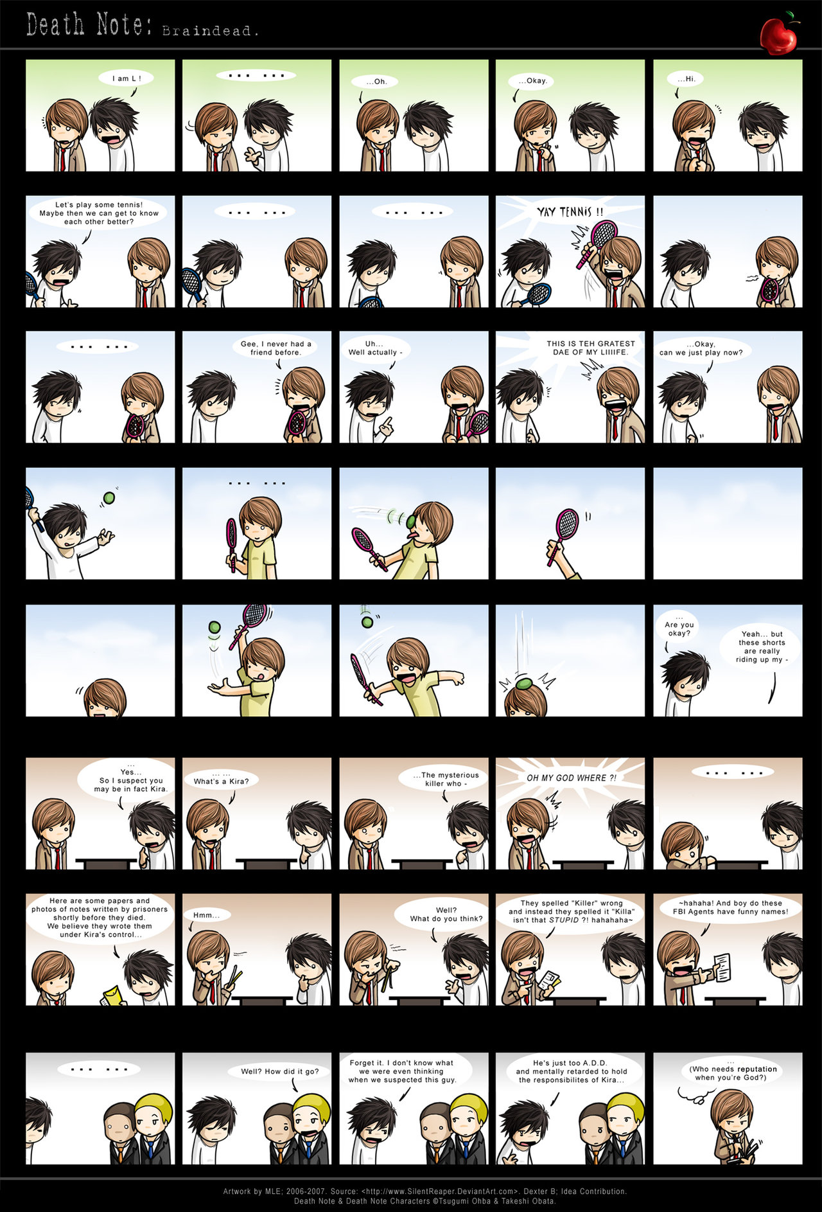
Read.(page19)
A1
Practice with a partner.
Say the telephone number for these people:
Dao Van An
Pham Viet Anh
Pham Thanh Ba
d) Dinh Thi Bang
e) Vu Thanh Bat
f) Bui Ngoc Bich
Tell me An’s number
Wait…
Here, 8 237 789

Slide 12


A2
Listen and write the telephone numbers.(page 20)
8 251 654
8 351 793
8 250 514
8 237 041
8 521 936
8 821 652

Slide 13
A3
Listen.
HOA
LAN
Thanks . I’ll call you soon
8 262 019
Yes , Lan ?
Excuse me, Hoa.
What’s your telephone number ?

Slide 14
Now ask your classmates and complete the list
NAME | ADDRESS | TELEPHONE NUMBER
HOA | HANOI | 8 262 019
What’s your name?
Where do you live? = What’s your address?
What’s your telephone number?

Slide 15
HOMEWORK
Learn by heart new words and the form .
Ask and answer about the phone number .
Rewrite the survey in your notebooks.
Prepare A4 – A5 .

