Slide 1

TEACHER : LÊ THANH HÀ

Slide 2


Slide 3
Monday, September,13th , 2021
STARTER UNIT
Lesson 3
Vocabulary – Prepositions and everyday objects

Slide 4

New words
a poster (n) /ˈpoʊ.stɚ/

Slide 5
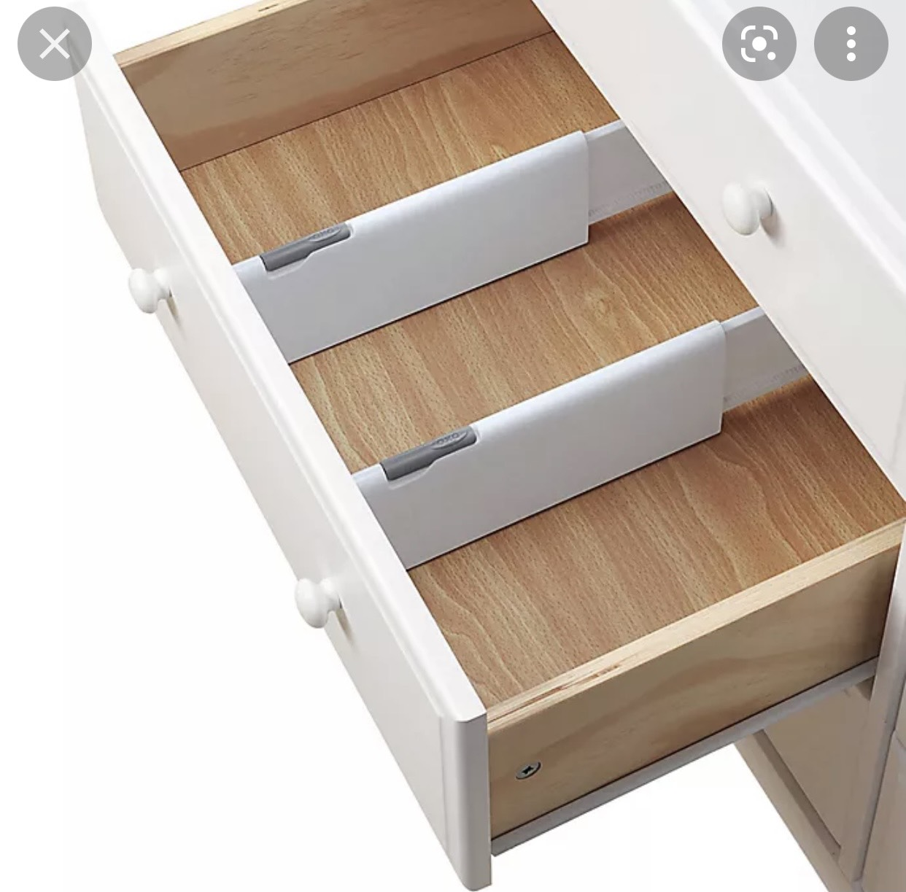
a drawer (n) /drɑː/

Slide 6

a dictionary (n) /ˈdɪk.ʃən.er.i/

Slide 7
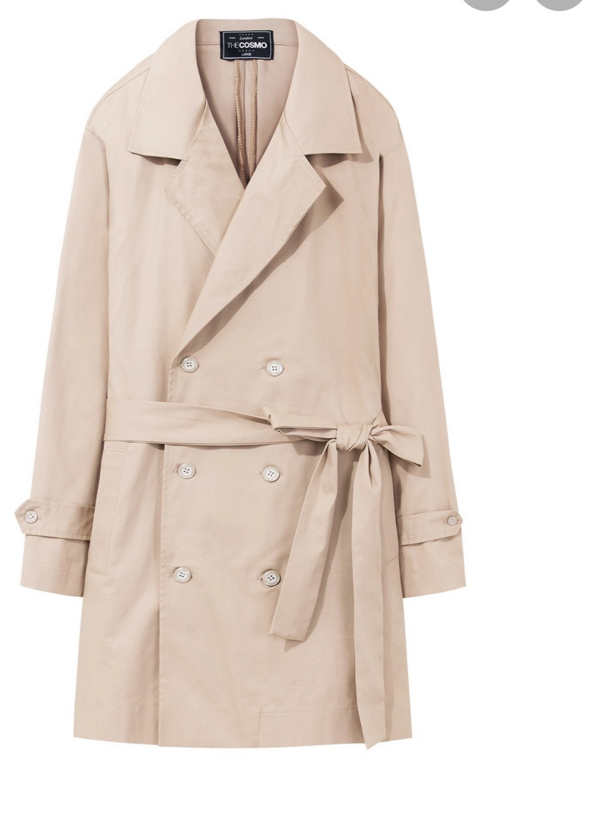
a coat (n) /koʊt/

Slide 8
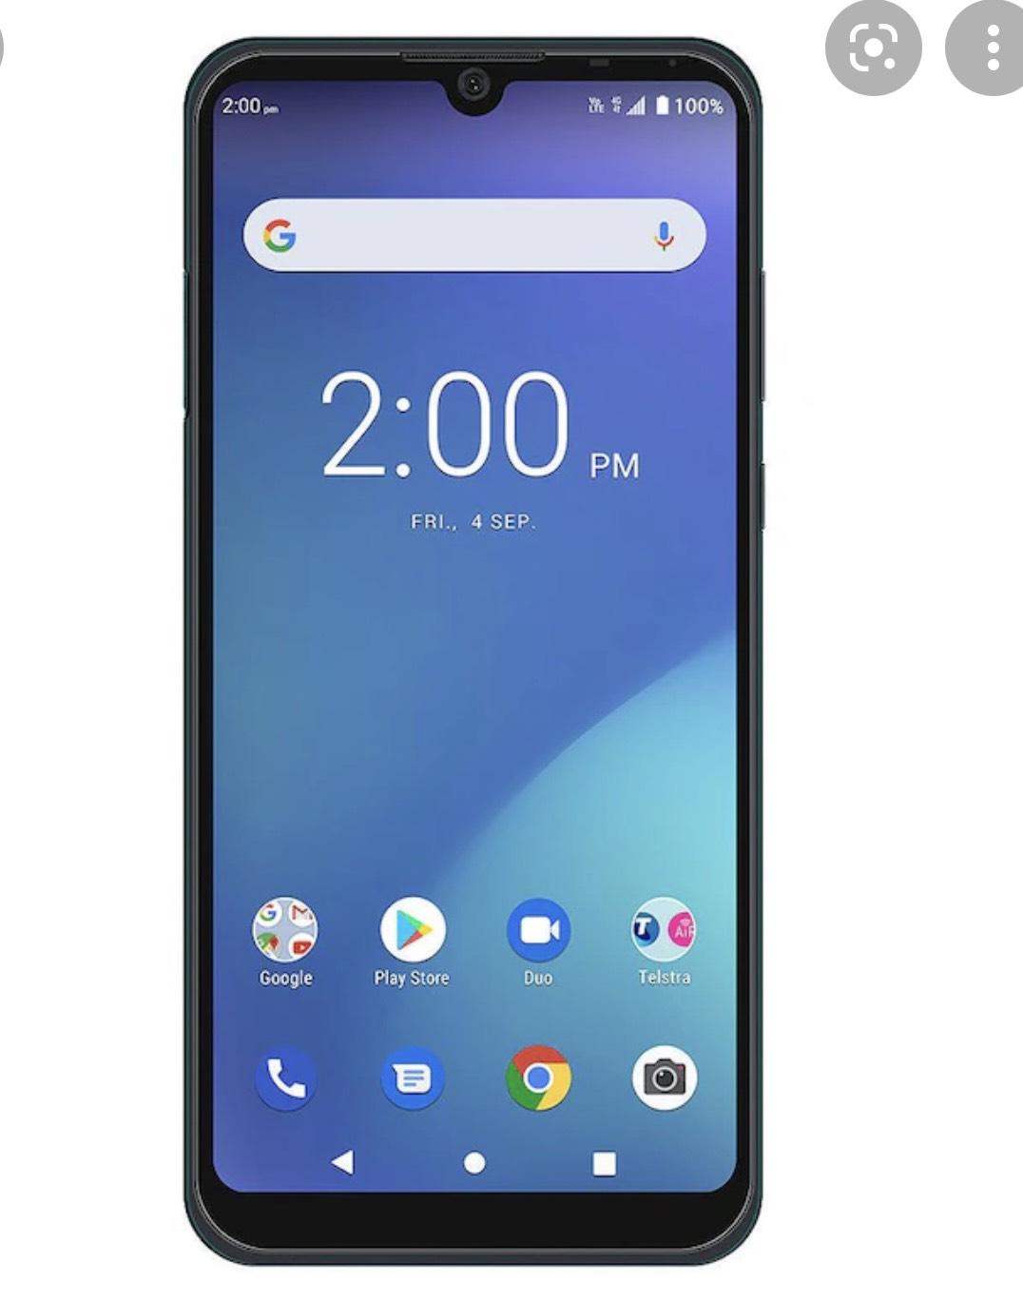
a mobile phone (n)
/ˈmoʊ.bəl/ /foʊn/

Slide 9
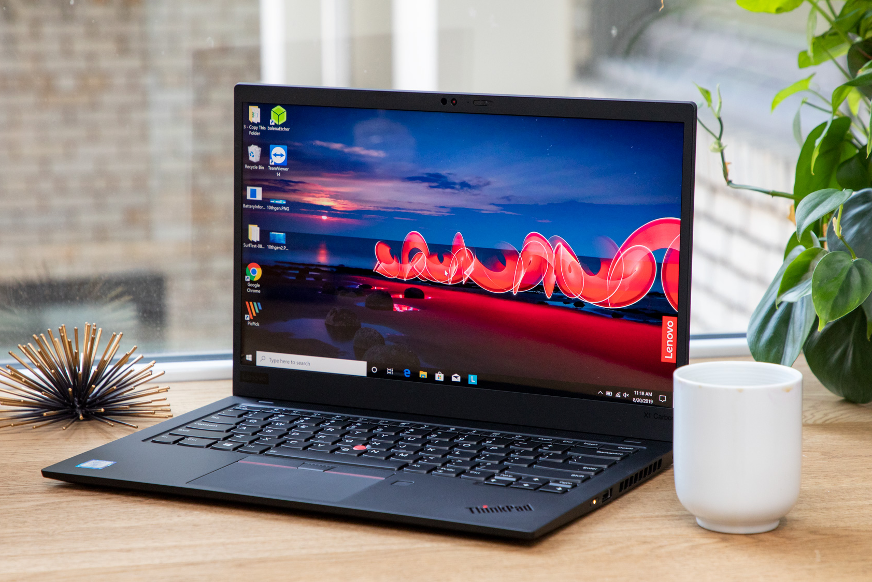
a laptop (n)
/ˈlæp.tɑːp/

Slide 10

a clock (n)

Slide 11
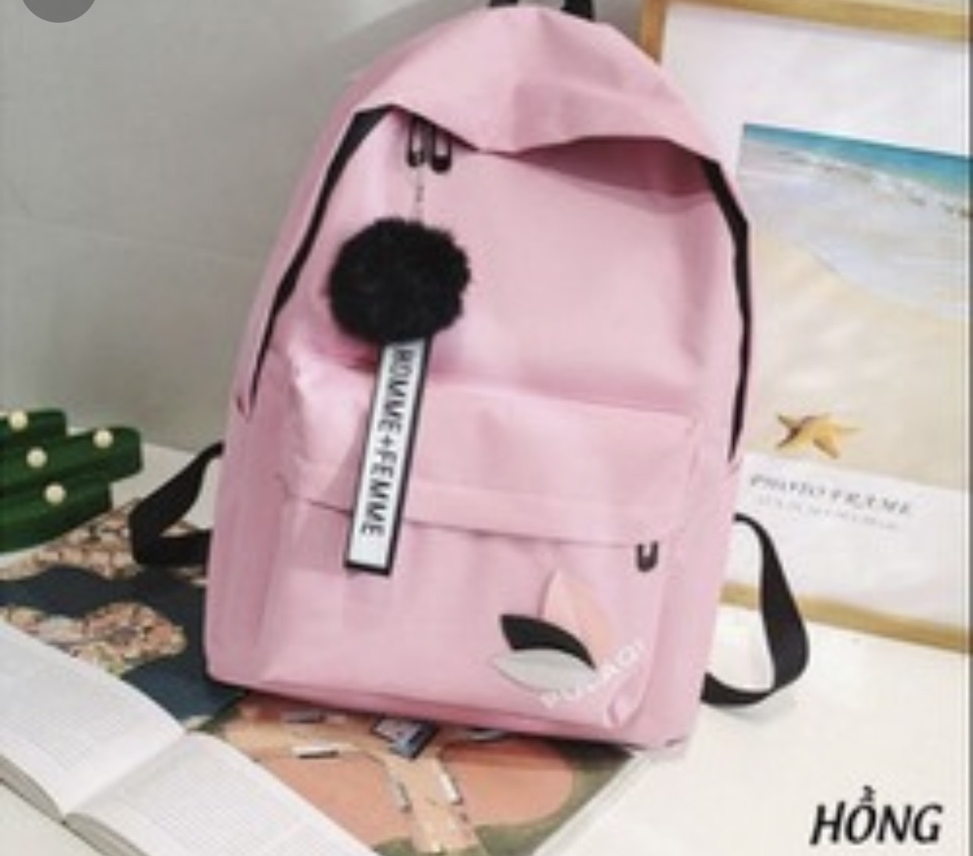
a bag (n)

Slide 12

a notebook

Slide 13
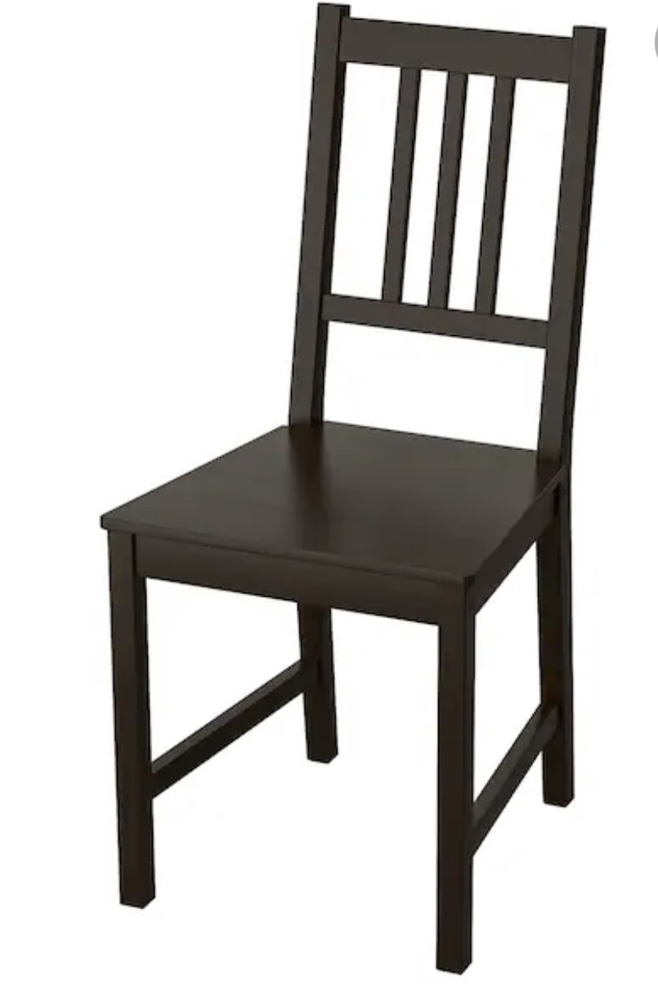
a chair

Slide 14
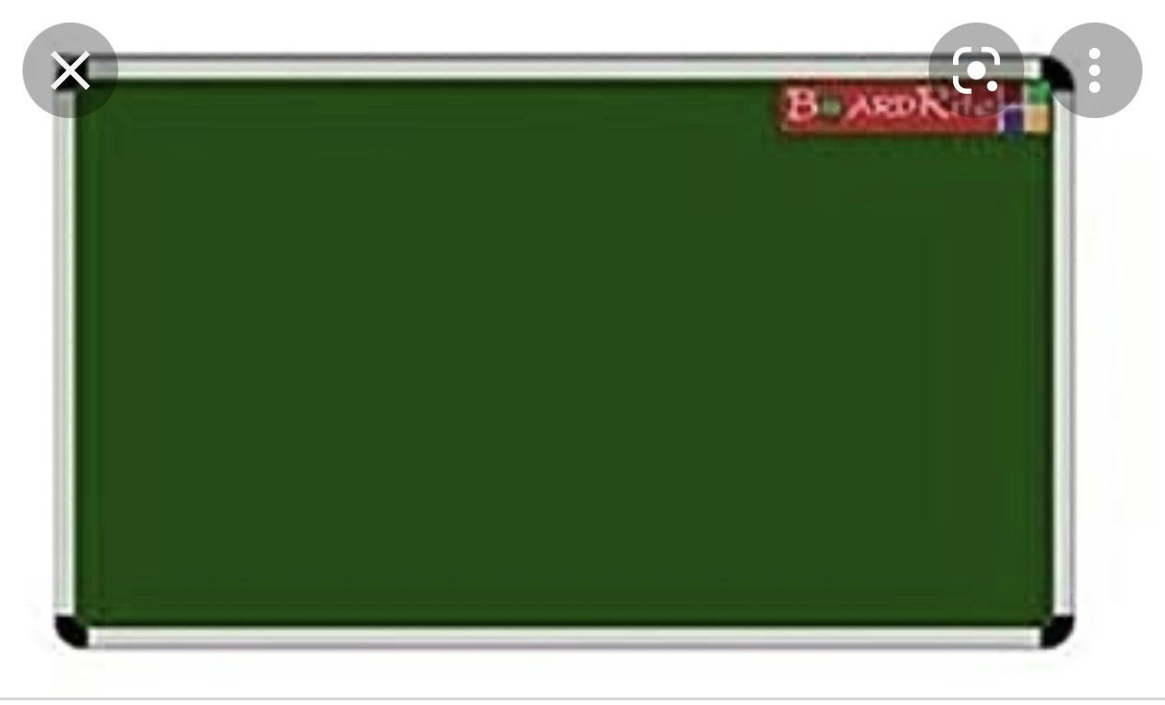
a board

Slide 15

a shelf

Slide 16
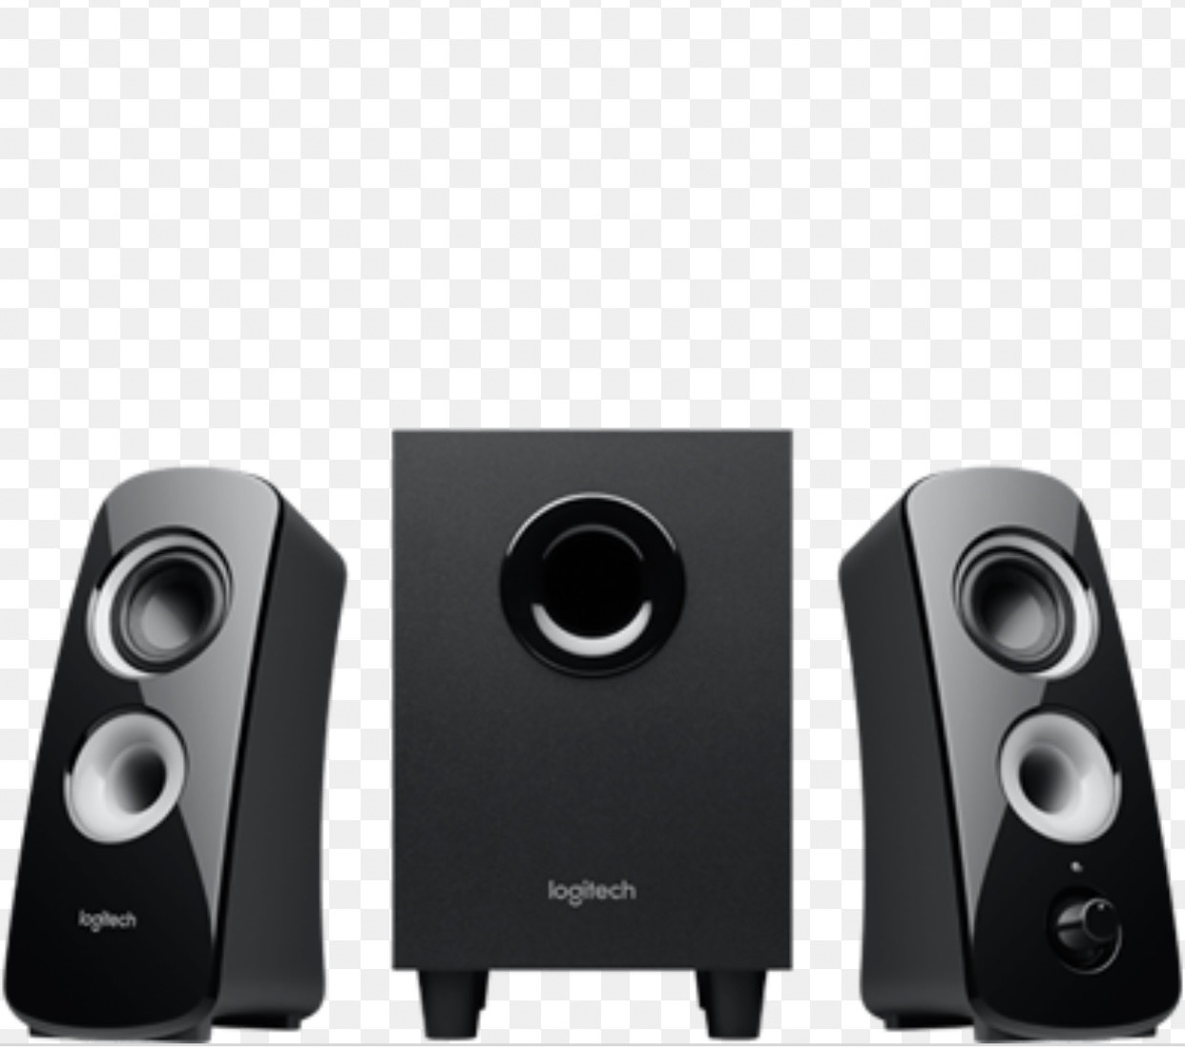
a speaker

Slide 17
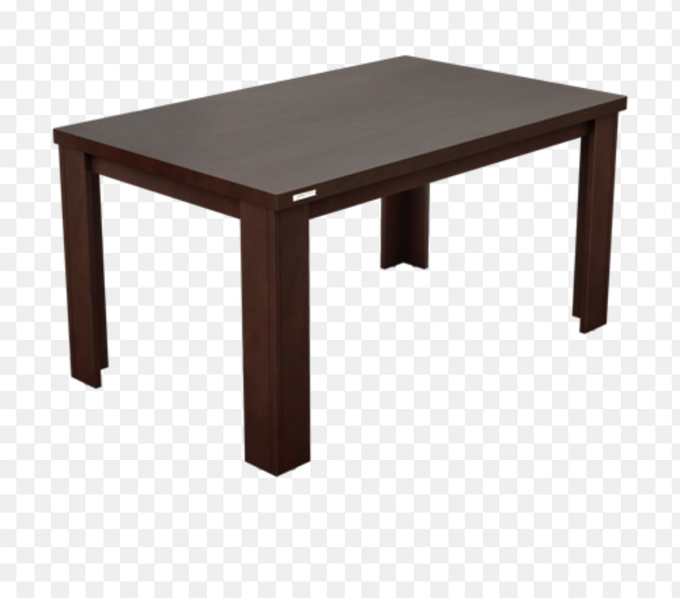
a table

Slide 18
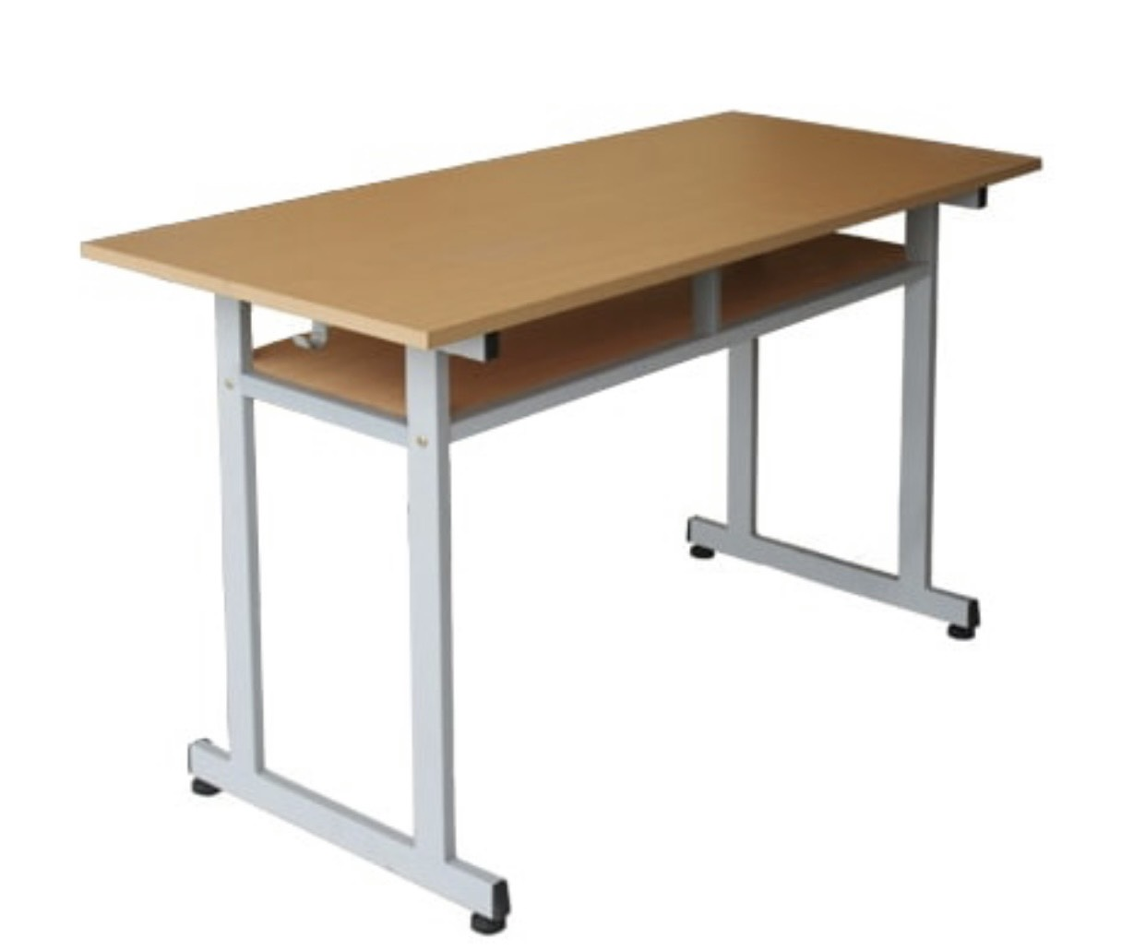
a desk

Slide 19
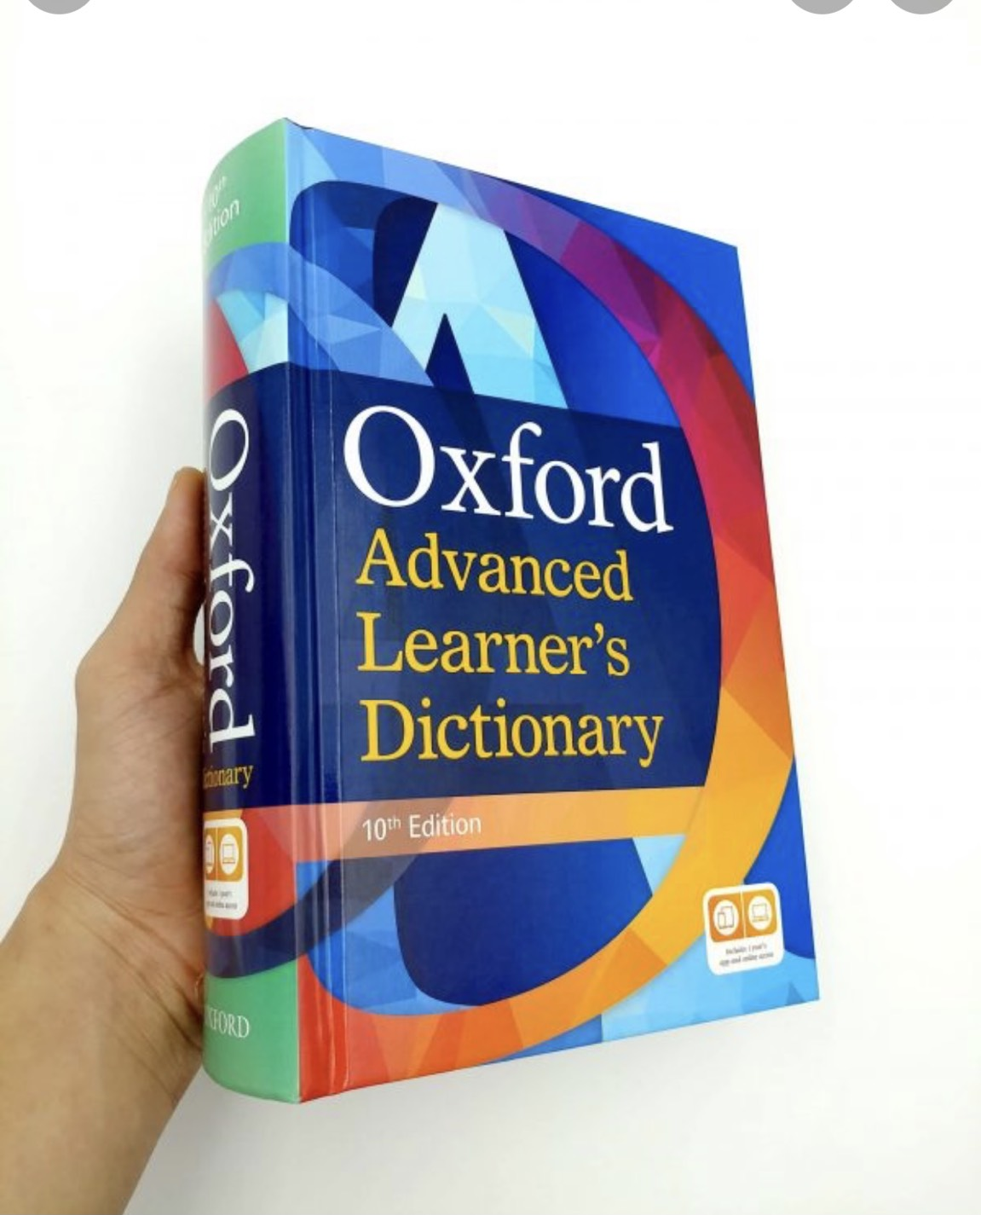
a dictionary

Slide 20
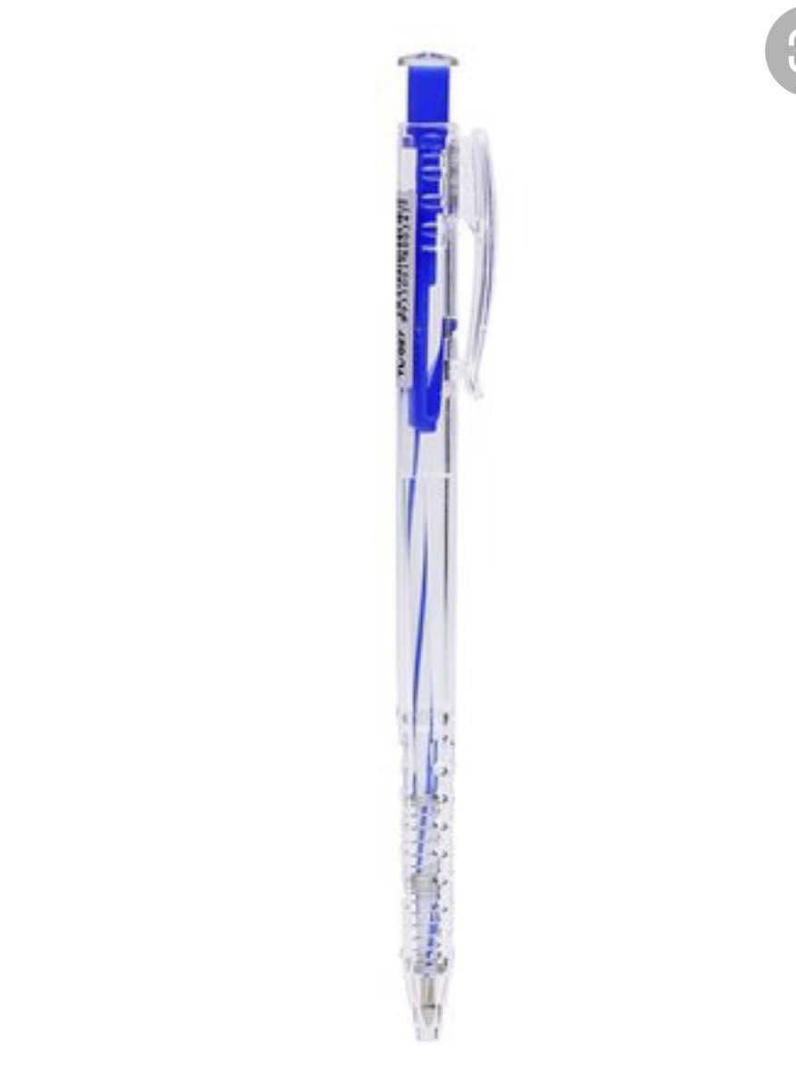
a pen

Slide 21
NEW WORDS
NOUNS
poster 12. desk
speaker 13.note book
laptop 14.coat
table 15.chair
drawer 16.bag
mobile phone PREPOSITIONS
clock 17. between 22.opposite
8. board 18. under 23.in
9. dictionary 19.next to
10.shelf 20.near
11.pen 21. on

Slide 22
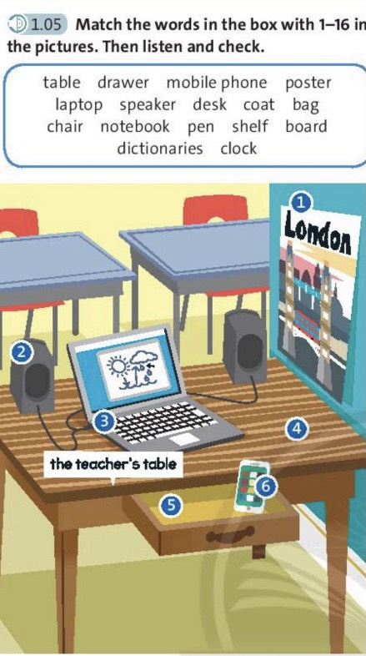
Exercise 1

Slide 23
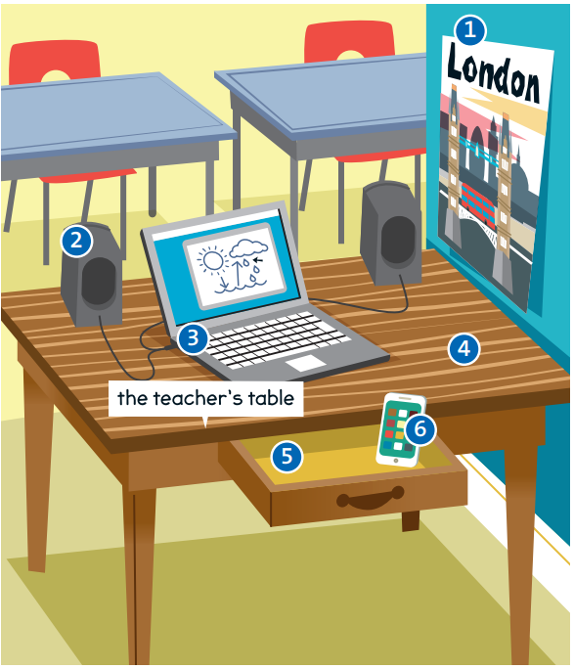
1. poster
2. speaker
4. table
3. laptop
6. mobile
phone
5. drawer

Slide 24
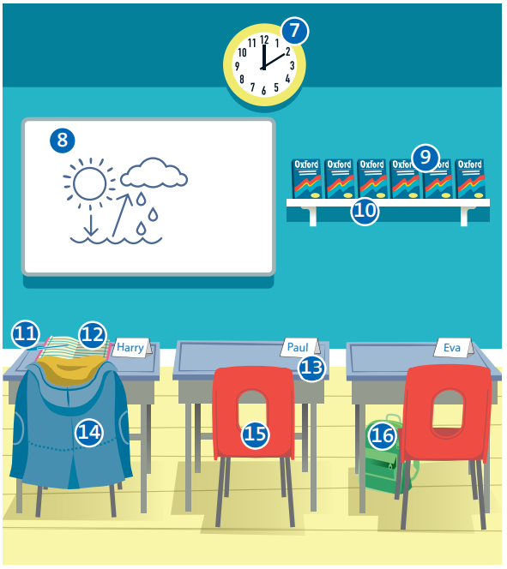
7. clock
8. board
9. dictionaries
10. shelf
11. pen
13. desk
12. notebook
14. coat
16. bag
15. chair

Slide 25
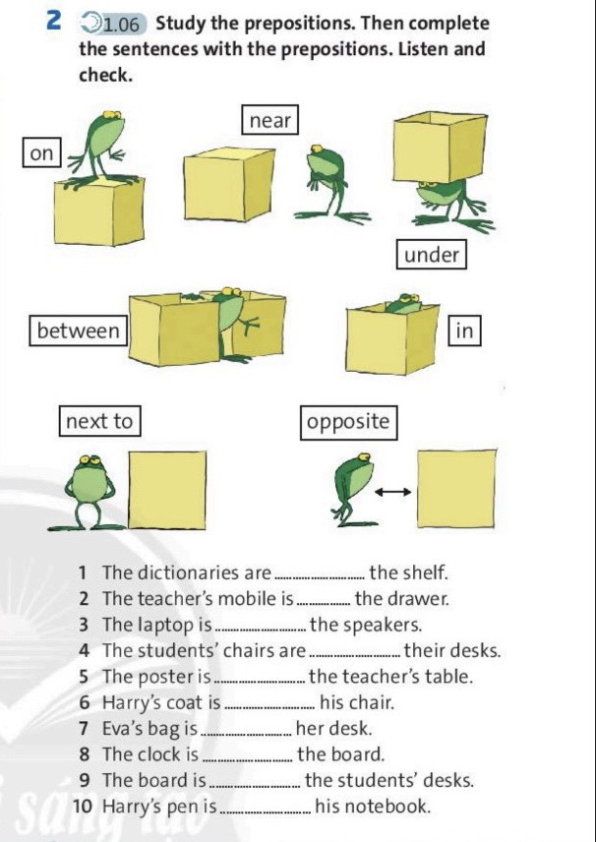
Exercise 2

Slide 26
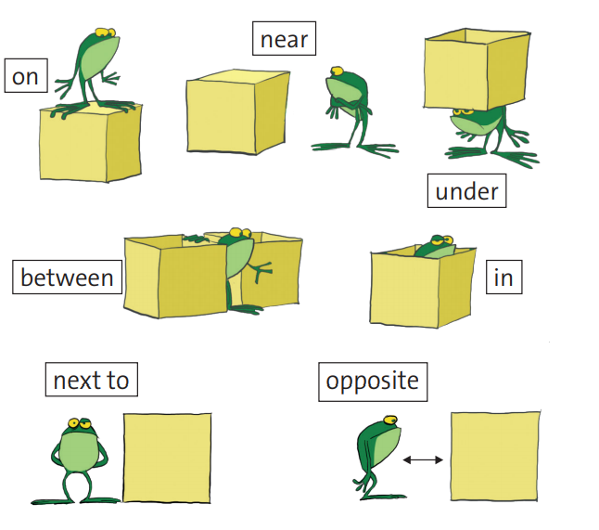

Slide 27
Exercise 2
on
1. The dictionaries are _______the shelf.
2. The teacher’s mobile is ______ the drawer.
3. The laptop is __________ the speakers.
4. The students’ chairs are _____ their desks.
5. The poster is ________ the teacher’s table.
in
between
under
next to

Slide 28
on
6. Harry’s coat is _______ his chair.
7. Eva’s bag is ________ her desk.
8. The clock is ________ the board.
9. The board is _______ the students’ desks.
10. Harry’s pen is _________ his notebook.
under
near
opposite
on

Slide 29
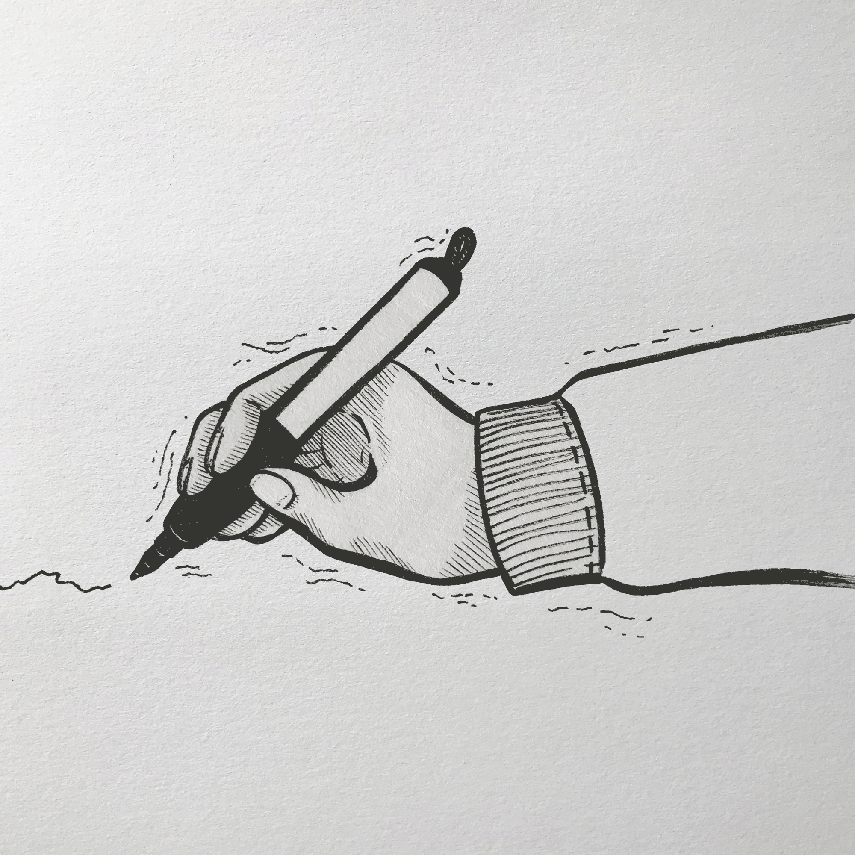
Draw a picture

Slide 30

WRITING
In my picture, a ruler under ....

Slide 31

Work in pairs
In my picture, a laptop
is on the desk. ..
…...

Slide 32

- Learn by heart all the new words
- Prepare for next lesson – Language focus: Possessive " 's "

