Slide 1

TEACHER : LÊ THANH HÀ

Slide 2


Slide 3
STARTER UNIT
Lesson 4
Language Focus
Possessive ’s • be: questions
• Possessive pronouns

Slide 4
STARTER UNIT
Lesson 4
Language Focus
Possessive Case ( Sở hữu cách )

Slide 5
1. It’s Mary’s cell phone
a person
something
2. It’s David’s camera
3. It’s Anna ’s book

Slide 6
Possessive Case ( Sở hữu cách )
Sở hữu cách là hình thức chỉ định quyền sở hữu của một đối tượng với một cá thể/ vật thể khác

Slide 7
What is the Possessive Case?
's or s’
Noun’s/s’ + Noun
(something)

Slide 8
 | Noun 's or noun s' | Noun
Singular | Anna's | pen
Plural | My parents' | house

Slide 9
RULES
1 We use 's for possession with | ____________words.
2 we use s' for possession with | ____________words.
Singular
Plural

Slide 10
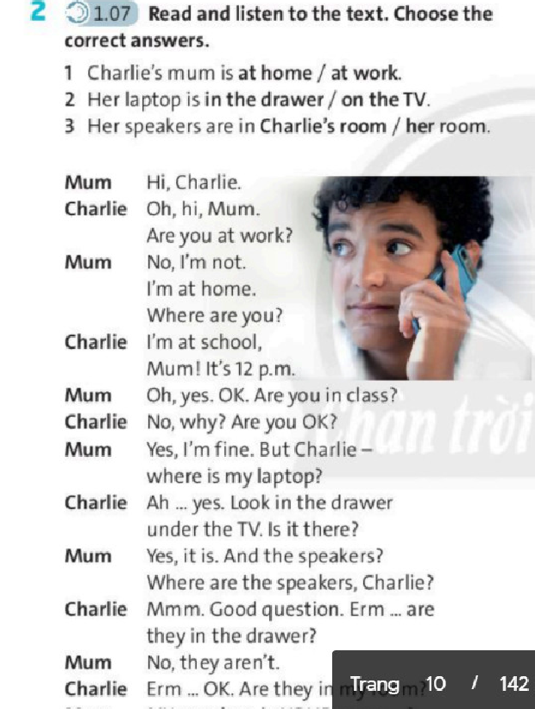
Exercise 2 Listen

Slide 11

Exercise 2 – Listen
1 Charlie's mum is at home / at work.
2 Her laptop is in the drawer / on the TV.
3 Her speakers are in Charlie's room / her room.

Slide 12
STARTER UNIT
Lesson 4
Language Focus
Be. Questions
( Câu hỏi với động từ “to be”)

Slide 13
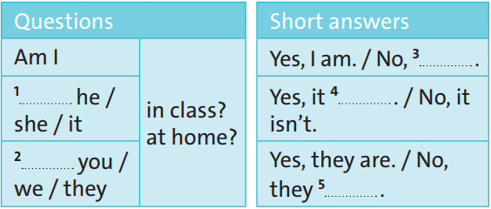
Exercise 3 - Work in pairs
I'm not
Is
is
Are
aren't

Slide 14
Possessive Pronouns
( Đại từ sở hữu)
Là những đại từ chỉ sự sở hữu được sử dụng thường xuyên nhằm tránh sự lặp từ ở những câu phía trước.

Slide 15


1 This is our house.
It's ours.
2 This is my bedroom.
It's mine.

Slide 16
Subject Pronouns | Possessive
 | Adjectives | Pronouns
I | my | mine
you | your | yours
he | his | his
she | her | hers
it | its | its
we | our | ours
you | your | yours
they | their | theirs

Slide 17
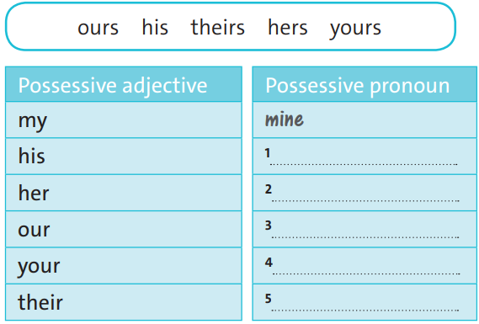
Exercise 4 – Matching
his
hers
ours
theirs
yours

Slide 18
Exercise 5 – Writing
2. This is his.
3. This is hers.
4. This is ours.
5. This is yours.
6. This is theirs.

Slide 19

- Learn by heart all the new words
- Prepare for next lesson – Language focus: Basic adjectives.

