Slide 1

TEACHER : LÊ THANH HÀ

Slide 2


Slide 3
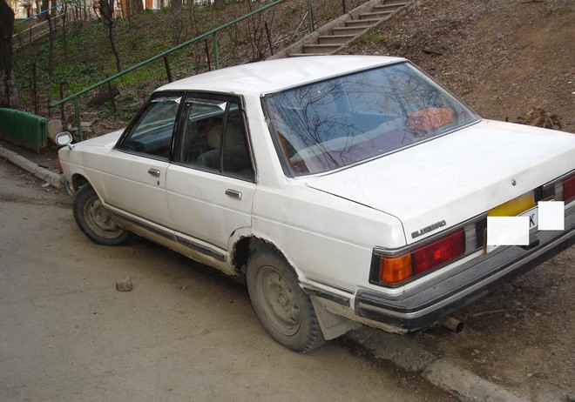
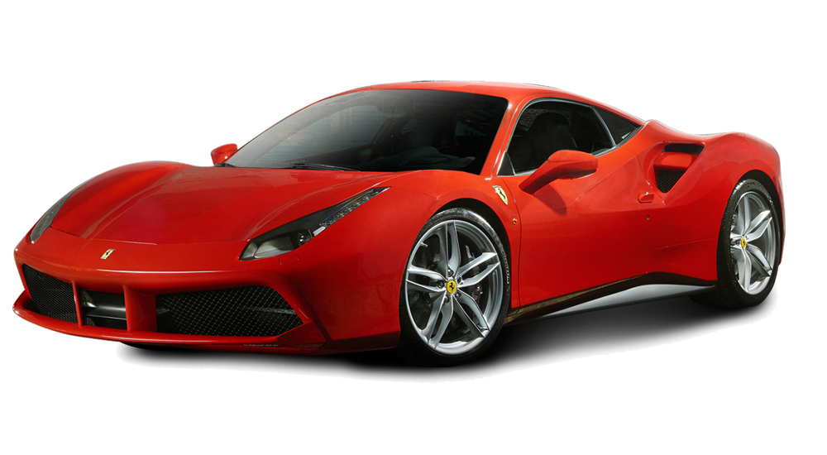
What's the difference
between them?

Slide 4
STARTER UNIT
Lesson 5
Vocabulary
Basic adjectives

Slide 5

What are adjectives?

Slide 6
1.This is a blue plate.
Adj
Noun
2.This mobile phone is expensive.
tobe
Adj

Slide 7
Position of Adjective
after to be
before Noun
to be +Adj
Adj + noun

Slide 8
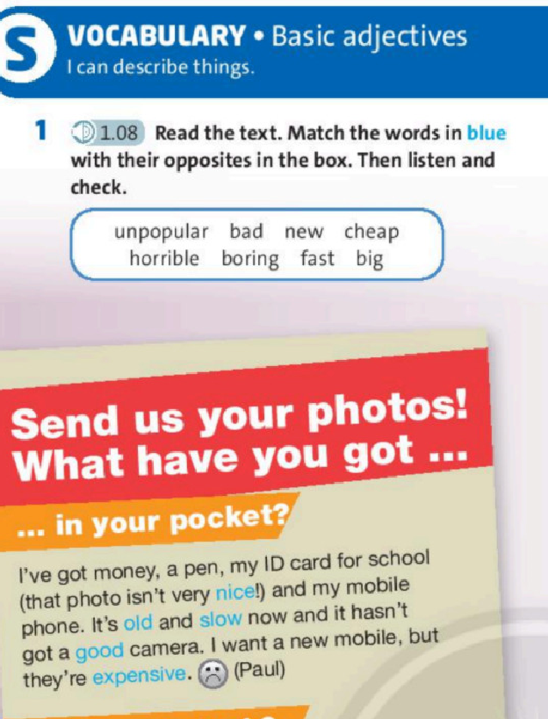
Exercise 1 Reading

Slide 9
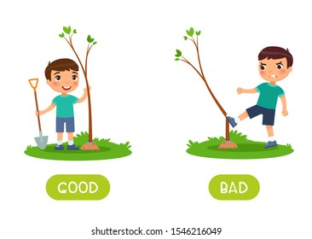

Slide 10
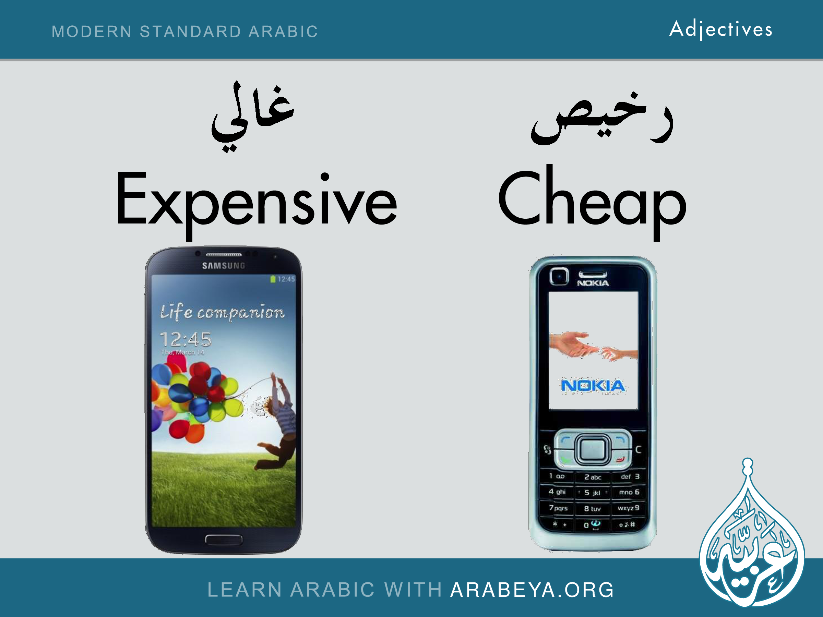

Slide 11
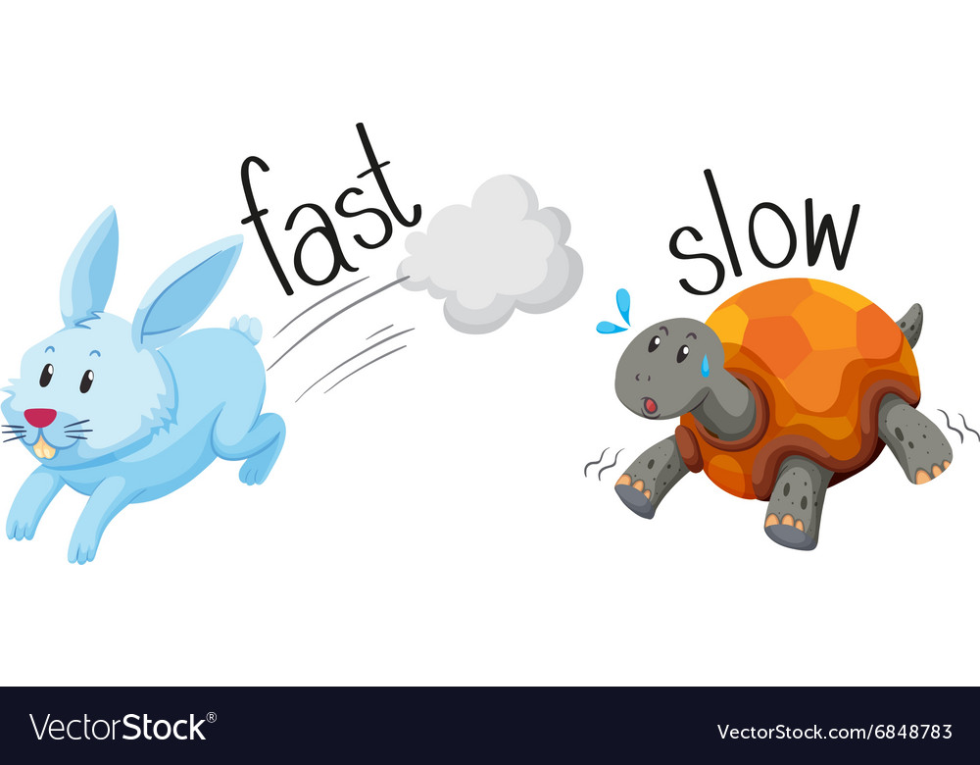

Slide 12
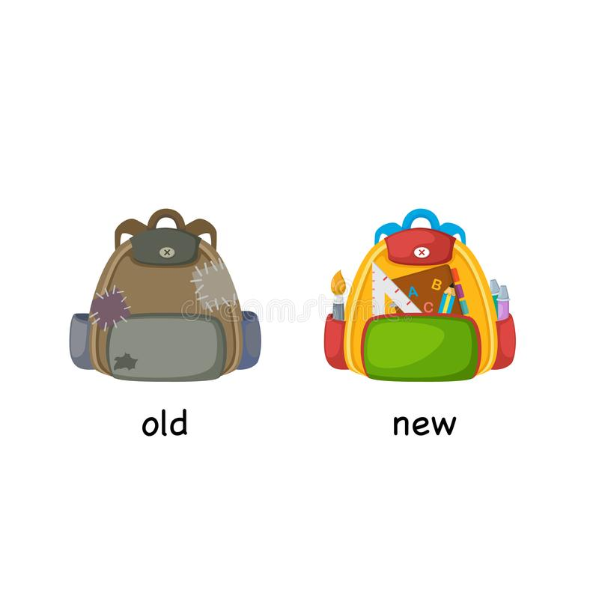

Slide 13
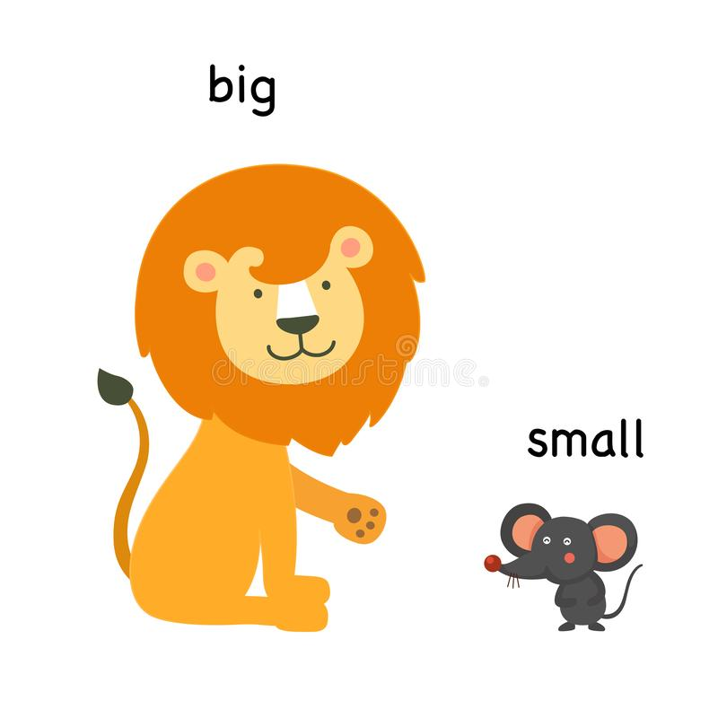

Slide 14
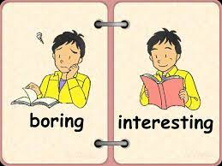

Slide 15

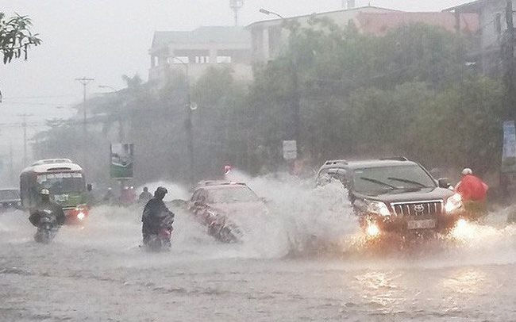
nice
> <
horrible

Slide 16
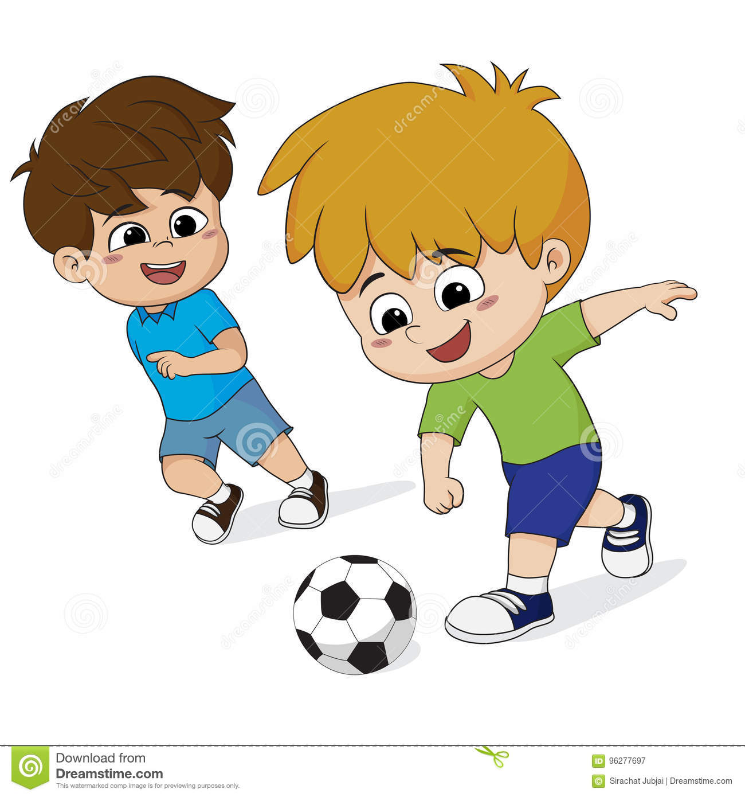
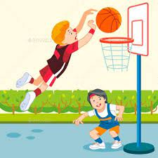
popular
unpopular

Slide 17
NEW WORDS
ADJECTIVES
nice >< horrible
old >< new
slow >< fast
good >< bad
expensive ><cheap
small >< big
popular >< unpopular
8. interesting>< boring

Slide 18
Exercise 1 – Matching
1.nice.
2.old
3.slow
4.good
5.expensive
6.small
7.popular
8. interesting
a.bad
b.horrible
c.unpopular
d.new
e.boring
f.cheap
g.fast
h.big

Slide 19
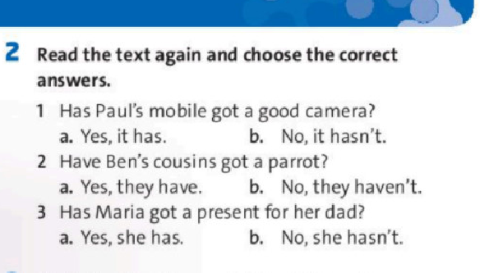
Exercise 2 Reading

Slide 20
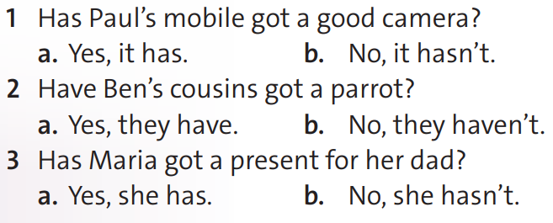
Exercise 2 – Reading

Slide 21
quite
Adverbs
of degree
very
really

Slide 22
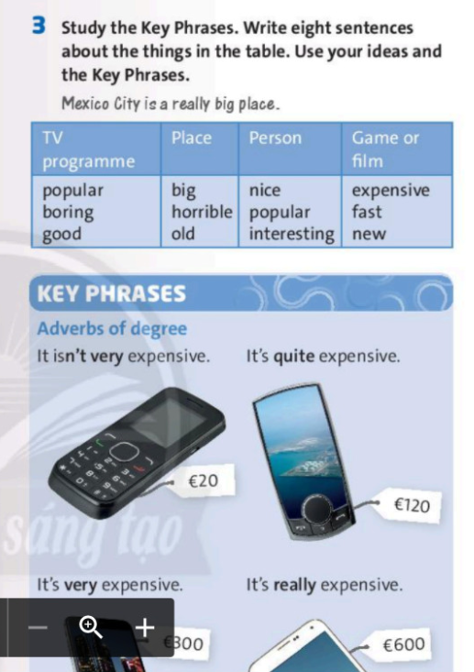
Exercise 3 Writing

Slide 23
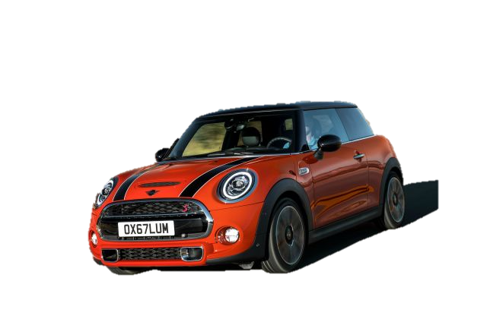
His car is really good

Slide 24
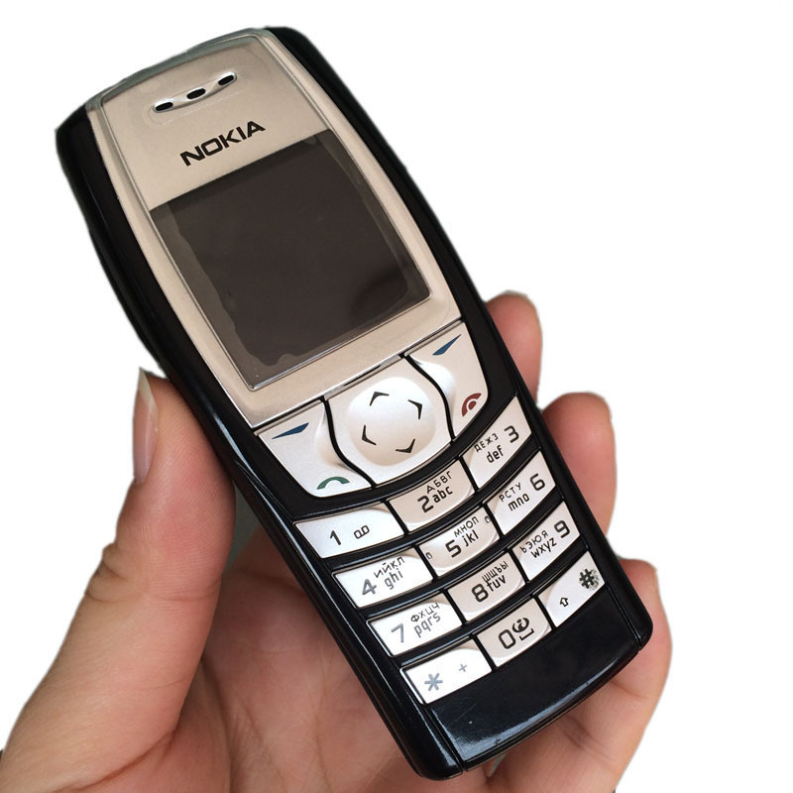
The mobile phone
Is quite cheap

Slide 25

2. My cat
is very nice .

Slide 26
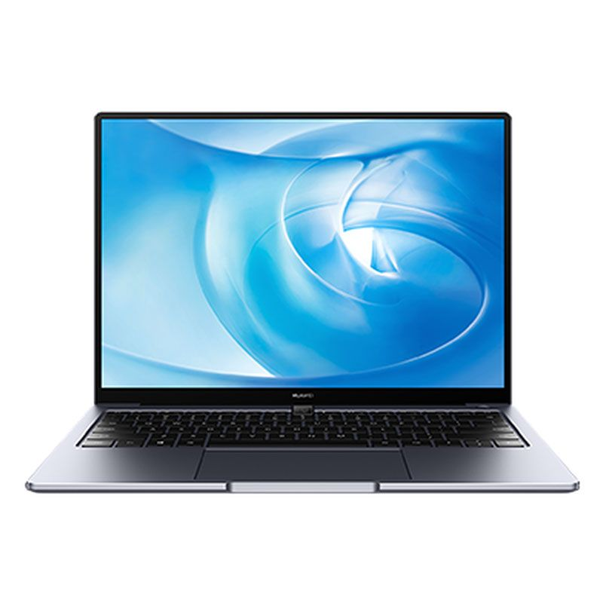
2. My dad's laptop
is very expensive.

Slide 27
Exercise 3 – Writing
Ex: 1. The mobile phone is quite cheap.
2. My dad's laptop is very expensive.
3.His car is really good

Slide 28


Slide 29

- Learn by heart all the new words
- Prepare for next lesson – Language focus: This, That, These, Those, Have got

