Slide 1

GIÁO VIÊN : LÊ THANH HÀ

Slide 2


Slide 3
STARTER UNIT
Lesson 6
Language Focus
THIS-THAT-THESE-THOSE-HAVE GOT

Slide 4
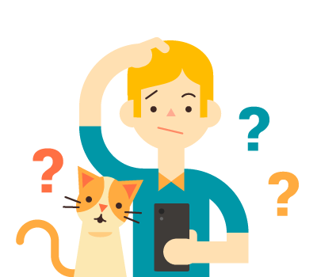
What is the difference between this/that and these/those?

Slide 5


This cat is happy.
singular Noun
These cats are happy.
plural Noun

Slide 6


That cat is sad.
singular Noun
Those cats are sad.
plural Noun

Slide 7
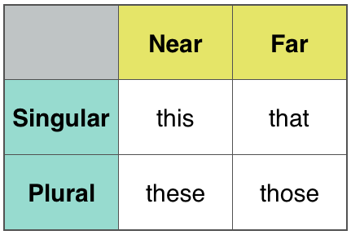
this-that-these-those

Slide 8
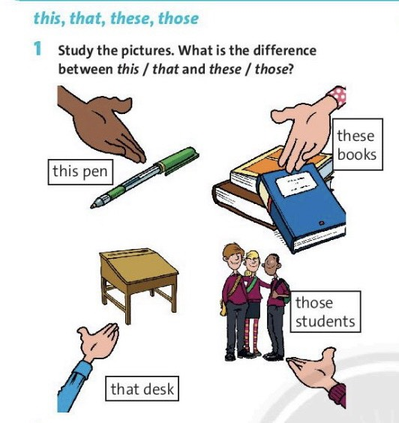

Slide 9
Exercise 1
We use this and these when the object(s) is near.
We use that and those when the object(s) is far away.

Slide 10
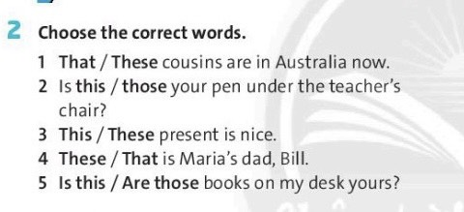

Slide 11
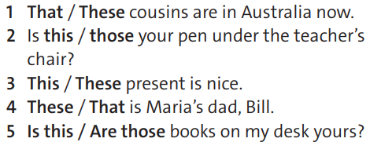
Exercise 2

Slide 12
HAVE GOT
S+ have got (‘ve got) + O
has got (‘s got)
Affirmative form
Negative form
Question
S + have not (haven’t) got +O
has not (hasn’t) got
Have/Has + S + got …..?

Slide 13
*Note
HAVE GOT has
the same meaning as HAVE
I've got a new computer
= I have a new computer.

Slide 14
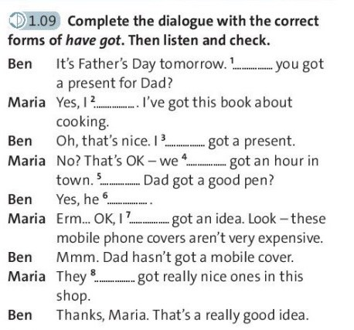

Slide 15
Exercise 3
1. 've 2. haven't
3. hasn't 4. Has
5. haven't

Slide 16

New words
present (n) /ˈprez.ənt/
expensive (adj) /ɪkˈspen.sɪv/
costing a lot of money

Slide 17
nice (n) /naɪs/
Example: He is a nice person.

Slide 18
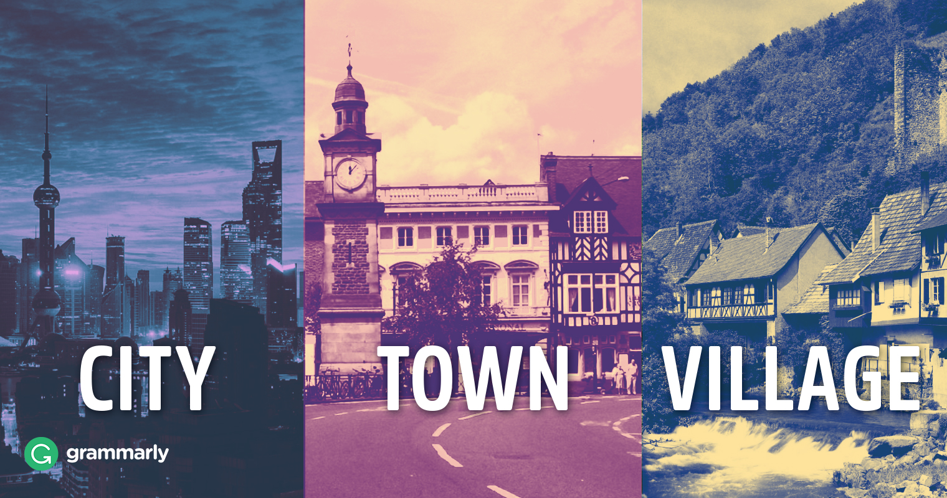
town (n) /taʊn/

Slide 19
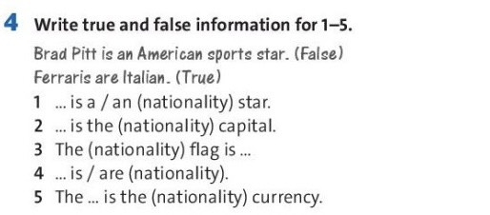

Slide 20
Exercise 4
1. Have 2. have
3. haven't 4. ‘ve
5. Has 6. has
7.’ve 8.’ve

Slide 21
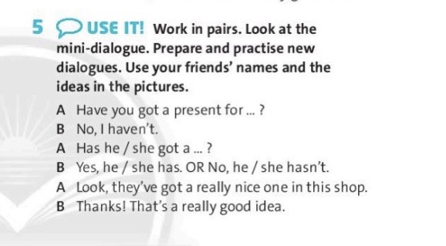

Slide 22

1. What have you got?
2. What haven't you got?

Slide 23

- Learn by heart all the new words
and structures.
- Prepare for next lesson:
Vocabulary. Countries and Nationalities.

