Slide 1
ENGLISH 9
UNIT 1
A VISIT FROM A PENPAL
Hoa Lu Junior High School

Slide 2
WELCOME TO OUR CLASS
School Year: 2021-2022

Slide 3
You have just had a wonderful summer, haven’t you?
1. Where did you go last summer vacation?
→
2. What did you do during your summer vacation?
→
3. What do you think about the summer vacation in Viet Nam?
→

Slide 4
Do you have any penpals?
a person that you make friends with by writing letters
1. Where is he / she?
2. What is his / her nationality?
3. How often do you and your penpal correspond?
write letters to s.b and receive letters from them

Slide 5
4. Have you and your penpal met each other?
5. If your penpal came to visit you , which places would you drive her /him to ( take .....to )?

Slide 6
Read the passage and answer these questions
1. What was Maryam impressed by in Ha Noi?
→
2. Where did the girls go on the first day in Ha Noi?
→

Slide 7
3. How long have Lan and Maryam been penpals?
→
4. How often do Lan and Maryam correspond?
→
5. Has Lan ever visited the mosque before?
→

Slide 8
6. Did Maryam enjoy the trip to Viet Nam?
→
7. Did Lan accept Maryam’s invitation to Malaysia immediately?
→

Slide 9
GETTING STARTED & LISTEN AND READ
pen pal (n)
foreign(a)
foreigner(n)
3. correspond(v)
correspond to
correspondence (n)
correspondent(n)
4. at least
5. modern(a)
modernize(v)
modernity(n)
modernistic (a)
bạn qua thư
thuộc nước ngoài
người nước ngoài
3. liên lạc = thư từ
tương xứng với
sự liên lạc qua thư
phóng viên
4. ít nhất
5. hiện đại
hiện đại hóa
tính chất / cái hiện đại
theo cách hiện đại

Slide 10
GETTING STARTED & LISTEN AND READ
6. impress (v)
impression (n)
impressive(a)
≠ unimpressive (a)
7. beauty(n)
beautiful(a)
beautifully(adv)
beautify(v)
beautician (n)
8. friendly (a)
friendliness (n)
friendless (a)
friendship (n)
6. gây ấn tượng, làm cảm động
ấn tượng, cảm tưởng
hùng vĩ, đẹp, gây ấn tượng
không gây ấn tượng
7. vẻ đẹp
đẹp
hay ( chơi thể thao, nhạc)
làm đẹp
người giải phẫu thẩm mỹ
8. thân thiện
sự thân thiện
không có bạn bè
tình bạn

Slide 11
GETTING STARTED & LISTEN AND READ:
9. mausoleum(n)
10. mosque (n)
11. walk past (v)
12. primary school
secondary school
high school
college / university
13. atmosphere (n)
14. peace (n)
(=peacefulness)
peaceful (a)
( = peaceable)
9. lăng, tẩm
10. đền thờ hồi giáo
11. đi bộ ngang qua
12. trường tiểu học
trường THCS
trường THPT
trường CĐ / ĐH
13. bầu không khí
14. hòa bình,
sự thanh bình
êm ả,
thanh bình

Slide 12
GETTING STARTED & LISTEN AND READ
18. touch (v)
(n)
keep in touch with
be/get in touch with
19. recreation (n)
areas for recreation
20. worship
18. chạm, tiếp xúc, với tới
sự chạm vào, tiếp xúc
giữ liên lạc, quan hệ với
19. sự giải trí, sự tiêu khiển
những khu giải trí
20. sự thờ cúng, sự tôn kính

Slide 13
Structures:
Subject + used to+ Bare Infinitive
past habit
động từ nguyên mẫu không “to”
- When I was a child, I used to watch cartoons

Slide 14
Structures:
- My sister used to stay up late last year.
- There used to be a dance hall here but they knocked it down yesterday.

Slide 15
Structures:
Subject + didn’t use to + V- 0
- I’m surprised that they joined the tennis club, They didn’t use to like tennis.

Slide 16
Structures:
Did + Subject + use to + V- 0 ?
- Did you use to travel a lot before you got that job?

Slide 17
Notes:
Subject + be used to + Noun/V-ing
get used to
quen với việc gì / làm gì
- We are used to the noise from the traffic now

Slide 18
- She is used to getting up early
- John and his wife have been here for 5 months. They are getting used to eating Asian food.

Slide 19
SPEAK:
Make and respond to introduction
Let me introduce myself,
I am Minh.
Nice to meet you, Minh
( I am.......)
B. Pleased to meet you, Minh ( I am.......)
A. Nice to see you, too.

Slide 20
Language Focus
WISH FOR UNREAL THINGS

Slide 21
Language Focus
b. I wish I were in the swimming pool now.
c. I wish I had a computer.
d. I wish I lived close to ( near) school
( I wish I didn’t live far from school)

Slide 22
Language Focus
e. I wish I had a sister.
f. I wish I drew well. ( I wish I didn’t draw badly)
g. I wish I had my friend’s phone number.

Slide 23
Language Focus
h. I wish I knew many friends
i. I wish it rained so often in my hometown
j. I wish there were many rivers and lakes and in my hometown

Slide 24
SPEAK
You must be .....
That’s right, I am.
Pleased to meet you !
Let me introduce
myself !
5. I see.
6. in some ways
Vâng, chính là tôi.
Hân hạnh gặp bạn !
xét về vài khía cạnh
Xin cho tôi tự giới
thiệu mình !
e. Bạn chắc hẳn là
f. Tôi hiểu rồi

Slide 25
SPEAK
You must be .....
That’s right, I am.
Pleased to meet you !
Let me introduce
myself !
5. I see.
6. in some ways
Vâng, chính là tôi.
Hân hạnh gặp bạn !
xét về vài khía cạnh
Xin cho tôi tự giới
thiệu mình !
e. Bạn chắc hẳn là
f. Tôi hiểu rồi

Slide 26
SPEAK (Page 8)
1
C
5
B
4
D
2
E
3
A
6

Slide 27
READING
        (PAGE 9-10)

Slide 28
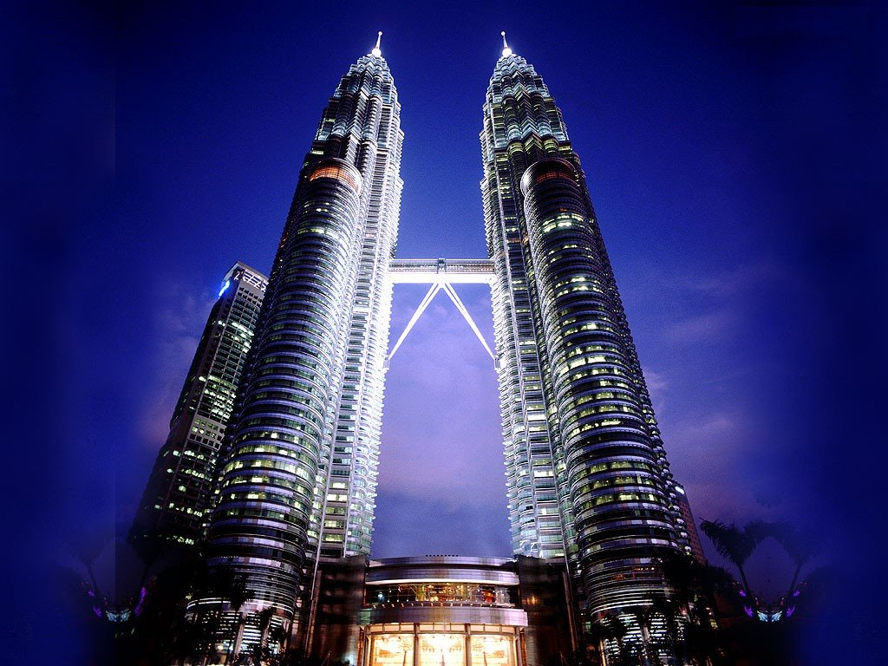
WARM UP
Petronas Twin Towers
They are in Kuala Lumpur

Slide 29
Capital City: Kuala Lumpur
M
ALAYS
I A
Official Religion: Islam
Other Religions: Buddhism, Hinduism
National Language:
Bahasa Malaysia( Malay)

Slide 30
Other Languages:
English, Chinese, Tamil
M
ALAYS
I A
Compulsory second Language:
English
Unit of currency: The ringgit = 100 sen

Slide 31
M
ALAYSI A
Climate: Tropical
Population:
over 22 million ( 2001)
over 28 million ( 2011)
Area:
329,758 sq km

Slide 32
Geography:
It has land borders with Thailand in West Malaysia, and Indonesia and Brunei in East Malaysia.
M
ALAYS
I A
East Malaysia:
Malaysian Borneo
West Malaysia: Peninsular

Slide 33
READ:
associate (v)
association (n)
* The Association of
South East Asian
Nations (ASEAN)
2. divide (v) ... into ...
division (n)
(in) divisible (a)
3. region (n)
4. separate (v)
separation (n)
5. climate (n)
tropical climate (n)
liên kết, kết hợp
hiệp hội, sự liên kết
* Hiệp Hội Các Quốc gia
Vùng Đông Nam Á
(ASEAN)
2. chia ... thành
phép chia, sự phân chia
(không) chia được
3. miền, vùng
4. tách ra, phân ra
sự tách ra
5. khí hậu
khí hậu nhiệt đới

Slide 34
6. be comprised of
= comprise
consist of (v)
7. tropic (n)
tropical (a)
temperate (a)
8. unit of currency (n)
9. Ringgit (n)
10. religion (n)
religious (a)
official religion (n)
11. officer (n)
(un) official (a)
official (n)
6. bao gồm
gồm có
7. miền nhiệt đới
thuộc về nhiệt đới
thuộc về ôn đới
8. đơn vị tiền tệ
9. đồng Ringgit
10. đạo, tín ngưỡng
có tín ngưỡng
đạo chính thức
11. sĩ quan quân đội
(không) chính thức
viên chức

Slide 35
READ:
12. instruct (v)
instruction (n)
instructor (n)
* The language of
instruction
13. compulsory (a)
compel (v)
14. National language
Native language
First language
Second language
Foreign language
15. area (n)
12. hướng dẫn, dạy
sự hướng dẫn
người hướng dẫn
* Ngôn ngữ giảng dạy
13. mang tính bắt buộc
bắt buộc, ép buộc
14. Ngôn ngữ quốc gia
Tiếng mẹ đẻ
Tiếng mẹ đẻ
Ngôn ngữ thứ hai
Tiếng nước ngoài
15. khu vực, diện tích

Slide 36
I. TRUE FALSE TEST:
a. Malaysia is a member country of ASEAN
True
b. There are two religions in Malaysia.
False
→ There are more than two
c. People speak only Malay in Malaysia.
False
→ Besides Malay, people also speak English, Chinese and Tamil in Malaysia.

Slide 37
I. TRUE FALSE TEST:
d. Primary school children learn three languages at school
False
→ They learn one of the three: Malay, Chinese or Tamil
e. All secondary school children learn in English.
False
→ English is a compulsory second language, not primary language of instruction

Slide 38
WRITE:
imagine: tưởng tượng
outline(n): dàn ý
airport(n): sân bay
disappointed(a): thất vọng
mention(v): đề cập đến

Slide 39
OUTLINE
First paragraph:
When did you arrive there?
Who met you at the air port / the bus station / the train station?

Slide 40
OUTLINE
2. Second paragraph:
What have you done there?
Which places have you visited?
Who have you met there?
What food have you tried?
What things have you bought?

Slide 41
OUTLINE
3. Third paragraph:
How do you feel about the trip?
What interests you most in this trip?
When are you going to return home?

Slide 42
Dear Mom,
I arrived at Dalat bus station at six pm. on Saturday evening.
Nga, Minh and uncle Ha met me at the MaiLinh station and took me home by car.
After dinner, Nga, Minh and I walked around and ate ice cream at Ngan Ha Restaurant near XuanHuong Lake.

Slide 43
I have been to many interestingplaces in Dalat such as Love Valley, CamLy Water Fall, Langbiang Mountain,….
I have tried lots of fruit and specialities here such as “Can” Wine,

Slide 44
LANGUAGE FOCUS
PAST SIMPLE:
What did Ba do on the weekend?
He went to see a movie called “Percy Jackson”
When did Ba see it (the movie)?
He saw it on Sunday the first.

Slide 45
What did Ba do on the weekend?
He visited his grandfather in DaNang.
When did Ba visit his grandpa?
He visited his grandfather on Saturday the thirty first.

Slide 46
Stay home
Keep safe
Be healthy
&
Have a nice day

Slide 47






- Learn by heart the new words.
- Do the exercises in your textbook
- Prepare “Language Focus”

Slide 48


THANK YOU
for your attention
GOOD BYE & SEE YOU AGAIN

