Slide 1
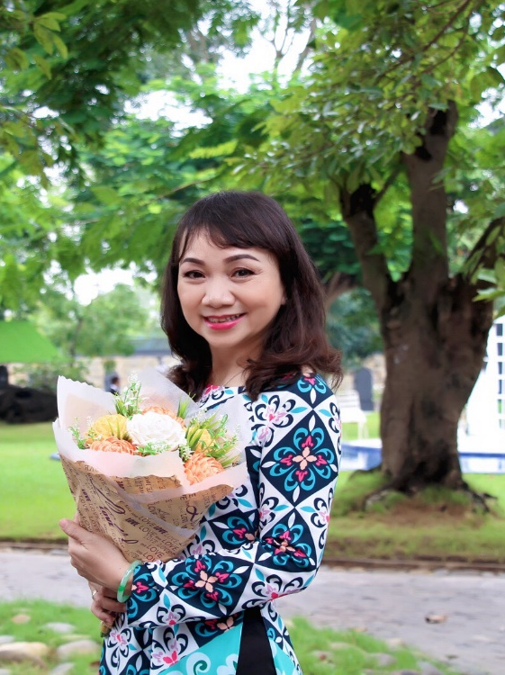
ENGLISH 9
UNIT 2
CLOTHING
Ms: Tran Thi Kim Trang
Hoa Lu Junior High School

Slide 2
WELCOME TO OUR CLASS
CLASS 9A...
School Year: 2021-2022

Slide 3
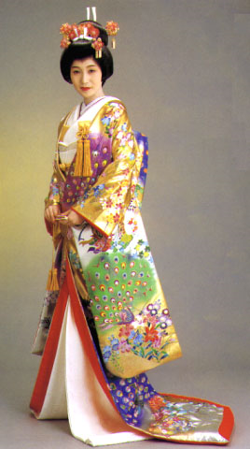

GETTING STARTED
Look at the dress these people are wearing. Decide where each person comes from
Where does she come from?
Why do you know?
She comes from Japan
Because she’s wearing the traditional clothes – kimono.

Slide 4
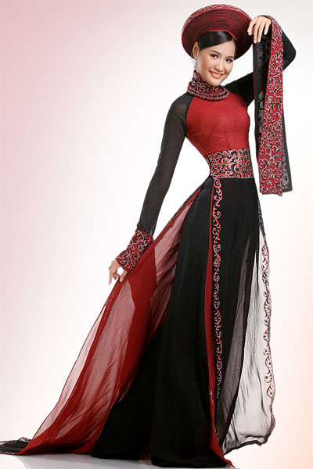
Look at the dress these people are wearing. Decide where each people comes from
Where does she come from?
Why do you know?
She comes from Vietnam
Because she’s wearing the traditional clothes – ao dai.

Slide 5
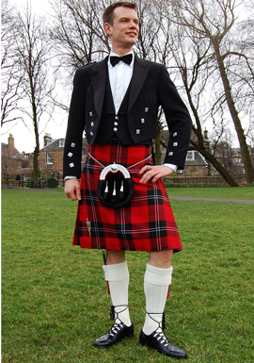
Look at the dress these people are wearing. Decide where each people comes from
Where does he come from?
Why do you know?
He comes from Scotland
Because he’s wearing the traditional clothes – kilt.

Slide 6
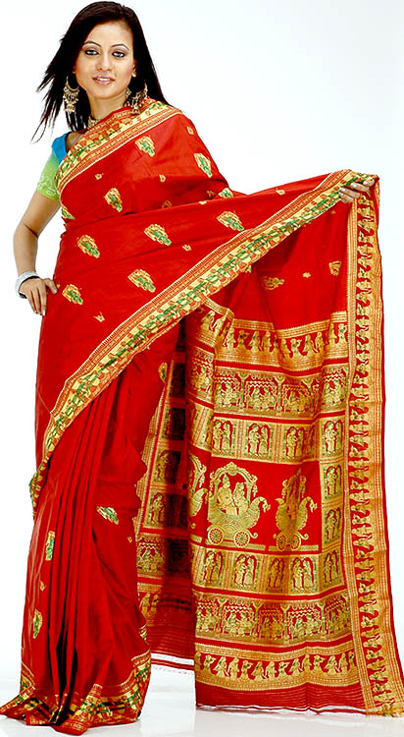
Look at the dress these people are wearing. Decide where each people comes from
Where does she come from?
Why do you know?
She comes from India
Because she’s wearing the traditional clothes – sari

Slide 7
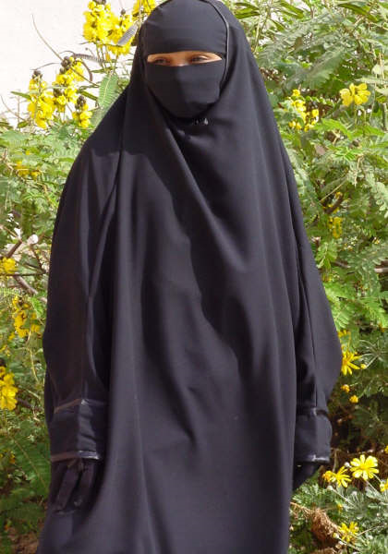
Look at the dress these people are wearing. Decide where each people comes from
Where does she come from?
Why do you know?
She comes from Saudi Arabia
Because she’s wearing the traditional clothes – veil

Slide 8
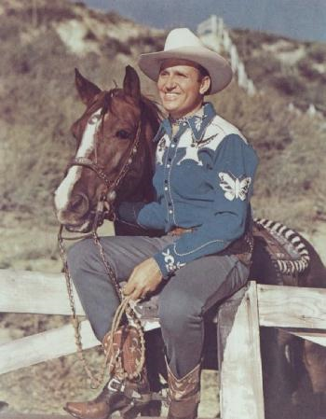
Look at the dress these people are wearing. Decide where each people comes from
Where does he come from?
Why do you know?
He comes from the USA
Because he’s wearing the traditional clothes – blue jeans

Slide 9
LISTEN & READ
I) Vocabulary
Century (n) : thế kỷ
Poet (n) : nhà thơ
Poetry (n) : thơ ca
Poem (n) : bài thơ
Poetic (a) : thuộc về thơ ca
Music (n) : âm nhạc
Musical (a) : thuộc về âm nhạc
Musician (n) : nhạc sỹ
Write (v) : viết
Writer (n) : nhà văn
Author (n) : tác giả (văn, thơ)
Novel (n) : tiểu thuyết

Slide 10
LISTEN & READ
I) Vocabulary
6) Story (n) : truyện
7) Song (n) : ca khúc
8) Tradition (n) : truyền thống
Traditional (a) : thuộc về truyền thống
Traditionally (adv) : về mặt truyền thống
By Tradition : về mặt truyền thống
9) Silk (n) : lụa
10) Tunic (n) : áo thụng
11) Slit / slit / slit (v) (n) : xẻ rãnh, đường xẻ
12) Wear / wore / worn (v) : mặc (quần áo, nón, ...)
13) Loose (a) : lỏng, rộng, chùng
14) Pants (pantaloons) (n) : quần dài

Slide 11
LISTEN & READ
I) Vocabulary
15) Frequently = usually (adv) : thường xuyên
16) Design (n) (v) : thiết kế
Designer (n) : nhà thiết kế
Noun
17) be used for + : được dùng để
V-ing
18) Especially (adv) : một cách đặc biệt
Special (a) : đặc biệt
Occasion (n) : cơ hội, dịp
Occasional (a) : tình cờ
Occasionally (adv) : đôi khi = sometimes
Chance (n) : dịp, cơ may
20) Change (v) (n) : thay đổi

Slide 12
LISTEN & READ
I) Vocabulary
21) At work / At home : ở nơi làm / ở nhà
22) Inspiration (n) : sự cảm hứng
Inspire (v) : lấy cảm hứng
23) (In)Convenient (a) : (không) thuận tiện
(In)Convenience (n) : sự (không) thuận tiện
24) Fashion (n) : thời trang
Fashionable (a) : hợp thời trang
Fashionably (adv) : một cách hợp thời
25) Lines of poetry (n) : dòng thơ, nét thi vị
26) Minority ≠ majority : thiểu số ≠ đa số
Ethnic minority : dân tộc thiểu số
27) Symbol (n) : biểu tượng
Symbolize (v) : tượng trưng cho

Slide 13
28) Modern (a) : hiện đại Modernize (v) : hiện đại hóa
29) Cross (v) : băng ngang
(n) : vạch chéo, dấu chữ thập
30) Stripe (n) : vạch kẻ
Striped (a) : có sọc
31) Pattern (n) : mẫu, khuôn
32) Unique (a) : độc nhất
33) Describe (v) : mô tả
Description (n) : sự mô tả
34) Alternative (n) : sự thay thé
(a) : thay đổi
35) Plaid (a) : kẻ ô vuông

Slide 14
36) Plain (a) : trơn, không có hoa
37) Sleeve (n) : tay áo
Short-sleeved (a) : ngắn tay
Sleeveless (a) : không tay áo
38) Baggy (a) : rộng thùng thình
39) Faded (a) : bạc màu
Faded jeans (n) : đồ jeans bạc màu
40) Casual clothes (n) : quần áo bình thường
41) Cloth (n) - : vải
- : khăn bàn
Clothe (v) : cung cấp quần áo
Clothes (n) : quần áo
Clothing (n) : y phục

Slide 15
Answer: a) / p. 14
1. ….. poems , novels and songs
2. ….. long silk tunic that is slit on the sides and worn over loose pants
3. ….. to wear modern clothing at work
4. lines of poetry on it
5. …. symbols such as suns, stars, crosses, and stripes

Slide 16
Answer: b) / p. 14
1. Traditionally, both men and women used to wear it.
2. Because it is more convenient.
3. In order to modernize the Aodai, they ( fashion designers) have printed lines of poetry on it or they have added symbols such as suns, stars, crosses, and stripes

Slide 17
READ
I) Vocabulary
Sail (v) (n)
Sailor (n)
Complete (v) (a)
Completely (adv)
Wear out (v)
Worn out (a)
Style (n)
Embroider (v) Embroidered jeans (n)
6) Situation (n)
Situate (v) 7) Own (a) (v)
Owner (n)
đi thuyền(v)/thuyền buồm (n)
thủy thủ
hoàn tất (v) / hoàn chỉnh (a)
một cách hoàn toàn
mòn, hỏng
bị mòn, bị rách
kiểu dáng
thêu
quần jeans được thêu
tình trạng, vị trí
đặt, bố trí
của riêng (a) / sở hữu (v)
chủ sở hữu

Slide 18
I) Vocabulary
READ
Label (v) (n)
Sale (n)
Worldwide (adv)
Nationwide (adv)
11) Generation (n)
12) So on = etc.
13) Grow / grew / grown (v)
Growth (n)
14) Economy (n)
Economic (a)
Economics (n)
Economize (v)
Economical(ly) (a/adv)
dán nhãn(v)/nhãn hiệu(n)
việc mua bán, doanh số
toàn thế giới
toàn quốc
thế hệ
còn nữa
tăng trưởng, mọc, trồng
sự tăng trưởng
nền kinh tế
thuộc về (nền) kinh tế
môn Kinh tế
tiết kiệm
mang tính kinh tế

Slide 19
READ
I) Vocabulary
Out of fashion
Rivalry (n)
Europe (n)
European (a)
18) Material (n)
19) Name after (v)
20) Cotton (n)
21) Strong (a)
Strength (n)
Strengthen (v)
22) Get worse (v)
23) Go up (v)
Go down (v)
lỗi thời
ganh đua
châu Âu
thuộc về châu Âu
chất liệu, vải
đặt tên dựa theo
sợi bông
chắc, khỏe
khỏe mạnh
tăng cường
trở nên tệ hơn
tăng lên
giảm đi

Slide 20
Answer: a) / p.17
1. 18th Century jean cloth
2. 1960s students
3. 1970s cheaper
4. 1980s fashion
5. 1990s sale

Slide 21
Answer: b) / p.17
1. It comes from a kind of material that was made in Europe
2. The 1960s’ fashions were embroidered jeans, painted jeans and so on
3. Because jeans became cheaper at that time.

Slide 22
Answer: b) / p.17
4. In the 1980s, jeans at last ( finally) became high fashion clothing.
5. Because the worldwide economic situation got worse in the 1990s.

Slide 23
LISTEN
announce(v)
announcement(n)
public announcement(n)
a lost girl
(= a missing girl)
Attention(n)Attention!
entrance(n)
Fair(n)
doll(n)
information desk(n)
loan báo, đọc bản tin
thông báo, cáo thị
thông báo công cộng
đứa bé gái bị lạc
sự chú ý, / Thông báo!....
lối vào
hội chợ
búp bê
bàn hướng dẫn, cung cấp thông tin

Slide 24
I) Vocabulary
WRITE
Present (a) (n)
Present (v)
Presentation (n)
Side (n)
Argue (v)
Argument (n)
Persuade (v)
Persuasion (n)
Persuasive (a)
5) Logic (n)
Logical (a)
Bear / bore / born (v)
Bear one’s name
hiện diện (a) / quà tặng (n)
giới thiệu, trình bày
sự trình bày
cạnh, phía, khía cạnh
tranh luận
sự tranh luận
thuyết phục
sự thuyết phục
có tính thuyết phục
tính hợp lý
hợp lý
mang
mang tên

Slide 25
WRITE
7) Series (singular & plural)
A series of + ( plural noun)
Series of + ( plural noun )
8) Sum up = summarize (v)
9) Conclude (v)
Conclusion (n)
In conclusion , ...
10) Encourage (v)
Encouragement (n)
Encouraging (a)
11) Equal (a)
Be equal in ... (v)
Equality (n)
hàng loạt, chuỗi
một chuỗi ... , một loạt ...
nhiều ... , một loạt ...
tổng kết, tóm lược
kết luận
sự kết luận
Tóm lại, ...
động viên, khích lệ
sự động viên
đáng khích lệ
bằng, bình đẳng
bình đẳng về ...
sự bình đẳng

Slide 26
WRITE
I) Vocabulary
12) Free (a)
Freedom (n)
Freedom of choice
13) Choose/chose /chosen (v)
Choice (n)
14) Confident (a)
Confidence (n)
Self-confident (a)
15) Practical (a)
≠ Impractical (a)
rỗi rảnh
tự do
miễn phí
sự tự do
quyền tự do chọn lựa
chọn lựa
sự chọn lựa
đáng tin cậy
lòng tin, sự tin cậy
tự tin
thực tế, thực tiễn
không thực tế

Slide 27
WRITE
I) Vocabulary
In many ways
Opinion = Idea (n)
Pride (n)
Proud (a)
Be proud of …. (v)
Take pride in …. (v)
Pride oneself on …. (v)
Lively (adv)
Live (a)
bằng nhiều cách
ý kiến quan điểm
niềm tự hào
tự hào
tự hào về
tự hào về
tự hào về
sống động
trực tiếp

Slide 28
WRITE
** Exercise **
computerize (v)
personality (n)
match (v)
4) earthquake (n)
5) occur (v)
look forward to + V-ing
relate (v)
exam (n)
exammine (v)
pollute (v)
pollution (n)
pollutant (n)
polluted (a)
vi tính hóa
nhân cách
làm cho hợp với
trận động đất
xảy ra = happen (v)
mong đợi làm .....
có liên quan
bài kiểm tra
kiểm tra, kiểm soát
gây ô nhiễm
sự ô nhiễm
chất gây ô nhiễm
bị ô nhiễm

Slide 29
WRITE
Present an argument
1. Introduction
Nêu quan điểm của mình
Những mẫu câu thường dùng:
My opinion is …..
I think ….
Ex: - I think it’s necessary to do morning exercise everyday.
( Point of view (n) : quan điểm )

Slide 30
2. Persuasion – Series of argument
Trình bày các ý kiến để thuyết minh
Những mở đầu thường dùng:
Firstly …
Secondly …
Thirdly …
..........
Finally, .....
Ex: - Firstly, doing morning exercises keeps body fit.

Slide 31
3. Conclusion
Tổng kết các ý kiến đã nêu
Những mở đầu thường dùng:
In conclusion, …
Therefore, …
Ex: - In conclusion, doing morning exercises is good for our health, both young and old.

Slide 32
In my opinion, secondary school students should wear casual clothes when they are at school. ( when they go to school)
Firstly, casual clothes make students feel more comfortable when they take part in some activities at recess.

Slide 33
Secondly, wearing casual clothes gives students freedom of choice. They have rights to choose sizes, colors, and fashion that they love
( enjoy). However the fashion and stytes they choose should be suitable for students

Slide 34
Thirdly, casual clothes make students feel more self-confident when they are in their favorite clothes.
Finally, casual clothes make school more colorful, and lively
In conclusion, secondary school students should wear casual clothes.
Wearing casual clothes is convenient, comfortable and fun

Slide 35
E. LANGUAGE FOCUS
GRAMMAR :
A. Present Perfect
B. Passive Voice
C. Present Participle vs. Gerund
D. Infinitive (To Infinitive & Bare Infinitive)

Slide 36

GRAMMAR
PRESENT PERFECT
TENSE
Teacher: Tran Thi Kim Trang

Slide 37
FORMATION:
Subject
+
have / has + V-3/ed
Chuû ngöõ
Past Participle
( Quaù khöù phaân töø )
I have learned English for two years.
(được hai năm rồi)
She has lived here since 1998.
(từ năm 1998)

Slide 38
II. USAGE:
1.Thì HTHT diễn đạt hành động vừa mới xảy ra
We have just had dinner.
Minh has just finished his homework.
Key words:
+ just : vừa mới

Slide 39
2.Thì HTHT diễn đạt hành động đã xảy ra và hoàn tất trong quá khứ nhưng không đề cập thời gian
He has already done his homework.
They have (already) seen that film before.
Mr. Tan has been to New York several times.
His sisters have bought a lot of new clothes lately. (recenly)

Slide 40
Key words:
+ already...before: đã rồi...trước đây
+ lately / recently: gần đây, mới đây
+ several times / many times:
nhiều lần
+ once / twice / three times:
một / hai / ba lần
+ so far / up to (till) now: cho tới nay

Slide 41
3.Thì HTHT diễn đạt hành động bắt đầu trong quá khứ và còn kéo dài tới hiện tại ( có thể tới tương lai)
+ I have learned English for four years
+ Lan has taught in this school since 1999.

Slide 42
Key words:
+ for + khoảng thời gian
for ten years
for two weeks
+ since + mốc thời gian
since 2001
since she left here

Slide 43
4.Thì HTHT diễn đạt hành động
chưa xảy ra so với hiện tại
+ I haven’t eaten my lunch yet.
+ He hasn’t finished his exercises yet.
+ Have you met your new teacher yet?
No, I haven’t.
Key words:
+ not ......yet : chưa làm việc gì ( phủ định)
+ ...........yet ? : hỏi đã làm việc gì đó chưa?
( nghi vấn)

Slide 44
5.Thì HTHT diễn đạt hành động đã từng hoặc chưa từng xảy ra ( tính đến hiện tại)
+ I have ever been to DaLat.
+ Lan has never eaten hamburger.
+ Have you ever watched action movie (before)?
Yes, I have.
+ Has your father ever been to Nha Trang?
No. He has never been there.

Slide 45
Key words:
+ ever: đã từng + never: chưa từng
NOTES:
+ I never eat durian
+ I have never eaten durian (before)

Slide 46
1a. He began working (to work) in this factory two years ago.
→ He has
worked in this factory for 2 years.
1b.They started learning (to learn) English last month.
→They have
learned English since last month.
2. Nga hasn’t smoked for three months.
→ Nga stopped
smoking three months ago.
3. Tim has never been to HaNoi before.
→This is the first time
Tim has been to HN.

Slide 47
4. He hasn’t met his wife for five months.
He last
The last time
met his wife five months ago.
he met his wife was 5 months ago.
5.He hasn’t painted his house for over2 years.
→ It is over
→The last time
→ He last
2 years since he last painted his house.
he painted his house was 2 years ago.
painted his house 2 years ago.
6. When did he begin playing tennis ?
→ How long has → How long is it
he played tennis ?
since he began playing tennis ?

Slide 48
1. Subj + began + V-ing(To-V-0) +... 2 years ago. started in 2009. →
Subj + have + V-3/ed + ... for 2 years. has since 2009.
2. When + did + Subj ( last) + V-o ...?
→ a. How long + have/has+ Subj + V-3/ed ...?
→ b. How long is it since+Subj+(last)+V2-/ed..?

Slide 49
3. Subj + last + V-2/ed +... 2 years ago. in 2009. last year.→
a.The last time+Subj+ V-2/ed..+ was + 2 years ago. last year.
in 2009.
b. It is(over)+khoảng t.gian+ since+Subj+(last)+V-2/ed
c. Subj + have/has not+ V-3/ed +... for 2 years. since 2009.
since last year.
4. Subj + have/has never+ V-3/ed +... before
→ This is the first time + Subj + have/has + V-3/ed

Slide 50
Transformation:
(Simple Past or Present Perfect)
1. We began studying French four years ago.
→ We’ ve
2. Lan has worked in this factory since last year.
→ Lan started
3. I have never eaten durian before.
→ This is the first time

Slide 51
Transformation:
( Simple Past or Present Perfect)
4. The last time we met him was two months ago.
→ We have
5. This is the first time I have heard such a story.
→ I have

Slide 52
1. We began studying French four years ago.
→ We’ ve
2. Lan has worked in this factory since last year.
Lan started
3. I have never eaten durian before.
→ This is the first time
studied French for 4 years
working in this factory last year
I have eaten durian

Slide 53
4. The last time we met him was two months ago.
We have
5. This is the first time I have heard such a story.
→ I have
not met him for two months
heard such a story.

Slide 54
6. Her father stopped jogging five months ago.
→ Her father hasn’t
7. We started playing tennis at this club in 2006.
→ We’ ve
8. When did they move to their new house?
→ How long have

Slide 55
9. How long is it since you last visited your uncle?
→ When
10. When did they get married?
→ How long

Slide 56
6. Her father stopped jogging five months ago.
→ Her father hasn’t
7. We started playing tennis at this club in 2006.
→ We’ ve
8. When did they move to their new house?
→ How long have
jogged for five months.
played tennis at ... since 2006.
they lived in their new house

Slide 57
9. How long is it since you last visited your uncle?
When
10. When did they get married?
→ How long
did you last visit your uncle?
have they been married?

Slide 58
11. They haven’t visited us for three years.
→ They last
12. Our grandfather hasn’t smoked since last year.
→ Our grandfather stopped
13. It’s over 6 months since he last had his hair cut.
→ He hasn’t

Slide 59
14. The last time we went to the discotheque was in August.
→ We haven’t
15. She has taught in that school for ten years.
→ She began

Slide 60
16. His wife last performed on this stage three months ago.
→ The last time
17. Mr. Jones has never shopped in that mall.
→ This is
18. Is this the first time you have cooked Indian Curry? → Have

Slide 61
19. They moved to this new apartment two weeks ago.
→ They have
20. How long has her sister worked in that company?
→ When

Slide 62
PRESENT PERFECT OR SMPLE PAST
1. We have studied French for 4 years
2. Lan started working ....... last year
3. This is the first time I have eaten durian
4. We haven’t met himfor 2 months
5. I have never heard..... before

Slide 63
PRESENT PERFECT OR SMPLE PAST
6. Her father hasn’t jogged for 5 months
7. We have played .......since 2006
8. How long have they lived in their new house
9. When did you last visit your uncle
10. How long have they been married

Slide 64
PRESENT PERFECT OR SMPLE PAST
11. They last visited us three years ago
12. Our grandfather stopped smoking last year
13. He hasn’t had his hair cut for over 6 months
14. We haven’t gone to....... since August
15. She began teaching ..... ten years ago.

Slide 65
PRESENT PERFECT OR SMPLE PAST
16. The last time his wife performed.... was three months ago
17. This is the first time Mr. Jones has shopped...
18. Have you ever cooked Indian Curry?
19. They have lived in this .... for 2 weeks
20. When did her sister begin working....?

Slide 66
GRAMMAR
PASSIVE VOICE
Teacher: Tran Thi Kim Trang

Slide 67
I. Caùch chia ñoäng töø ôû theå bò ñoäng:
Subj + / to be / + V– 3/ed
chia theo thì của caâu
Past Participle
(Quaù khöù phaân töø )
Active: Lan painted that door yesterday.
Passive: That door was painted by Lan yesterday.

Slide 68
1. Active: Mrs Nga cleaned the room two days ago.
Passive: The room was cleaned by Mrs Nga two days ago
2. Active: People speak English in Australia.
Passive: English is spoken in Australia by people.

Slide 69
3. Active: People don’t grow potatoes in this field.
Passive: Potatoes aren’t grown in this field by people
4. Active: The examiners are asking Nga a lot of questions in that room.
Passive: Nga is being asked a lot of questions in that room by the examiners.

Slide 70
5. Active: They have built a new library in our school.
Passive: A new library has been built in our school by them.
6. Active: Nam will repair this washing machine next week.
Passive: This washing machine
will be repaired by Nam next week

Slide 71
II. Caùch ñoåi töø caâu chuû ñoäng sang caâu bị động
Xác định: Subj - Verb - Object
( Chủ từ) ( Động từ) (Túc từ)
Active: Lan painted that door yesterday.
Passive: That door was painted by Lan yesterday.
2. Chuyển: Object (câu Active) → Subj (câu Passive)
Chuyển: Subj (câu Active) → Object (câu Passive)
và đặt sau từ “by”

Slide 72
II. Caùch ñoåi töø caâu chuû ñoäng sang caâu bị động
3. Áp dụng công thức Passive Voice
/ to be / + V– 3/ed
chia theo thì của caâu
Past Participle
(Quaù khöù phaân töø )
4. Hoàn chỉnh câu

Slide 73
III. Löu yù:
by + people
them boû
somebody / someone
by + me / you / him / her / us / coù theå boû
“by + Object” thöôøng ñöùng cuoái caâu
nhöng neáu caâu coù traïng töø chæ thôøi gian thì
“by + Object” ñöùng tröôùc traïng töø chæ thôøi gian

Slide 74
IV. Passive của MODAL VERBù:
can, could, shall, will, should, would,
ought to, must, have to, has to, may, might,
(used to , be going to )
Active:
Subj + Modal Verb + V– 0
Passive:
Subj + Modal Verb + be + V– 3/ed

Slide 75
7. Active: People can reuse cloth bags
Passive: Cloth bags can be reused by people
8. Active: They shouldn’t plant these flowers in the house.
Passive: These flowers shouldn’t be planted in the house by them.

Slide 76
9. Active: You must write those words on the notice board
Passive:
Those words must be written on the board ( by you)

Slide 77
Verb tense
have cooked
1. I ………………….. (cook) it many times before.
haven’t seen
2. We ……………………(not see) Katy since last Christmas.
have learned
3. How long …......... you ..................
( learn) English?

Slide 78
Passive
4. We will send this car next month.
→ This car will be sent next month.
5. They haven’t used this room for two years.
→ This room hasn’t been used for two years

Slide 79
TEXTBOOK – PAGE 21
a. Jean cloth was made completely by cotton in the 18th century
b. Rice is grown in tropical countries.
c. Five million bottles of champagne will be produced in France next year.

Slide 80
TEXTBOOK – PAGE 21
d. A new style of jeans has just been introduced in the USA
e. Two department stores have been built this year

Slide 81
TEXTBOOK – PAGE 21
a. The problem can be solved
b. Experiments on animals should be stopped
c. Life might be found on another planet
d. All the school in the city have to be improved
e. A new bridge is going to be built in the area

Slide 82
Stay home
Keep safe
Be healthy
&
Have a nice day

Slide 83






- Learn by heart the new words.
- Do the exercises in your textbook
- Prepare “Language Focus”

Slide 84

THANK YOU
for your attention
GOOD BYE & SEE YOU AGAIN

