Slide 1

Revision

Slide 2

REVISION
My mother ______ in the kitchen at the moment.
1
A
cooks
B
cooking
C
is cooking
D
is cook

Slide 3
REVISION
______ do you do in your free time ?
2
A
How
B
Which
C
When
D
What

Slide 4
REVISION
Ba goes ______ in his free time.
3
A
fishing
B
school
C
aerobics
D
the movies

Slide 5
REVISION
She plays ______ on weekends.
4
A
aerobics
B
swimming
C
rope
D
badminton

Slide 6
REVISION
Which sports do you play?
- ________________.
5
A
I do tennis.
B
I play tennis.
C
I’m doing tennis.
D
I’m playing tennis.

Slide 7
REVISION
______ does she go camping? - Once a month.
6
A
How
B
Which
C
How often
D
What

Slide 8
REVISION
_________Nam jog every morning ?
7
A
Do
B
Does
C
Is
D
Are

Slide 9
REVISION
They _________ go camping
because they don't have a tent.
8
A
always
B
often
C
usually
D
never

Slide 10
REVISION
______ Lan ______ aerobics every day?
9
A
Do – do
B
Does - do
C
Do – does
D
Does – does

Slide 11
REVISION
How often does your mother go to the supermarket?
- ________________.
10
A
Once week
B
One a week
C
Once a week
D
A week once

Slide 12
REVISION
They sometimes have a picnic but not ____.
11
A
never
B
sometimes
C
always
D
week

Slide 13
REVISION
The girls are ____ aerobics in the school yard.
12
A
doing
B
skipping
C
playing
D
going

Slide 14
REVISION
On the weekend,
my classmates often go walking ________ the mountains.
13
A
on
B
at
C
for
D
in

Slide 15
REVISION
He likes ______ a picnic in his free time.
14
A
have
B
having
C
go
D
going

Slide 16
REVISION
She needs a ______ of soap.
15
A
can
B
bottle
C
bar
D
tube

Slide 17
REVISION
There is a _____ of traffic on the road
16
A
lots
B
lot
C
some
D
little

Slide 18
REVISION
Mai doesn’t want _________ coffee.
17
A
some
B
any
C
a
D
an

Slide 19
REVISION
What about _________ a movie ?
18
A
to see
B
see
C
sees
D
seeing

Slide 20
REVISION
What color is your hair ?
-______________.
19
A
There are black
B
They are black
C
There is black
D
It is black

Slide 21
REVISION
He is ______ than his brother.
20
A
the taller
B
taller
C
the tallest
D
tallest

Slide 22
REVISION
What color ______ your eyes?
21
A
is
B
does
C
are
D
do

Slide 23
REVISION
She___________her bike at the moment.
22
A
are riding
B
is riding
C
rides
D
ride

Slide 24
REVISION
Nga wants ________ there by bike.
23
A
to go
B
goes
C
going
D
go

Slide 25
REVISION
________ doesn’t he walk there ?
-Because it is too far.
24
A
Why
B
What
C
Which
D
When

Slide 26
REVISION
_________ go to Huong Pagoda ?
25
A
Let’s
B
What about
C
How about
D
Why don’t we

Slide 27
REVISION
He is French. He is from ________.
26
A
French
B
France
C
English
D
England

Slide 28
REVISION
There isn’t any milk _________.
27
A
drink
B
eat
C
to drink
D
to eat

Slide 29
REVISION
What is there to _______?
There is some rice.
28
A
play
B
drink
C
do
D
eat

Slide 30
REVISION
________ are you going to visit Ha Noi?
- For a week.
29
A
How long
B
How old
C
How far
D
How aften

Slide 31
REVISION
How _____ is the Great Wall?
-It is over 6,000 kilometer long.
30
A
tall
B
long
C
high
D
thick

Slide 32
REVISION
Tokyo has a _______ of 12 millons.
31
A
environment
B
nationality
C
population
D
country

Slide 33
REVISION
There aren’t any_____ in Vietnam.
32
A
beaches
B
deserts
C
forests
D
rain

Slide 34
REVISION
Her teeth _____ small and white.
33
A
have
B
has
C
is
D
are

Slide 35
REVISION
These Asian animals are _____ danger.
34
A
on
B
at
C
in
D
to

Slide 36
REVISION
What are they doing ?
-They _______ this TV sports show.
35
A
watch
B
watches
C
are watching
D
are going to watch

Slide 37
I. Rewrite the sentences.he sentences.
1. What about having a picnic on Sunday?
Let’s …………………………………………………………………………………
2. How about taking some photos?
Why don’t we …………………………………………………………………….?
3. Let’s have some cold drinks.
How about ………………………………………………………………………..?
4. Why don’t we go to the post office?
What about ………………………………………………………………………?
5. Your hair is long.
You ………………………………………………………………………………

Slide 38
6. That boy’s legs are strong.
That boy …………………………………………………………………………
7. That child’s eyes are lovely.
That child …………………………………………………………………………
8. Their house is old.
They ………………………………………………………………………………
9. Her school bag is new.
She ………………………………………………………………………………
10. His test is awful.
He ………………………………………………………………………………

Slide 39
Keys:
1-Let's have a picnic on Sunday?
2 - Why don't we take some photos?
3 - How about having some cold drinks?
4 - What about going to the post office?
5 - You have long hair.
6 - That boy has strong legs.
7 - That child has lovely eyes.
8 - They have an old house.
9. Her school bag is new.
10 - He has an awful test.

Slide 40
II.Supply the correct forms of the verbs in brackets.
1.The girls _________________ (skip) at the moment.
2. Nam ________________ his bike at present. (ride).
3. We’d like _________________ (go) swimming. We don’t like going__________ (jog)
4. Mai never _______________ (stay) up late.
5. He ____________ (brush) his teeth often.
6. Lan always _______________ (do) her tests carefully.
7. He wants _______________ (travel) around the world.
8. Minh’d like _______________ (walk) in the rain.
9. Now Mr. Jones ______________ T.V. (not, watch)
10. What about ______________ (have) some coca cola?

Slide 41
11. What (you, watch) ____________________ now?
12. What about______________ (eat) some rice now?
13.I ______________ (play) sports now. I love going_____________ (play) sports.
14. Do you want ____________some food for me?(buy)
15. The girls _____________ (jog) now.
16. They ________________ (play) soccer at the moment.
17. (She, take) _______________________ some photos at present?
18. She________________ to eat fried rice. (not, want)
19. They _____________ (swim) at present.
20. Would you like ______________ some food? (buy)

Slide 42
Keys:
1.The girls ___________are skipping______ (skip) at the moment.
2. Nam __________is riding______ his bike at present. (ride).
3. We’d like ___________to go______ (go) swimming. We don’t like going_______jogging___ (jog)
4. Mai never ______stays_________ (stay) up late.
5. He ________brushes____ (brush) his teeth often.
6. Lan always _________does______ (do) her tests carefully.
7. He wants _______to travel________ (travel) around the world.
8. Minh’d like _____to walk__________ (walk) in the rain.
9. Now Mr. Jones ______isn't watching________ T.V. (not, watch)
10. What about ______having________ (have) some coca cola?

Slide 43
11. What (you, watch) ____are you watching___now?
12. What about________eating______ (eat) some rice now?
13. I ____am playing______ (play) sports now. I love going
_______to play______ (play) sports.
14. Do you want _______to buy_____some food for me?(buy)
15. The girls ________are jogging_____ (jog) now.
16. They___are playing_____ (play) soccer at the moment.
17. (She, take) ___is she taking____ some photos at present?
18. She___does not want___ to eat fried rice. (not, want)
19. They ________are swimming_____ (swim) at present
20. Would you like ________to buy______ some food? (buy)

Slide 44
III.Arrange these words into the sentences.
1/does/ oil/ many/ of/ rice/ how/ she/ bottles/ kilos/ of/ want/ and/ cooking?
_______________________________________
2/ and/ milk/ on/ there/ is/ any/ juice/ table/ the?
_______________________________________
3/goes / Ba / when / is / cold / never / it / swimming //
→_______________________________________
How many bottles of cooking oil and kilos of rice
does she want ?
Is there any juice and milk on the table?
Ba never goes swimming when it is cold.

Slide 45
4/ don’t / He / Why / his / want / there / by / go / bikes / friends/ and / to// ?
__________________________________
5/ the / cutting / we / forests / down/ are //
__________________________________
6/ Mexico City / biggest / world / is / city / in / the / the//
→_________________________________
Why don’t he and his friends want to go there by bikes ?
We are cutting down the forests.
Mexico City is the biggest city in the world.

Slide 46
IV.Write the sentences with cues:
1/ He / often / go / zoo / free time//
→_________________________________
2/ They / play / badminton / the yard / moment//
_________________________________
3/ We / stay / friend’s / house / five days / next summer//
→ _____________________________________
He often goes to the zoo in his free time.
They are playing badminton in the yard at the moment.
We are going to stay at our friend’s house for five days next summer.

Slide 47
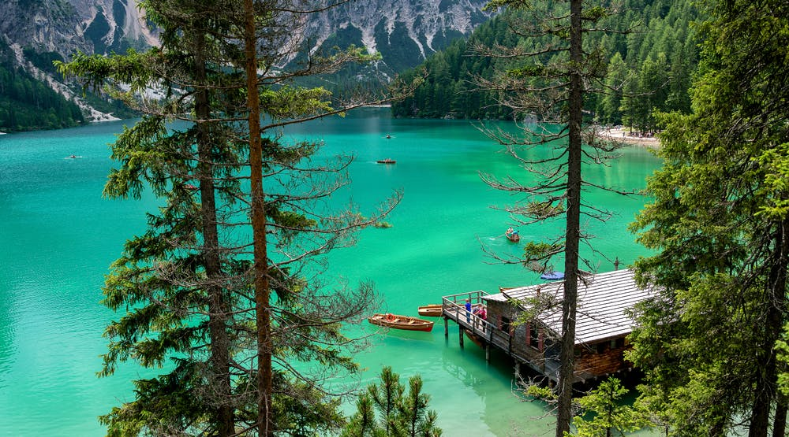
Homework
Review the vocabularies and structures in this lesson.
- Prepare vocabularies and structures in Unit 1. A –Friends

