Slide 1

UNIT 1. Back to school.
A.Friends

Slide 2

I. VOCABULARIES
- classmate (n):
bạn cùng lớp
- So I am =
Me, too.
Tôi cũng vậy.
- still (adv) :
vẫn
- unhappy (adj) :
không vui
- different (adj) :
không giống, khác
- lots of = a lot of :
nhiều
- uncle (n):
cậu, chú, bác
- aunt (n) :
cô, dì, thím, mợ
- miss (v) :
nhớ, nhớ nhung

Slide 3
II. STRUCTURES
Nice to meet you.
Nice to meet you,too.
Nice to see you again.
Nice to see you, too.
I’m in class 7A.
So am I./ I am, too./ Me,too.
Her new school is bigger than her old school.

Slide 4
Wordsquares
Find out 10 words in this box.
School
Old
Big
New
Parent
Live
Aunt
Student
Friend
happy
S | C | H | O | O | L | D
T | T | B | I | G | H | N
U | N | C | L | E | A | E
D | U | J | I | T | P | I
E | A | S | V | N | P | R
N | E | W | E | U | Y | F
T | N | E | R | A | P | Q
S
C
O
B
H
L
U
A
N
F
P

Slide 5

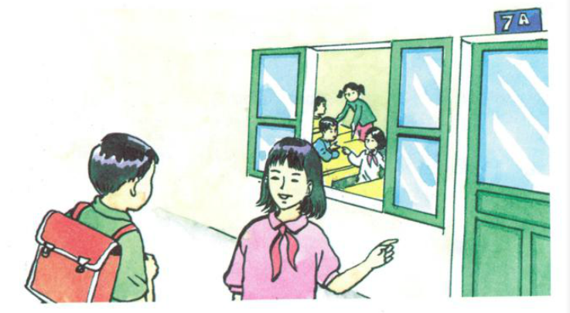
A1.Listen:
Then practice with a partner.
b) Hoa: Good morning. My name’s Hoa.
Nam: Nice to meet you, Hoa.
My name’s Nam.
Are you a new student?
Hoa: Yes. I’m in class 7A.
Nam: Oh, so am I.
Ba: Hello, Nga
Nga: Hi, Ba. Nice to see you
again.
Ba: Nice to see you, too.
Nga: This is our new classmate.
Her name’s Hoa.
Ba: Nice to meet you, Hoa.
Hoa: Nice to meet you, too.

Slide 6
 Answer the questions:
a. What is the new girl’s name?
b. What class is she in?
c. Who is also in class 7A?
Her name is Hoa.
She’s in class 7A.
Nam is also in class 7A.

Slide 7
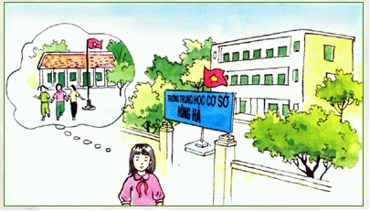
A2.Listen:

Slide 8

 Answer true/false sentences:
A. Hoa’s parents live in Ha Noi.
B. She has more friends in Ha Hoi than in Hue.
C. There are a lot of students in her old school.
D. She misses her friends in Hue.
E.. Hoa is not happy in Ha Noi.
F
F
F
T
T

Slide 9

Hoa is a new student in class 7A. She is from Hue and her parents still live there. She lives with her uncle and aunt in Ha Noi.
Hoa has lots of friends in Hue. But she doesn’t have any friends in Ha Noi. Many things are different. Her new school is bigger than her old school. Her new school has a lot of students. Her old school doesn’t have many students.
Hoa is unhappy. She misses her parents and her friends.

Slide 10
 Answer the questions:
a/ Where is Hoa from?
b/ Who is she staying with?
c/ Does she have a lot of friends in Ha Noi?
d/ How is her new school different from her old school?
e/ Why is Hoa unhappy?

Slide 11
a) Where is Hoa from?
She is from Hue.
b) Who is she staying with?
She is staying with her uncle and aunt.
c) Does she have lots of friends in Ha Noi?
No, she doesn’t.

Slide 12
d) How is her new school different from her old school?
 Her new school is bigger than her old school.
 Her new school has a lot of students.
e) Why is Hoa unhappy?
Because she misses her parents and her friends.

Slide 13
A3.Listen:
Then practice with a partner.
Nga: Good morning, Mr. Tan.
Mr.Tan: Good morning, Nga.
How are you?
Nga: I’m very well, thank you.
And you?
Mr.Tan: I’m fine, thanks.
Goodbye. See you later.
Nga: Goodbye.

Slide 14
Matching:
Pretty good.
How is every thing?
Nice to see you.
So am I.
Not bad.
Just fine.
I’m Ok.
Me, too.
Quite good.
I’m so so.
How are you?
Great seeing you.

Slide 15

A4.Listen and complete the dialogues:
a. Mr Tan: Hello Lien. ………………………… ?
Miss Lien: ………………………., thank you.
………………………….., Tan?
Mr Tan: …………………., but I’m very busy.
Miss Lien: ………………. .
b. Nam: Good afternoon, Nga. ……………………?
Nga: …….. ,thanks. ……………………… , Nam ?
Nam: ………………,thanks.
Nga: I’m going to the lunch room.
Nam: Yes, …………. .

Slide 16
A4.Listen and complete the dialogues:
How are you
a. Mr Tan: Hello Lien. ………………………… ?
Miss Lien: ………………………., thank you.
………………………….., Tan?
Mr Tan: …………………., but I’m very busy.
Miss Lien: ………………. .
Pretty good
How about you
Not bad
Me, too

Slide 17
b, Nam: Good afternoon, Nga.
……………………………………..?
Nga: ………, thanks. ……………………………...., Nam ?
Nam: …………………,thanks.
Nga: I’m going to the lunch room.
Nam: Yes, ……………… .
How is everything
Ok
How are you today
Just fine
so am I

Slide 18
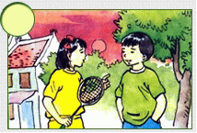
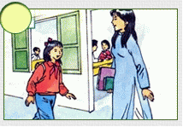
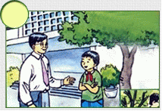
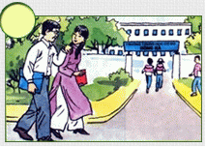
A5.Listen and order the dialogues:
a)
4
b)
2
c)
1
d)
3

Slide 19

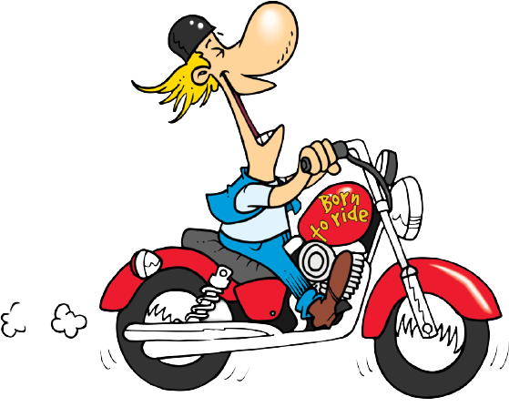
Exercise 1.Fill in the blanks with the correct form of the adjectives.
1. Walking is _________________ running (slow).
2. A new house is ________________ an old one ( expensive).
3. Motorbikes are ____________ bicycles (fast).
4. My TV is __________________his TV(modern).
5. Summer is ___________ spring (hot).
6. Jane is _____________________ her sister (beautiful).
7. Skirts are ________________ dresses (cheap).
8. Her English is ___________my English (good).
slower than
more expensive than
faster than
more modern than
hotter than
more beautiful than
cheaper than
better than
more expensive

Slide 20
Exercise 2.Rewrite the sentences.
1. My house is bigger than your house.
=> Your house is _____________
2. The black car is cheaper than the red car.
=> The red car is____________
3. Nam is taller than me.
=> I am _____________
4. My kitchen is smaller than yours.
=> Your kitchen is________________
smaller than my house.
more expensive than the black car.
shorter than Nam.
bigger than my kitchen.

Slide 21
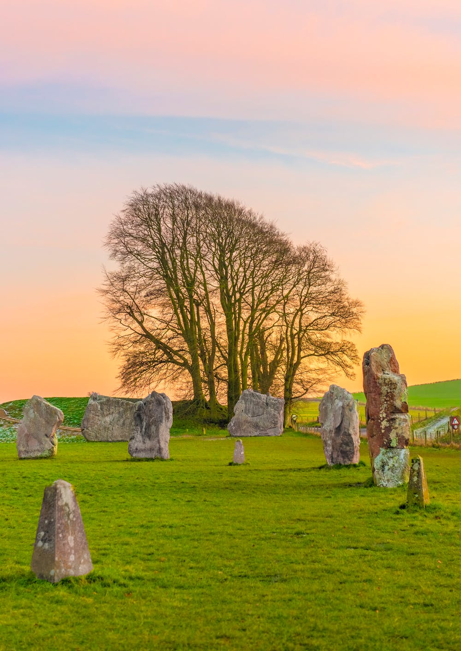


Homework
Learn by heart the vocabularies and structures.
- Prepare vocabularies and structures in Unit 1. B –Names and addresses.

