Slide 1

Unit 1: BACK TO SCHOOL
B - Names and addresses

Slide 2





Who's a millionaire?
Where is Hoa from?
50:50
A. I am from Hue
B. She is from Hue
B. She is from Hue
C. She is from Ha Noi
D. She from Hue

Slide 3
Who's a millionaire?
Where do Hoa’s parents live ?
50:50
A. They live on Hue
B. They live in Ha Noi
C. They live in Hue
D. They lives in Hue
C. They live in Hue

Slide 4
Who's a millionaire?
Which class is Hoa in?
50:50
A. She is in class 7A
A. She is in class 7A
B. I am in class 7A
C. She is in class 6A
D. I am in class 6A

Slide 5
Who's a millionaire?
Hoa is staying with …………..
50:50
A. her friends
B. her uncle and aunt
B. her uncle and aunt
C. her parents
D. her uncle.

Slide 6
Unit 1: BACK TO SCHOOL
B - Names and addresses

Slide 7
I. VOCABULARIES
- family name (n):
họ
- middle name (n):
tên lót
- distance (n):
khoảng cách
xa
- far (adj) :
- means of transport (n) :
phương tiện giao thông

Slide 8
II. STRUCTURES
-How far is it from your house to your school ?
-What’s the distance between your house and your school ?
-Where do you live ?
I live on Tran Hung Dao Street./ I live at 4 Dien Bien Phu Street.
-What’s your address?
My address is 4 Nguyen Du Street.

Slide 9

Pham Thi Hoa 12 Tran Hung Dao
Street
Family name
middle name
first name
address
full name

Slide 10



Listen. Then practice with a partner:
What
Miss Lien : ____’s your ________ , Hoa?
Hoa : It’s Pham. My ________ is Thi.
Miss Lien : _____ old are you?
Hoa : I’m 13.
Miss Lien : _____ do you live?
Hoa : 12 Tran Hung Dao street.
Miss Lien : Thank you, Hoa.
family name
middle name
How
Where

Slide 11
Answer:
a. Who is Hoa talking to?
* Hoa talking to Miss Lien.
b. What is Hoa’s family name?
* It’s Pham.
c. What is her middle name?
* Her middle name is Thi.
d. Where does she live?
* She lives at 12 Tran Hung Dao street.

Slide 12



Write. Complete this dialogue.
Nga : …………………is that ?
Lan : That is Nam
Nga : No ………………is the girl talking to Miss Lien ?
Lan : Her name’s Hoa . She’s a new student .
Nga :…………… class is she in ?
Lan : She’s in our class – class 7A .
Nga : ………. does she live ?
Lan : She lives on Tran Hung Dao street with her aunt and uncle .
Nga : ………. do her parents live ?
Lan : They live in Hue
Nga : She’s tall . ………old is she ?
Lan : She’s 13
Who
Who
Which
Where
Where
How

Slide 13
Name | Age | Class | Address
Lan
13
7A
12 THĐ street
Which class are you in ?
I live at 12 THĐ street
Where do you live ?
My name is Lan
I am 13 years old
What’s your name?
I am in class 7A
How old are you ?

Slide 14
Practice the dialogue :
Nam : Where do you live, Hoa?
Hoa : I live at 12 Tran Hung Dao street.
Nam : How far is it from your house to school?
Hoa : It’s not far, about one kilometer.
Nam : How do you go to school?
Hoa : I go to school by bike.

Slide 15

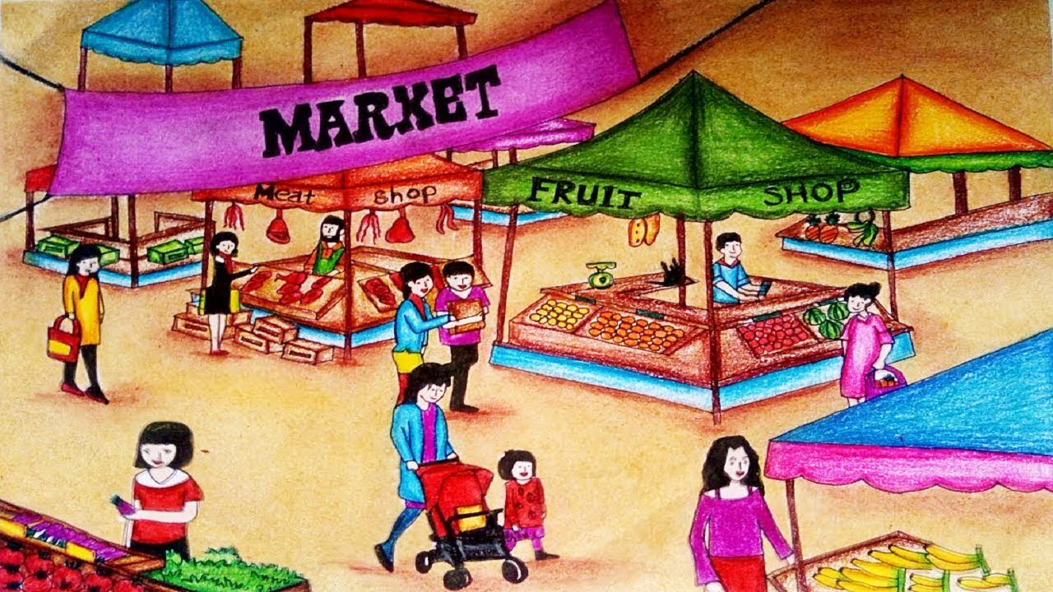

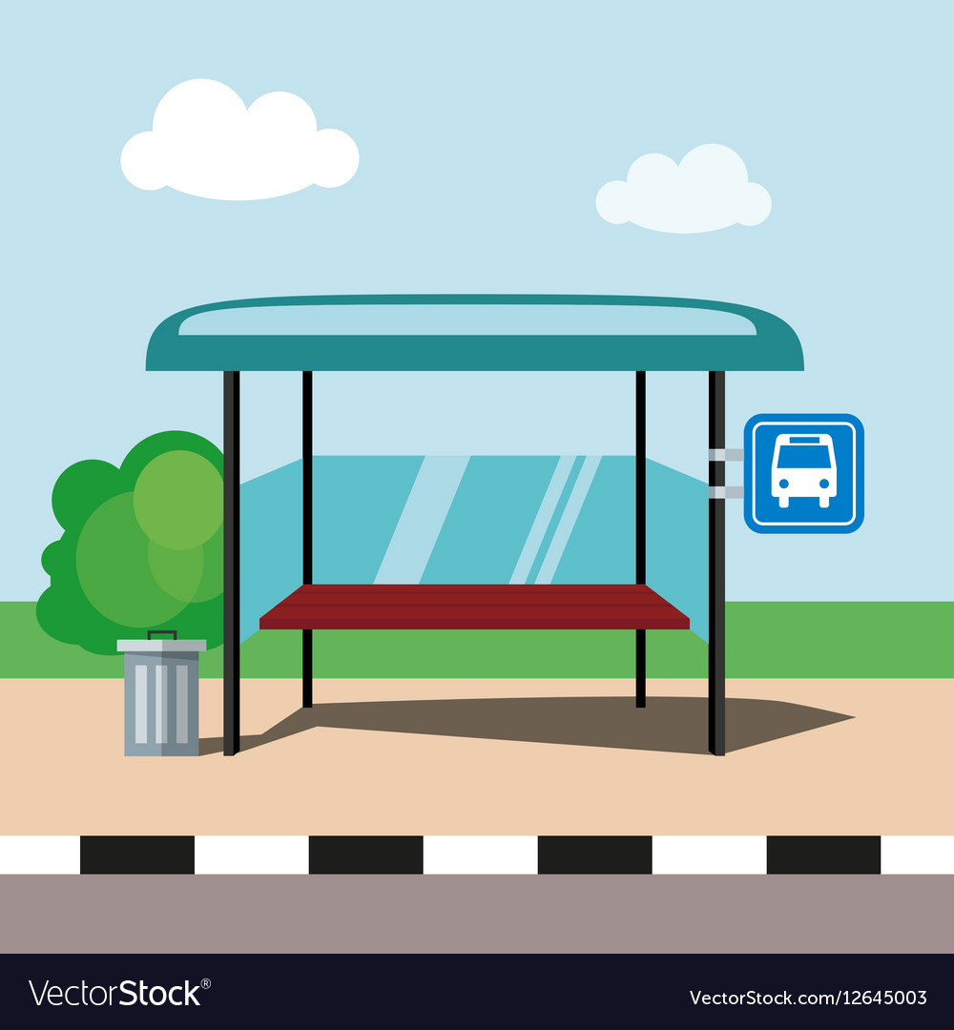


Ask and answer with a partner:
How far is it from the ............... to the ............ ?
→ It’s about ………….. kilometer (s) / meter (s)
Post office
1 kilometer
Market
200
m
3
km
Movie theater
Bus stop
500 meters

Slide 16
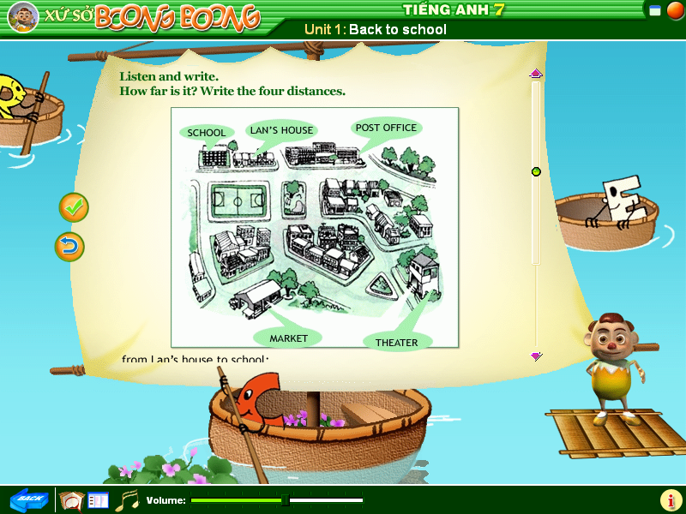
a. Is Lan’s house near from school / market?
b. Is Lan’s house far from the movie theater?

Slide 17

Listen four dialogues and find the distances of the places.
1. From school to Lan’s house.
a.200m b.300m c. 600m
2. Lan’s house to the post office.
a. 400m b.500m c.700m
3. Lan’s school to the movie theater.
a.2km b.3km c.4km
4. Movie theater to the post office.
a.2km b.5km c. 6km

Slide 18
A survey
- What is your name ?
- Where do you live ?
- How far it is from your house to school ?
- How do you go to school ?
*Fill in the survey form
Name:......................................
Address:...................................
Distance:..................................
Mean of transport:.......................
Tran Van An
50 Tran Hung Dao Street
3 kilometers
motorbike

Slide 19

Exercise I. Using Wh-question words to fill in the blanks
What
1 . …………………… is your family name ?
→ It’s Nguyen
2. . …………………… are you ?
→ I’m thirteen.
3. . …………………… does Minh live ?
→24 Ngo Quyen Street.
4. . …………………… do you live with ?
→ My parents.
5. . …………………… is it from your house to the market?
→ About 2 kilometers.
6. . …………………… do you have English ?
→ On Tuesday and Wednesday .
7. . …………………… are you unhappy ?
→ Because I miss my friends.
8. ………………………do you go to school ?
→ By bus.
How old
Where
Who
How far
When
Wh-words
Why
How

Slide 20

II. Fill the blanks, using “on”, “in”, or “at”:
on
1. She lives …………….Hoan kiem street.
2. He is waiting for you ………….. the bus stop no 1.
3. We live …………….Yen bai city.
4. They have a house …………………ho chi minh city.
5. Mary lives with her parents ……………39 yen ninh road.
6. Hoa doesn’t live ………….Hue now. She is staying with her aunt and uncle ………………tran hung dao street, ha noi city.
at
in
in
on
in
on

Slide 21


III. Ask and answer about the distance.
How far is it from…………….to…………….?
→ It is (about)………………………..m/ km
Your house / school / 3km
2. The museum / the movies / 7 km
3. Ba’s house / the post office / 900m

Slide 22

Thanks for listening

