Slide 1
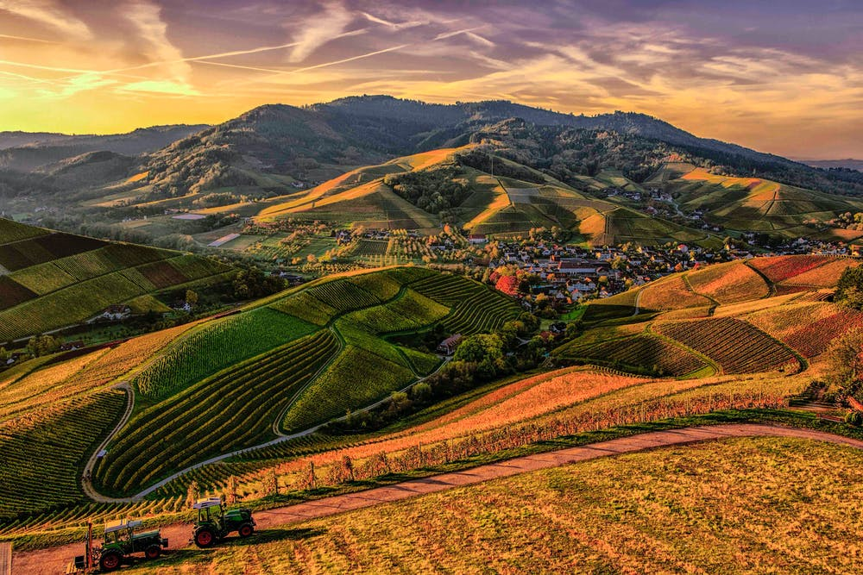

Unit 1: BACK TO SCHOOL
(Practice)

Slide 2
I. Fill in the words with missing letters.
n_c_ p_r_nt | d_ff_r_nt h_pp_ | b_sy p_ett_ | m_ss m_ _t
II.Choose the ood-one-out.
good morning thank you hello good afternoon
parent uncle friend aunt
nice miss pretty different

Slide 3
I. Fill in the words with missing letters.
nice parent | different happy | busy pretty | miss meet
II.Choose the odd-one-out.
thank you
friend
miss

Slide 4
III. Fill in the words with missing letters.
a-dr-ss f-m-l- n-me m-d-le n-me b-s s-op | –ar-et m-v-- th-at-r p-st o-fi-e me-ns
IV. Complete the sentences with the words given in exercise III.
They are waiting for a bus at the _____________ .
I am going to the __________to send a letter.
My home __________is 92A Nguyen Trai Street.
His __________is Tran.
Her __________is Thi.
Ben Thanh __________is not far from my house.

Slide 5
III. Fill in the words with missing letters.
address family name middle name bus stop | market movie theater Post office means
IV. Complete the sentences with the words given in exercise III.
They are waiting for a bus at the bus stop .
I am going to the post office to send a letter.
My home address is 92A Nguyen Trai Street.
His family name is Tran.
Her middle name is Thi.
Ben Thanh market is not far from my house.

Slide 6
V. Fill in the blanks with What, Where, When, Why, Who, How, How far.
________is your family name? – it’s Nguyen.
________ old are you? – I’m thirteen.
________ do you live? – On Nguyen Trai street.
________ do you live with? – My parents.
________ is it from your house to school? – About three kilometers.
________ do you go to school? – By bus.
________ do you go to school? – At half past six.
________ are you late? – Because I miss the bus.

Slide 7
V. Fill in the blanks with What, Where, When, Why, Who, How, How far.
What is your family name? – it’s Nguyen.
How old are you? – I’m thirteen.
Where do you live? – On Nguyen Trai street.
Who do you live with? – My parents.
How far is it from your house to school? – About three kilometers.
How do you go to school? – By bus.
What time do you go to school? – At half past six.
Why are you late? – Because I miss the bus.

Slide 8
VI. Fill in the blanks with the words given
any go far still new with miss a lot of
My name is Nguyen Minh Trung. I am a (1).... student in class 7A. I am from Da Nang and my family (2).... live there. In Ho Chi Minh City, I live (3).... my grandparents at 21/3B Nguyen Trai Street. My new school is not (4).... from our house - about one kilometer, so I (5).... to school by bike. There are (6).... students in my new school. But I don't have (7).... friends. I am unhappy. I (8).... my parents, my sisters and my friends in Da Nang.
1. What is his full name?
2. Is he a new student?
3. Where is he from?
4. Who is he living with?
5. What is his address?
6. How far is it from his house to his school?
7. How does he go to school?
8. Why is he unhappy ?

Slide 9
Keys:
1. new 2. still 3. with 4. far
5. go 6. a lot of 7. any 8. miss
Suggested answers:
1. His full name is Nguyen Minh Trung.
2. Yes, he is.
3. He's from Da Nang.
4. He is living with his grandparents.
5. His address is 21/3B Nguyen Trai street.
6. It's about one kilometer.
7. He goes to school by bike.
8. He is unhappy because he doesn't have any friends and he misses his parents, his sisters and his friends in Da Nang.

Slide 10
VII. Choose the best answers:
Hi! My name’s John. I live in London. It is only 8 km from my house to my school. I usually go by bus. There is often a lot of traffic, so it can be quite slow. I usually leave home at 8 o’clock, and get to school at twenty past eight. The journey home is always terrible. Sometimes I get home in forty-five minutes!
Where is John from?
Tokyo
London
New York
No information
2. How far is it from John’s house to his school?
One kilometer
Seven kilometers
Eight kilometers
Nine kilometers

Slide 11
VII. Choose the best answers:
Hi! My name’s John. I live in London. It is only 8 km from my house to my school. I usually go by bus. There is often a lot of traffic, so it can be quite slow. I usually leave home at 8 o’clock, and get to school at twenty past eight. The journey home is always terrible. Sometimes I get home in forty-five minutes!
3.How does he go to school?
By bike
By bus
By car
By train
5.What time does he get to school?
Eight o’clock
Twenty past eight
Forty-five minutes
Five o’clock
4.What time does he usually leave home?
Eight o’clock
Twenty past eight
Forty-five minutes
Five o’clock

Slide 12
Keys:
B
2. C
3. B
4. A
5. B

Slide 13
VIII. Complete the dialogue.
Miss Thanh: Good morning. ________ ________ ________ ________?
Phuong: My name’s Phuong.
Miss Thanh: ________ ________ ________ ________ ________?
Phuong: It’s Tran. My middle name is Minh.
Miss Thanh: ________ ________ ________ ________ , Phuong?
Phuong: I’m thirteen years old.
Miss Thanh: ________ ________ ________ _______?
Phuong: I live at 162/ 10B Hoang Van Thu Street.
Miss Thanh: ________ ________ _______ ________ from your house to school?
Phuong: It’s about one kilometer
Miss Thanh: ________ ________ ________ go to school ?
Phuong: I go to school by bike.

Slide 14
VIII. Complete the dialogue.
Miss Thanh: Good morning. What is your name ?
Phuong: My name’s Phuong.
Miss Thanh: What is your family name ?
Phuong: It’s Tran. My middle name is Minh.
Miss Thanh: How old are you, Phuong?
Phuong: I’m thirteen years old.
Miss Thanh: Where do you live?
Phuong: I live at 162/ 10B Hoang Van Thu Street.
Miss Thanh: How far is it from your house to school?
Phuong: It’s about one kilometer
Miss Thanh: How do you go to school ?
Phuong: I go to school by bike.

Slide 15
IX. Supply the correct forms of the verbs in brackets.
Hoa (be) ________ a new student in class 7A. Her parents (live) ________ in Hue, and she (live) ________ with her uncle and aunt in Ha Noi. Hoa (have) ________ a lot of friends in Hue, but she (not have) any friends in Ha Noi. Many things (be) ________ different. Her new school (be) ________ bigger than her old school. Her new school (have) ________ lots of students. Her old school (not have) ________ many students. Hoa(be) ________ unhappy. She (miss) ________ her parents and her friends.

Slide 16
IX. Supply the correct forms of the verbs in brackets.
Hoa (be) is a new student in class 7A. Her parents (live) live in Hue, and she (live) lives with her uncle and aunt in Ha Noi. Hoa (have) has a lot of friends in Hue, but she (not have) does not have any friends in Ha Noi. Many things (be) are different. Her new school (be) is bigger than her old school. Her new school (have) has lots of students. Her old school (not have) does not have many students. Hoa(be) is unhappy. She (miss) misses her parents and her friends.

Slide 17

Thanks for your attention

