Slide 1
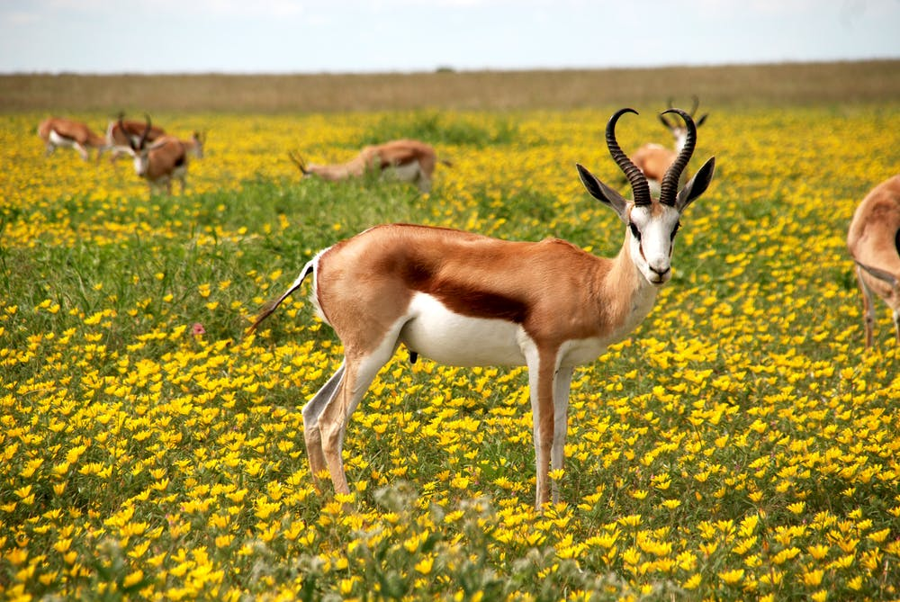

Unit 1: BACK TO SCHOOL
(Practice)

Slide 2
I. Choose the best answers:
1. .... class are you in?
- I'm in class 7B.
a. Where b. How many c. Which d. What's
2. Nam is a friendly person. He has .... friends.
a. some b. many c. few d. much
3. I like swimming and .... does my sister.
a. so b. too c. neither d. also
4. What is her .... name?
- Pham Thi Hoa.
a. last b. family c. full d. middle
5. When I'm away from home, I .... my family very much.
a. love b. miss c. like d. hate

Slide 3
6. Hoa lives .... Ha Noi, .... 12 Tran Hung Dao Street.
a. in – on b. in – at c. at – on d. on - at
7. .... is it from here to school? - About two kilometers.
a. How far b. How high c. How long d. How often
8. I'm very busy these days .
- ........ .
a. So I am b. I do, too c. Neither am I d. Me, too

Slide 4
Keys:
1c 2b 3a 4c
5b 6b 7a 8d

Slide 5
II. Supply the correct forms of the verbs in brackets.
1. Hoa(have).... a lot of friends in Hue.
2. She (be).... unhappy now. She (miss).... her parents in Hue.
3. Hoa (talk).... to Miss Lien at the moment?
4. (you be).... a new student?
- Yes. I (be).... in class 7B.
5. Hoa's old school (be).... small. It (not have).... many students.
6. I (walk).... to school every day, but today I (ride).... my bike
to school.
7. We (not got).... to class on Sunday.
8. Where .... Hoa's parents (live).... ?

Slide 6
Keys:
has
2. is-misses
3. is talking
4. are you - am
5.is - doesn't
6. walk - am riding
7. don't go
8. do...live

Slide 7
III. Match.
A B
1. How are you? a. By bus.
2. Are you a new student? b. It's Tran.
3. What is his family name? c. Fine, thanks.
4. What is your address? d. About one kilometer.
5. How do you go to school? e. It's Ok now.
6. How far is it? f. 6B Dien Bien Phu Street.
7. How is everything? g. Yes, I am.
8. Who are you phoning to? h. My brother.

Slide 8
Keys:
1c 2g 3b 4f
5a 6d 7e 8h

Slide 9
IV.Rearrange the words to make complete sentences.
1. is/ your/ how/ school/ to/ it/ far/ your/ from/ house?
2. your/ classmate/ where/ live/ does?
3. have/ any/ doesn't/ in/ she/ friends/ Ha Noi
4. new/ has/ a/ students/ of/ her/ school/ lot.
5. with/ her/ lives/ Hoa/ in/ uncle/ aunt Ha Noi/ and.

Slide 10
Keys:
1. How far is it from your house to your school?
2. Where does your classmate live?
3. She doesn't have any friends in Ha Noi.
4. Her new school has a lot of students.
5. Hoa lives with her uncle and aunt in Ha Noi.

Slide 11
V.Reorder the sentences to make a complete dialogue.
.... Hello, Nga. Nice to see you again.
.... Nice to meet you, Minh.
.... Hello, Phong.
.... Nice to see you, too. How are you?
.... Fine, thanks. This is our new classmate. His name is Minh.
.... Nice to meet you, too.

Slide 12
Keys:
2 Hello, Nga. Nice to see you again.
5 Nice to meet you, Minh.
1 Hello, Phong.
3 Nice to see you, too. How are you?
4 Fine, thanks. This is our new classmate. His name is Minh.
6 Nice to meet you, too.

Slide 13
VI. Choose the best answers:
Where do you live?
How far is it from your house to school?
What is your address?
How do you go home?
Where is your school?
2. Her new school is bigger than her old school
Her old school is smaller than her new school
Her old school is more beautiful than her new school
Her new school is different from her old school
No school is bigger than her new school
3. How do you go to school?
How do you travel to school?
How often do you go to school?
When do you go to school?
Is there a school near your house

Slide 14
Keys: 1.B 2.A 3.A

Slide 15
VII.Make questions and answers.
1.Nam/ go/ the post office// bike.
How does Nam go to the post office ?
He goes to the post office by bike.
2.Nga and Lan/ go/ school// school bus.
3.your father/ travel/ Ha Noi// plane.
4.The children/ go/ the zoo// bus.
5.You and your friends/ go/ the stadium// foot.
6.Mrs. Lien/ go/ the market// motorbike.

Slide 16
VII.Make questions and answers.
1.Nam/ go/ the post office// bike.
How does Nam go to the post office ? He goes to the post office by bike.
2.Nga and Lan/ go/ school// school bus.
How do Nga and Lan go to school ? They go to school by school bus.
3.your father/ travel/ Ha Noi// plane.
How does your father travel to Ha Noi ? He travels to Ha Noi by plane.
4.The children/ go/ the zoo// bus.
How do the children go to the zoo ? They go to the zoo by bus.
5.You and your friends/ go/ the stadium// foot.
How do you and your friends go to the stadium ? They go to the stadium on foot.
6.Mrs. Lien/ go/ the market// motorbike.
How does Mrs. Lien go to the market ? She goes to the market by motorbike.

Slide 17


